Slide 1
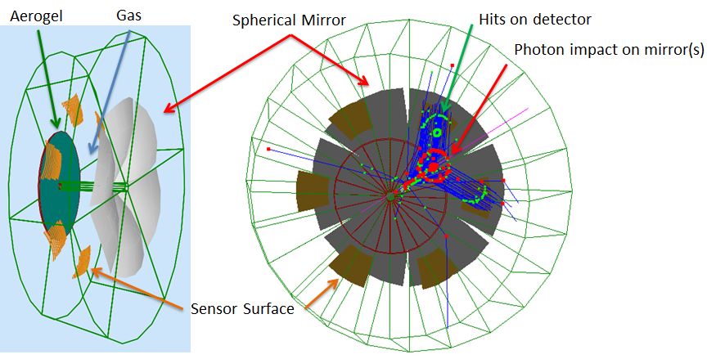
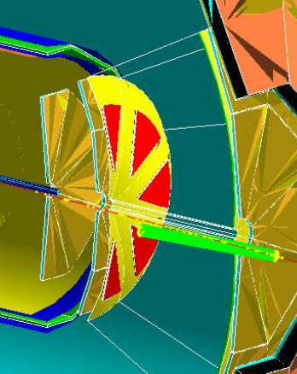
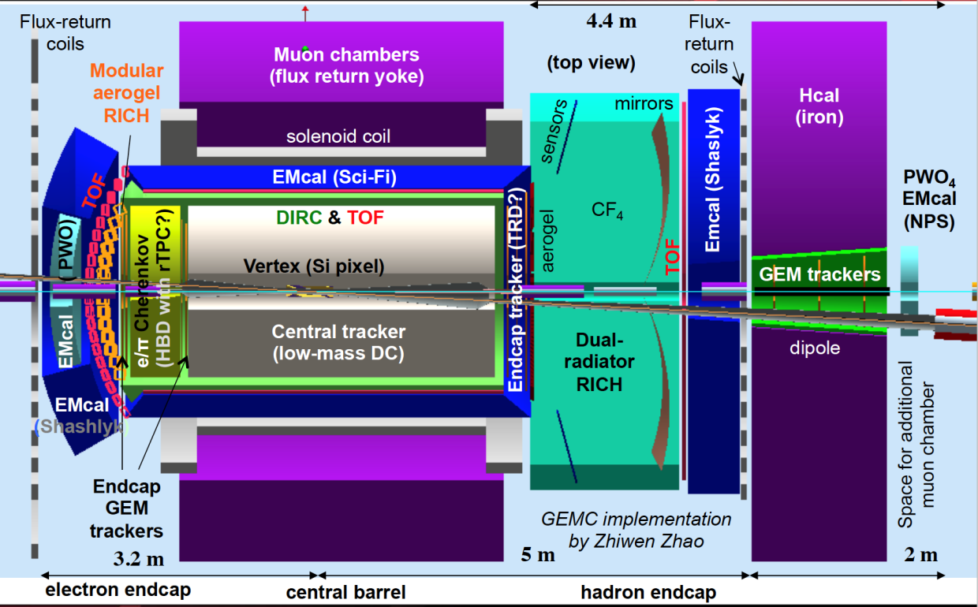
Dual Radiator RICH in EIC Hadron-endcap
Hit on detector
ePHENIX
Photon impact
on mirror(s)
INFN & DUKE
dRICH: flexible configuration (JLEIC, ePHENIX)
Radiators: Aerogel (n_{AERO}~1.02) + Gas (n_{C2F6} ~ 1.0008)
Detector: 0.5 m²/sector , 3x3 mm² pixel
Single-photon detection in ~1T magnetic field
Outside acceptance, reduced constraints
→ best candidate for SiPM option
JLEIC
Phase Space:
- Polar angle: 5-25 deg
Momentum: 3-60 GeV/c

Slide 2
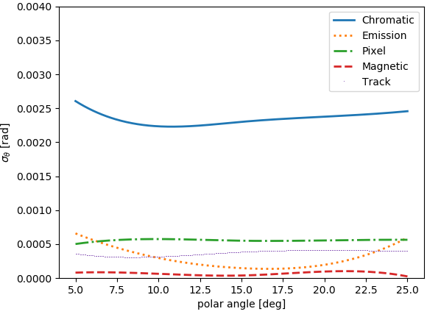
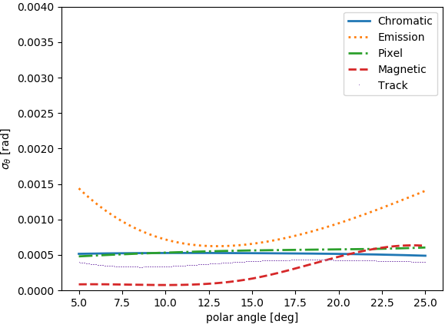
dRICH Feasibility Study
Compact and cost-effective solution for continuous momentum coverage (3-60 GeV/c)
Strong interest in the dRICH electron-pion separation capability
e-π
π−k
p-k
Studied with full Geant4 simulation, with Bayesian L. Barion et al., JINST 15 (2020) 02, C02040
optimization and analytic parameterizations E. Cisbani et al., JINST 15 (2020) 05, P05009
Aerogel SPE
Gas SPE
Gap length / Sensor surface
Refractive index / UV filters

Slide 3
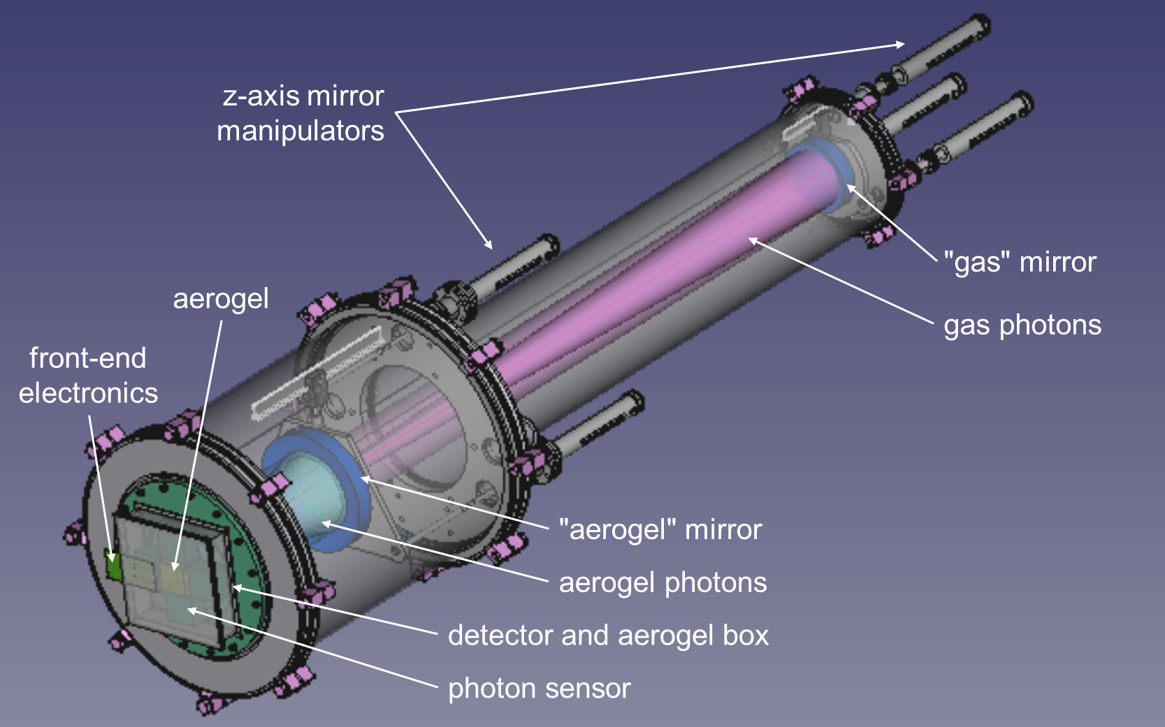
dRICH Prototype
Dual radiator imaging
Pressure vessel for gas & n tune
Sensor & readout friendly
Test-beams FY21 options
(post COVID-19):
Fermilab with SBU
JLab
CERN / DESY
Procurement initiated (INFN in-kind):
* Aerogel (n=1.02, n=1.03) with dimensions compatible with mRICH
Standard vacuum components (pipes, clamps, o-rings)
Custom flanges
Survey ongoing:
Gas / mirrors / mechanics

Slide 4
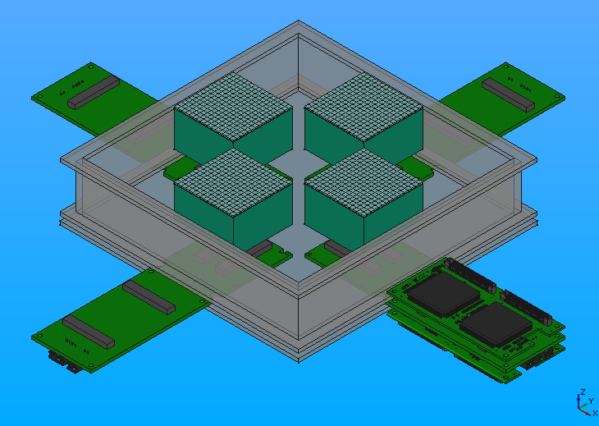
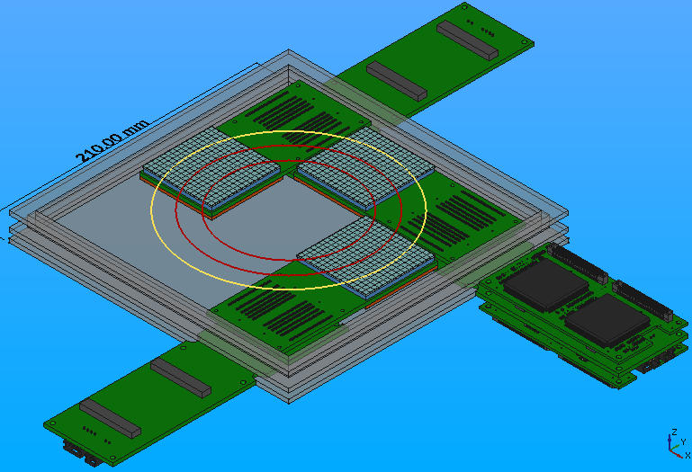
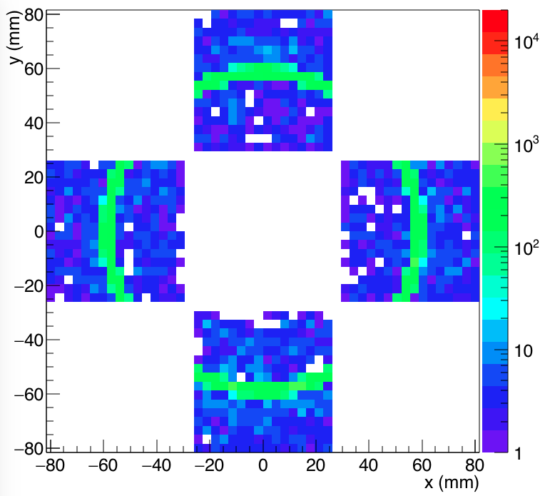
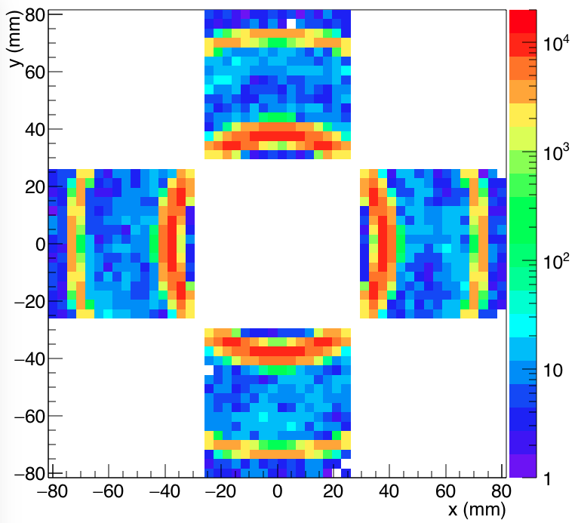
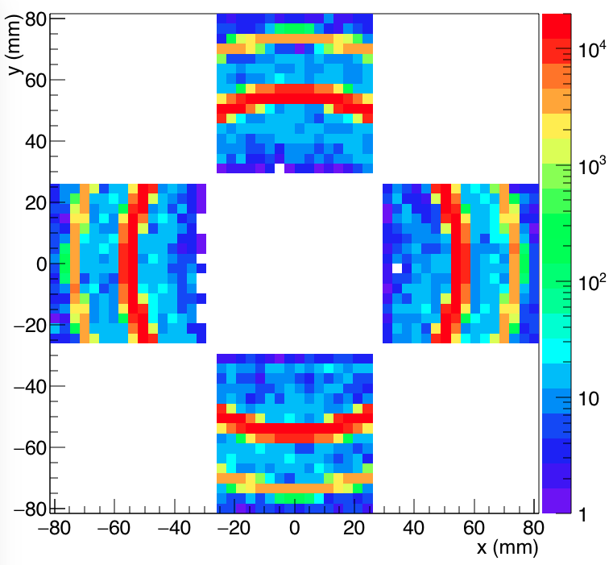
dRICH Imaging
House the same principles and readout units used for mRICH test-beams
Compatible with H13700/S12642 + MAROC front-end
Allows to study the working principles and optical performance of the components
4 x H13700
3 x S12642-1616PA
Kaon
4 GeV/c
Kaon
15 GeV/c
Kaon
25 GeV/c

Slide 5
dRICH Key Hardware Components
Component | Function | Specs/Requirements | Critical Issues / Comments
Mechanics | Support all other components and services Keep in position and aligned | Large volume gas and light tightness; alignment of components | Technically demanding but feasible; no major challenges expected
Optics (Mirrors) | Focus (expecially for gas) and deflect photons out of particle acceptance and reduce sensor surface | sub-mrad precision reflectivity ≥ 90% low material budget | Spherical mirrors technology of CLAS12 suitable (optical fiber and/or glass skin); similar geometry; Development for cost reduction
Aerogel Radiator | Cover Low Mom. Range between TOF and Gas | ≥3σ π-K separation up to Gas region (∼13 GeV) | Procurement: currently 1 active provider (2 main producers + 1 potential) Long term stability assessment in conjunction with gas
Gas Radiator | Cover High Mom. Range above Aerogel | ≥3σ π-K separation up to ∼50 GeV and overlap to aerogel | Greenhouse gas: potential procurement issue Search for alternatives
Photon Detector | Single photon spatial detection | Magnetic field tolerant and radiation hardness; ∼ few mm spatial resolution | MCP-PMT is likely doable, but expensive. LAPPD may represent an alternative. R&D on SiPM: a promising, quicky improving, wordwide pursued, and cheap technology.
Electronics | Amplify and shape single photon analog signal, convert to digital, transfer to DAQ nodes | Low noise Time res. ∼ 0.5 ns μs signal latency | MAROC3 based readout available for prototyping; final choice will depend on sensor. ASIC development for optimised streaming readout (discrimination vs sampling)

Slide 6
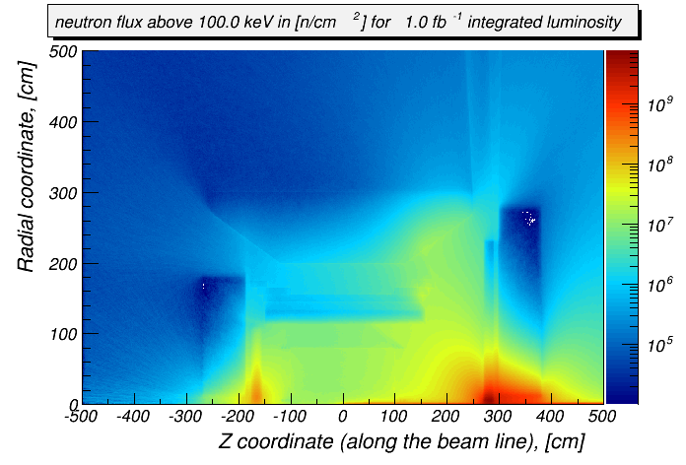
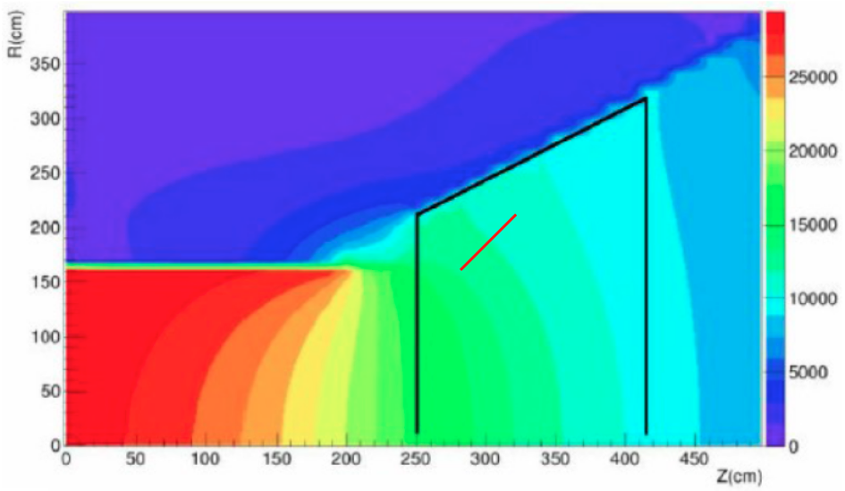
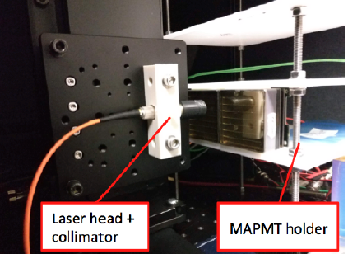
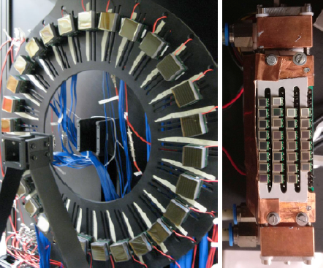
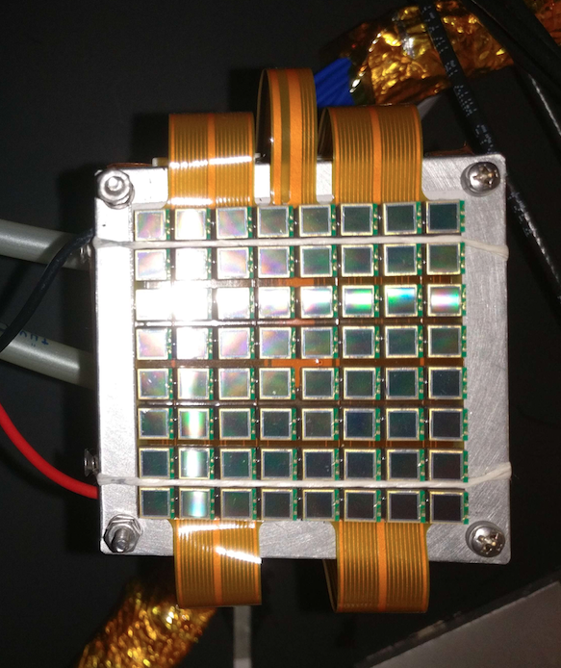
dRICH Detector Environment
dRICH sensor location relaxes requirements
on neutron dose and material budget
Neutron flux (Courtesy of A. Kiselev)
Neutron Fluence
Moderate except for very forward regions
Reference value ~ 10 ¹¹ n_{eq}/cm²
for several years at max lumi (10³⁴)
SiPM: radiation mitigation for SPE actively studied
till 10¹¹ n_{eq}/cm² and above 10.1016/j.nima.2019.01.013
10.1016/j.nima.2018.10.191
Magnetic Field
~ 1 T order of magnitude, varying orientation
SiPM: PET study up to 7 T 10.1109/NSSMIC.2008.4774097
Magnetic field
SiPM SPE capability under study since 2012 @ INFN
Contalbrigo++ NIMA 766 (2014) 22, Balossino ++ NIMA876 (2017) 89
dRICH
sensor
Notes:
Fare una immagine del PMT sulla risoluzione

Slide 7
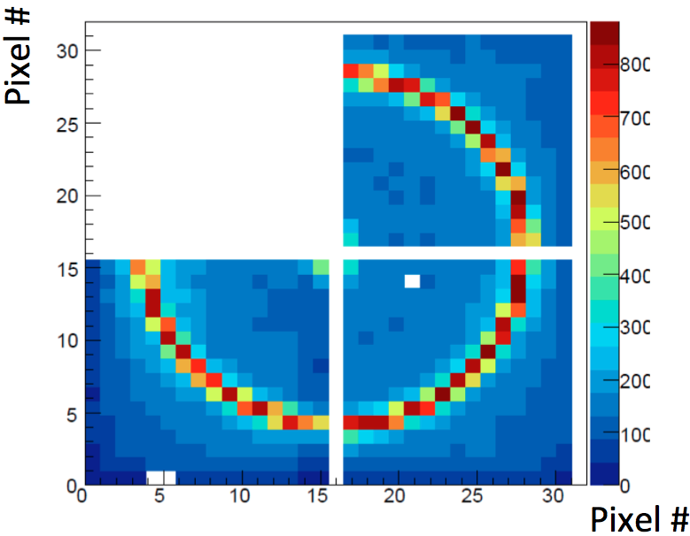
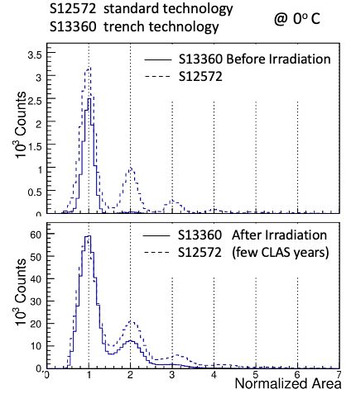
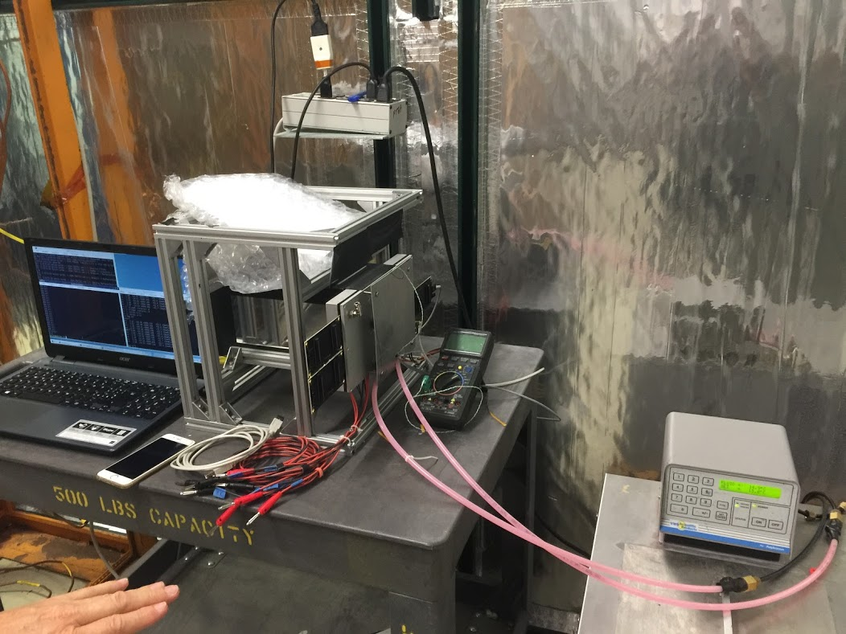
SiPM and Electronics
SiPM irradiation 2016
NIMA 876(2017) 89
mRICH test-beam @ Fermilab 2018
mRICH
Peltier cell cooling
Down to -30º in N₂
SiPM @ -30ºC
EIC Detector Advisory Committee, Report on dRICH 11/25/2019
“An important remaining issue is the SiPM noise rate after irradiation which should be clarified. We expect that it will take 2-3 years to fully understand if SiPMs can be used in RICH detectors at EIC“
EIC Detector Advisory Committee, Report on Electronics 01/30/2020
“The committee again recommends the group to re-examine options that do not rely on waveform sampling, e.g., a TOT-based design like the TOPFET2 ASIC, which is radiation hard, has low power consumption and has achieved a very good resolution per single photon with SiPMs.”

Slide 8
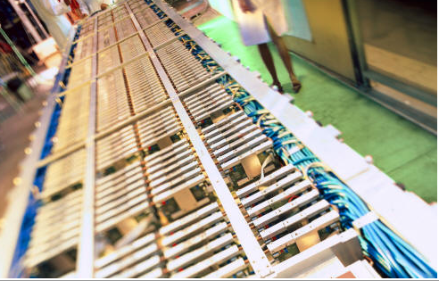
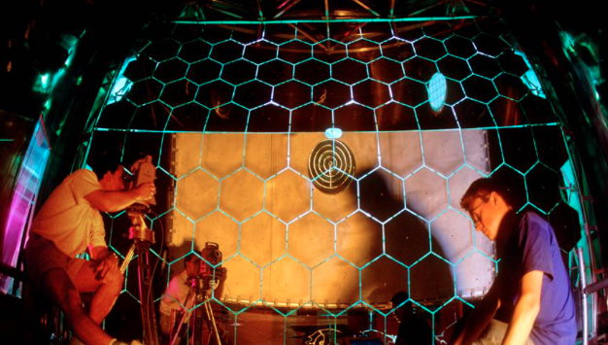
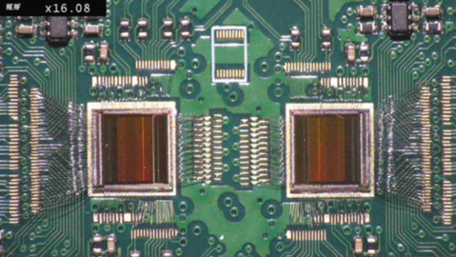
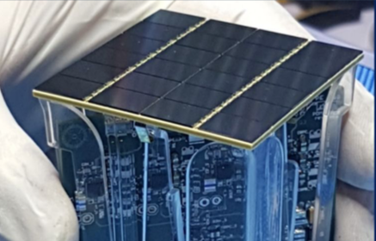
INFN Groups and eRD14
INFN-TO
COMPASS RICH F-E
DARKSIDE F-E
Enriched INFN expertise and manpower
to support dRICH, SiPM (and eRD14) program
INFN-BO
ALICE TOF
DARKSIDE SiPM
INFN-FE
CLAS12 RICH
INFN-LNF
CLAS12 RICH
INFN-RM1
HERMES RICH
Hall-A Tracking
INFN-CT
Hall-A HCAL

Slide 9
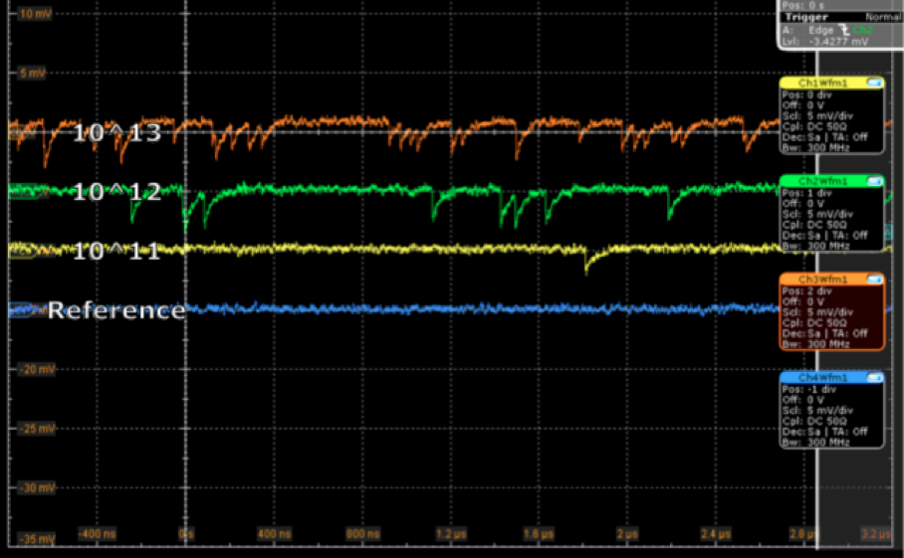
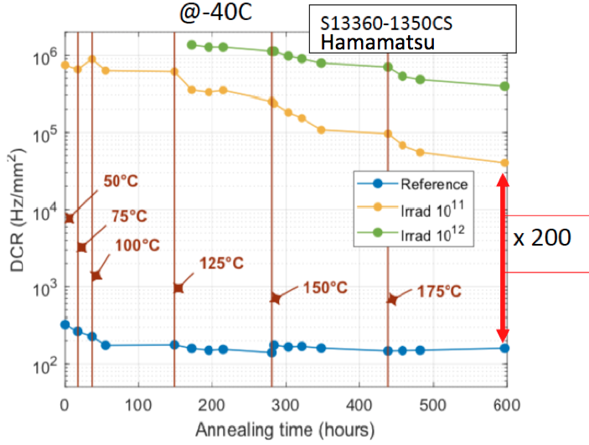
SiPM Program
Enriched INFN manpower and expertise towards a
comprehensive program of post-irradiation SiPM +
electronics single photon detection assessment.
Key: Temperature treatment & dedicated readout
Done so far, use few SiPM samples for the study of
- Cherenkov application prior of irradiation
- Single photon counting vs dose and temperature
Short term goal (~ 1 year):
- Characterize irradiated status-of-the-art SiPM candidates
- Exploit in-house dedicated electronics
(ToT based, for cooled SiPM + annealing)
- Cherenkov imaging after EIC-like irradiation
(proof-of-principle)
Long term plan (~2-3 years):
- Systematic study towards performance optimization
- SiPM engineering with producers
- Temperature treatment protocols vs radiation
- Assess discriminating vs sampling readout performance
- Development of an optimized streaming readout
At -30 ºC after annealing
M. Calvi et al., NIMA 922 (2019) 243

Slide 10
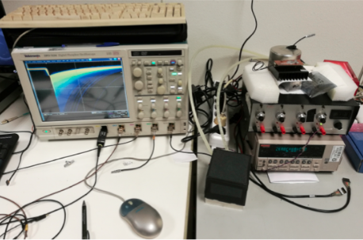
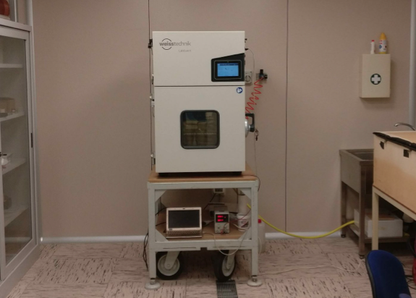
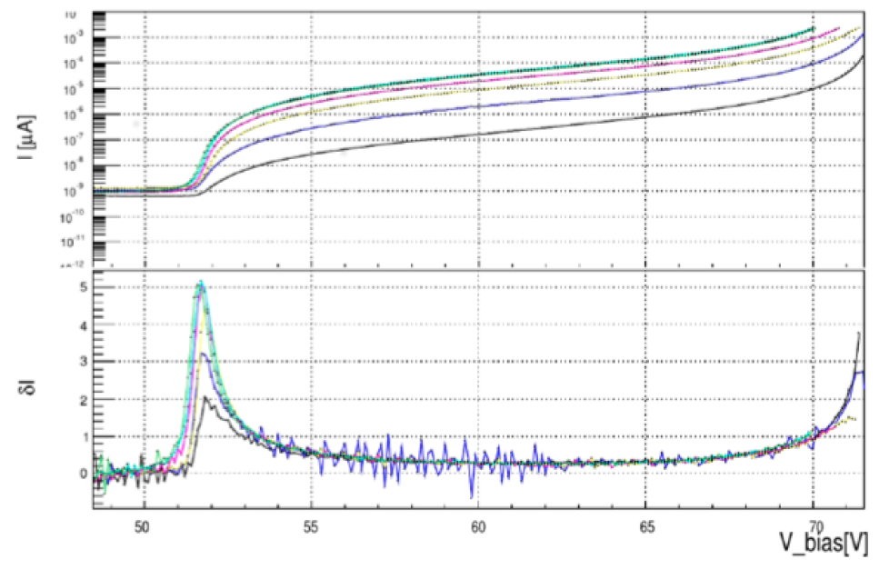
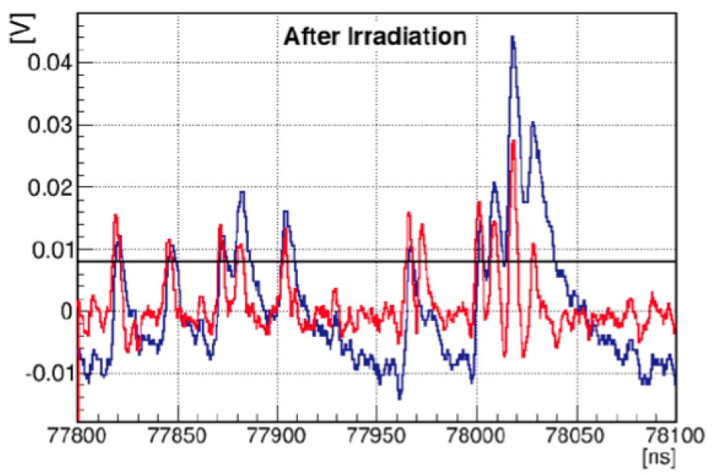
SiPM Characterization
SiPM characterization and proton irradiation @ Proton Therapy Center of Trento, IT
I-V characteristics & Signal sampling
Temperature control and treatments
Dark current after irradiation
Dark counts after irradiation
I (A)
Raw
Filtered
Sampled signal (V)
Working range
δI
Break-down
V_bias (V)
Time (ns)

Slide 11
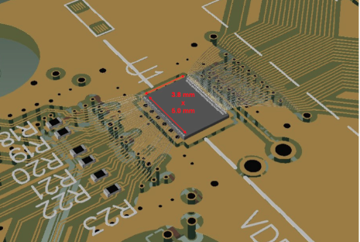
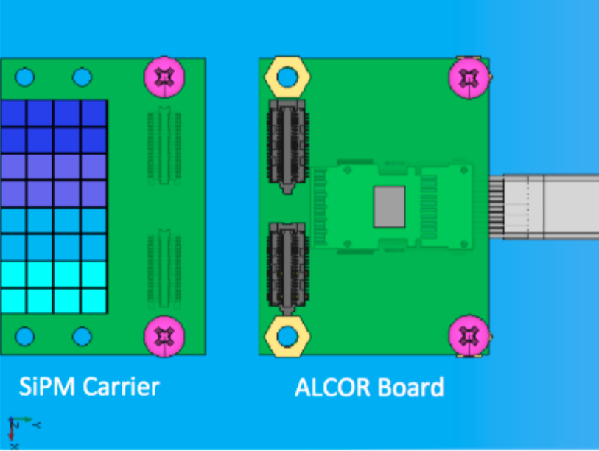
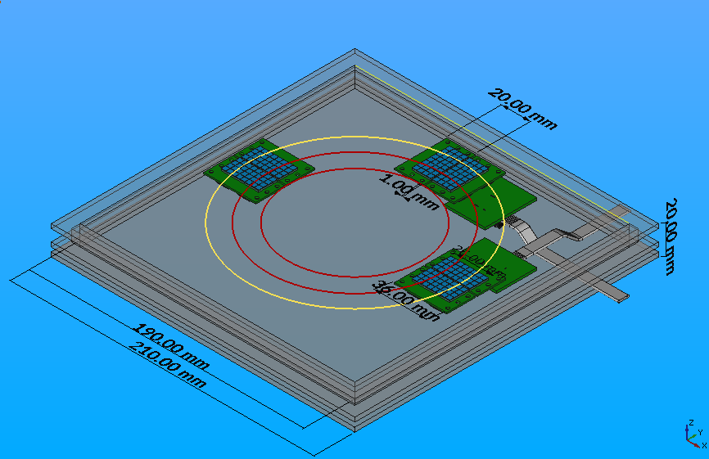
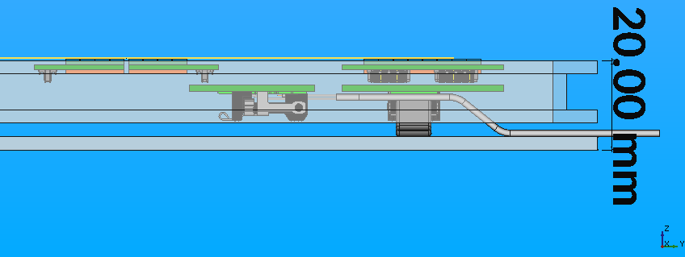
SiPM Readout
SiPM: sampled for vendor, type and dose (at groups of 4)
organized in 8 x 4 matrices for imaging
SiPM board: bias distributors and signal pre-conditioning
compatible with temperature treatments and
laboratory characterization
ALCOR chip: under development at INFN:
ToT architecture for cryogenic application
32 channels, 50 ps TDC, >500 kHz/channel
ALCOR board: connecting to a Xilinx FPGA via firefly lines

Slide 12
Activity Plan & Deliverables
As discussed with the EIC R&D Committee in September 2019 for TDR readiness in 2023
✔ Ongoing
✔ In preparation
2021
✔ Basic prototype
- tracking
- 1 choice per radiator
- commercial mirror
- reference readout
✔ Beam Test 1
- MA-PMTs, SiPMs
- proton beam
- critical aspects
✔ Optical components
- test and selection
✔ SiPM program
- radiation tolerance
- and cooling program
2020
✔ Prototype design, simulation and implementation
✔ Basic mechanics Electronics adaptation
✔ Component test and selection
✔ Start of INFN funds
Hamamtsu Broadcom
SensL …..
Prototype components
SiPM + electronics
Notes:
Vanno messi studi innovativi e pubblicazioni

Slide 13
Conclusions
Activity plan in line with the EIC R&D Committee recommendations and TDR readiness in 2023
To address crucial PID aspects at EIC synergic with other R&D programs (gaseous RICH, electronics, sensors):
cost-effective compact solution for hadron PID in the forward region in a wide kinematic range
in 1 year: prototype complete and first test-beam
investigation of novel single-photon detector solution to be operated in high magnetic field
in 1 year: post-irradiation characterization and imaging of a status-of-the-art SiPM selection
Goal: have in one year a full-chain assessment (proof-of-principle) of the
proposed approach and investigated technologies
A mandatory step for INFN and eRD14 given the YR, EoI and announced Call for Detectors in FY2021

Slide 14
Backup
2020
Prototype design,
simulation and
implementation
Basic mechanics
Electronics
adaptation
Component test
and selection
Start of INFN funds
2021
Basic prototype
- basic tracking
- 1 radiator choice
- commercial mirror
- reference readout
Beam Test 1
- MA-PMTs, SiPMs
- Proton beam
- Critical aspects
Optical components
test and selection
SiPM program
radiation tolerance
and cooling program
2022
Refined prototype
- precision tracking / alignment
- various radiators
- custom mirrors
- gas system
- optimized readout
- online reconstruction
Beam Test 2
- MCP-PMTs, SiPMs
- Hadron beam
- Performance optimization
Optical components
test and selection
SiPM program
radiation tolerance
and cooling program
2023
TDR readiness
EIC configuration
engineering, realistic PID
Contingency:
Beam test 3
- Performance assessment
- Component optimization
Optical components
refinement and
cost reduction study
(e.g. glass-skin mirror)
SiPM program
radiation tolerance
and cooling program

Slide 15
Backup

Slide 16
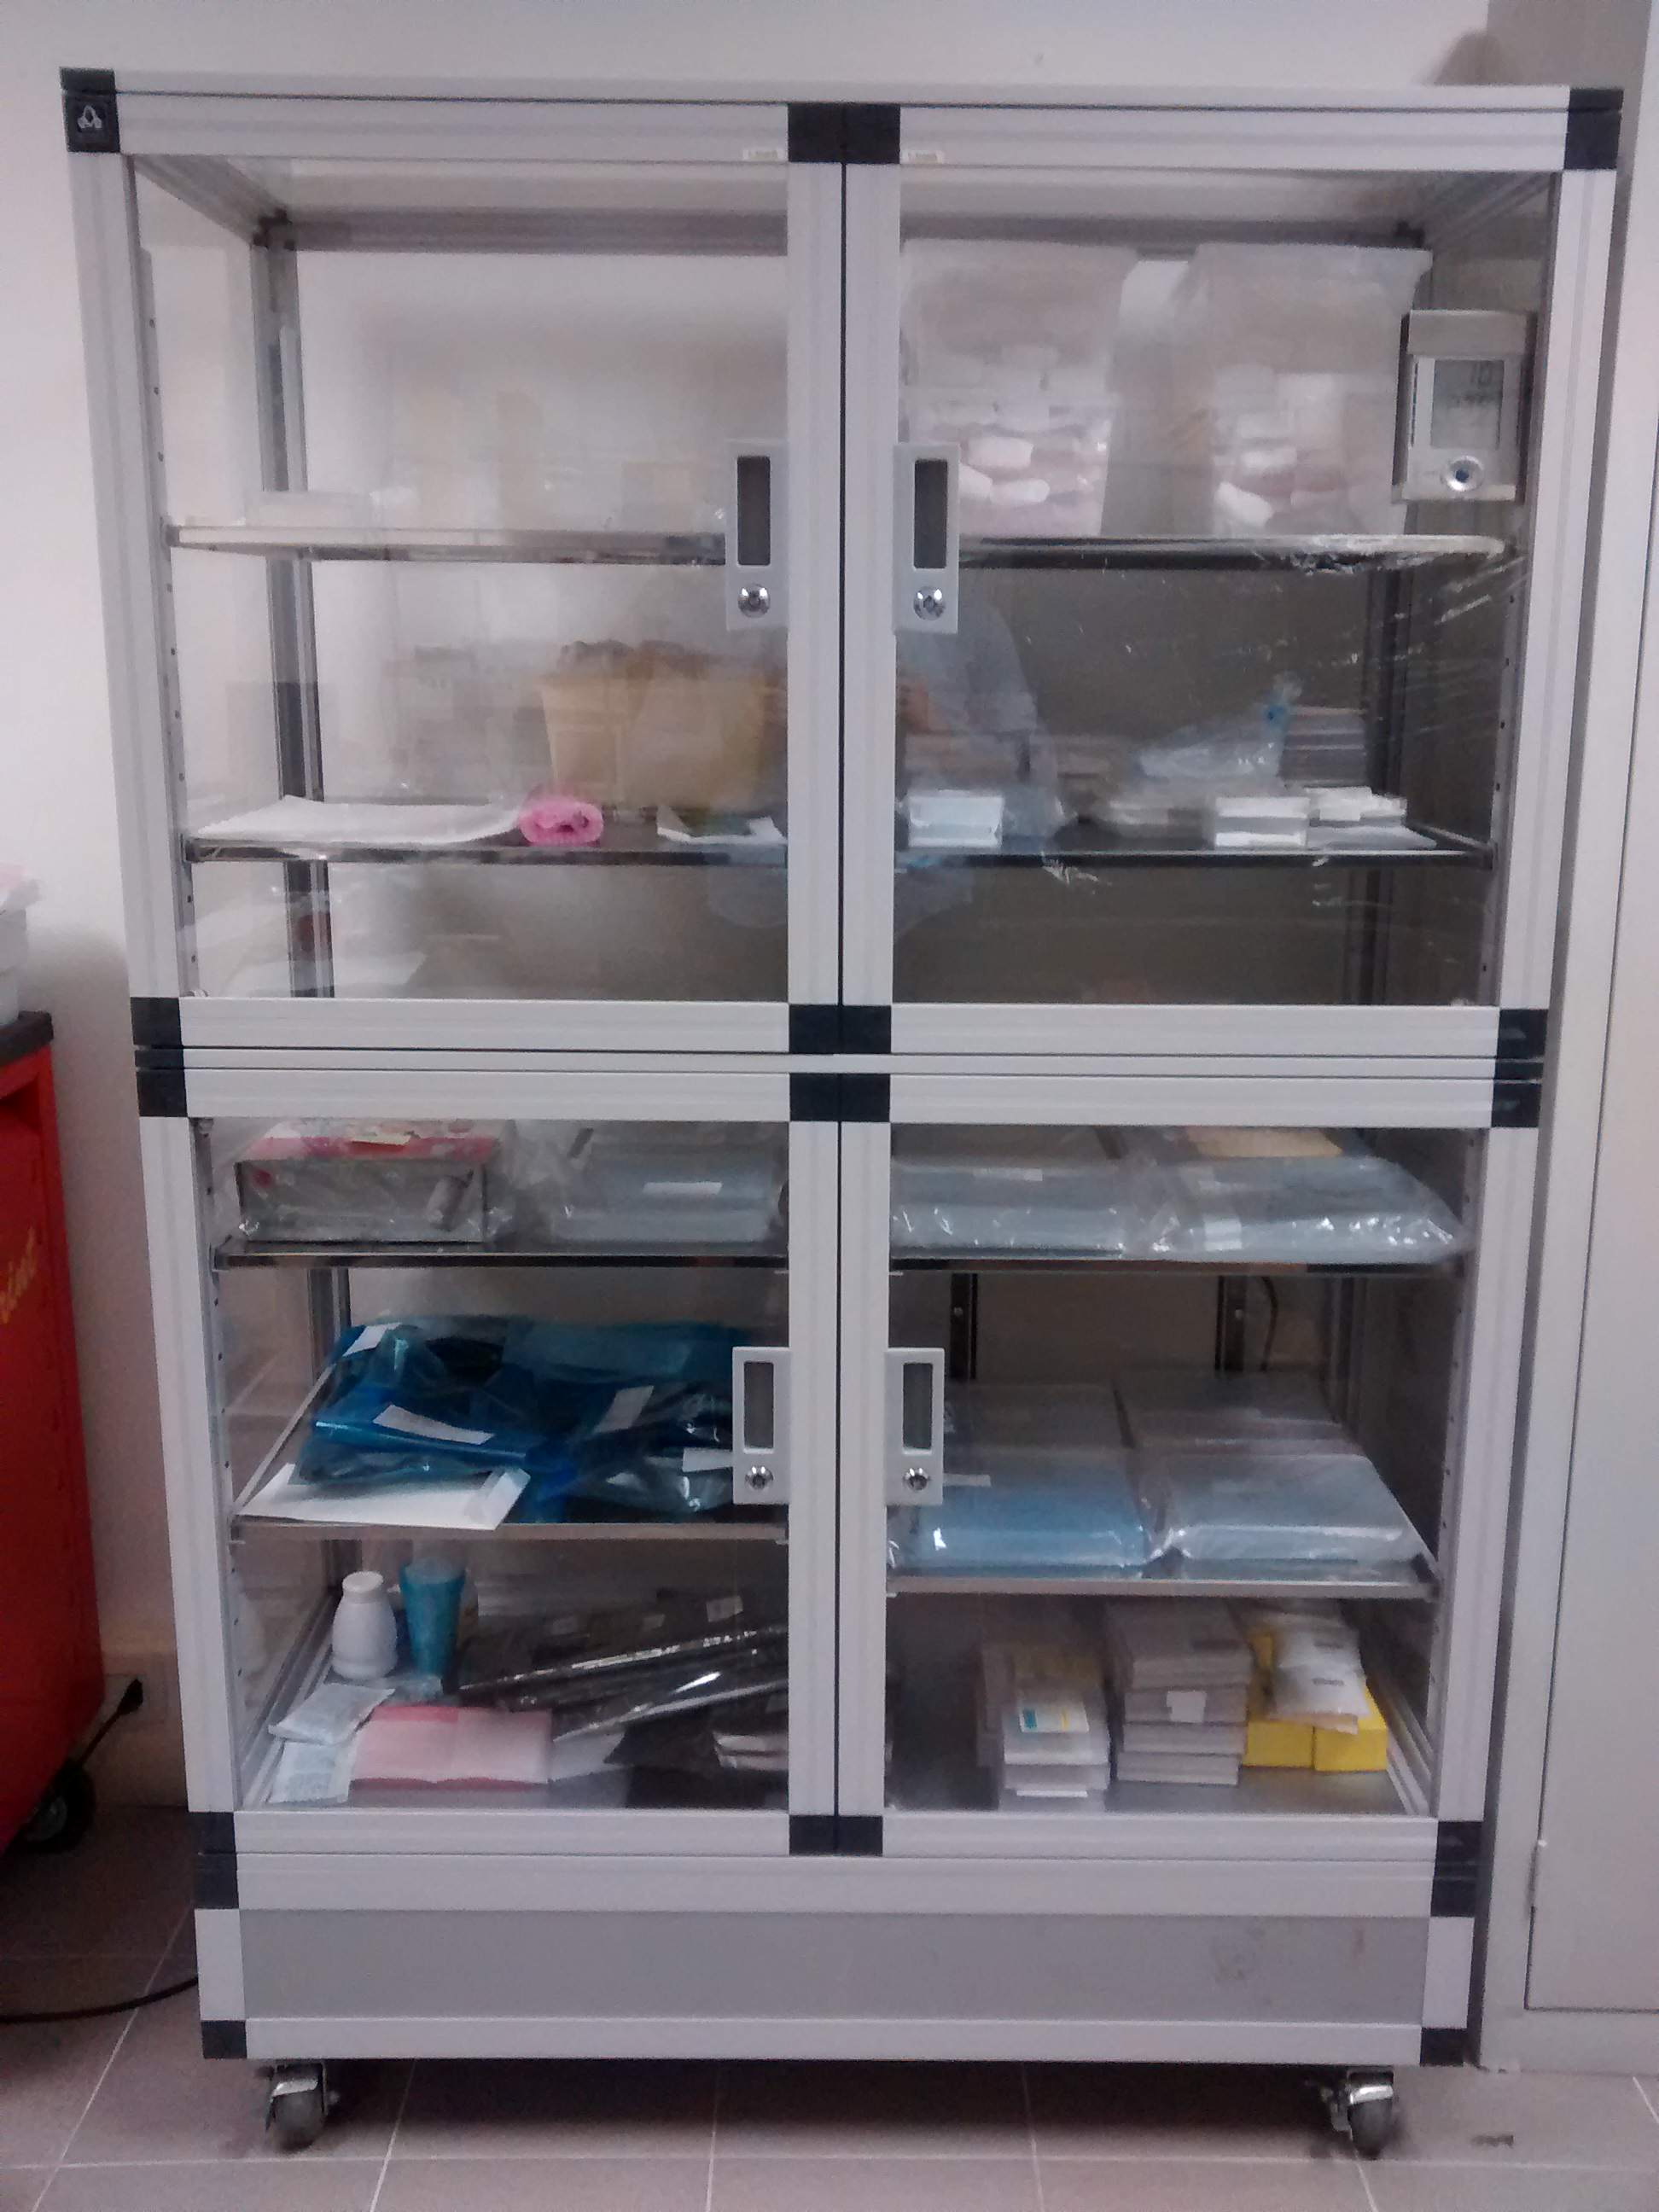
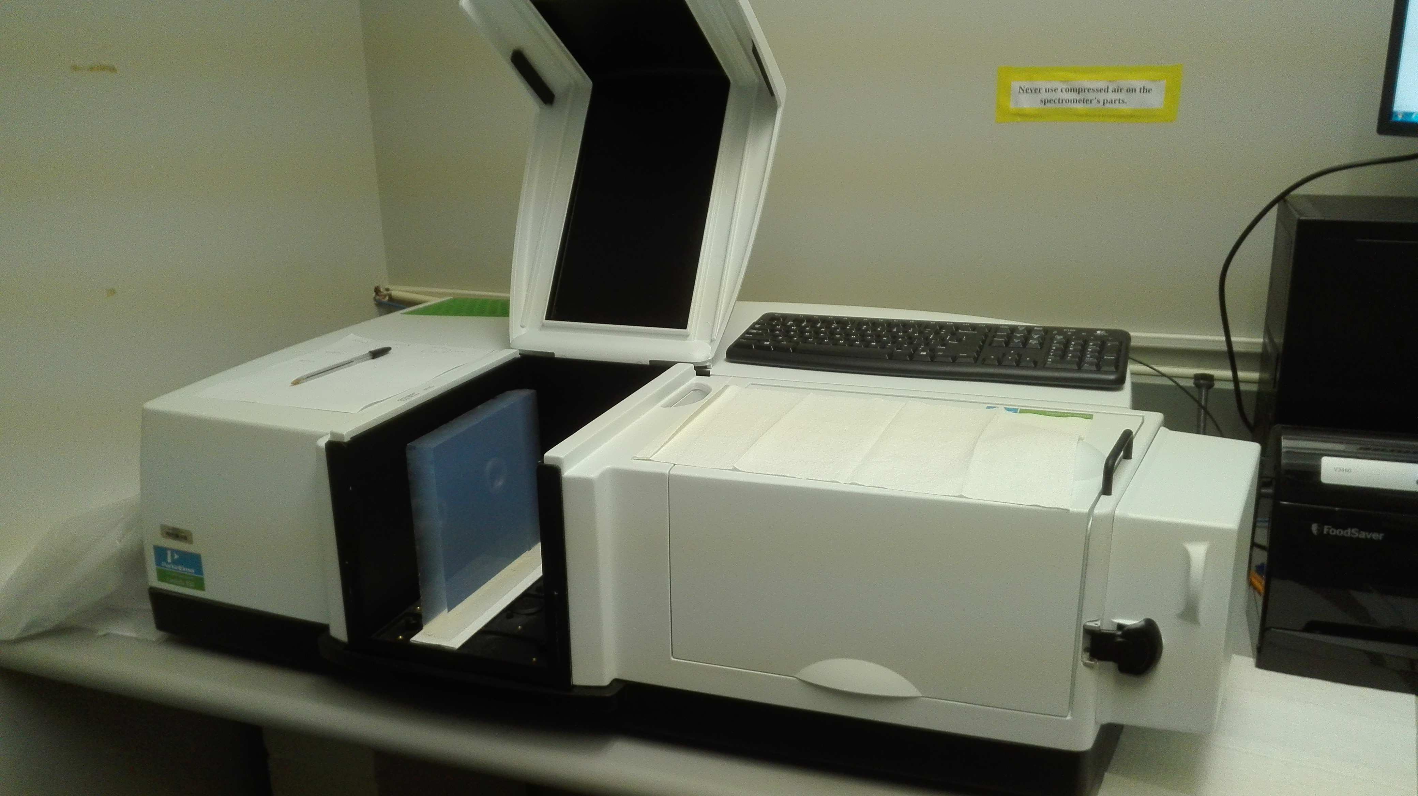
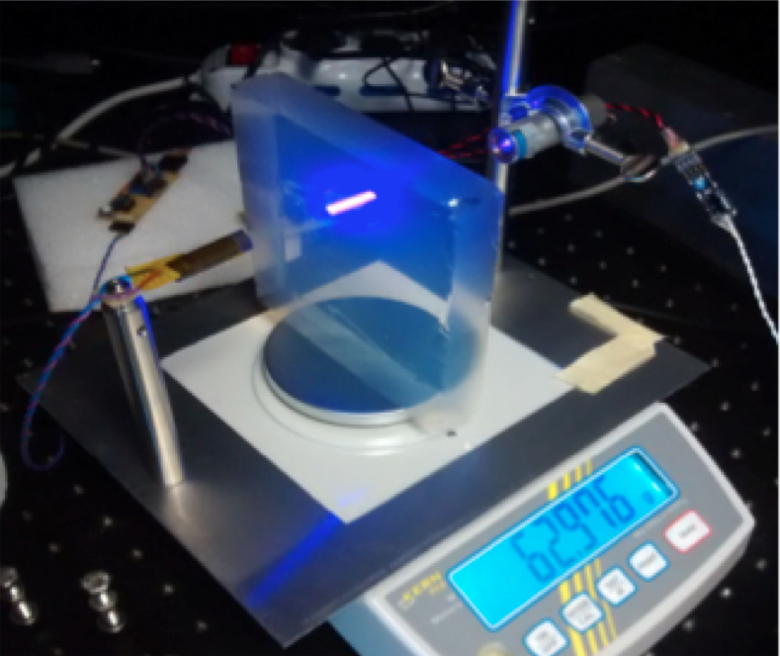
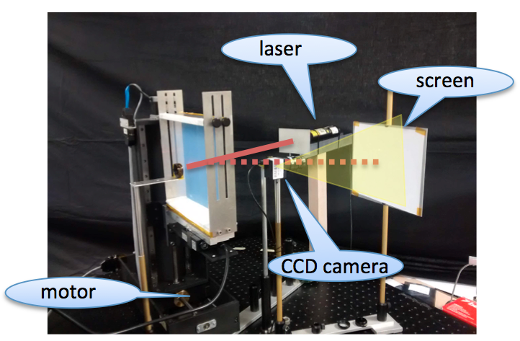
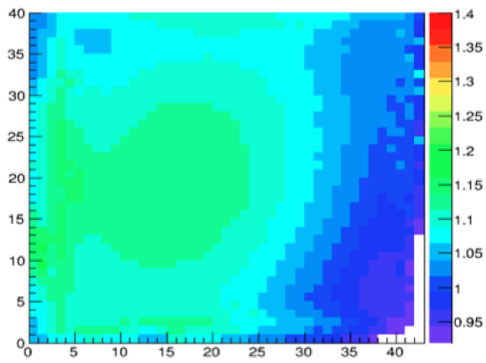
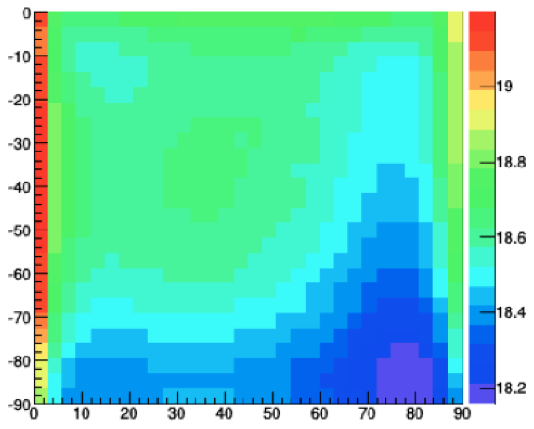
Aerogel Test Laboratory
Existing facility to study detailed aerogel optical properties
(refractive index, surface planarity, forward scattering)
safe handling and Interplay with gas radiator
Controlled storage
Spectrophotometer Characterization station
Surface map by laser setup vs touch machine
Contalbrigo M.
EIC eRD14, 19th September 2019
Contalbrigo M.
16
Notes:
Fare una immagine del PMT sulla risoluzione

Slide 17
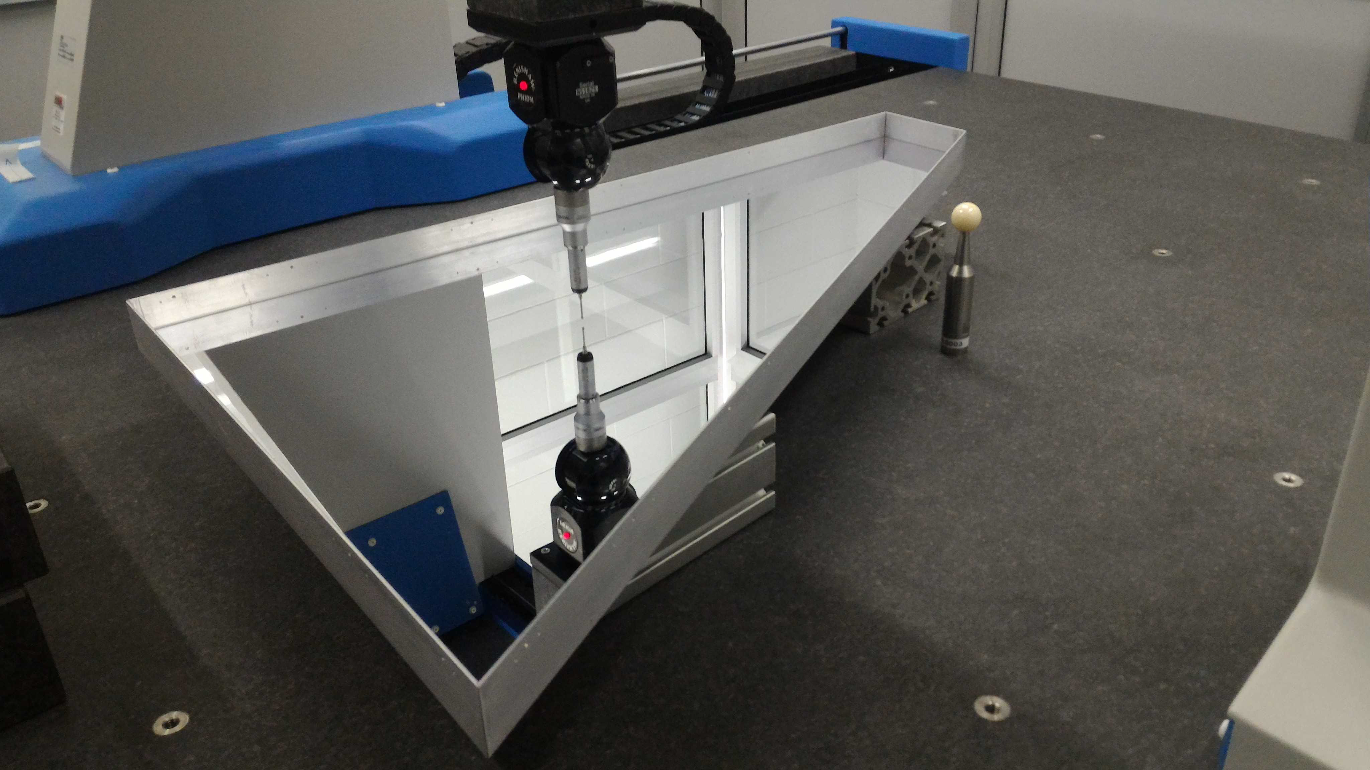
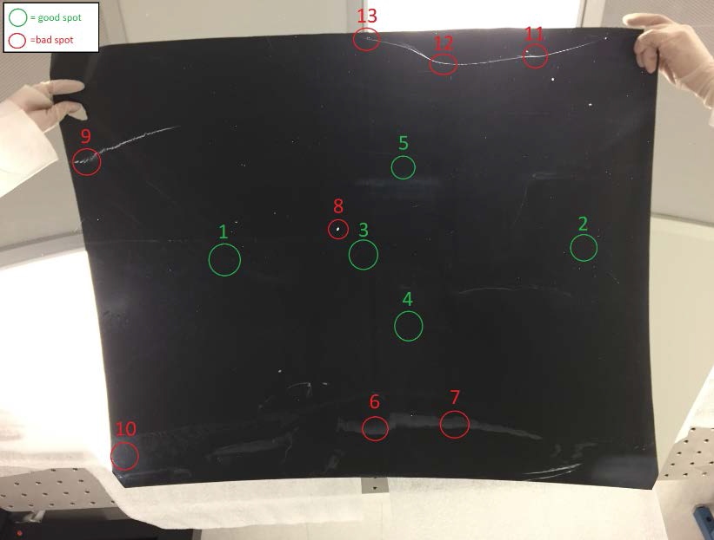
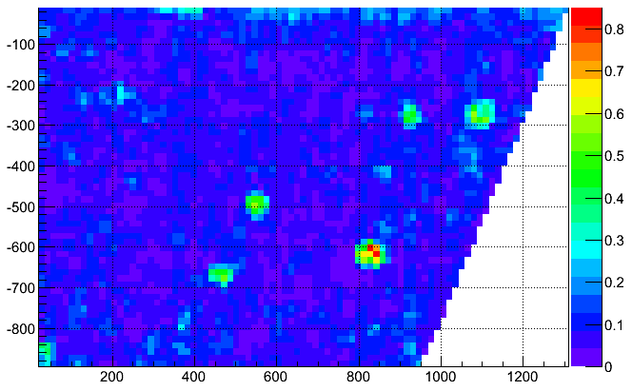
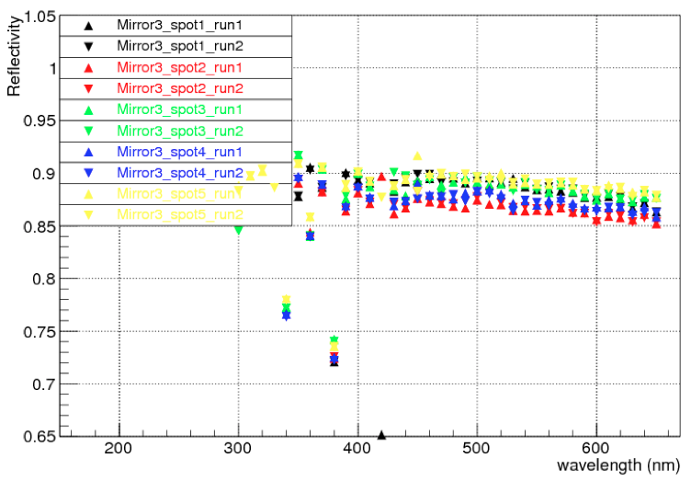
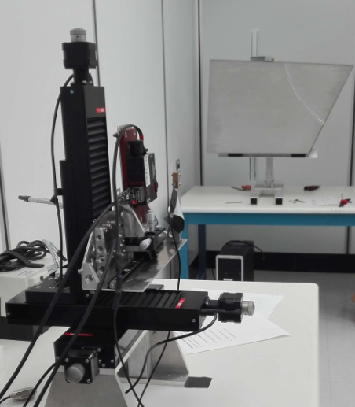
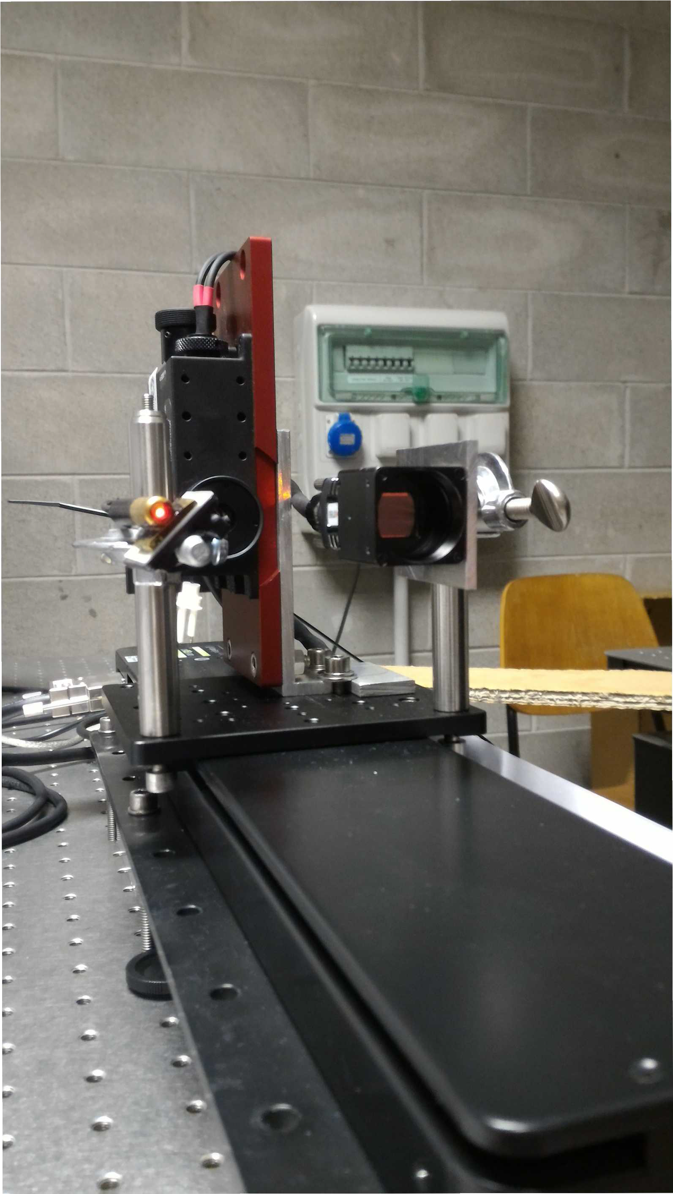
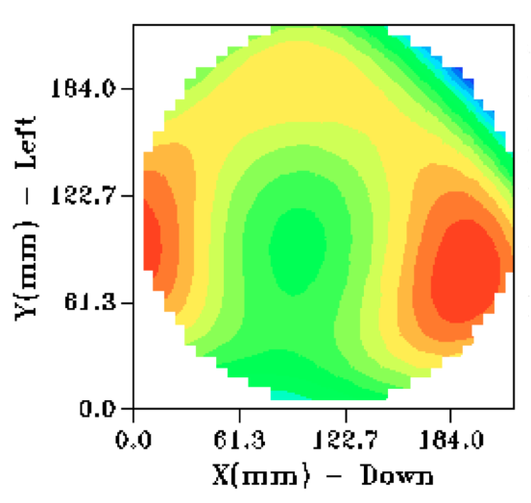
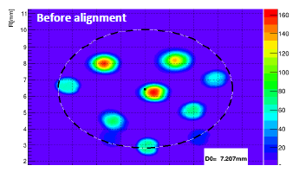
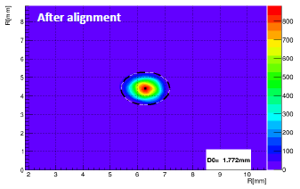
Mirror Test Laboratory
Existing facility to study detailed mirror optical properties
(surface map, radius of curvature, reflectivity)
Planarity
Reflectivity
Shack-Hartmann: Aberrations
Point Image: Alignment
Contalbrigo M.
EIC eRD14, 19th September 2019
Contalbrigo M.
17
Notes:
Fare una immagine del PMT sulla risoluzione

Slide 18
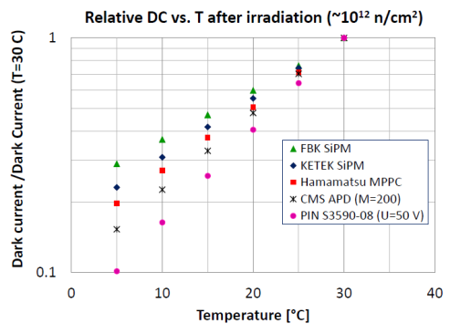
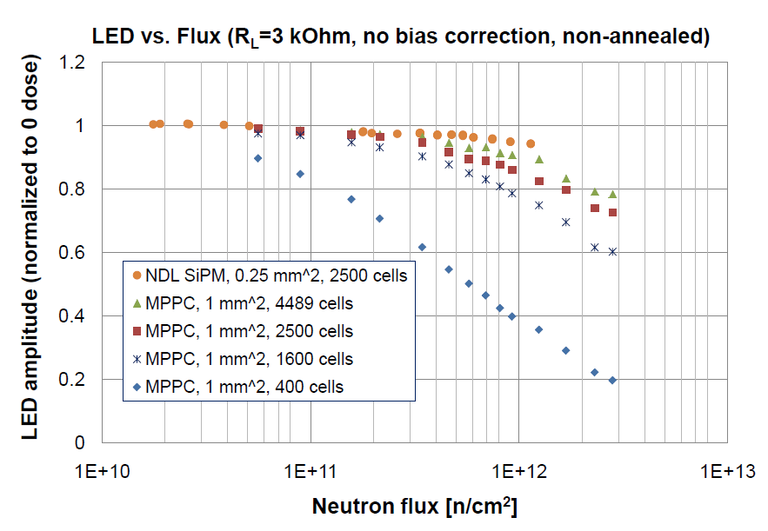
SiPM Radiation Tolerance Investigation
General trend is that SiPMs with high
VB value have faster dark current
reduction with the temperature
Yu. Musienko @ DIRC2019
SiPMs with high cell density and
fast recovery time can operate up
to 3*10¹² neutrons/cm²
(gain change is< 25%).
+ Low/uniform field
+ Entrance window (annealing)
+ Packaging (ΔT, cooling)
+ ……
Contalbrigo M.
EIC eRD14, 19th September 2019
Contalbrigo M.
18
Notes:
Fare una immagine del PMT sulla risoluzione

Slide 19
dRICH Resolution
1 p.e. error (mrad) | Aerogel Demo dRICH | Gas Demo dRICH
Pixel ( 3mm pixel) | 1.9 (0.6) | 0.6 (0.5)
Chromatic (300 nm filter) | 1.8 (2.2) | 0.6 (0.5)
Emission (1 cm out of focus) | 0.3 (0.3) | 0.4 (0.6)
Tracking (0.5 mrad) | 0.4 (0.3) | 0.4 (0.4)
Total | 3.0 (2.3) | 1.1 (1.0)
Aerogel
Gas

Slide 20
SiPM Candidates Survey
Hamamatsu (a sort of reference), Broadcom/FBK (a sort of INFN partner in Italy), ……

Slide 21
INFN Groups and eRD14
INFN-FE
CLAS12 RICH
INFN-RM1
HERMES RICH
Hall-A Tracking
Several INFN groups interested to pursue dRICH
and other activities within the eRD14 Consortium
6m
INFN-LNF
CLAS12 RICH
INFN-CT
Hall-A HCAL

Slide 22
Conclusions
INFN has developed a plan to address the EIC R&D Committee recommendations
To address crucial PID aspects at EIC:
cost-effective compact solution for hadron PID in the forward region in a wide kinematic range
in 1 year: prototype complete and first test-beam
investigation of novel single-photon detector solution to be operated in high magnetic field
in 1 year: post-irradiation characterization and imaging of a status-of-the-art SiPM selection
Goal: have in one year a full-chain assessment (proof-of-principle) of the
proposed approach and investigated technologies
A mandatory step for INFN and eRD14 given the YR, EoI and announced Call for Detectors in FY2021
Co-funding
stimulus for INFN
manpower involvement
SiPM carrier
Radiators/Consumables
US test-beam needs
Travel/Transport

Slide 23
dRICH Model Integrated in Bayesian Optimizer
Use Bayesian Inference to efficiently maximize proper Figure of Merit
General optimization framework with parallelized computation associated to automated convergence criteria; implemented on python sklearn machine learning libraries
dRICH use case
FoM: π-K Cherenkov angles separation in critical phase space regions (other criteria can be added);
8 optimizable parameters selected (can be extended)
An efficient way to re-optimize relevant parameters and consolidate the performances of the dRICH once we have prototype test results
Recently published: J. Inst., vol.15, May 2020 DOI: 10.1088/1748-0221/15/05/P05009

Slide 24
dRICH Performance Parameterization Ab-initio
Chromatic term
Light Transmission
Sensor QE
Aerogel
Sellmeier parameterization
Data-Sheet
Mixture of air and quartz
Collection efficiency: 0.80
Packing fraction : 0.89
Discriminating eff. : 0.87
Instrumental to select & compare promising dRICH configurations prior to full MC simulation

Slide 25
Irradiation Tests
Organize groups of SiPM in 4x8 customized matrices, each group with
- various producers
- different n_{eq} integrated dose (cm⁻²)
- alternative designs (microcell size, quench resistor, wavelength range, …)
Use available facilities in Italy (protons: TIFPA, LNS neutrons: ENEA, )
Designed to be used for irradiation tests and at test-beams after irradiation

