Slide 1
Dual Ring Imaging Cherenkov Status
E. Cisbani, M. Contalbrigo
Italian National Istitute of Nuclear Physics - Rome1 and Ferrara
and
Italian National Institute of Health
EIC YP Meeting
Mar / 19-21 / 2020

Slide 2
Hadron ID @ EIC h-endcap
“Simulations show that in order to satisfy the physics goals of the EIC, it is desirable to provide π/K identification in the central barrel up to 5-7 GeV/c, in the electron-going endcap up ~10 GeV/c, and in the hadron-going endcap one would need to reach ~50 GeV/c.”, from the “Electron-Ion Collider Detector Requirements and R&D Handbook”, January 10, 2019
SIDIS
3D tomography
Diffraction
Gluon saturation
Open charm
Luminosity ≈ 10³⁴/s/cm²
Physics Requirement:
Continuous π/K/(p) identification up to ~50 GeV/c in hadron endcap
Main Technological Challenges:
Geometrical constraints (relatively small longitudinal space and large transverse space)
Solenoid Magnetic Field
Radiation levels

Slide 3
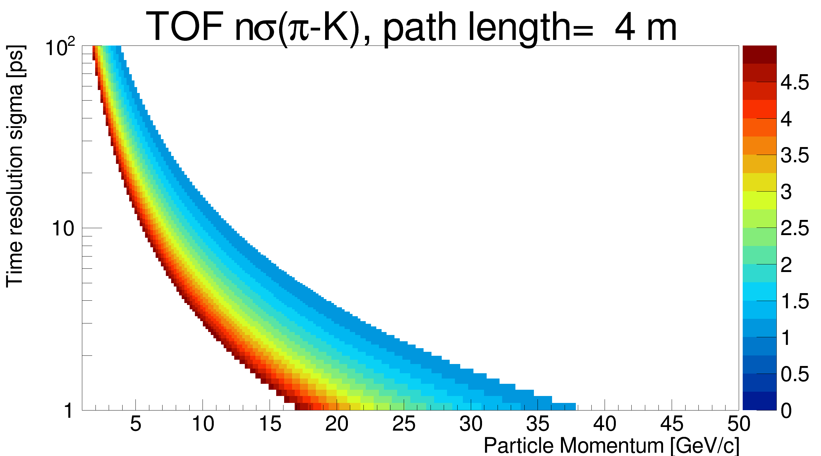
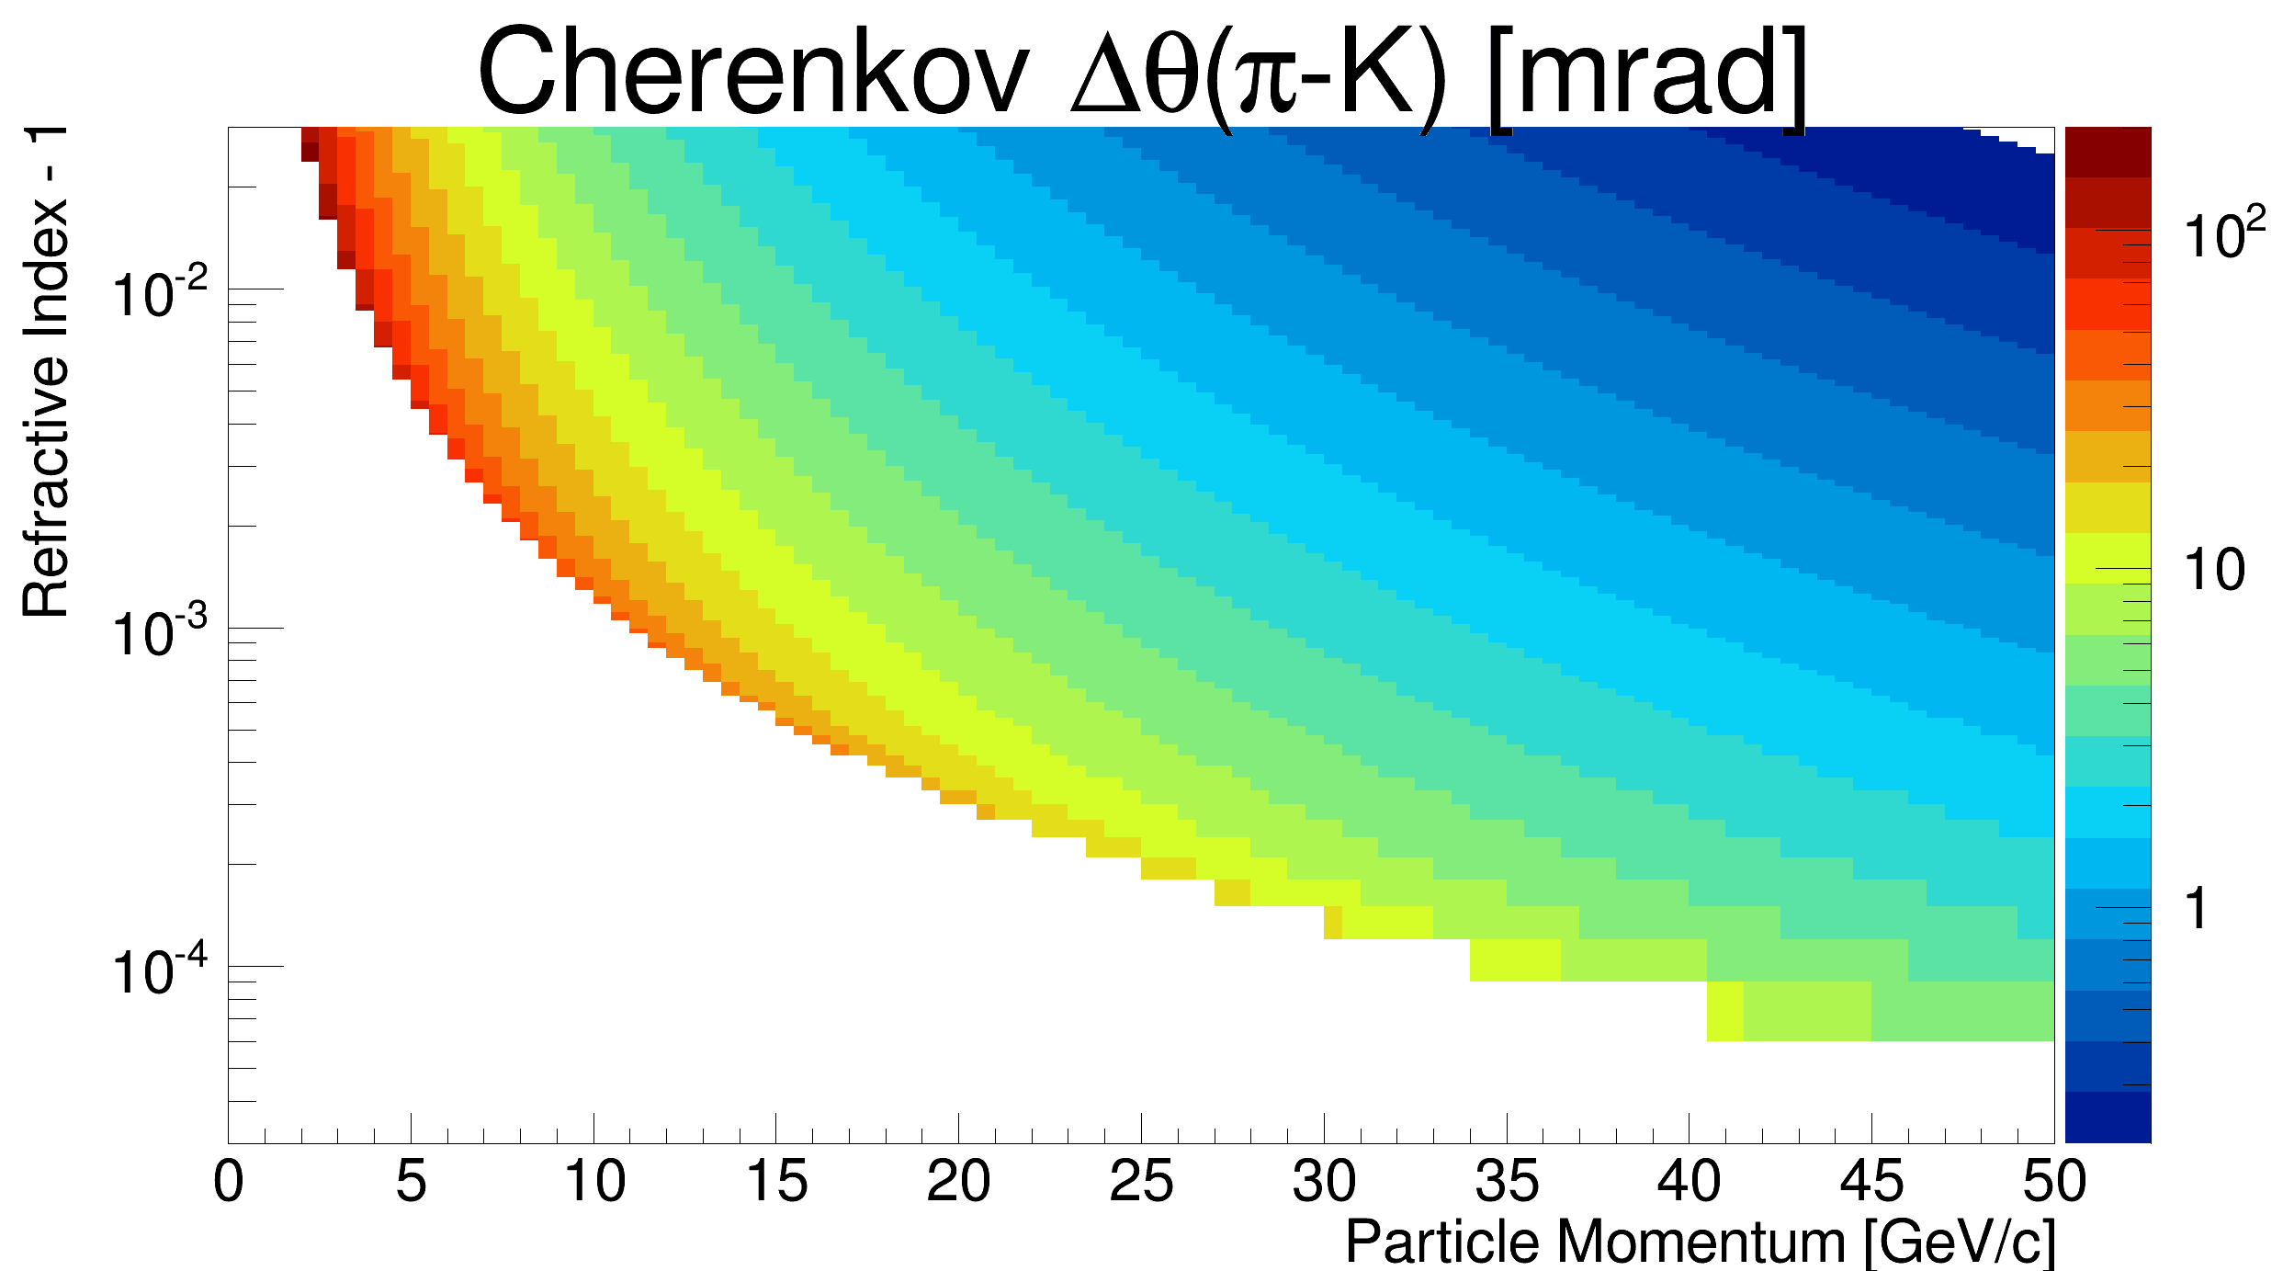
Why a dual radiator RICH ?
Single detector technology cannot cover the whole range up to ≈50 GeV/c with "good" separation of pi-K-p
Three main options:
1) TOF+RICH:
Need challenging time resolution (≈3 ps sigma!)
2a) TOF+RICH(n1)+RICH(n2)
Expected to be more expensive due to twice the sensors and electronics
2b) TOF+RICH(n1,n2)
… next slides

Slide 4
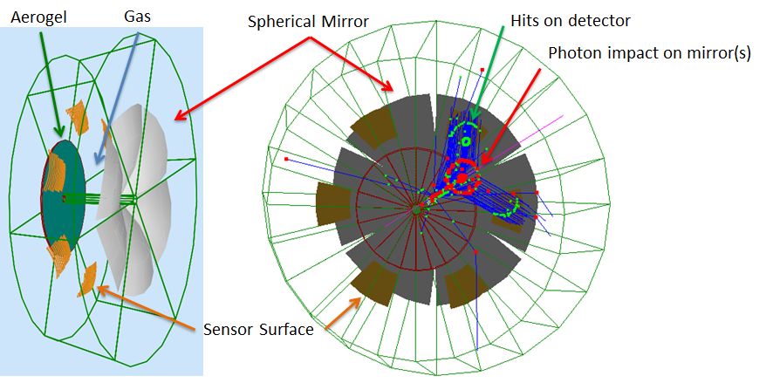
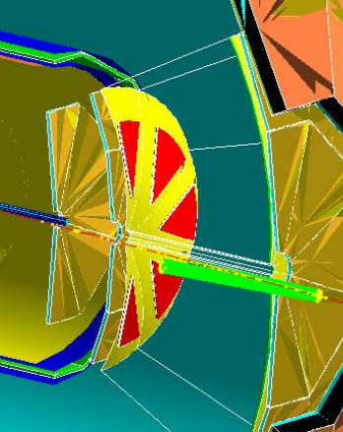
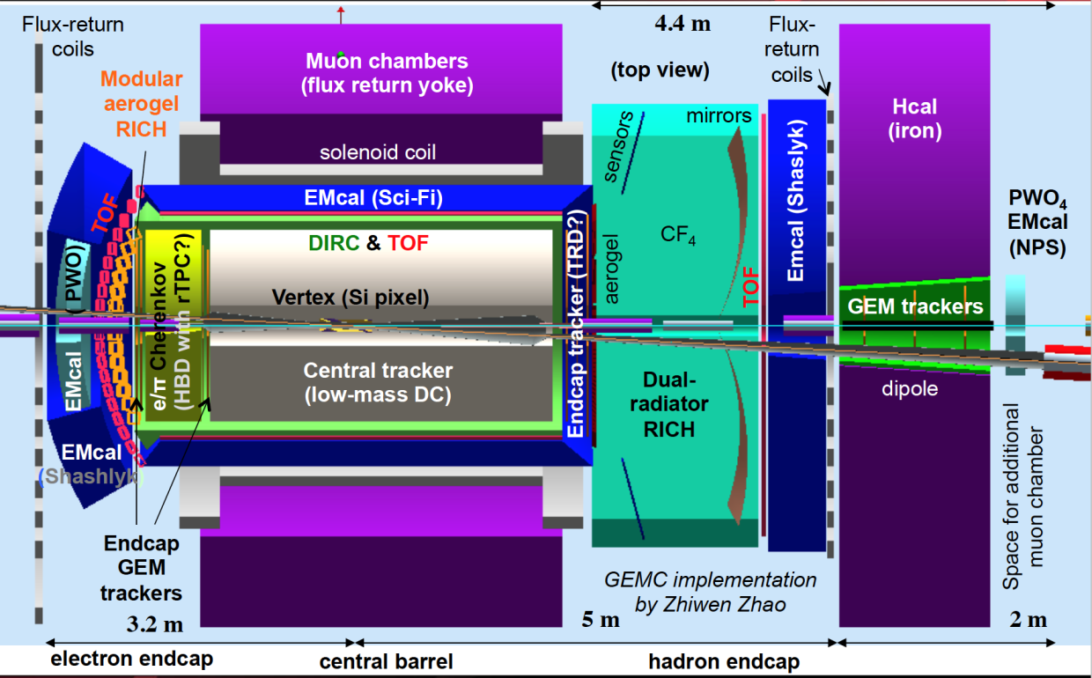
Dual Radiator RICH in EIC Hadron-endcap
ePHENIX
Radiators:
Aerogel: 4 cm, n_{(400nm)}∼1.02 + 3 mm acrylic filter
Gas: 1.6m (1.1m ePHENIX), n_{C2F6}∼1.0008
6 Identical Open Sectors (Petals):
Large Focusing Mirror with R ∼2.9m (∼2.0m ePHENIX)
Optical sensor elements: ∼4500 cm²/sector, 3 mm pixel size, UV sensitive, out of charged particles acceptance
Optimized for JLEIC, preliminary implementation in ePHENIX
JLEIC
Phase Space:
- Polar angle: 5-25 deg
Momentum: 3-50 GeV/c

Slide 5
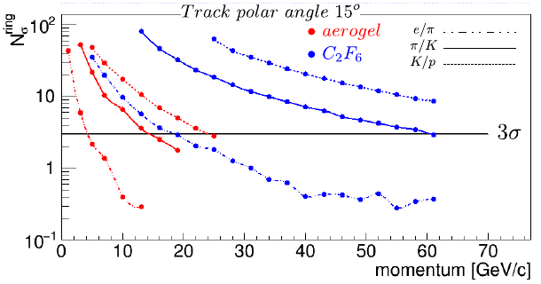
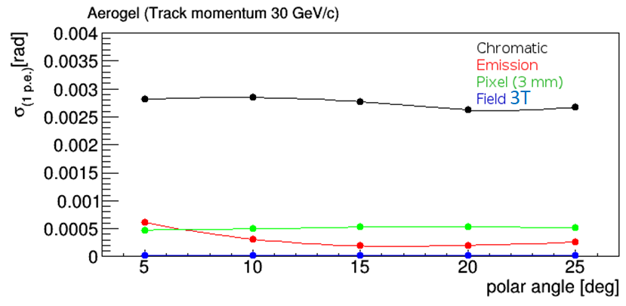
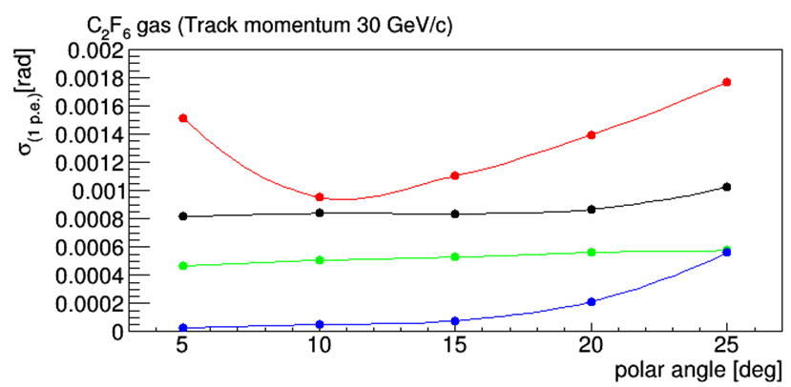
dRICH MonteCarlo Expected Performance
Montecarlo: GEMC (Geant4)
Acrylic Filter (<300nm) after the aerogel to minimize Rayleigh scattering
Mirror quality from CLAS12
PMT 3x3 mm pixel
QE from real CLAS12/PMT data (200-500 nm)
Tracking accuracy 0.5 mrad
Include 3T central magnetic field
Cherenkov Angle reconstruction based on Inverse Ray Tracing
Hadron identification (π/K/p): provides better than 3 sigma from ~3 up to ~50 GeV/c for π/K
Single Photon Angular resolution

Slide 6
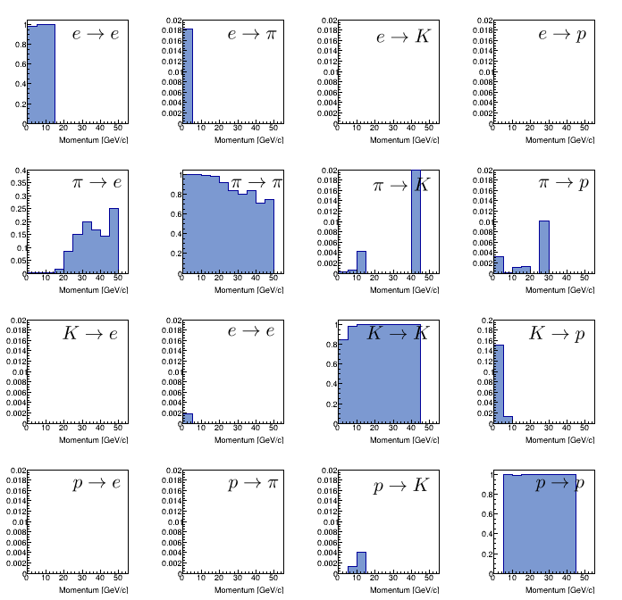
IRT Event Based Reconstruction for dRICH
Inverse Ray-Tracing
PYTHIA based DIS events: ≈20% with multiple tracks & overlapping rings
Implemented efficient event based reconstruction method:
it maximizes 2 likelihood functions in sequence to reduce significantly the computational efforts
$$K→π$$
Example: event with 2 tracks and 15 hits
Brute Force: up to ∼488 billion combinations
Our approach: 1200 combinations
… and it seems to perform pretty well (see above)

Slide 7
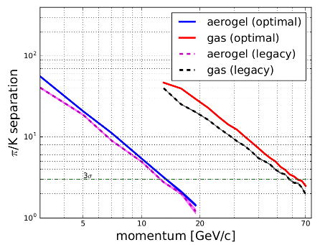
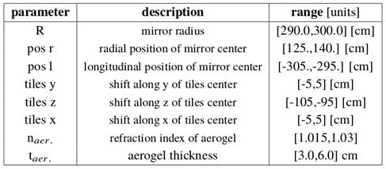
dRICH Model Integrated in Bayesian Optimizer
Use Bayesian Inference to efficiently maximize proper Figure of Merit: π-K Cherenkov angles separation in critical phase space regions (e.g. TOF-aerogel, aerogel-gas transitions, high momentum limit …)
Machine Learning Approach
Corrent implementation uses 8 parameters, but is not limited to them.
The optimization approach can be ported to any detector (or combination of detectors) development where a detailed MonteCarlo exists

Slide 8
dRICH Key Hardware Components
Component | Function | Specs/Requirements | Critical Issues / Comments
Mechanics | Support all other components and services Keep in position and aligned | Large volume gas and light tightness; alignment of components | Technically demanding but feasible; no major challenges expected
Optics (Mirrors) | Focus (expecially for gas) and deflect photons out of particle acceptance and reduce sensor surface | sub-mrad precision reflectivity ≥ 90% low material budget | Spherical mirrors technology of CLAS12 suitable (optical fiber and/or glass skin); similar geometry; Development for cost reduction
Aerogel Radiator | Cover Low Mom. Range between TOF and Gas | ≥3σ π-K separation up to Gas region (∼13 GeV) | Procurement: currently 1 active provider (2 main producers + 1 potential) Long term stability assessment in conjunction with gas
Gas Radiator | Cover High Mom. Range above Aerogel | ≥3σ π-K separation up to ∼50 GeV and overlap to aerogel | Greenhouse gas: potential procurement issue Search for alternatives
Photon Detector | Single photon spatial detection | Magnetic field tolerant and radiation hardness; ∼ few mm spatial resolution | MCP-PMT is likely doable, but expensive. LAPPD may represent an alternative. R&D on SiPM: a promising, quicky improving, wordwide pursued, and cheap technology.
Electronics | Amplify and shape single photon analog signal, convert to digital, transfer to DAQ nodes | Low noise Time res. ∼ 0.5 ns μs signal latency | MAROC3 based readout available for prototyping; final choice will depend on sensor. ASIC development for optimised streaming readout (discrimination vs sampling)

Slide 9
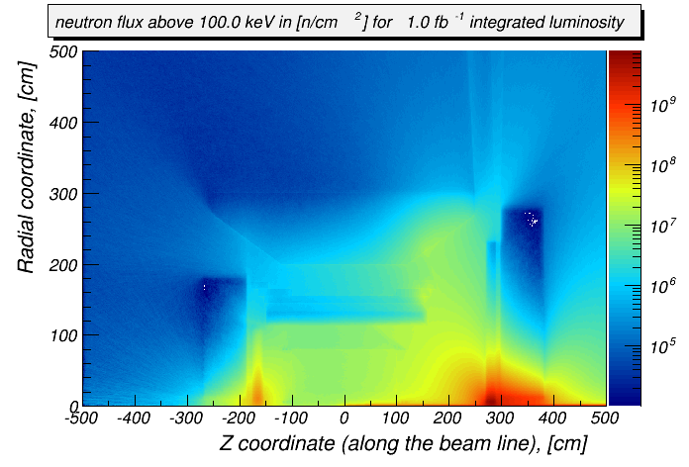
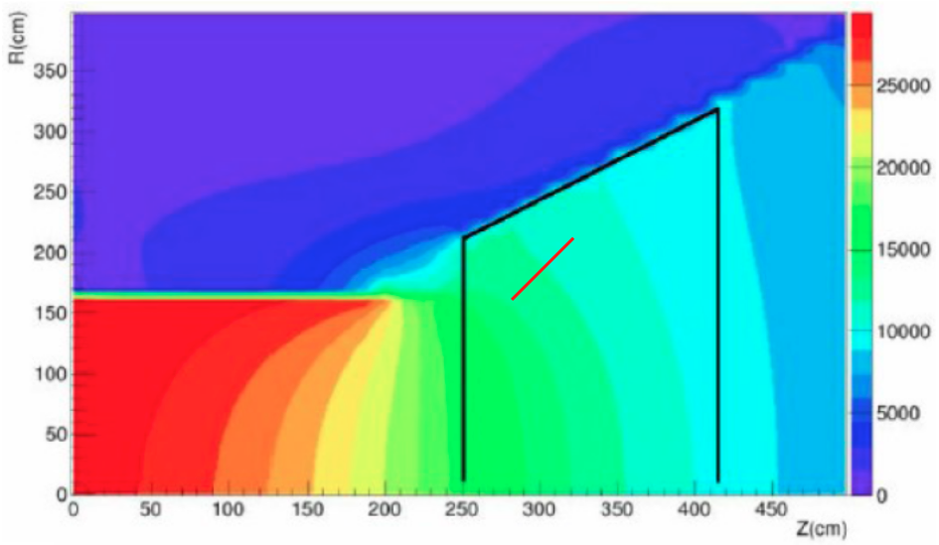
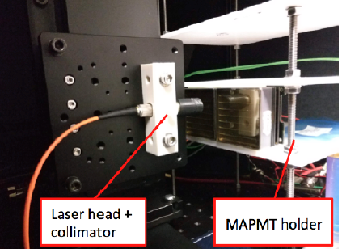
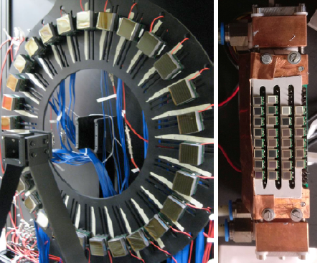
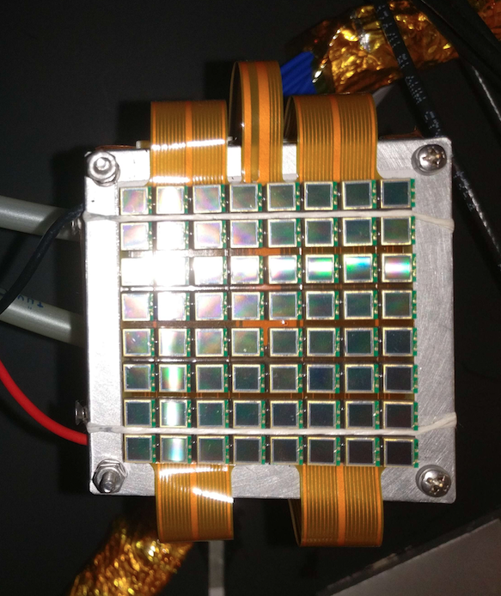
EIC Detector Environment
dRICH sensor location relaxes requirements
on neutron dose and material budget
Neutron flux (Courtesy of A. Kiselev)
Neutron Fluence
Moderate except for very forward regions
Reference value ~ 10 ¹¹ n_{eq}/cm²
for several years at max lumi (10³⁴)
SiPM: radiation mitigation for SPE actively studied
till 10¹² n_{eq}/cm² and above 10.1016/j.nima.2019.01.013
10.1016/j.nima.2018.10.191
Magnetic Field
~ 1 T order of magnitude, varying orientation
SiPM: PET study up to 7 T 10.1109/NSSMIC.2008.4774097
Magnetic field
SiPM SPE capability under study since 2012 @ INFN
Contalbrigo++ NIMA 766 (2014) 22, Balossino ++ NIMA876 (2017) 89
dRICH
sensor
Notes:
Fare una immagine del PMT sulla risoluzione

Slide 10
Electronics and DAQ
Electronics minimum features required:
Amplify and shape single photon analog signal
Convert to digital: amplitude (or 0/1 at least) and timing info
Transfer to DAQ nodes
Time resolution: ≤0.5 ns sub-ns timestamp accuracy (?)
Single photon sensitivity!
Estimated, very tentative DAQ performance requirement of Front End Electronics
 |  | dRICH | CLAS12-RICH
Time resolution (Sampling period) | ns | 0.5 | 1
# channels/sector |  | 50000 | 25000
# bits/ch (binary info) |  | 1 | 1
Data rate/sector | Gbits/s | 100000 | 50000
Data rate/sector – zero suppression* | Gbits/s | 800 | 375
Sort of streaming readout mode
*Assume 1 MHz dark count/pixel as dominant contribution
Current single JLab/SSP FPGA subsystem processor has ≈100 Gbits/s capability

Slide 11
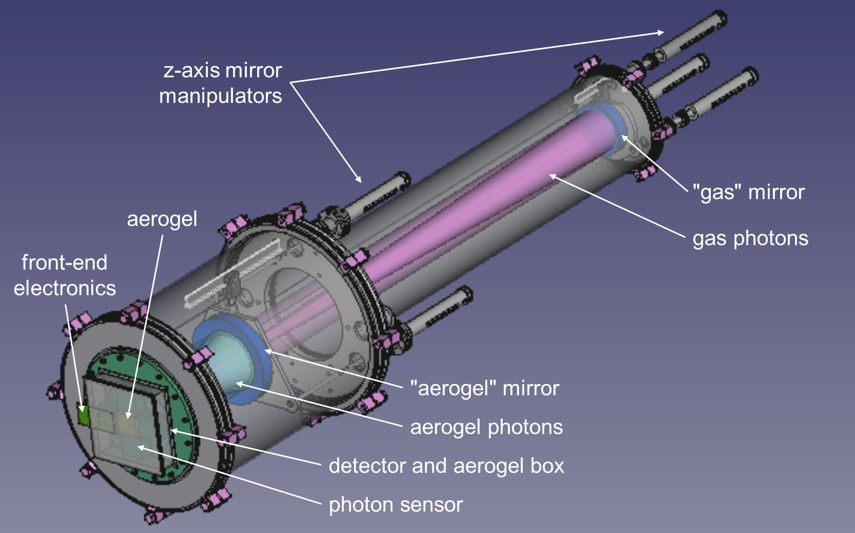
dRICH Prototype Design
Design in an advanced stage, mechanical details being finalized
Standard Vacuum Technologies to optimize gas handling
Two tuneable mirrors system for using the same detector
Common (limited) sensitive surface for both aerogel and gas photons
Detector and aerogel box isolated from the gas tank

Slide 12
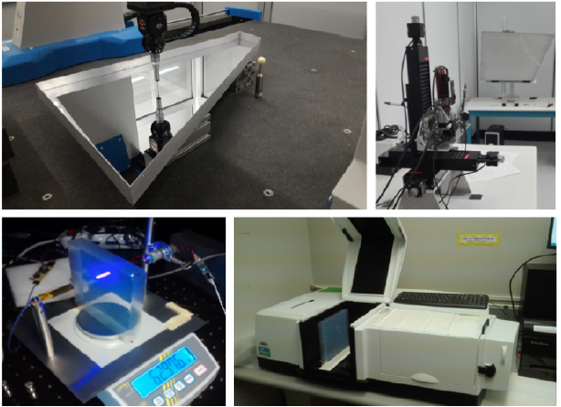
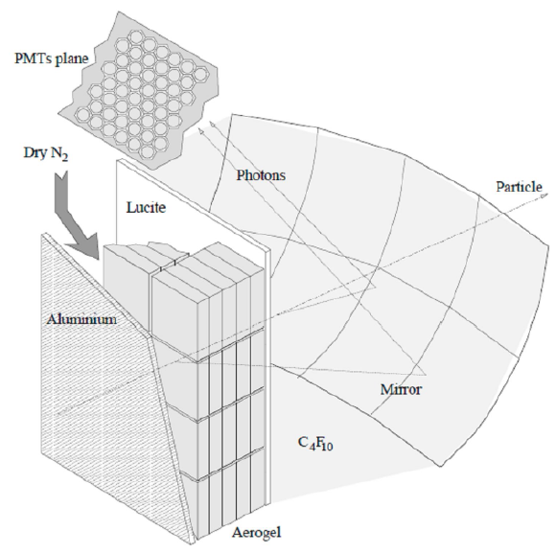
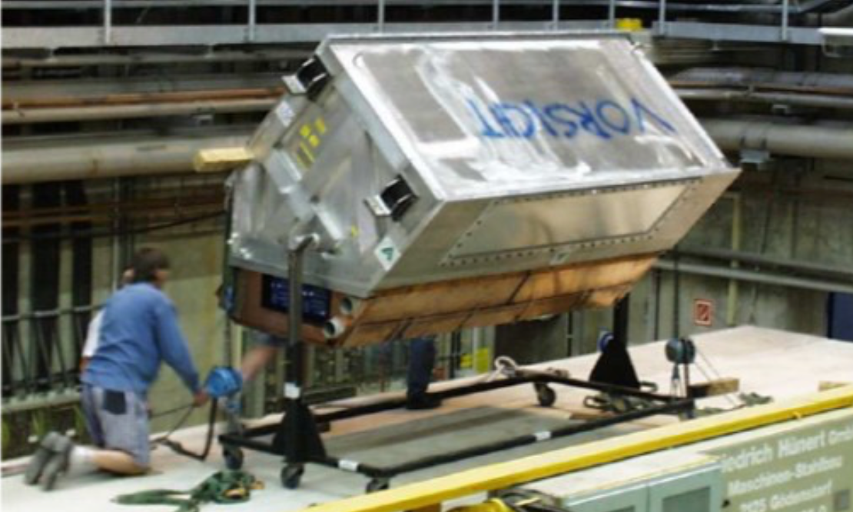
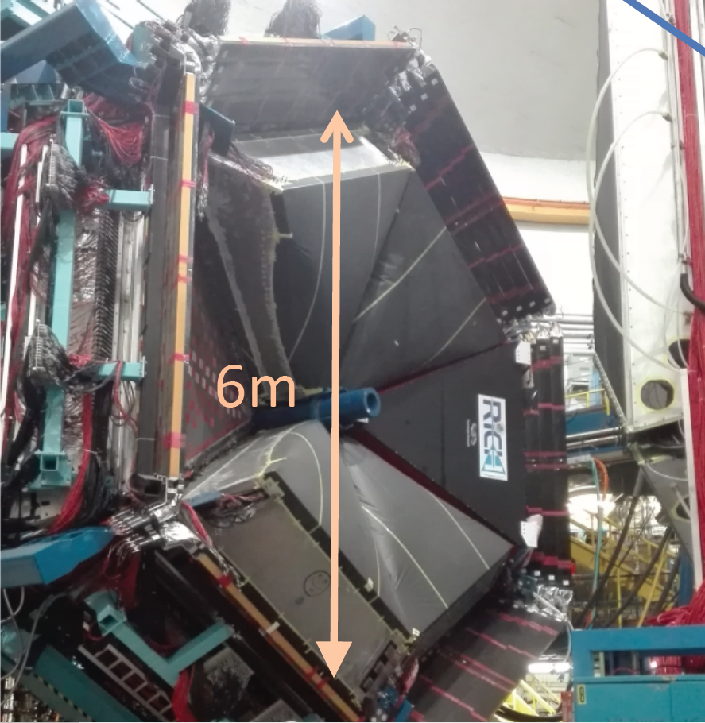
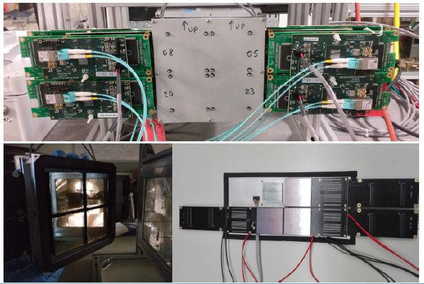
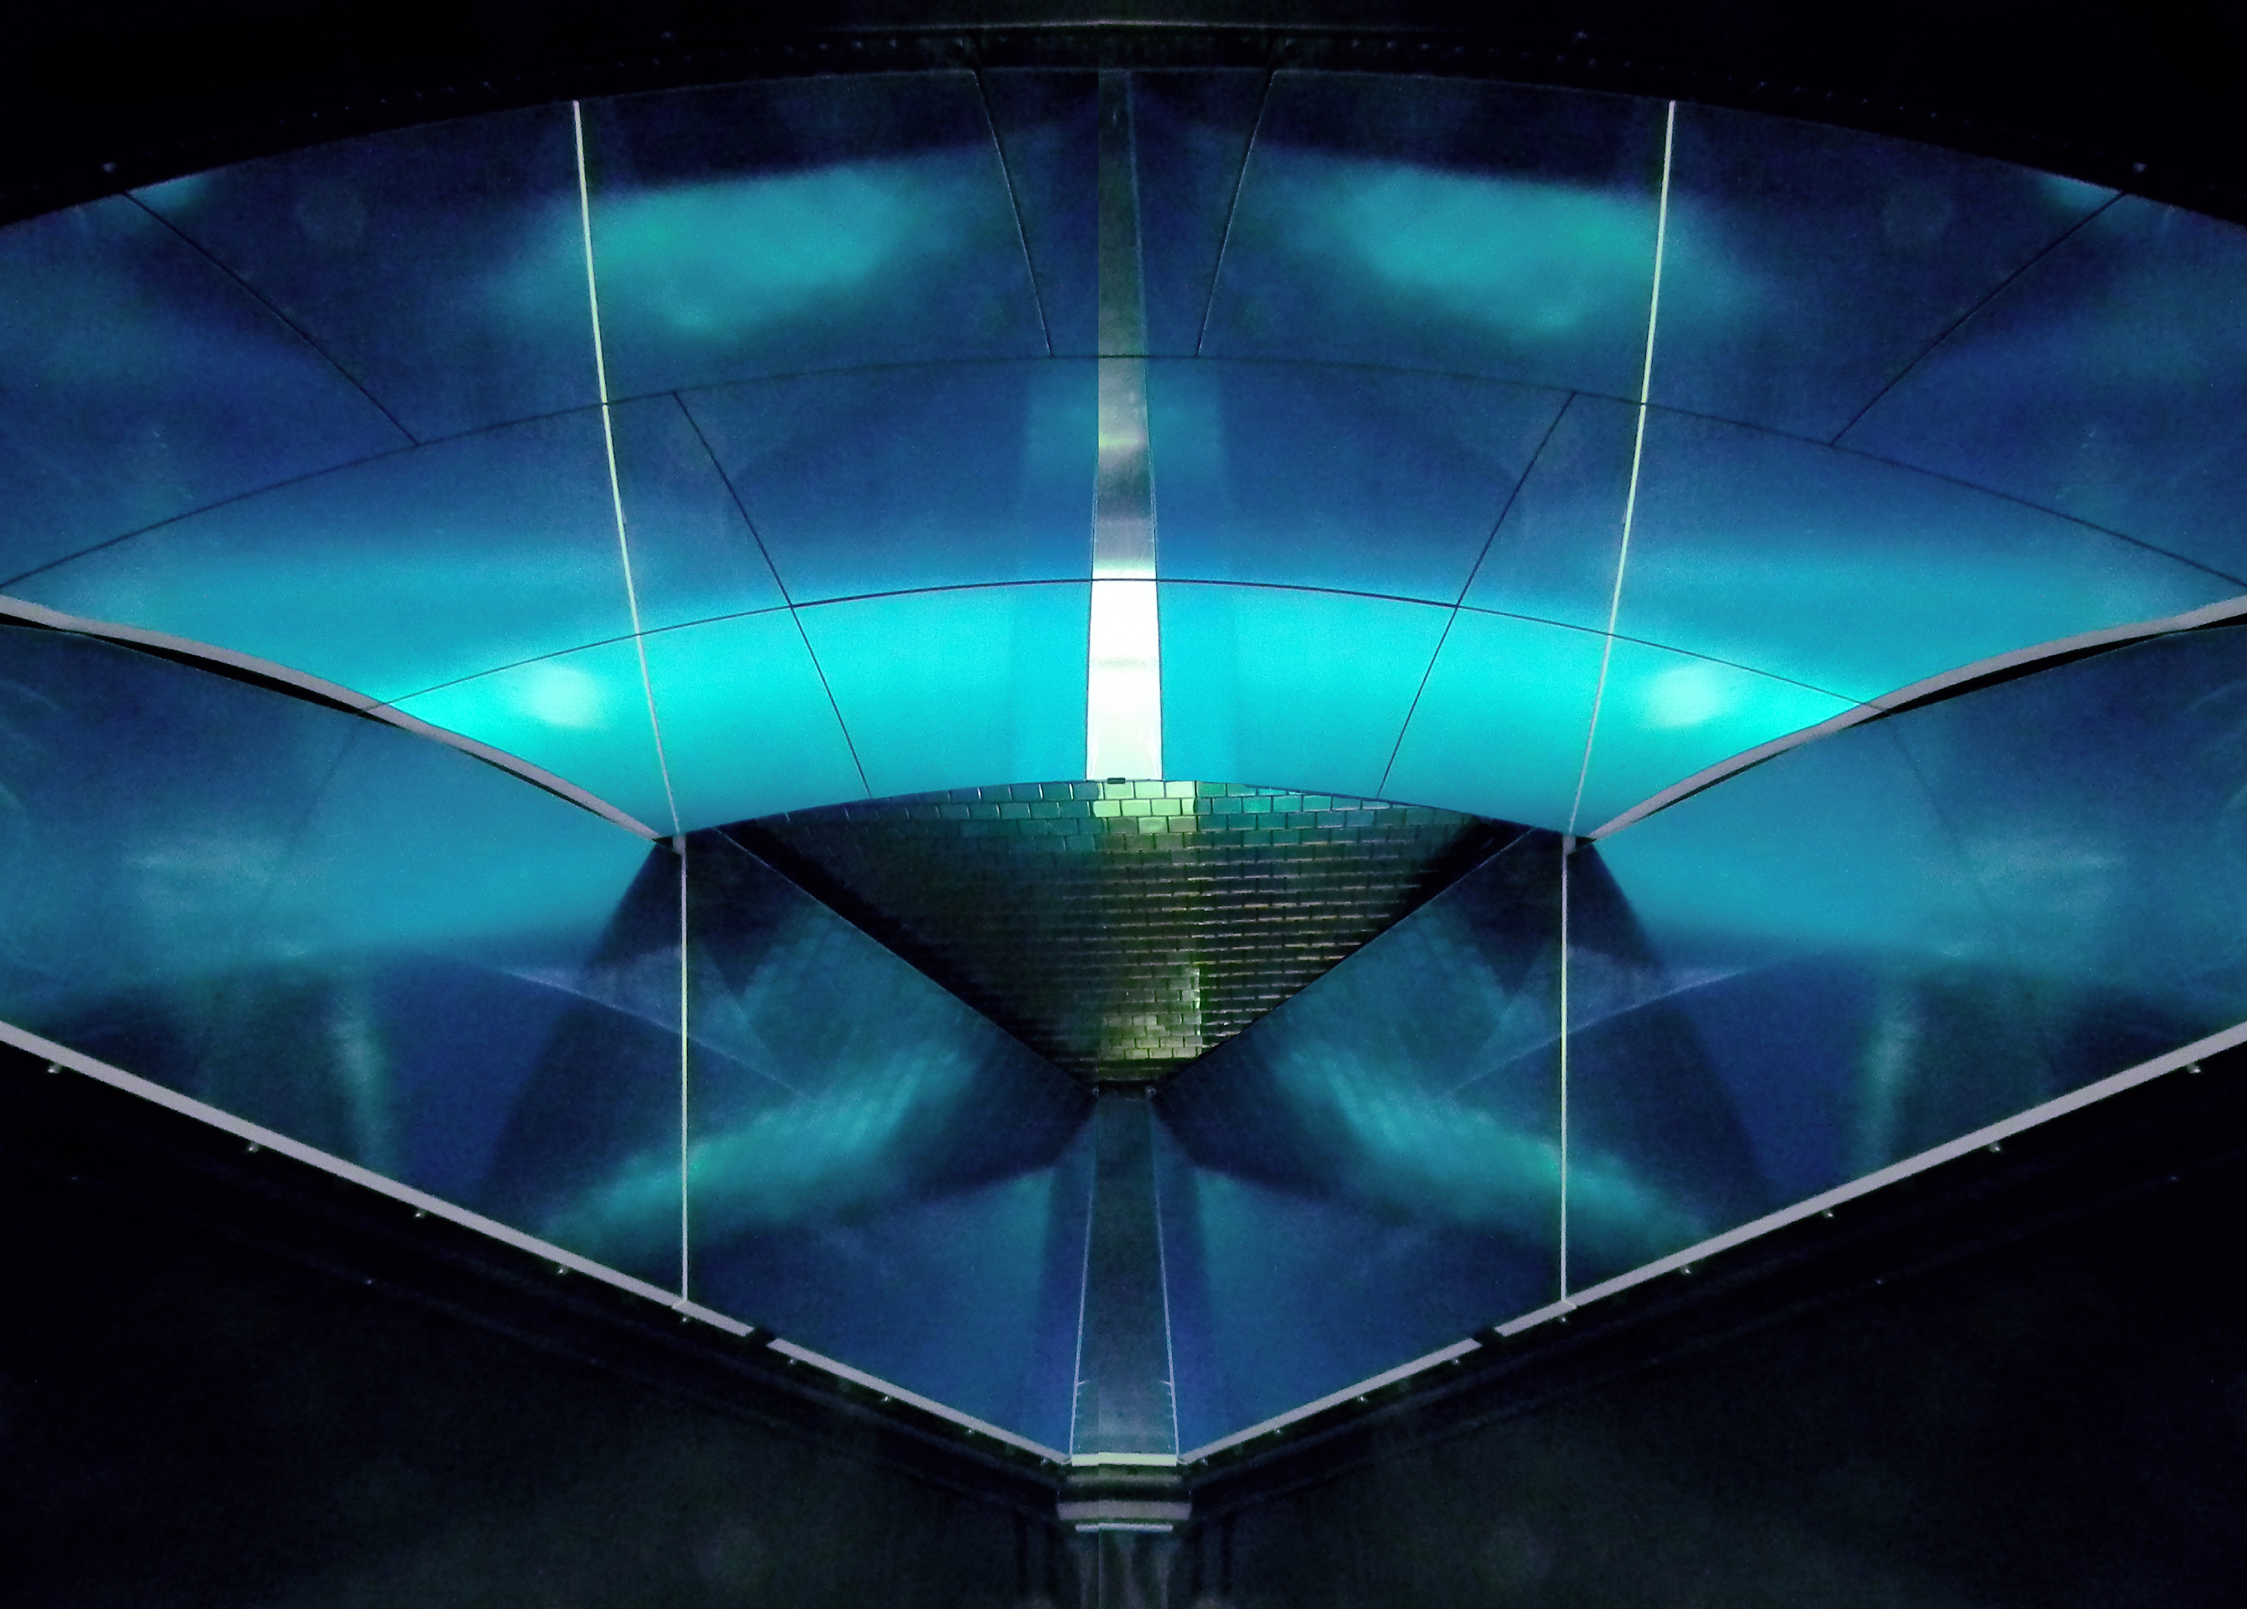
In-house Expertise and Equipment
INFN/Duke > 6 staff > 4 technicians + students
Workshops + laboratory test-benches
HERMES RICH: successful dual-RICH
Freon
Aerogel
CLAS12 RICH: geometry scale similar to EIC
Prototyping and test-beams

Slide 13
Summary
Patrizia’s Questions
Technology used: spell out clearly any risk associated, if any
Consolidated baseline of the dRICH design exists
Can in principle be realized with standard and mature technology solutions
Specific Risk: availability/procurement of Freon gases
Common Challenge: SPE sensor in high magnetic field
Momentum range covered: p versus theta and Nsigma vs. p
>3σ separation in the 3-50 GeV/c momentum and 5-25 deg polar angle ranges
Robustness of the design (e.g. sensitivity to magnetic field) and has a prototype been built?
Performance on physics (SIDIS) events simulated in high 3T field
Prototype design consolidated; component procurement started
Are the electronics considerations clear (channel count, data size, rate, background)
Can be realized with available architectures
Details under study: depends on machine design, IP, sensor and readout
Time needed to complete the R&D and available workforce
About 3 years
Experienced workforce available and increasing
INFN groups interested in the critical aspects: SiPM, electronics, radiators
Status of Simulation and Reconstruction
Software: realistic Geant4/GEMC MonteCarlo
Bayesian optimizer and event based PID implemented

