Slide 1
Particle Identification with future
ring-imaging Cherenkov detectors
Marco Contalbrigo
INFN - Ferrara
STRONG2020 Annual Meeting, LNF, June 20-22, 2024
1

Slide 2
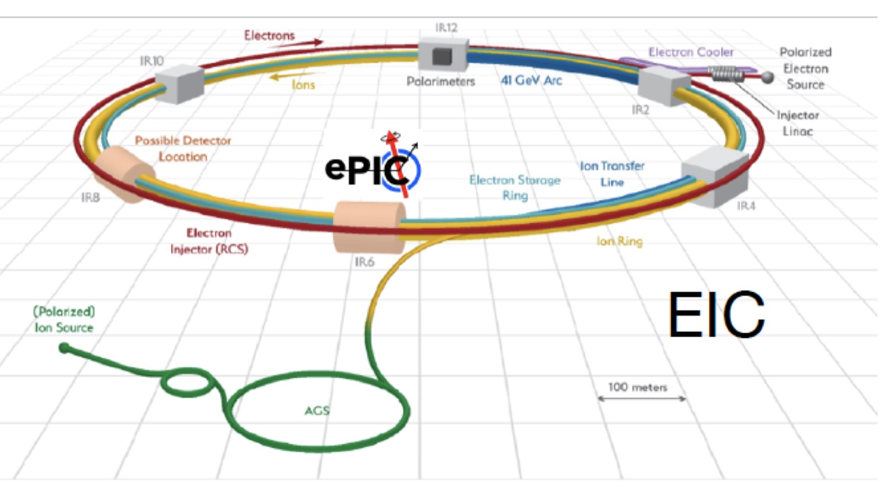
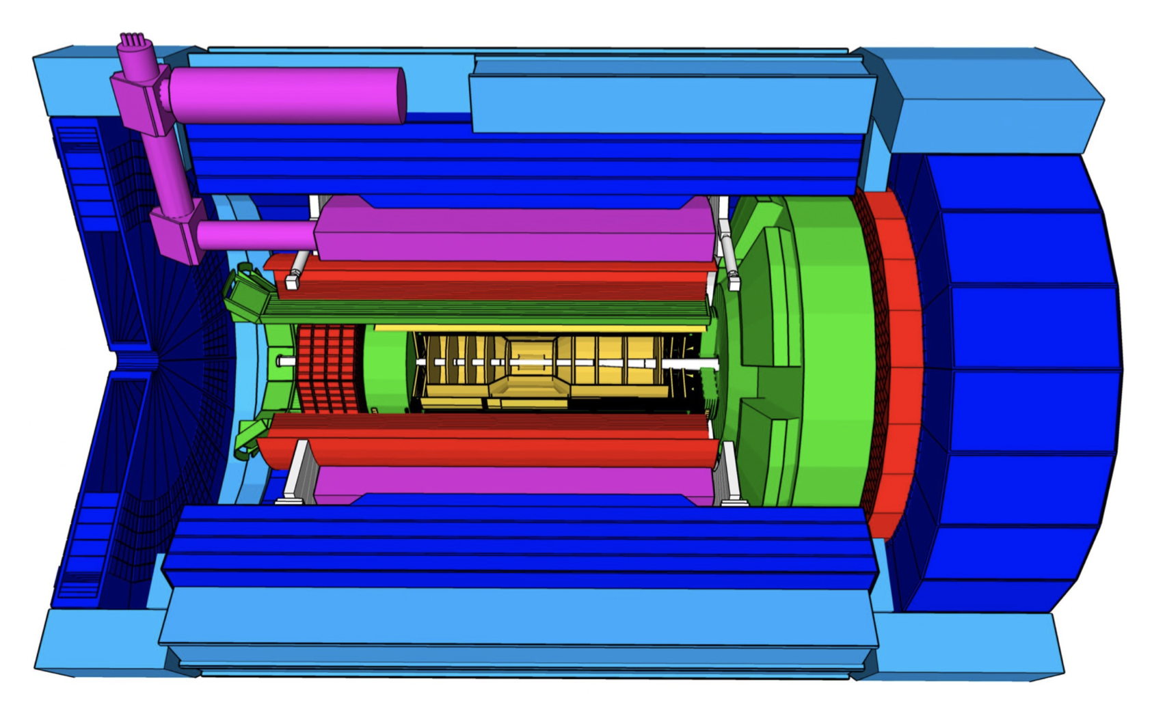
ePIC @ EIC
@ the Electron-Ion Collider
@ BNL
CD0 12/2019
CD1 06/2021
……
CD2 01/2025
……
STRONG2020 Annual Meeting - 21st June 2024
2

Slide 3
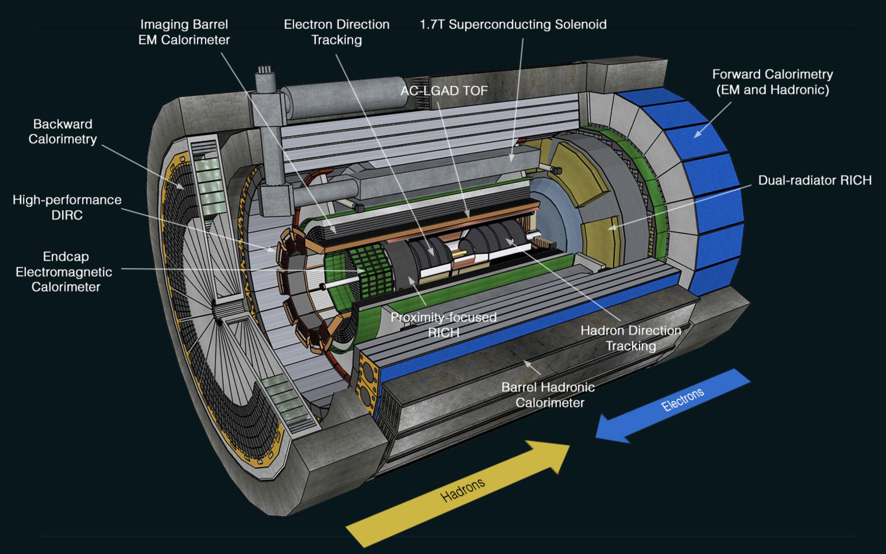
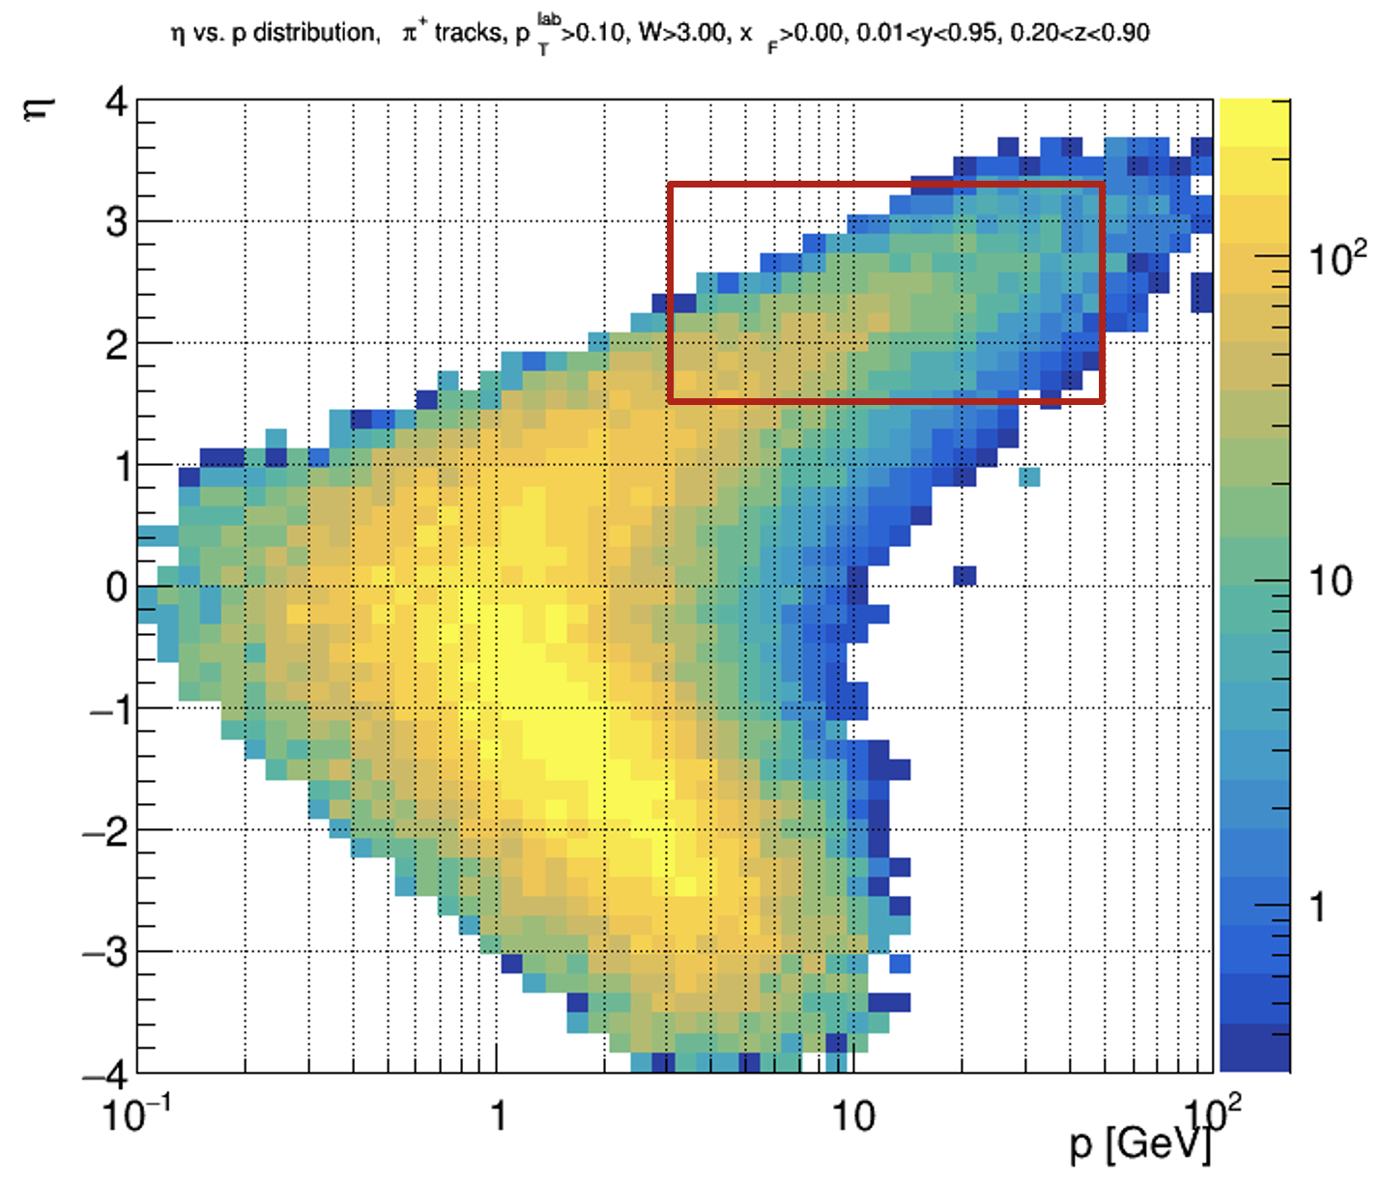
ePIC dRICH
Compact cost-effective solution for particle identification in the high-energy endcap at EIC
Essential for semi-inclusive physics due to absence
of kinematics constraints at event-level
EPIC
Main challenges:
Cover wide momentum range 3 - 50 GeV/c -> dual radiator
Work in high (~ 1T) magnetic field -> SiPM
Fit in a quite limited (for a gas RICH) space -> curved detector
Forward particle detection
Hadron ID in the extended 3-50 GeV/c interval
Support electron ID up to 15 GeV/c
STRONG2020 Annual Meeting - 21st June 2024
3

Slide 4
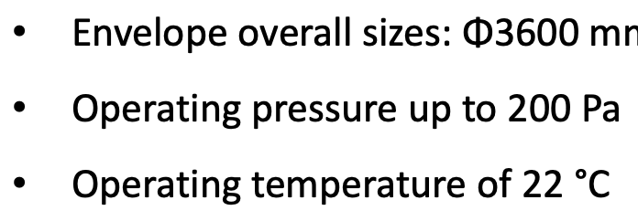
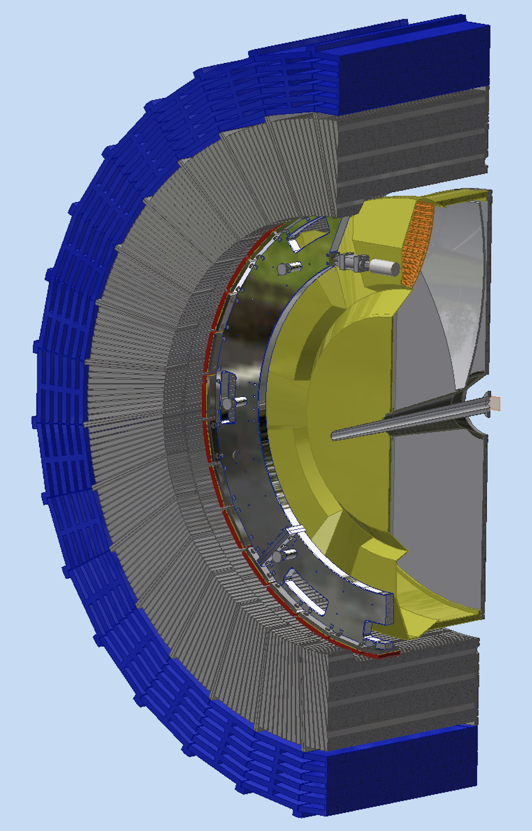
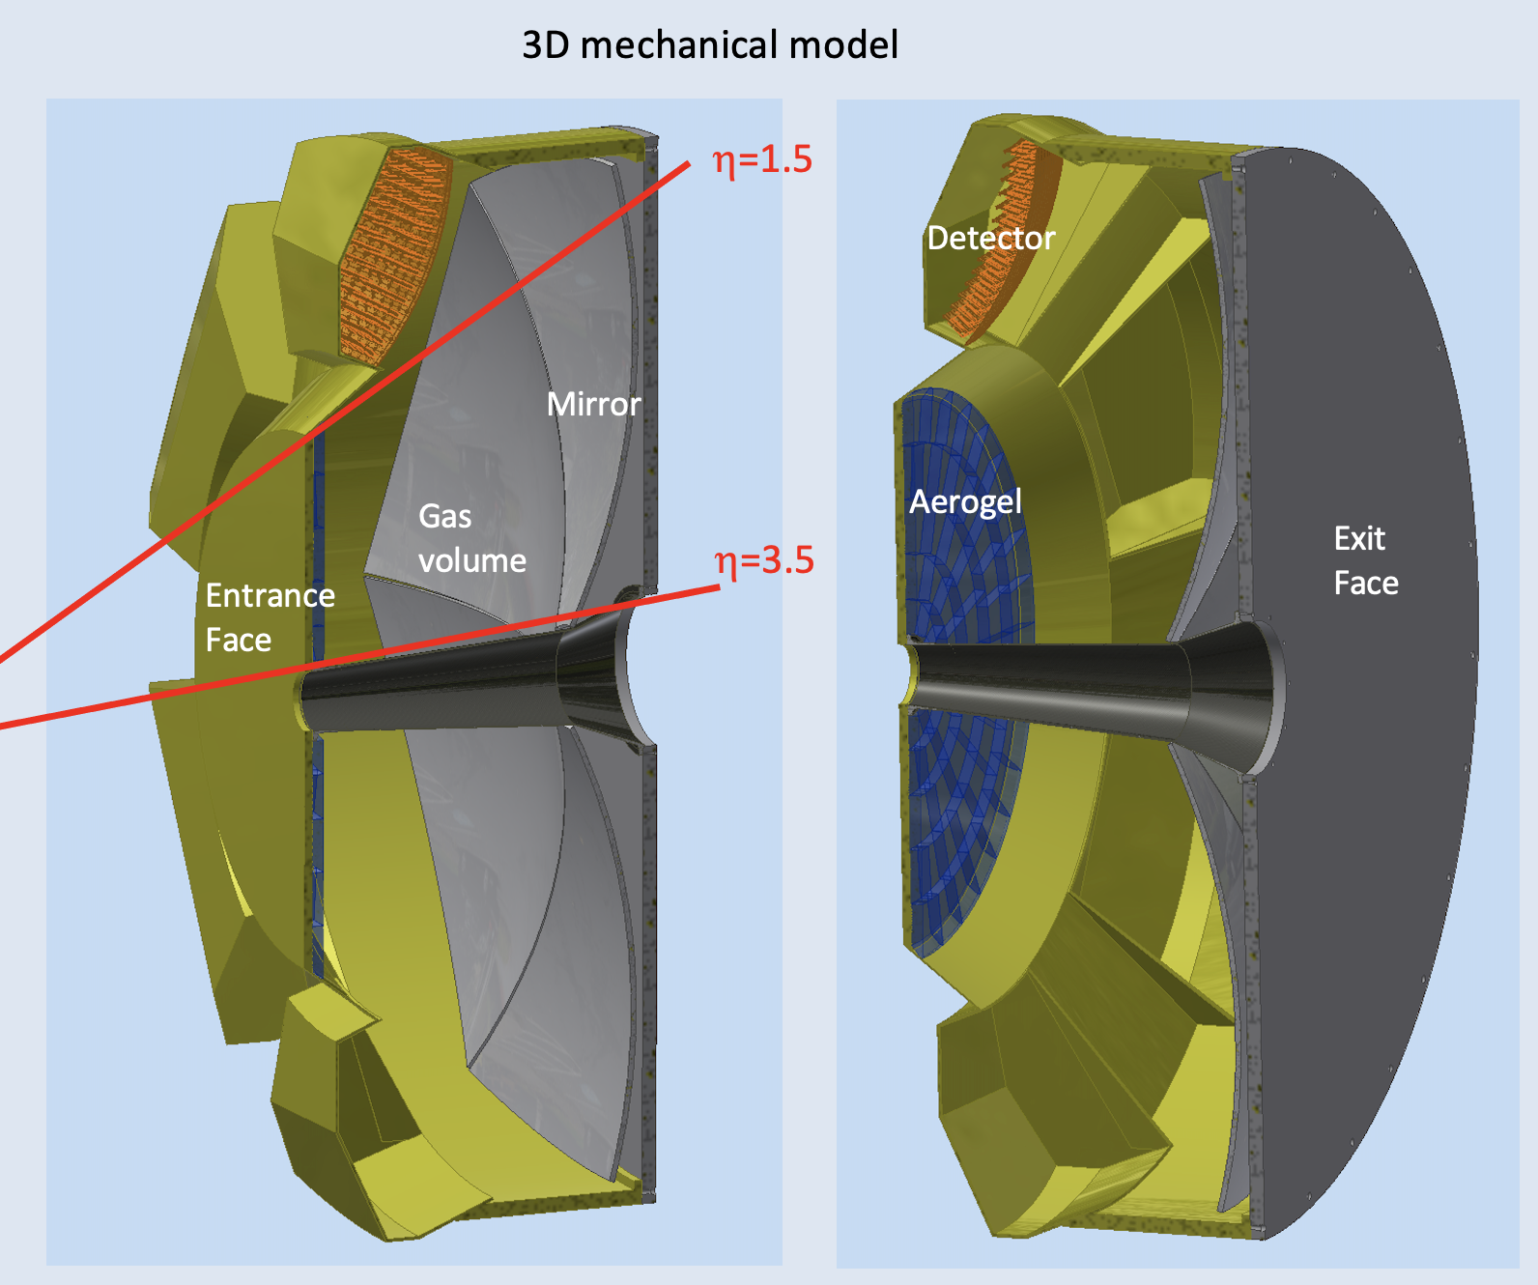
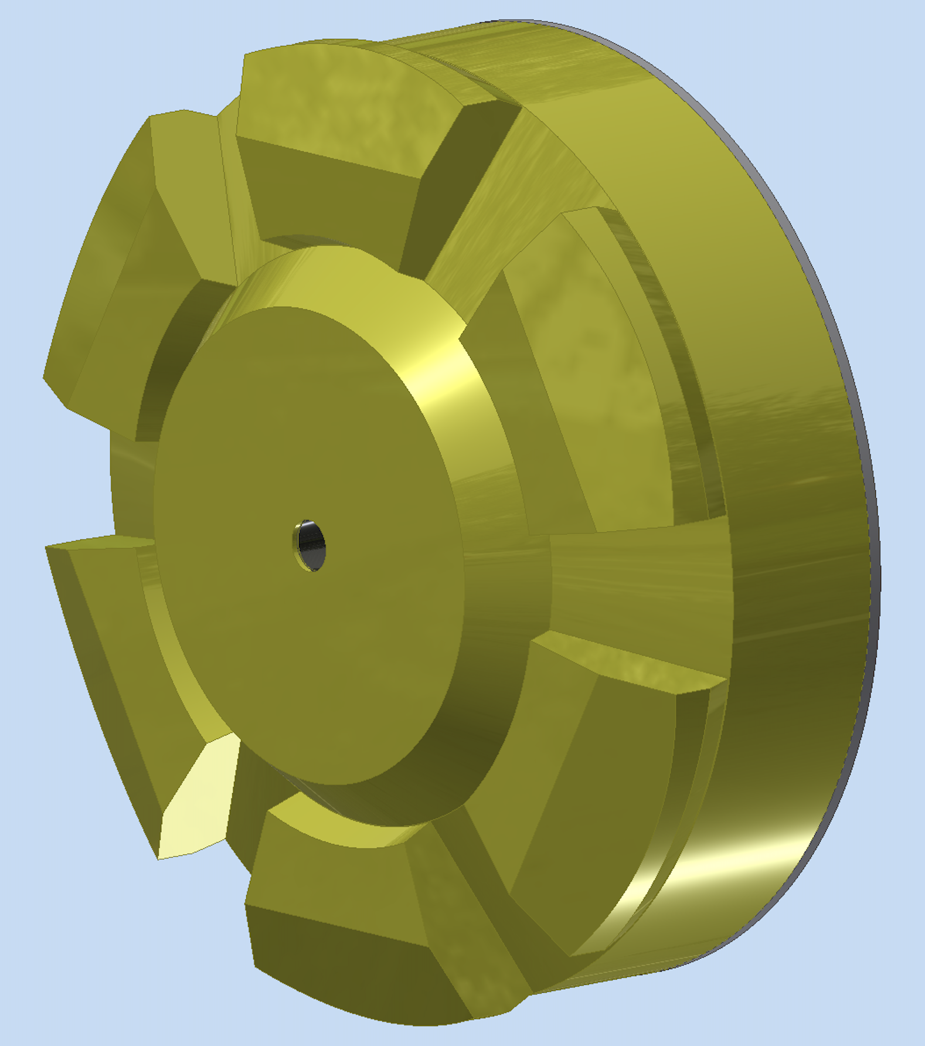
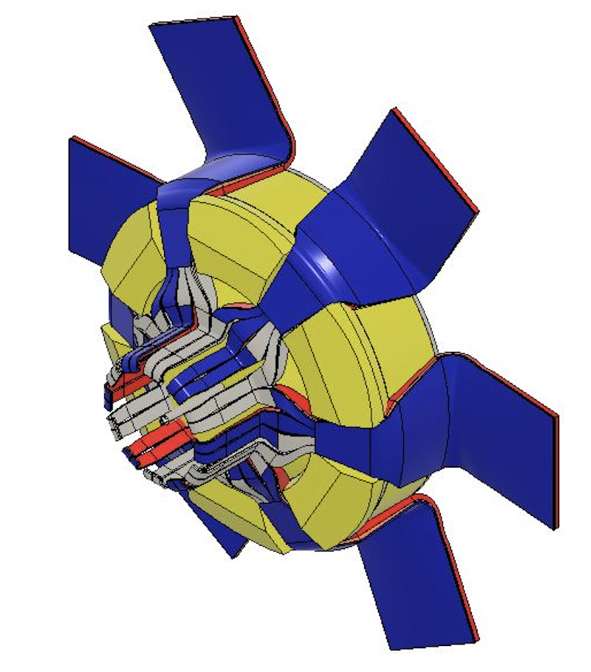
ePIC dRICH
Acceptance: defined by pipe and barrel ecal
minimize material budget with the use of composite materials
Interferences: material budget concentrated beheind the barrel ecal and its support ring
readout electronics design in order to minimize the detector box volume
STRONG2020 Annual Meeting - 21st June 2024
4
Notes:
Aggiungere distribuzioni in numero fotoni ?

Slide 5
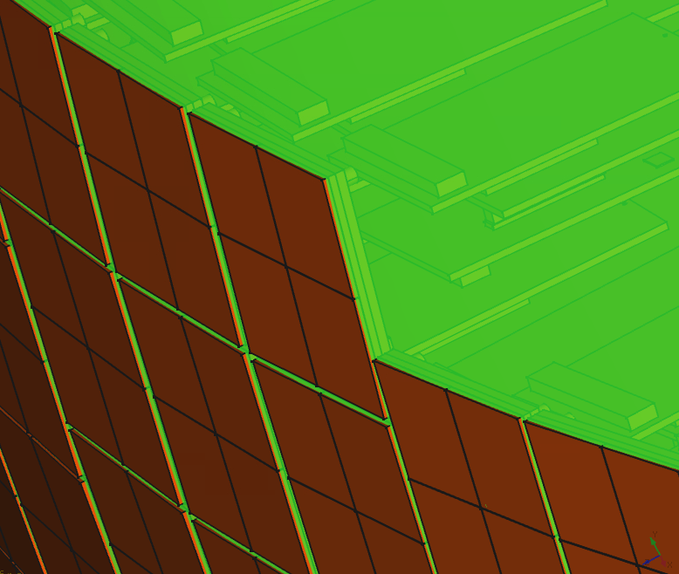
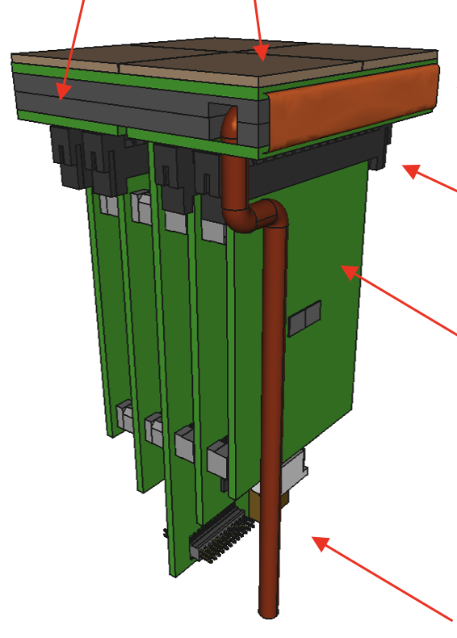
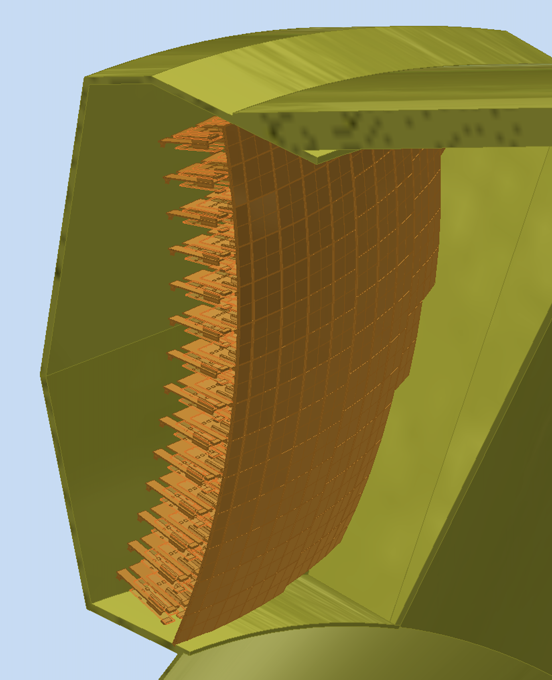
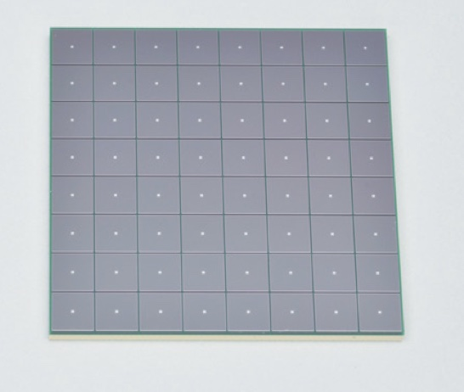
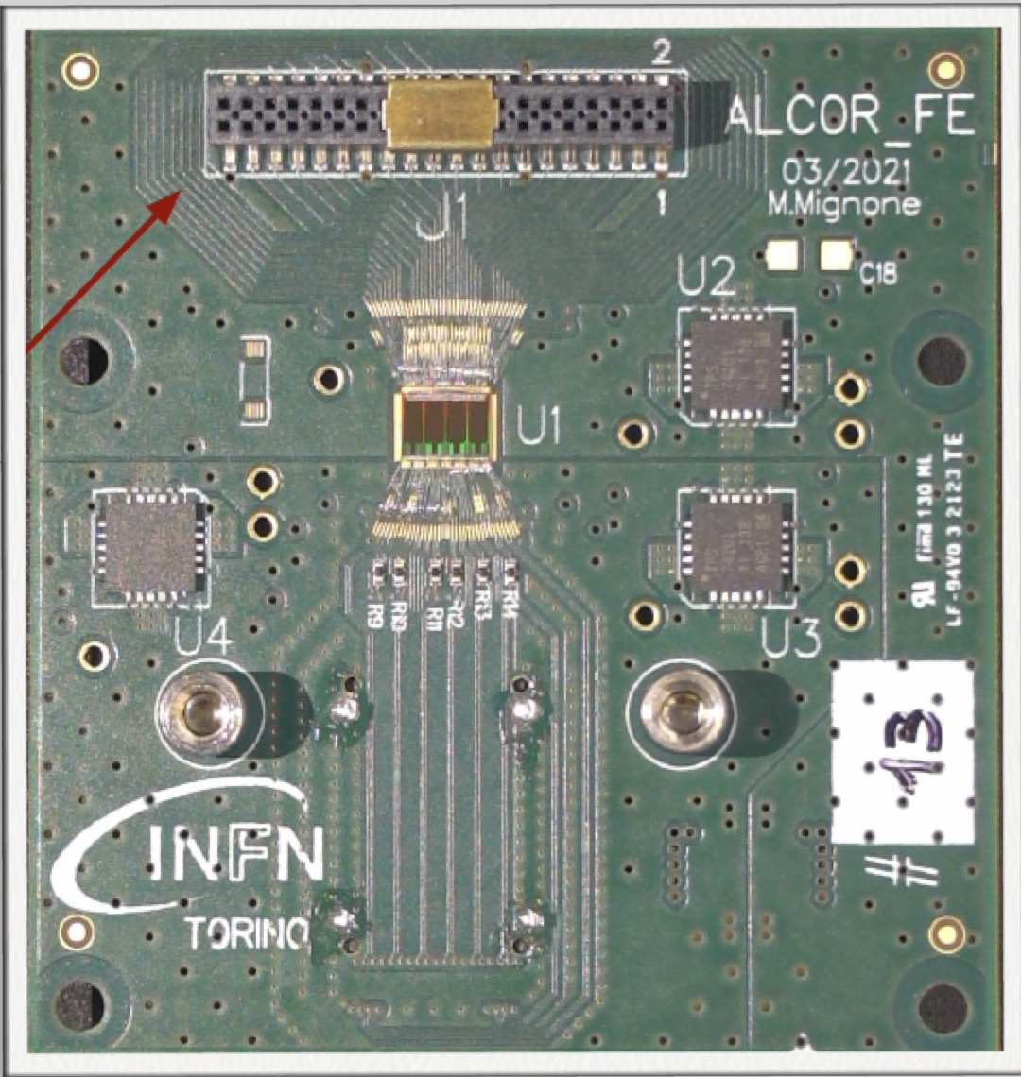
dRICH Photo-Detector
Heat exchanger
Cold plate
SiPM array
Photon Detector Unit (PDU):
Compact to minimize space
4x Hamamatsu S13361-3050HS SiPM arrays
4x Front-End Boards (FEB)
4x ALCOR chip (ToT discrimination)
4 x Annealing Circuitry
1x Read-Out Board (RDO)
1x Cooling plate (< -30 C)
Flex PCB
Back-side
connectors
14 cm
FEB
(ALCOR)
Service
connections
Active area is shaped to resemble the focal surface and best exploits the focalization
RDO
Detector box:
Shaped to fit the space
Quartz window
Cooling for sensors and electronics
Power distributing patch panel
Heat insulation
SiPM array
ALCOR chip
STRONG2020 Annual Meeting - 21st June 2024
5
Notes:
Capire quanto veloce va il chip (definizione shutter)

Slide 6
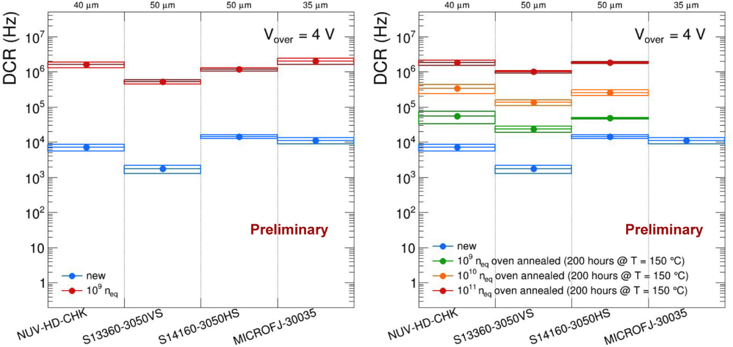
Radiation Tolerance Studies
STRONG2020 Annual Meeting - 21st June 2024
6
Notes:
Capire quanto veloce va il chip (definizione shutter)

Slide 7
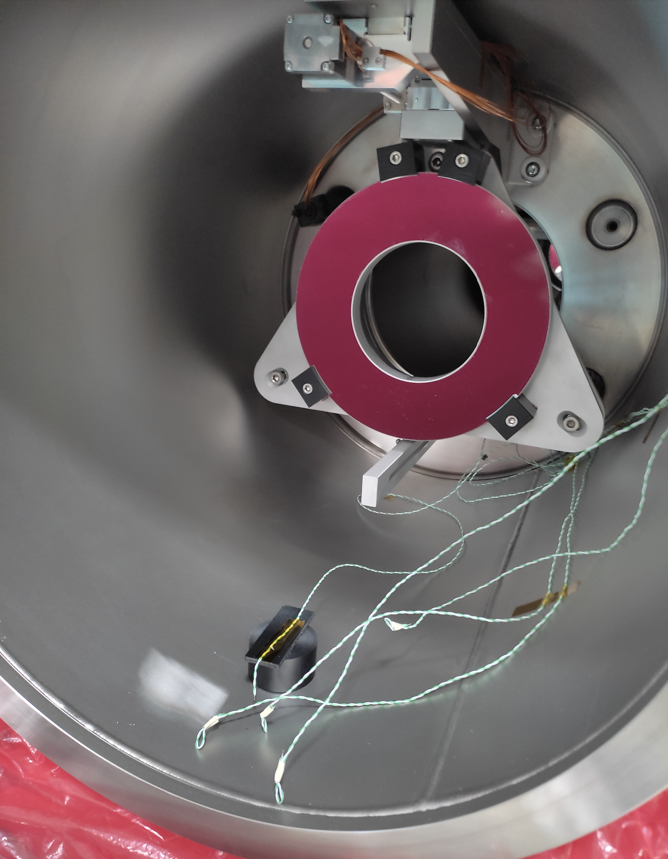
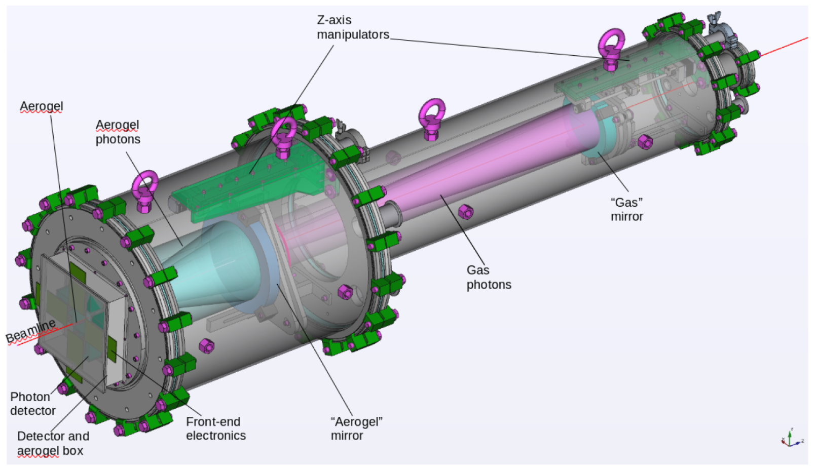
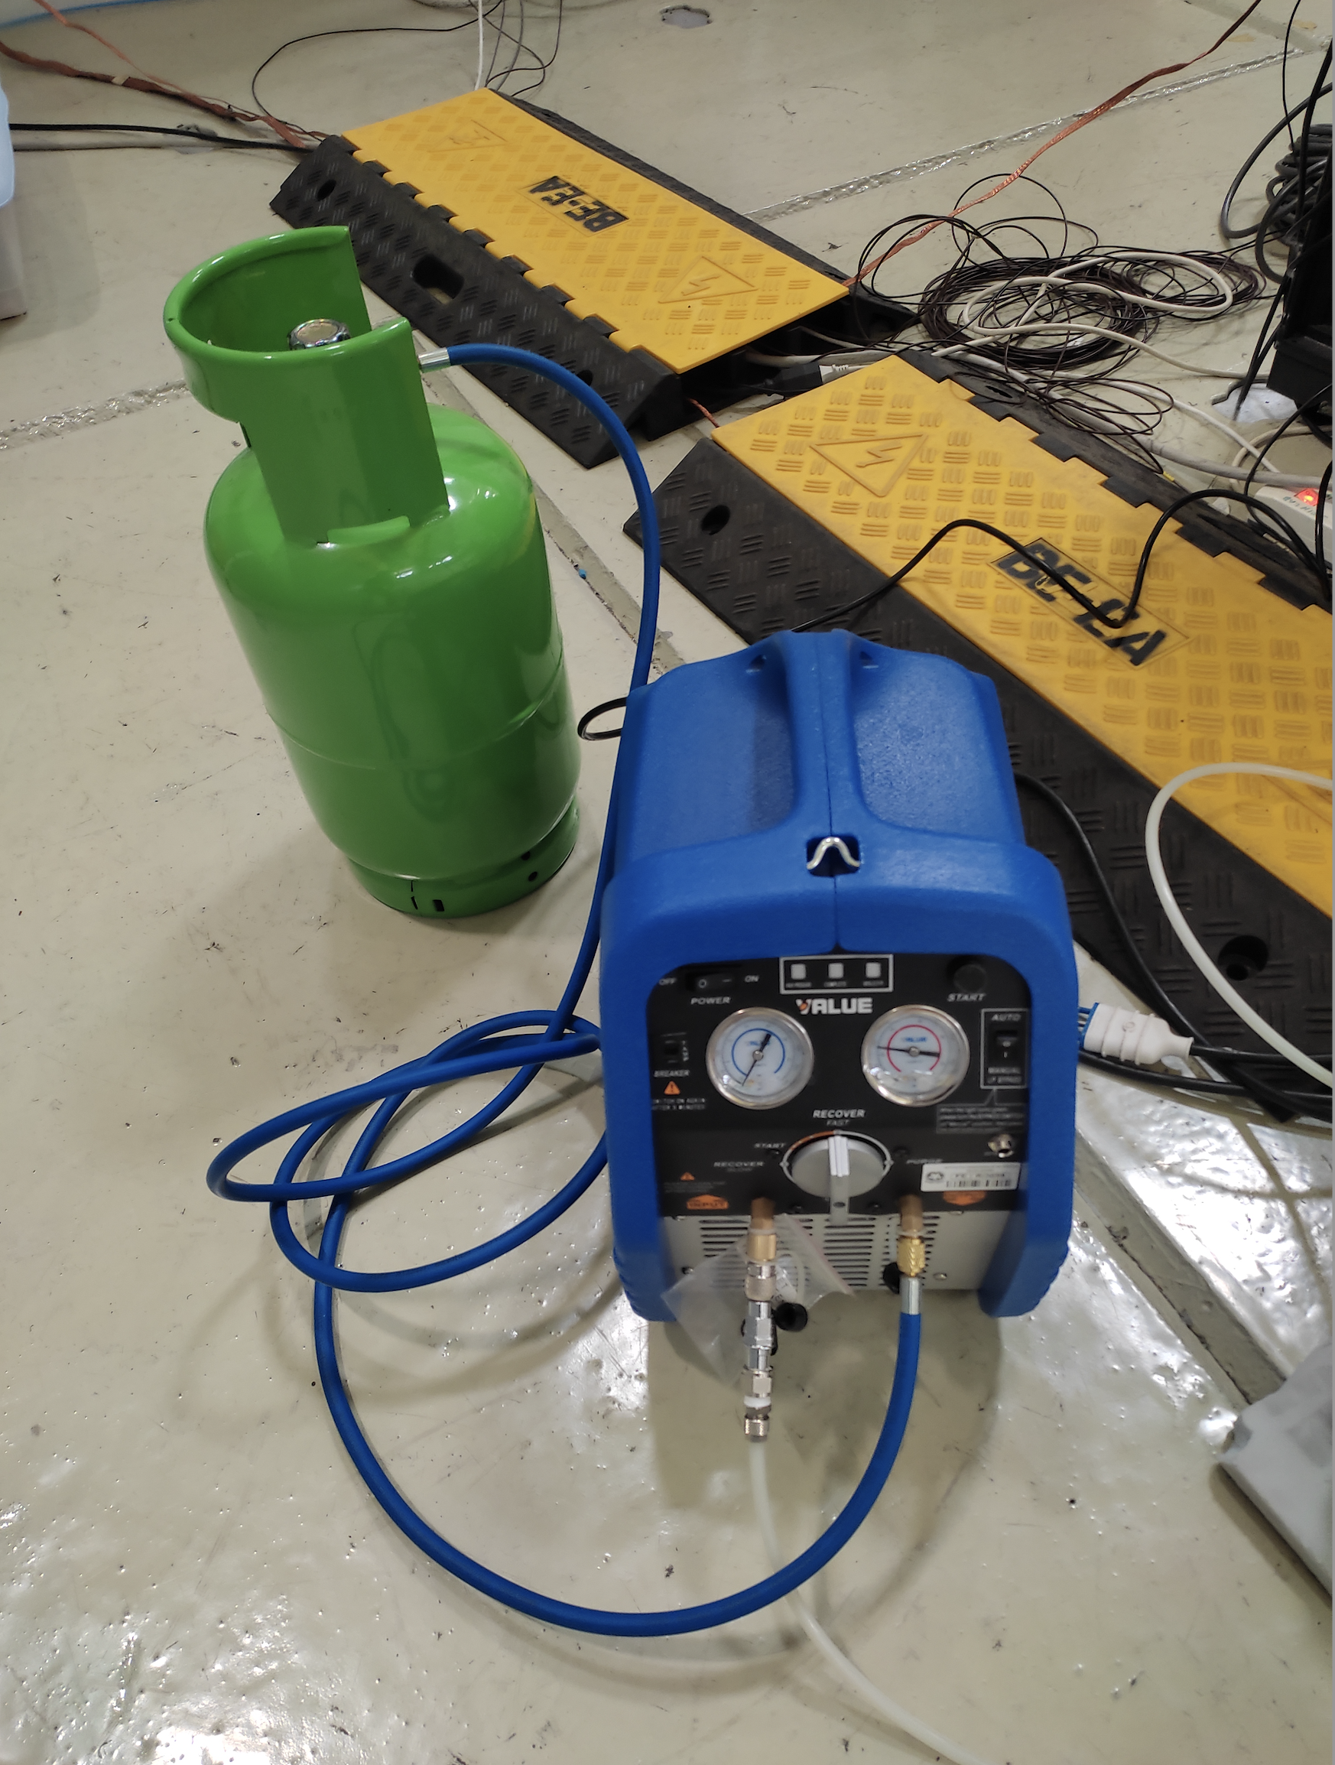
dRICH Prototype
1st chamber
On axis optics to minimize the active area, single or double radiator imaging
Vacuum technology & recovery system for efficient gas exchange
Gas recovery system
STRONG2020 Annual Meeting - 21st June 2024
7

Slide 8
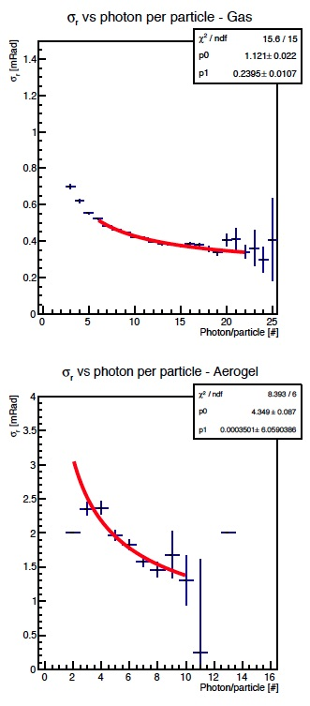
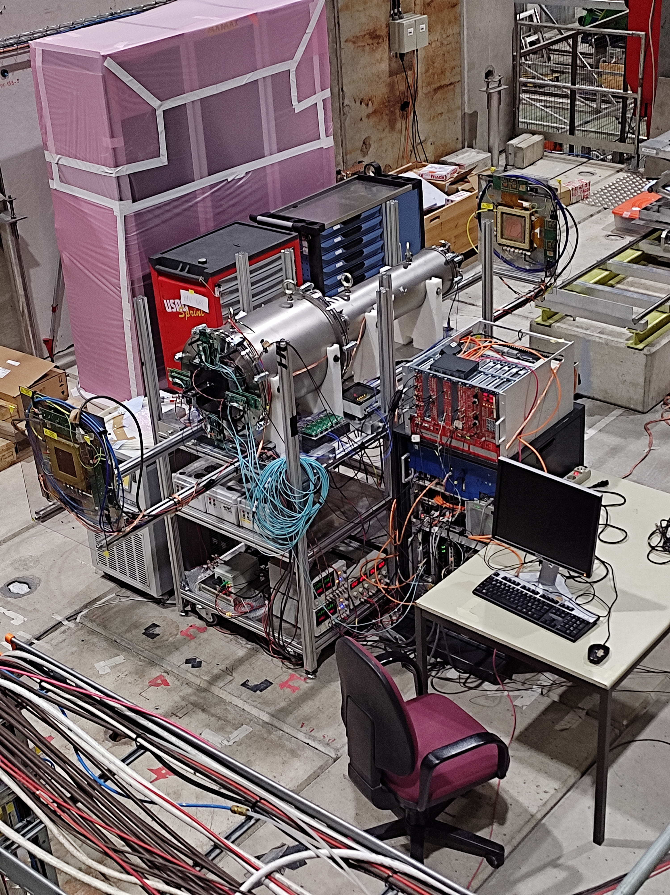
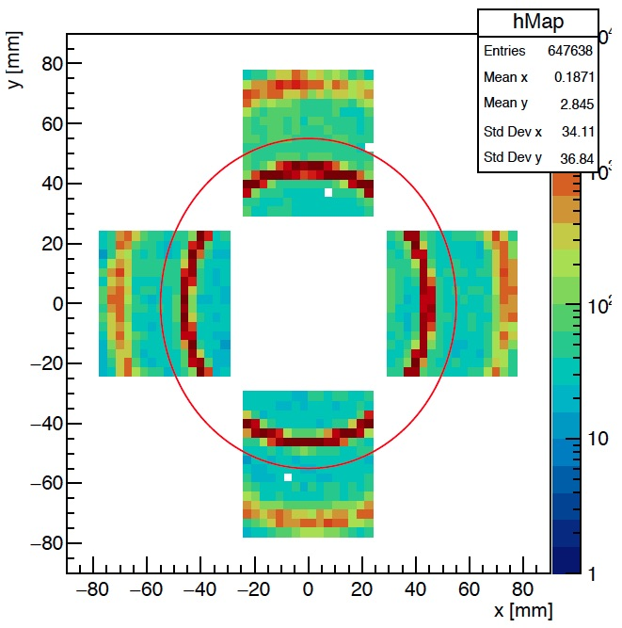
2023 Test-beam
Operative prototype commissioned. Double ring imaging achieved. Performance in line
with expectations except for aerogel single-photon angular resolution (worse by a factor ~ 1.5)
Reference readout from CLAS12 RICH:
H13700 MA-PMTs + ALCOR3 ToT chip
Expected SPE ~ 1 mrad
GEM
Gas Vessel
$$✓$$
MAPMTs
Aerogel
Expected SPE ~ 3 mrad
GEM
$$✓$$
Gas ring coverage: 60%
Aerogel ring coverage: 40 %
Optics at variance with respect EIC
STRONG2020 Annual Meeting - 21st June 2024
8

Slide 9
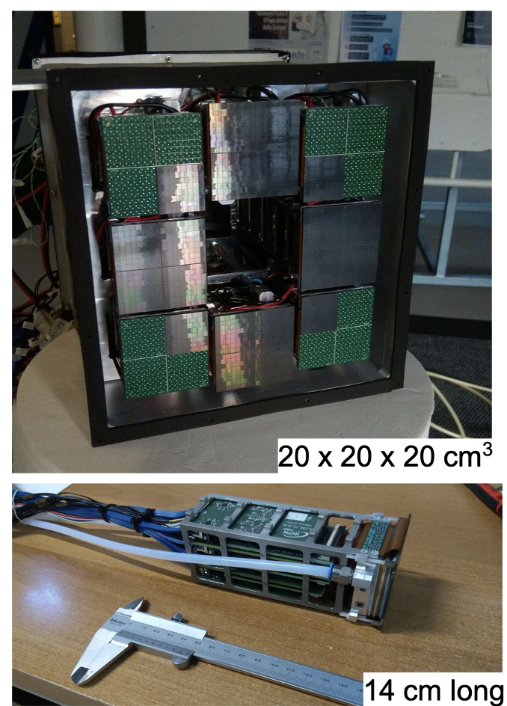
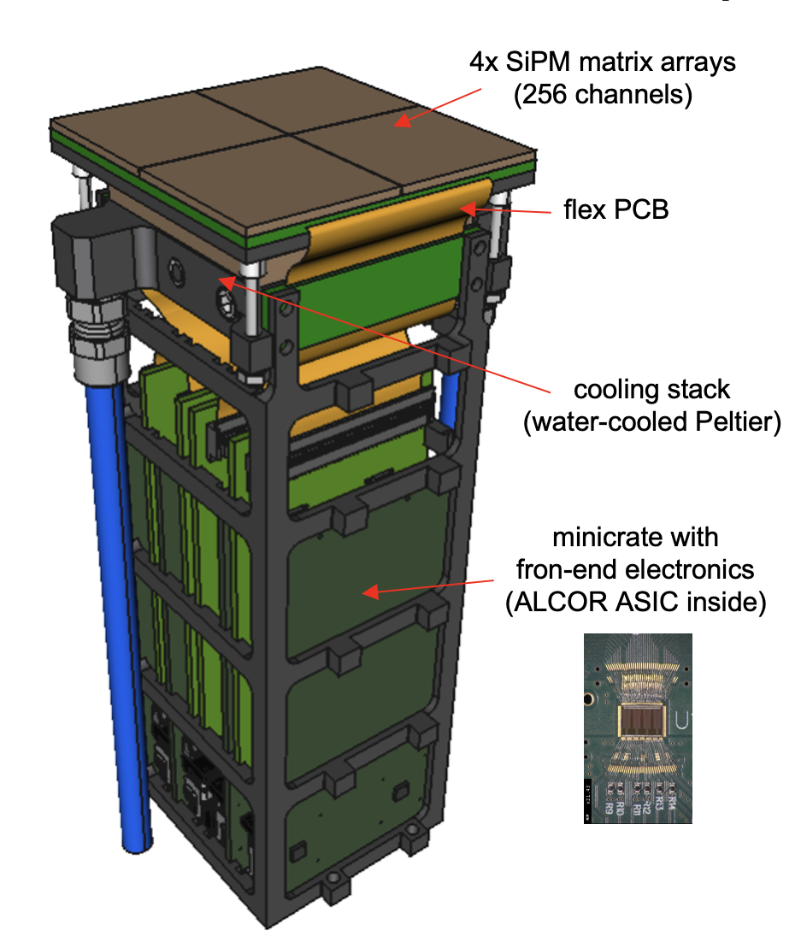
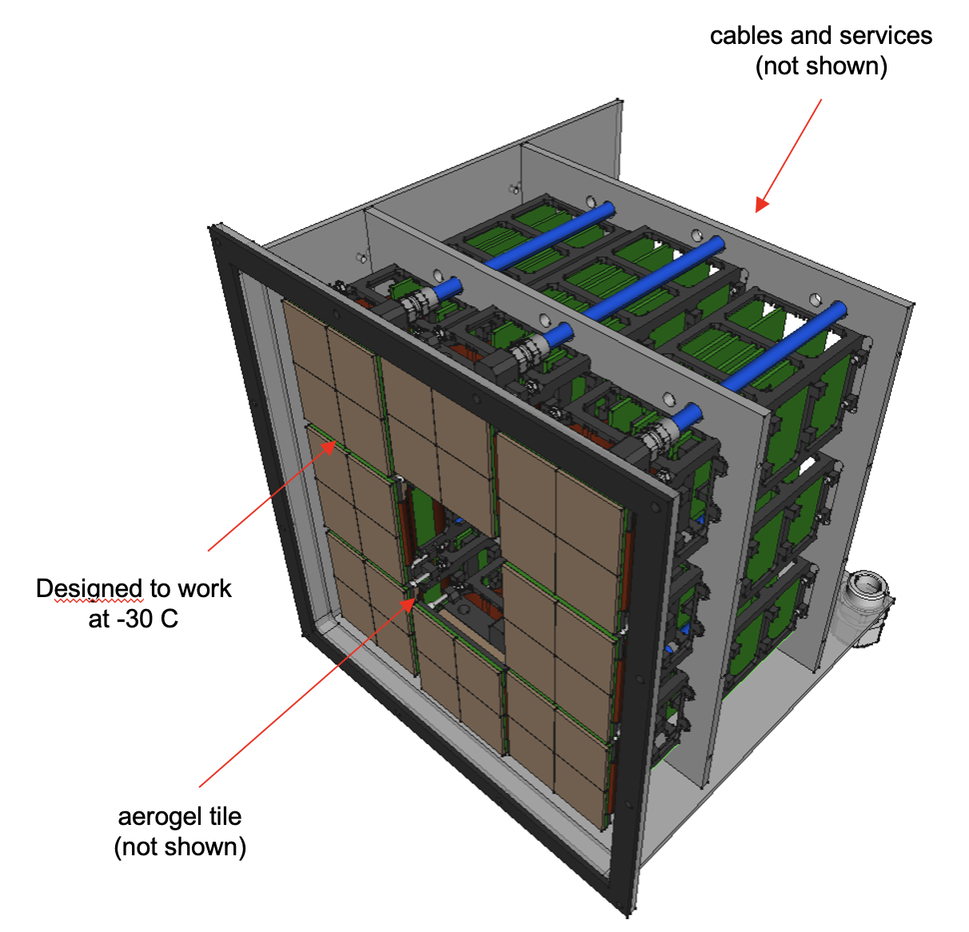
SiPM Detection Plane
Photon Detection Unit
Streaming readout mode
Readout Box
8 PDUs, 2048 channels
Prototype 2023
Working Pooint -40:-20 C
STRONG2020 Annual Meeting - 21st June 2024
9
Notes:
Dove metto NISER ?

Slide 10
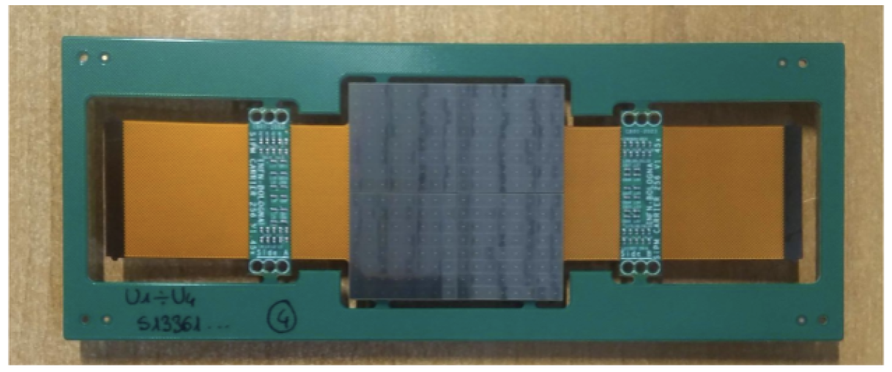
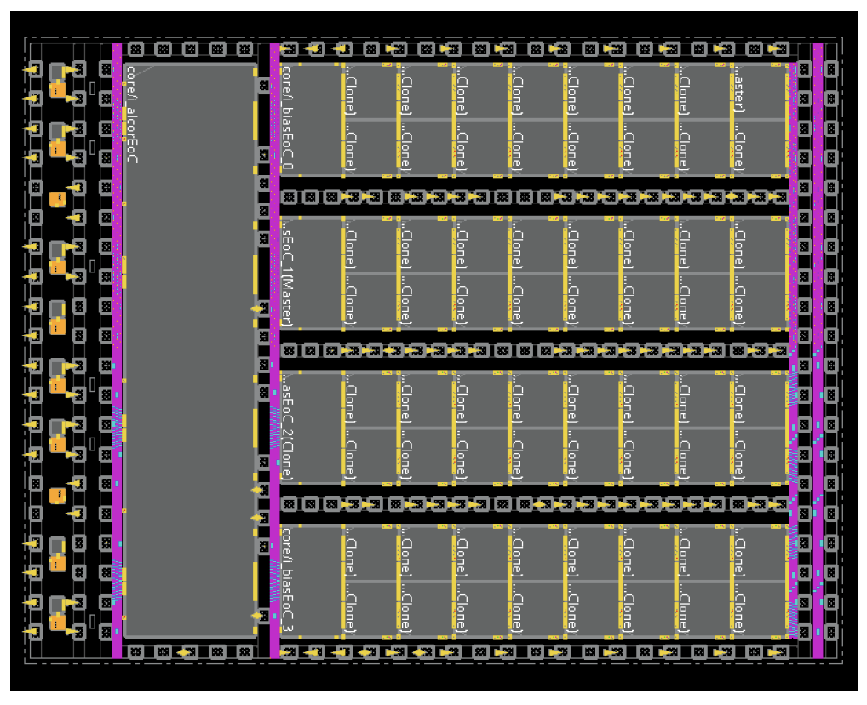
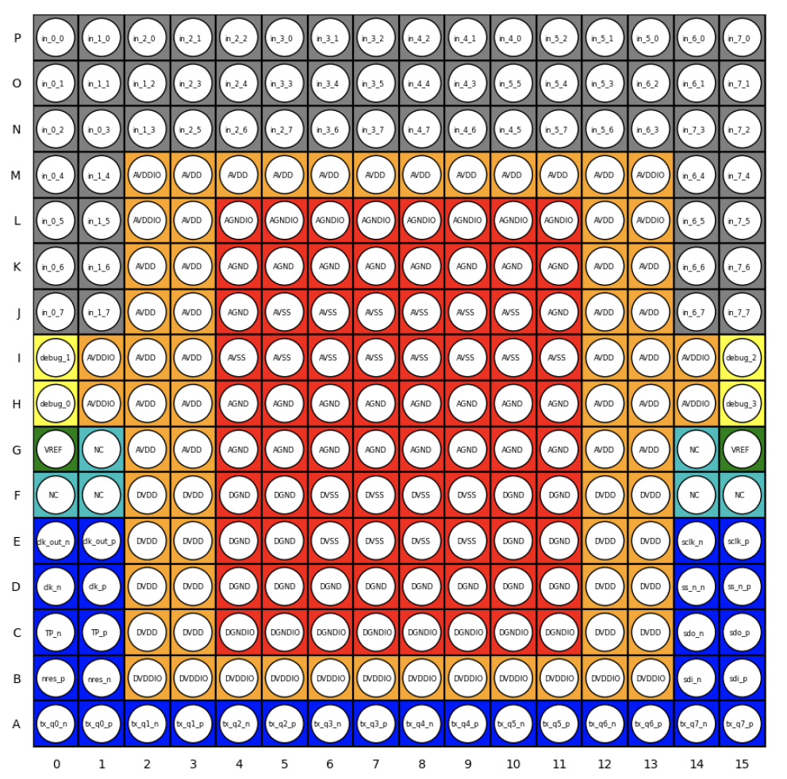
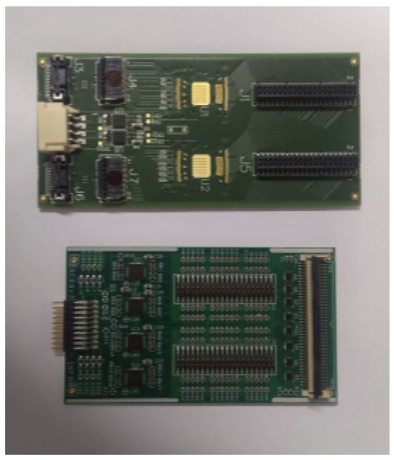
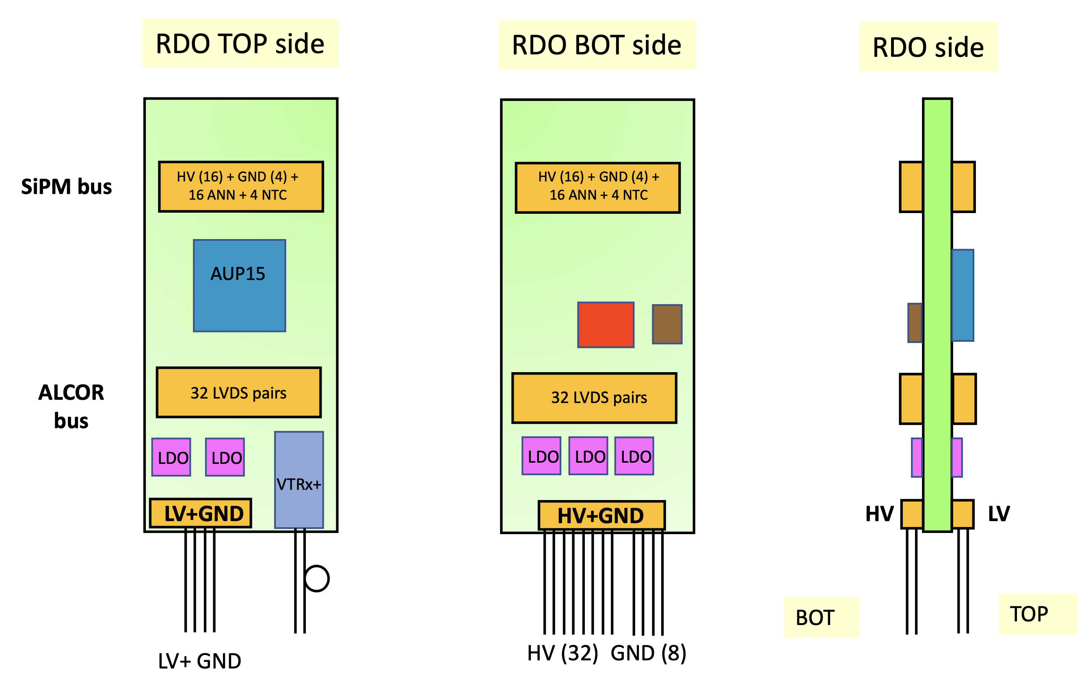
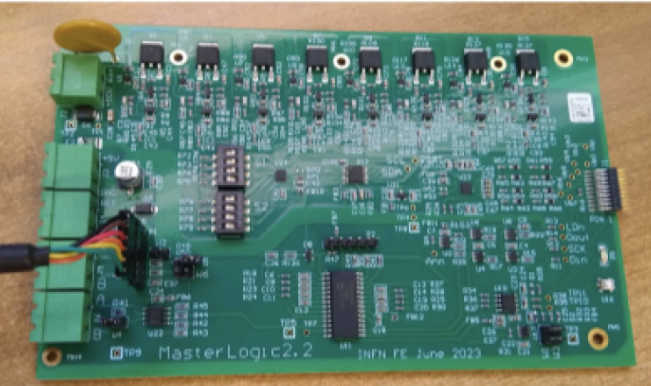
Readout Components
SiPM carrier board with 256 channels and flex connector circuits.
ALCORv64 digitazing chip
2x ALCOR front-end card and the adapter board
MasterLogic card to control SiPM bias
voltage & monitoring service
Readout Board to configure and connet to the back-end
STRONG2020 Annual Meeting - 21st June 2024
10
Notes:
Dove metto NISER ?

Slide 11
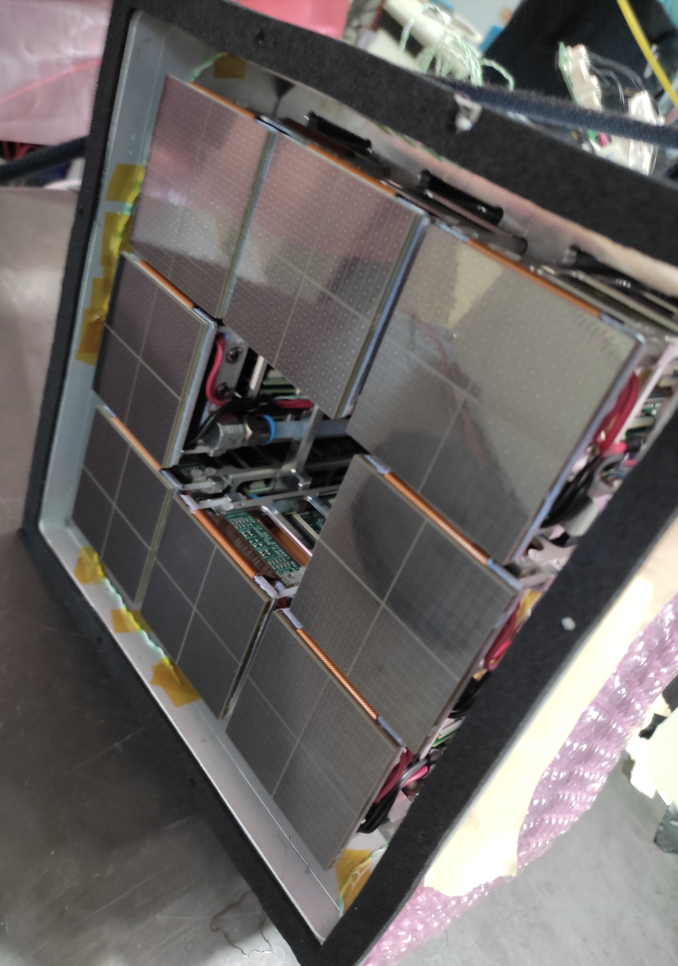
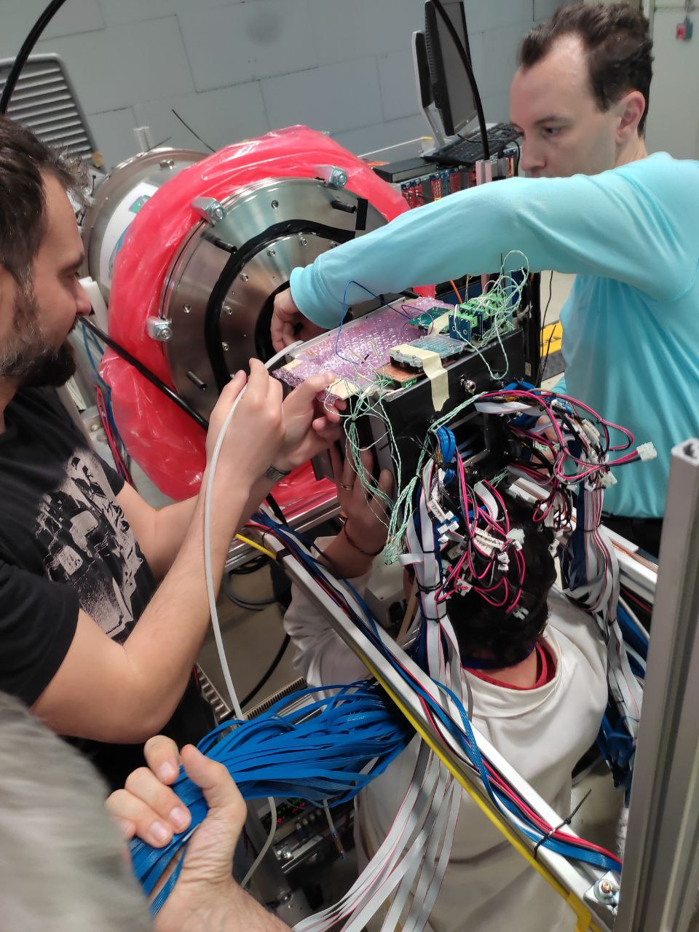
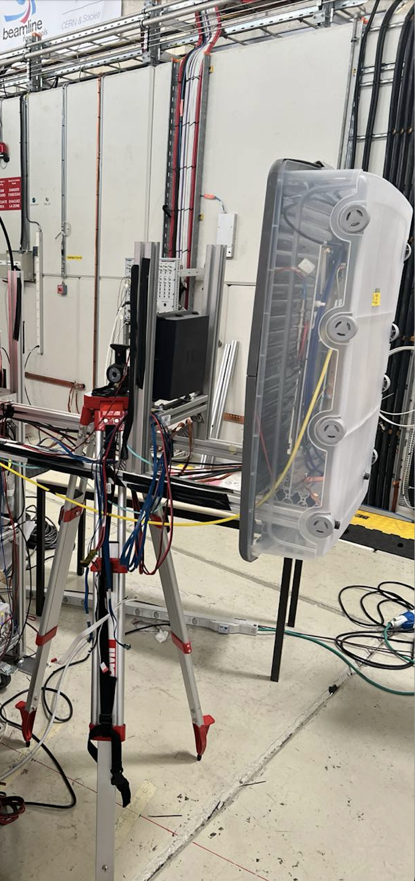
May 2024 Test-beam
SiPM Detector
Detector Mounting
Tracking GEM+SciFi
STRONG2020 Annual Meeting - 21st June 2024
11
Notes:
Dove metto NISER ?

Slide 12
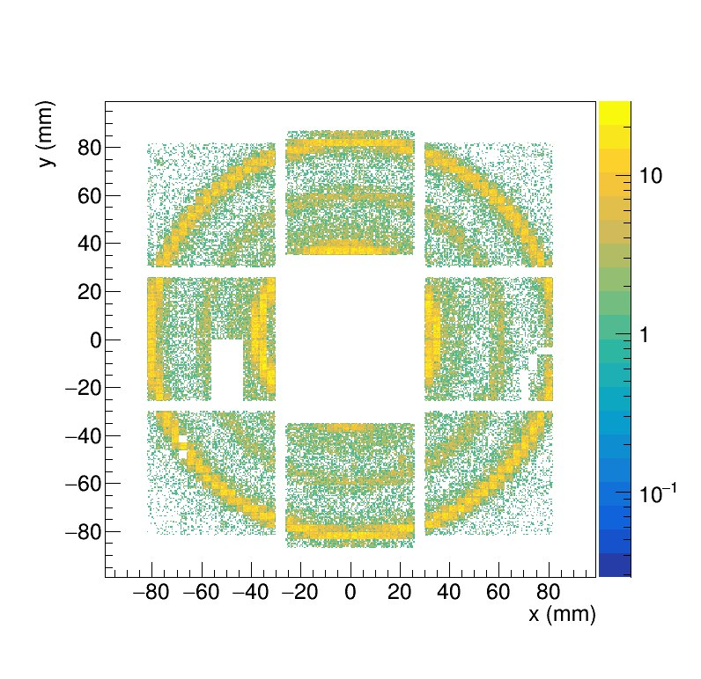
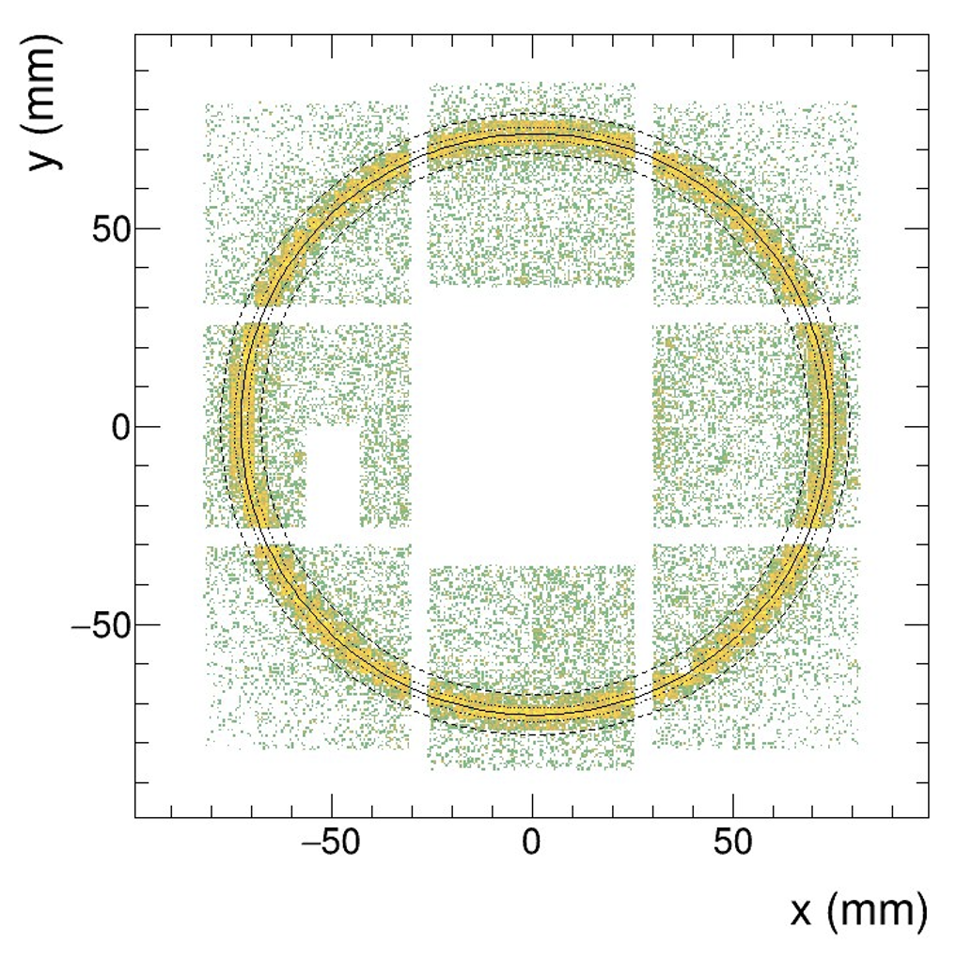
Dual Radiator Tests
Aerogel (n=1.020), negative beam, 10 GeV/c
Aerogel (n=1.026) + C₂F₆ radiators, positve beam, 8 GeV/c
π
p
π
e
STRONG2020 Annual Meeting - 21st June 2024
12
Notes:
Dove metto NISER ?

Slide 13
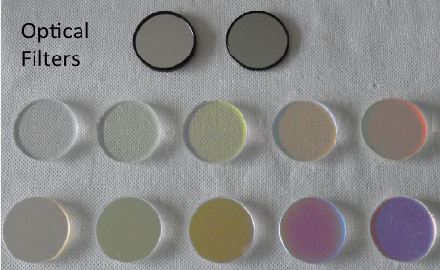
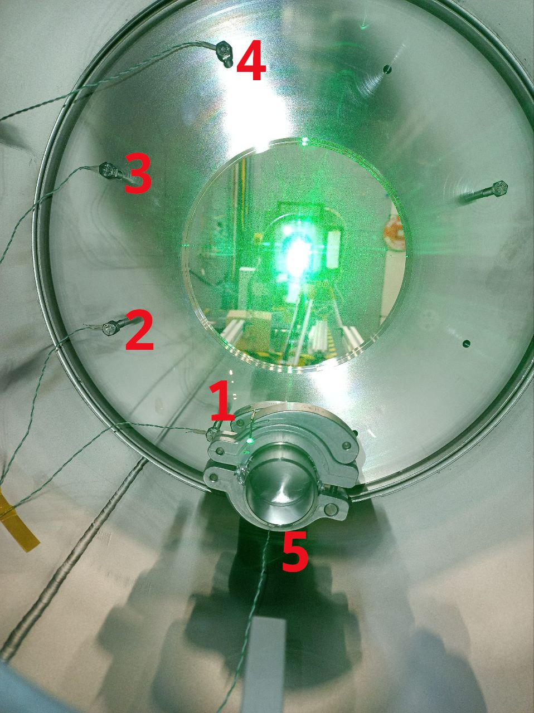
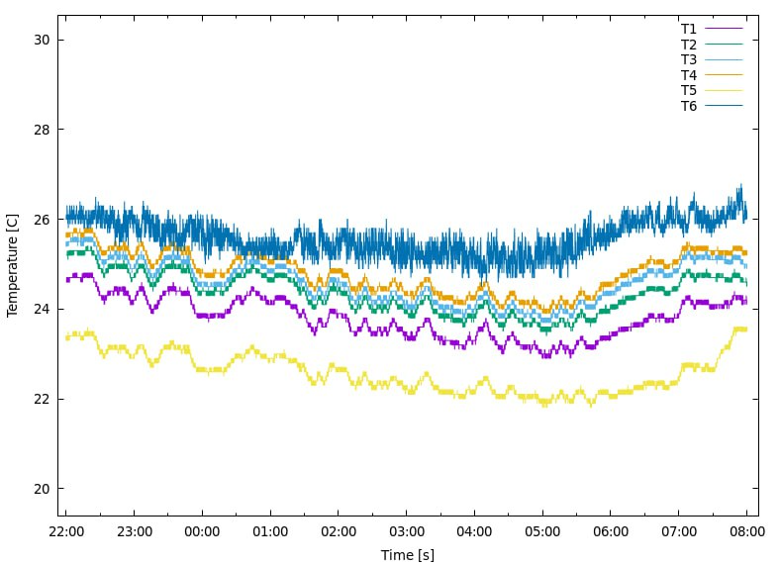
Test-beam Program
Successful campaign:
Mixed hadron beam 2-11 GeV/c
Various aerogel samples (1.020-1.026)
Two gas radiators (C₂F₆, C₄F₁₀)
Two SiPM working points (-40 C and -20 C)
Two tracking systems (GEM & SciFi)
Many optical fiters
Beam line Cherenkov tagging
Temperature monitor
Gas temperature
STRONG2020 Annual Meeting - 21st June 2024
13
Notes:
Dove metto NISER ?

Slide 14
Available Literature
A readout system based on SiPM for the dRICH detector at the EIC,
L.P. Rignanese et al., JINST 19 (2024) 02, C02062.
SiPM photosensors for the ePIC dual-radiator RICH detector at the EIC,
R. Preghenella et al., PoS EPS-HEP2023 (2024) 515.
Prototype of a dual-radiator RICH detector for the Electron–Ion Collider,
S. Vallarino et al., Nucl. Instrum. Meth. A 1058 (2024) 168834.
Study of radiation effects on SiPM for an optical readout system for the EIC dual-radiator RICH,
R. Preghenella et al., Nucl. Instrum. Meth. A 1056 (2023) 168578.
A SiPM-based optical readout system for the EIC dual-radiator RICH,
R. Preghenella et al., Nucl. Instrum. Meth. A 1046 (2023) 167661.
Science Requirements and Detector Concepts for the Electron-Ion Collider : EIC Yellow Report,
R. Abdul Khalek et al., Nucl. Phys. A 1026 (2022) 122447.
ATHENA detector proposal — a totally hermetic electron nucleus apparatus proposed for IP6 at the Electron-Ion Collider
J. Adam et al. , JINST 17 (2022) 10, P10019.
STRONG2020 Annual Meeting - 21st June 2024
14
Notes:
Dove metto NISER ?

