Slide 1
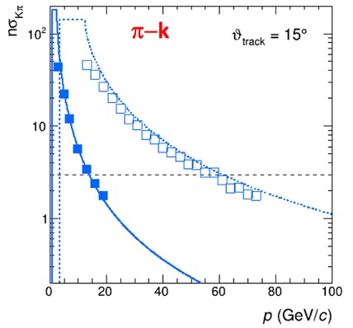
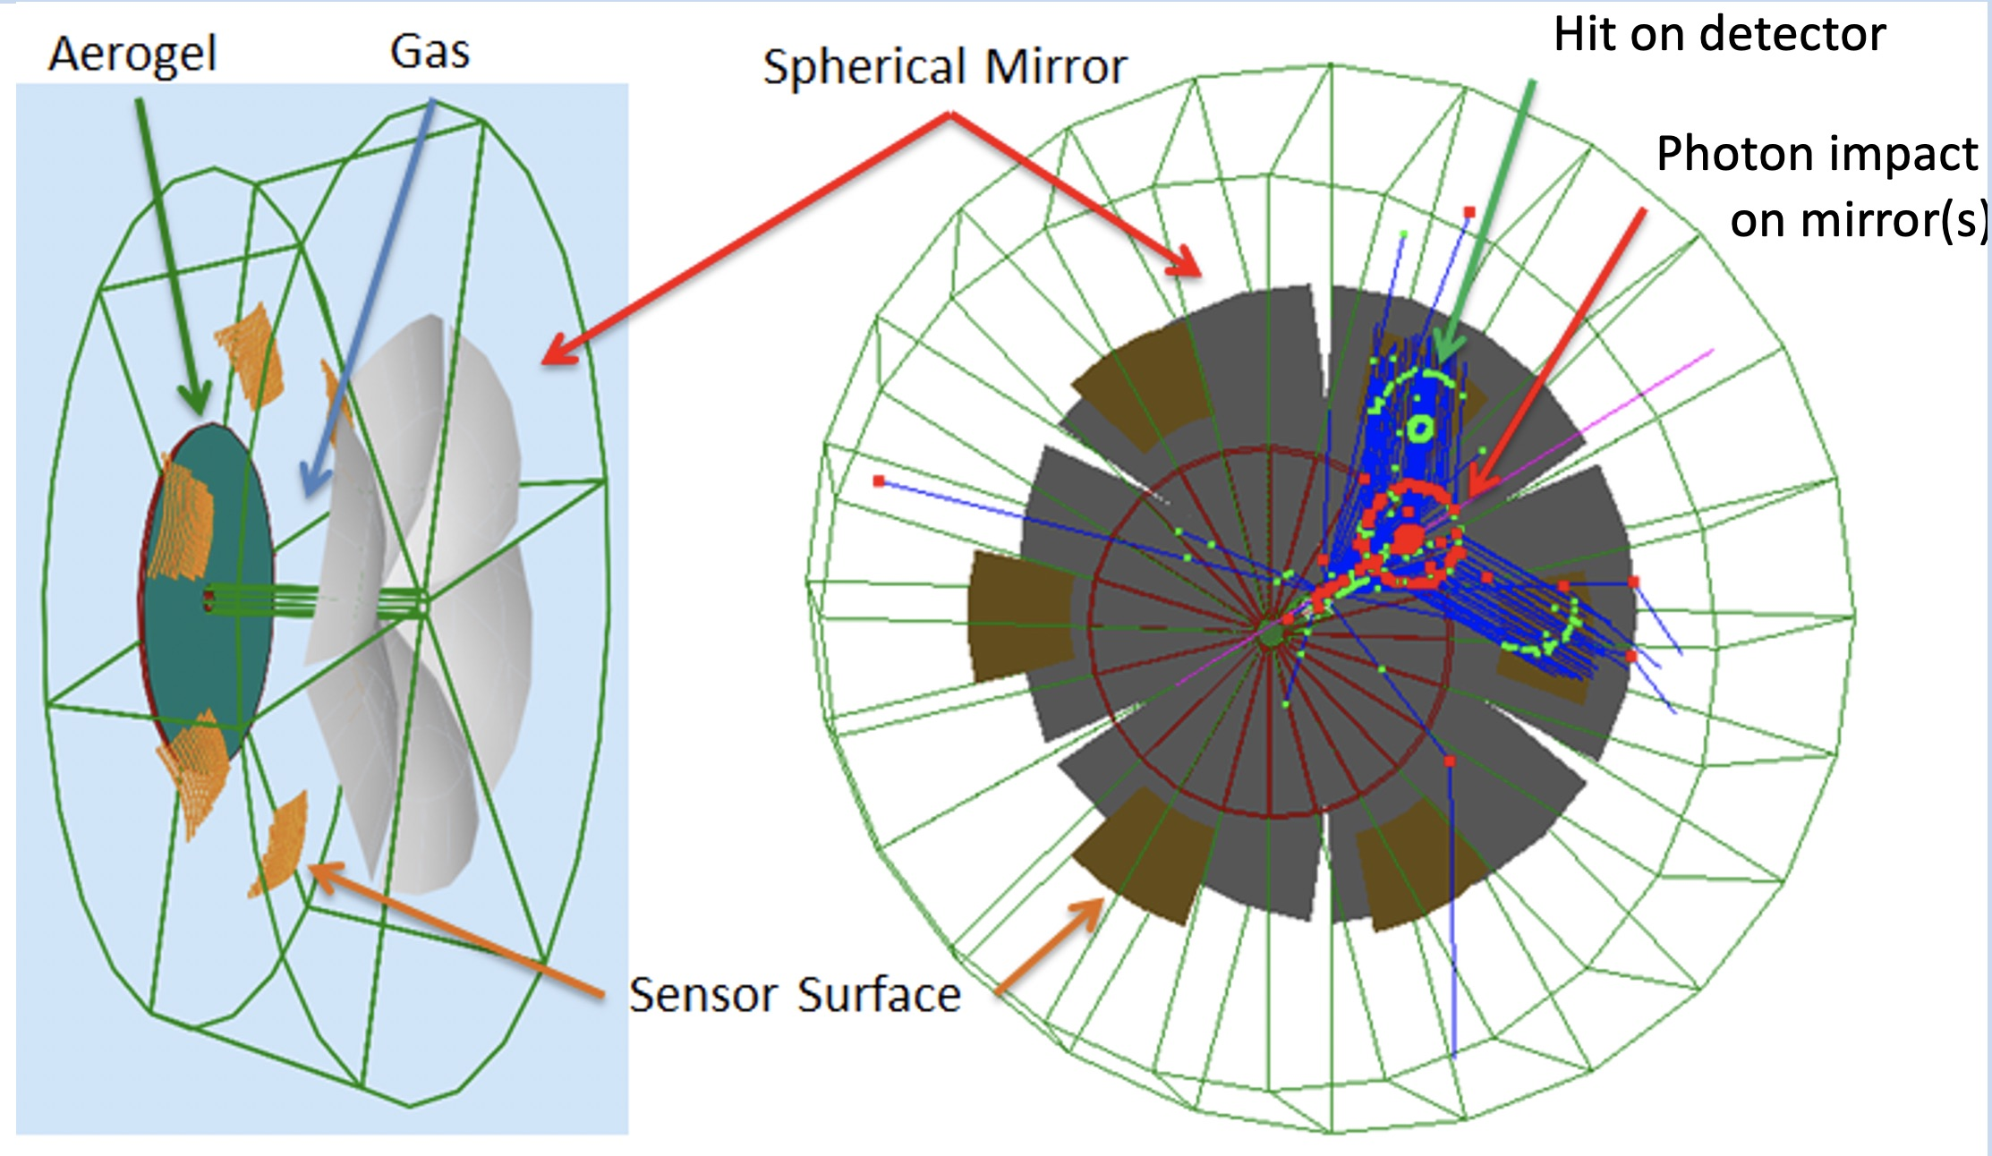
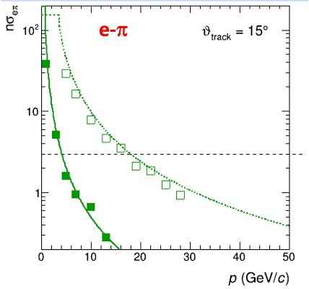
Dual Radiator RICH @ EIC
Two challenges: cover wide momentum range 3 - 60 GeV/c
work in high (~ 1T) magnetic field
dRICH: effective solution, part of EIC reference detector
Radiators: Aerogel (n_{AERO}~1.02) + Gas (n_{C2F6} ~ 1.0008)
Detector: 0.5 m²/sector , 3x3 mm² pixel. → SiPM option
Phase Space:
- Polar angle: 5-25 deg
Momentum: 3-60 GeV/c

Slide 2
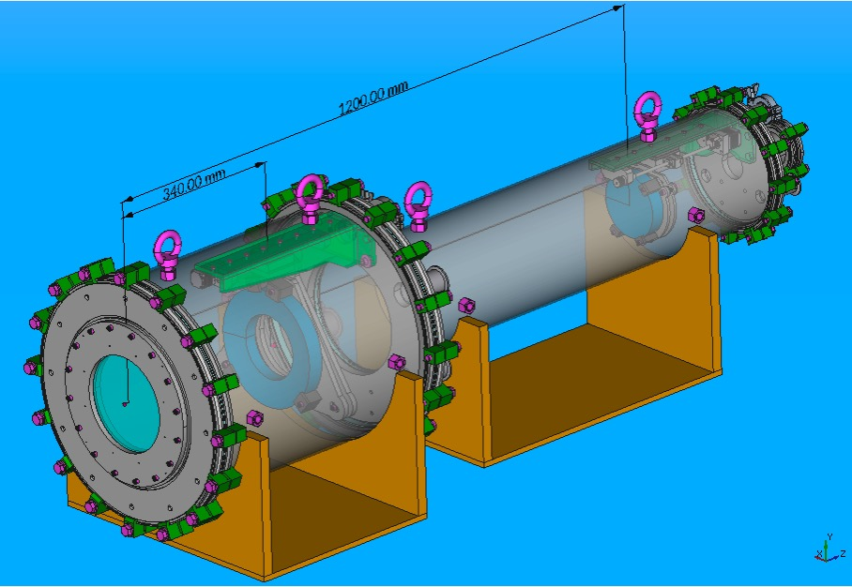
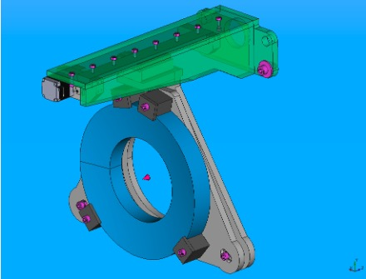
dRICH Prototype
Dual radiator imaging
Pressure vessel for gas & n tune
Sensor & readout friendly
Goals:
Study dual radiator performance and interplay
Study specifications and alternatives for optical components
Test alternate single-photon detection systems
* First test-beams in September and October ‘21 at CERN (in synergy with ALICE at PS T10)

Slide 3
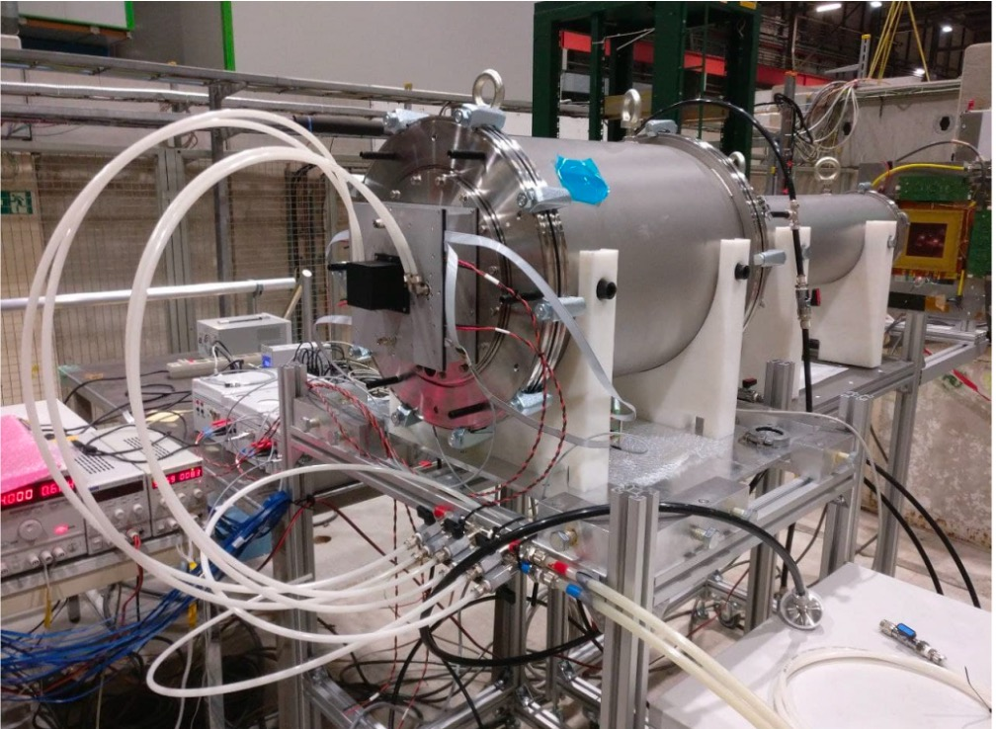
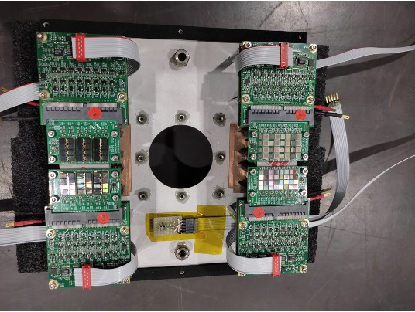
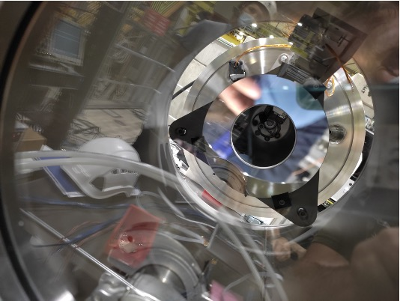
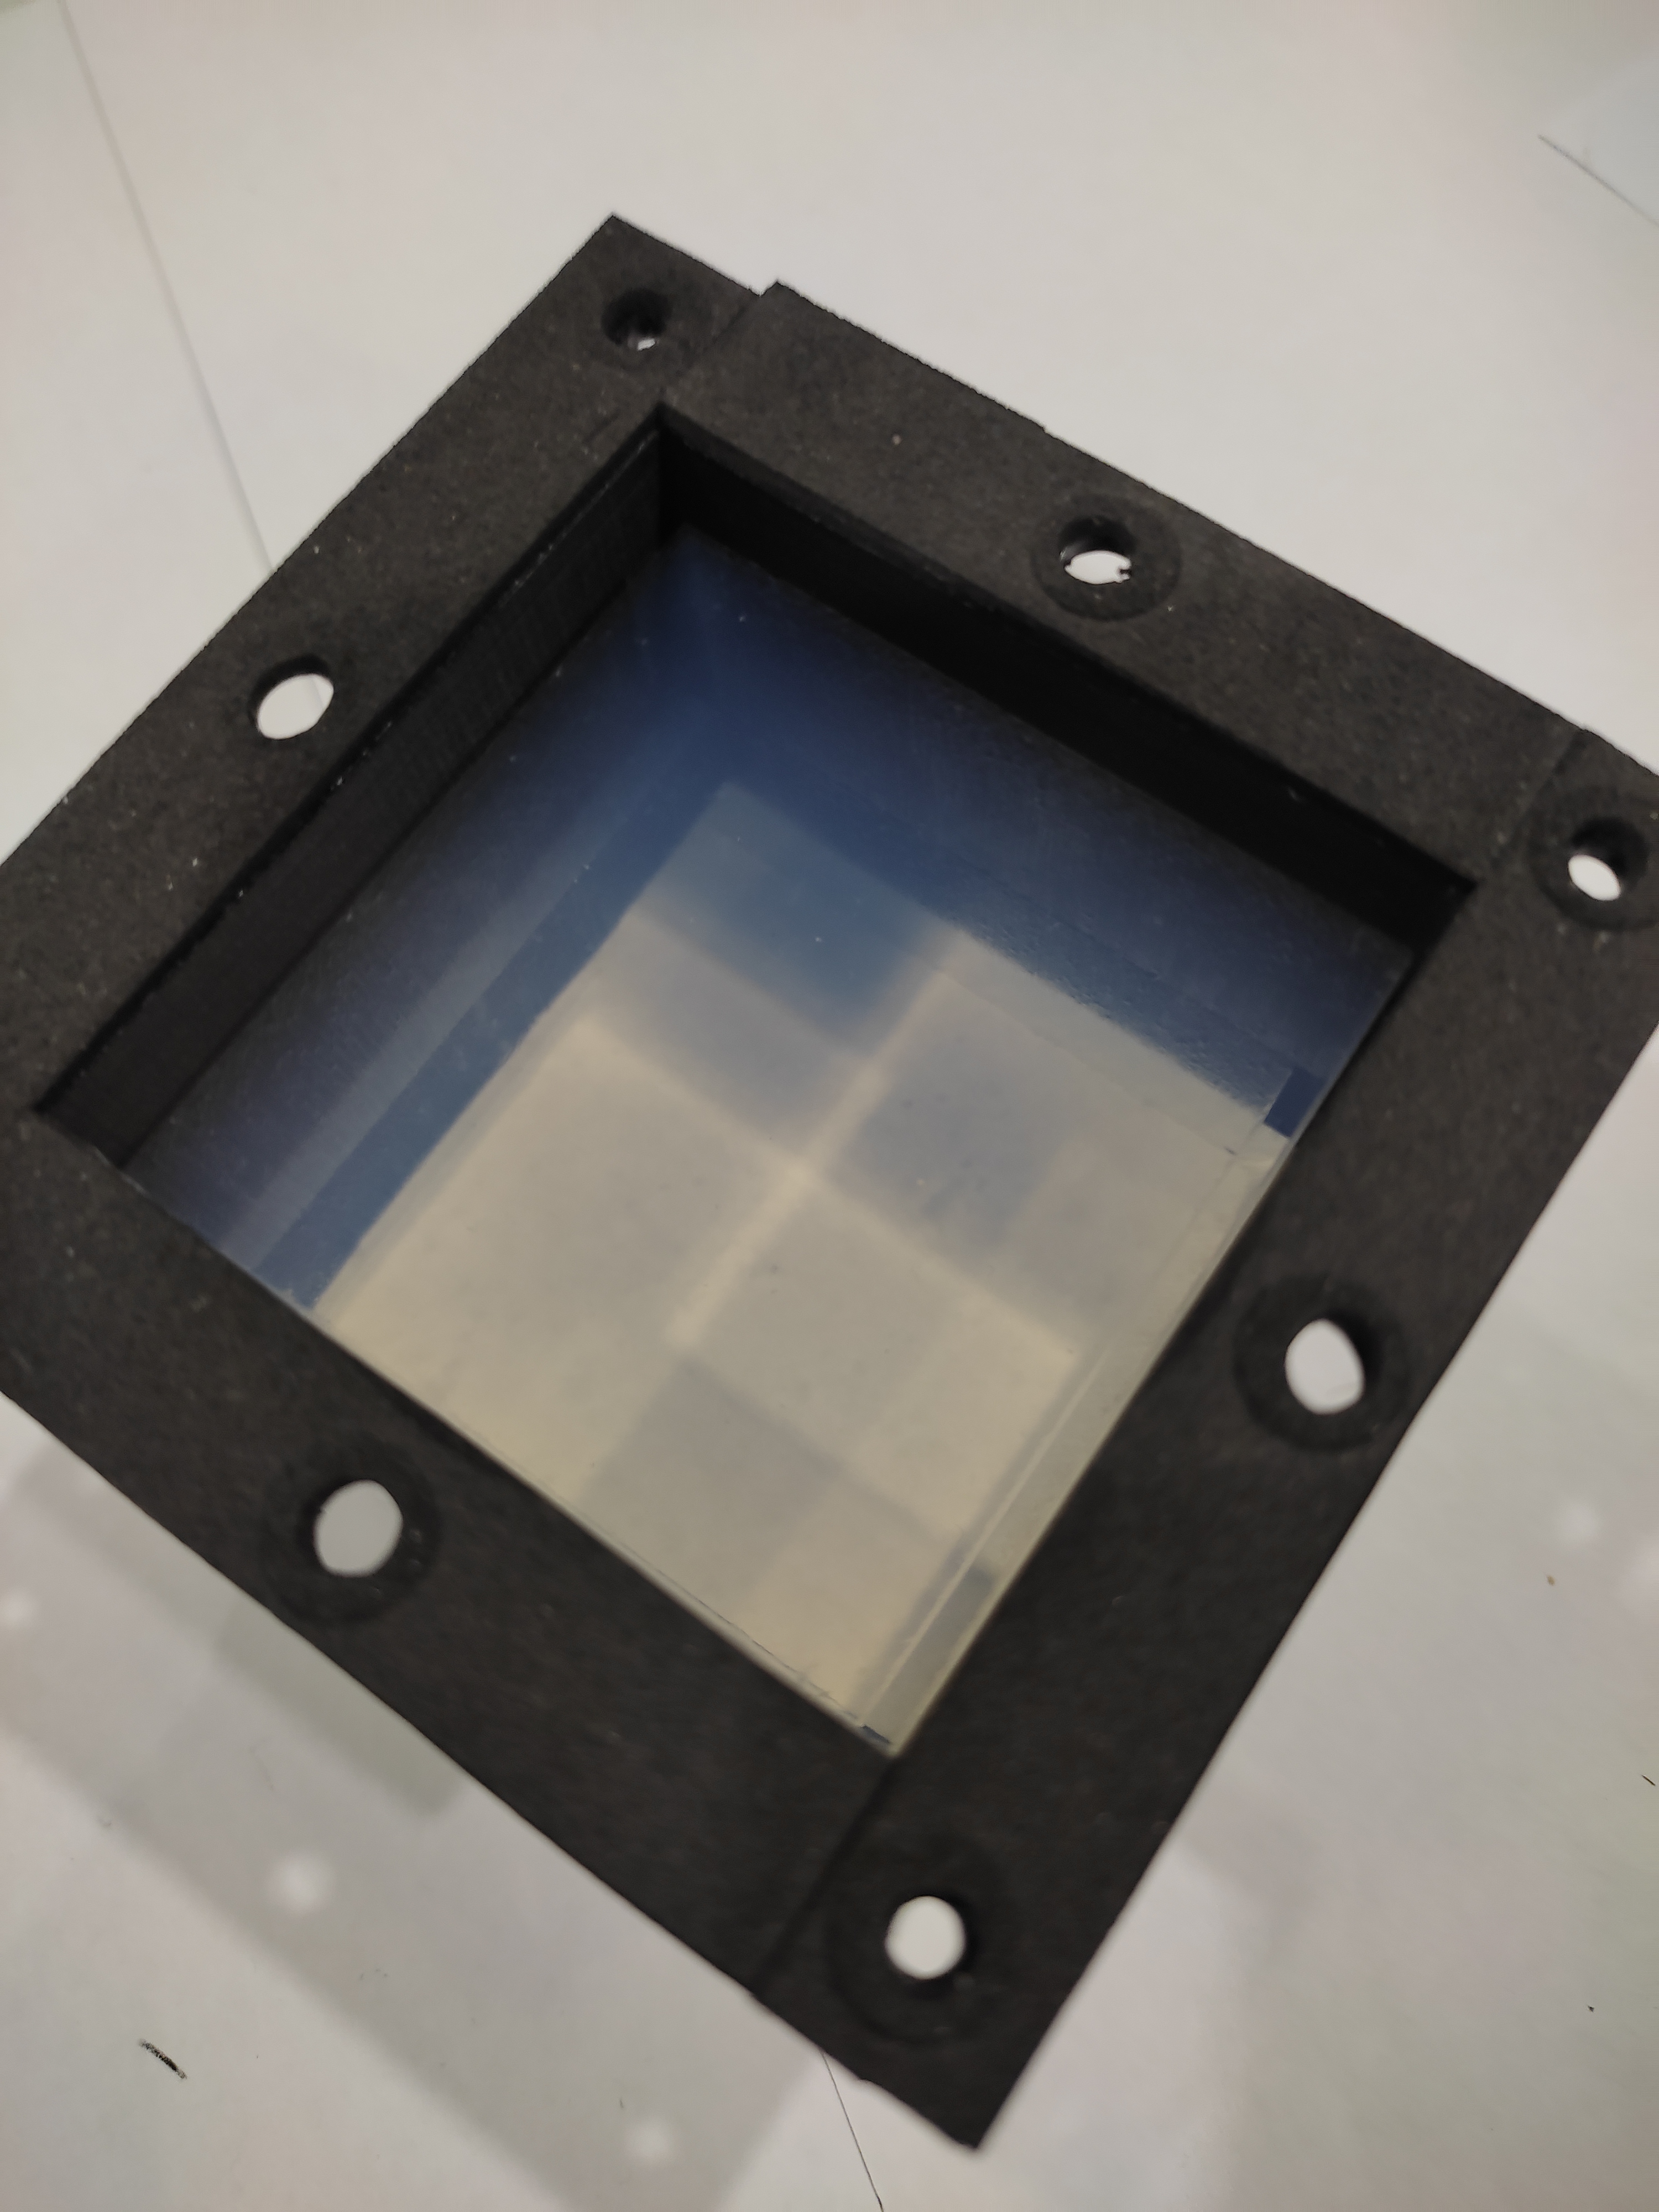
dRICH Setup
Cooling
Trackign GEM
Aerogel
Gas volume
Inner mirror
Photo detector

Slide 4
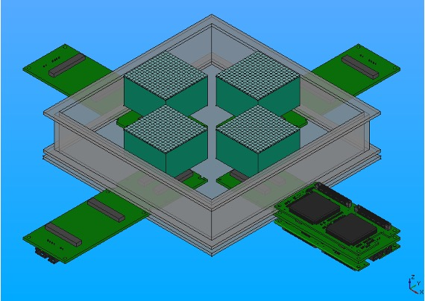
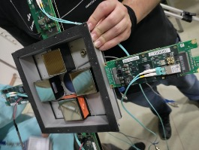
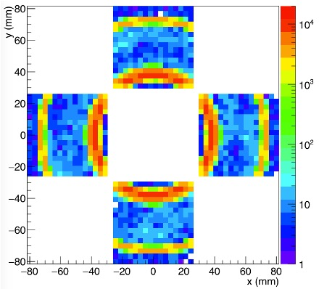
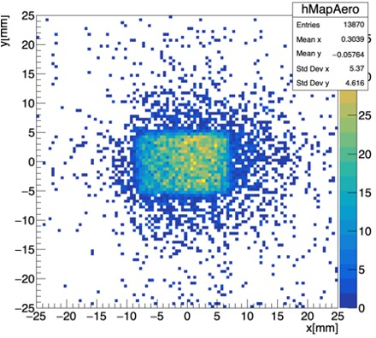
dRICH Online: Imaging
Use large area H13700 coupled to CLAS12 RICH MAROC front-end
Allows to study the working principles and optical performance of the components
4 x H13700
DATA π+
12 GeV/c
MC π+
12 GeV/c
Trigger area
by GEM

Slide 5
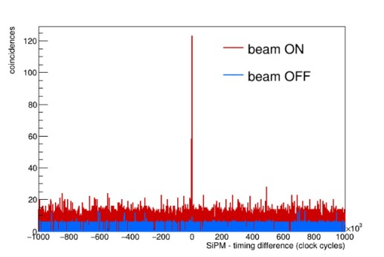
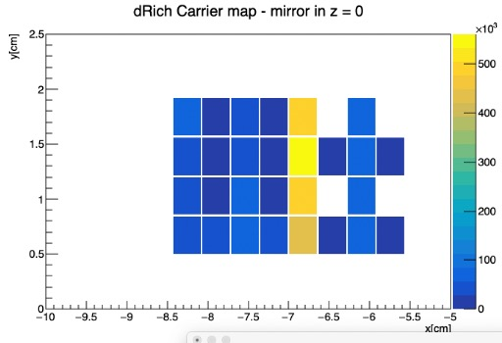
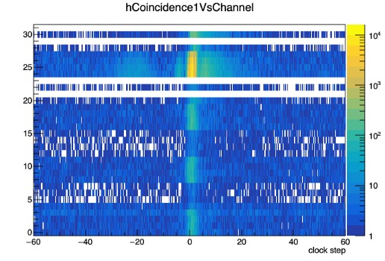
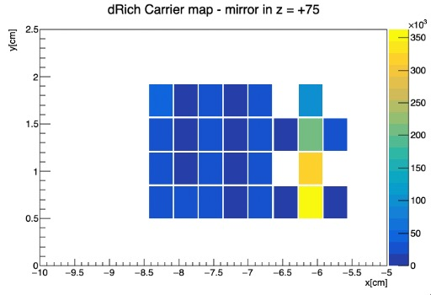
dRICH Online: SiPM Readout
Test Cherenkov application for magnetic field insensitive sensor (SiPM)
Control SiPM high dark count to isolate single photon signal (same amplitude!)
Use a new ALCOR chip (high-rate ToT architecture) in streaming mode
Time coincidence with beam particle
Reflected signal moves with mirror
30 mm
15 mm
SiPM
Sensor
Cherenkov ring

Slide 6
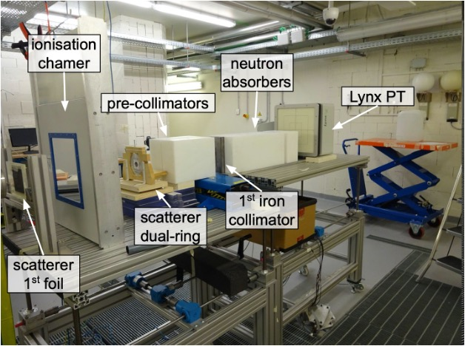
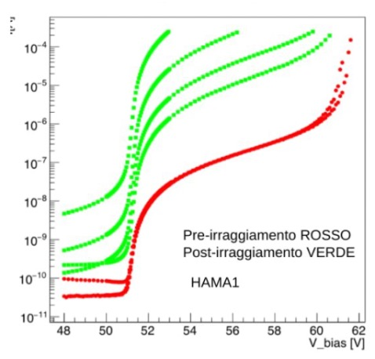
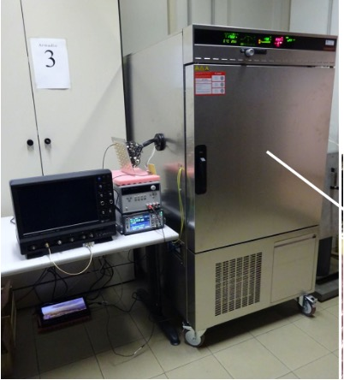
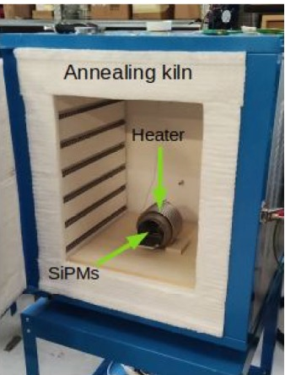
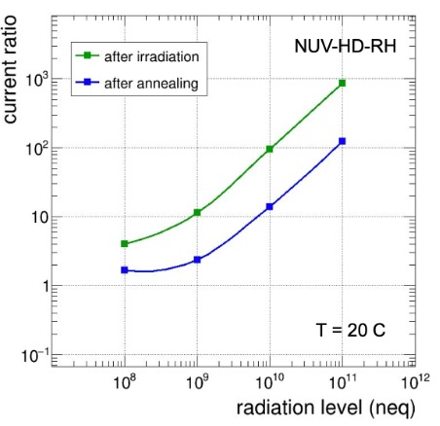
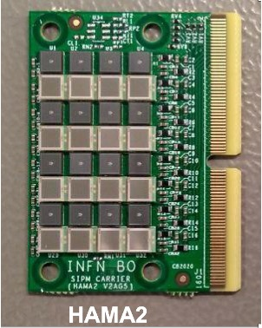
SiPM Irradiation Campaign
TIFPA
Proton
Beam
Facility
After
Before
Collimated
Beam
10⁹-10¹¹ n_{eq}
Various SiPM
Climate chamber
6

Slide 7
Status and Plans
2021: MC simulations
First SiPM irradiation + annealing campaign
Basic dRICH prototype
First dRICH test-beam with hadron beams (commissioning)
2022: Extended SiPM irradiation + annealing campaign
Improved prototype
Second test-beam campaign (realistic performance)
Data analysis and technical note (D24.3)
2023: Refined data analysis and simulation
Third test-beam campaign (component optimization)
Final assessment towardds TDR
7

