Slide 1
Dual-Radiator RICH
Marco Contalbrigo – INFN Ferrara
EIC eRD102 Meeting - 7nd September 2021
Contalbrigo M.
EIC eRD102 Meeting - 7th September 2021
1
Notes:
Vanno messi studi innovativi e pubblicazioni

Slide 2
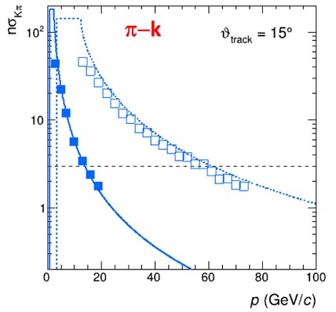
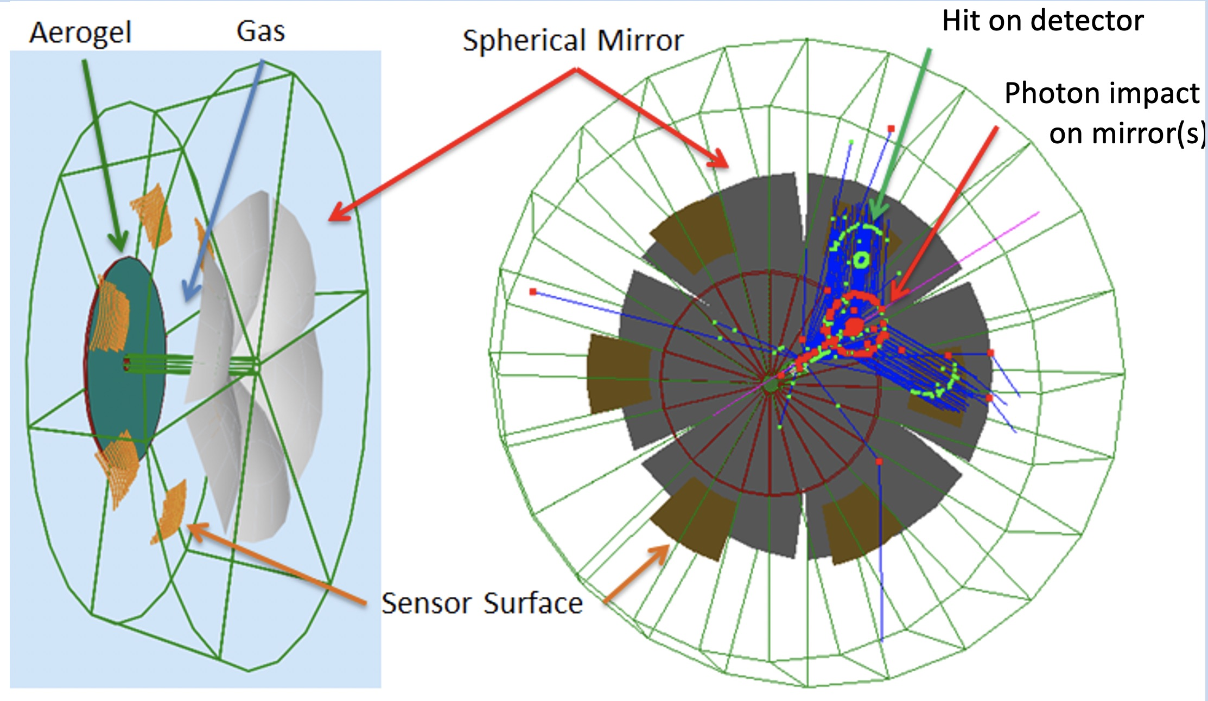
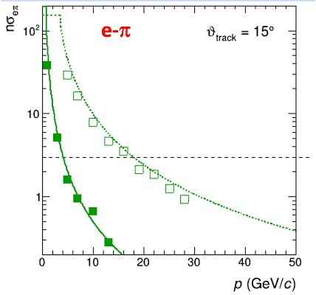
Dual Radiator RICH @ EIC
Two challenges: cover wide momentum range 3 - 60 GeV/c
work in high (~ 1T) magnetic field
dRICH: effective solution, part of EIC reference detector
Radiators: Aerogel (n_{AERO}~1.02) + Gas (n_{C2F6} ~ 1.0008)
Detector: 0.5 m²/sector , 3x3 mm² pixel. → SiPM option
Phase Space:
- Polar angle: 5-25 deg
Momentum: 3-60 GeV/c

Slide 3
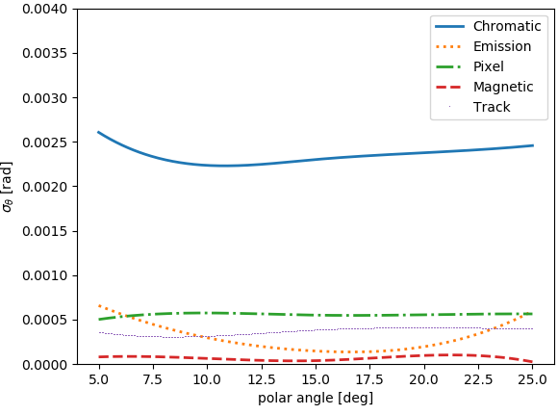
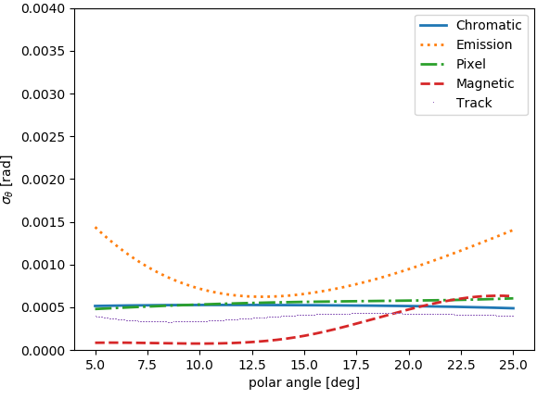
dRICH Feasibility Study
Compact and cost-effective solution for continuous momentum coverage (3-60 GeV/c)
Strong interest in the dRICH electron-pion separation capability
e-π
π−k
p-k
Studied with full Geant4 simulation, with Bayesian L. Barion et al., JINST 15 (2020) 02, C02040
optimization and analytic parameterizations E. Cisbani et al., JINST 15 (2020) 05, P05009
Aerogel SPE
Gas SPE
Geometry/Gap length / Sensor surface
Refractive index / UV filters
Contalbrigo M.
EIC eRD102 Meeting - 7th September 2021
3

Slide 4
dRICH in ATHENA +….
Firsts attempts to optimize optics in ATHENA with dRICh full simulation framework
photosensor
mirror
5 x mirrror segments
From Christopher Dilks - 1/Sep/2021
Contalbrigo M.
EIC eRD102 Meeting - 7th September 2021
4

Slide 5
dRICH Prototype
Procurement and
assembling ongoing
Dual radiator imaging
Pressure vessel for gas & n tune
Sensor & readout friendly
Goals:
Study dual radiator performance and interplay
Study specifications and alternatives for optical components
Test alternate single-photon detection systems
* First test-beams in September and October ‘21 at CERN (in synergy with ALICE at PS T10)
Contalbrigo M.
EIC eRD102 Meeting - 7th September 2021
5

Slide 6
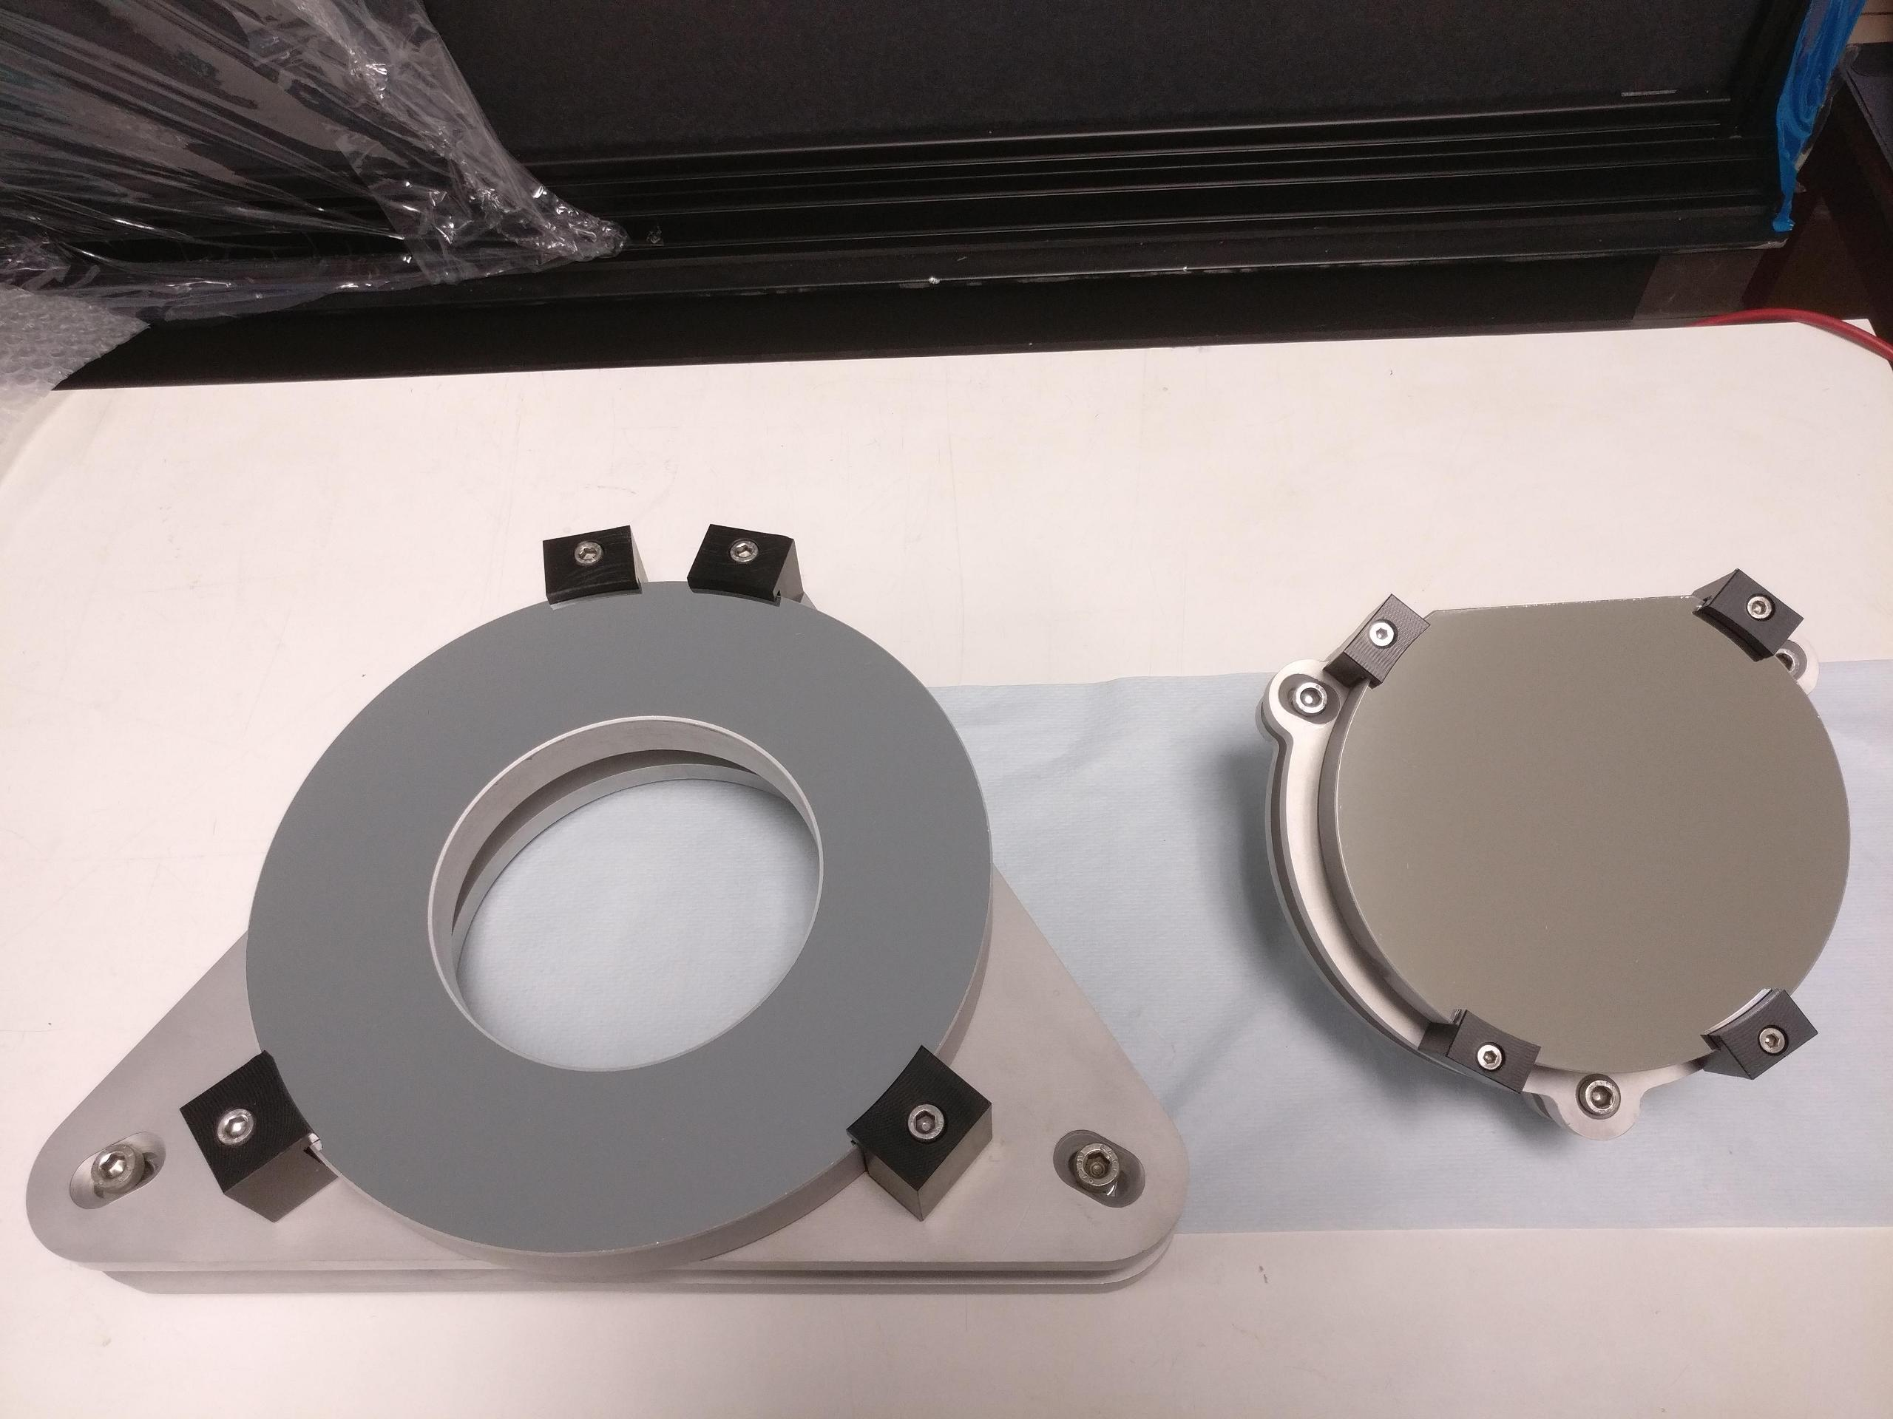
dRICH Prototype
Support
Inner volume
Mirrors + Support
Chamber
Contalbrigo M.
EIC eRD102 Meeting - 7th September 2021
6

Slide 7
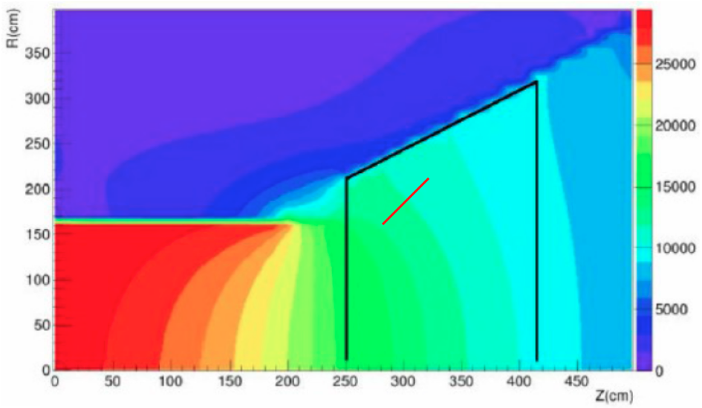
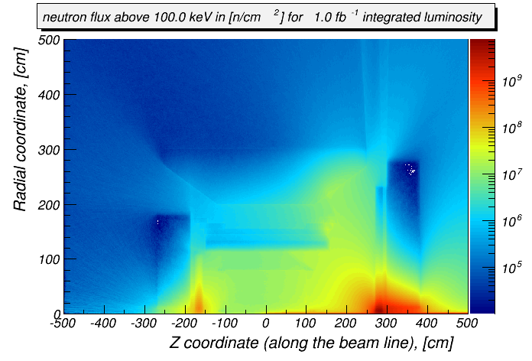
EIC Detector Challenge II
High Magnetic Field
~ 1 T order of magnitude, varying orientation
SiPM: PET study up to 7 T 10.1109/NSSMIC.2008.4774097
dRICH
sensor
dRICH sensor location relaxes requirements
on neutron dose and material budget
Neutron Fluence
Moderate except for very forward regions
Reference value. ~ 10 ¹¹ n_{eq}/cm²
for several years at max lumi (10³⁴)
SiPM: radiation mitigation for SPE actively studied
till 10¹¹ n_{eq}/cm² and above 10.1016/j.nima.2019.01.013
10.1016/j.nima.2018.10.191
Neutron flux (Courtesy of A. Kiselev)
Assumed: indepednent readout based
on SiPM and MAROC electronics
Contalbrigo M.
EIC eRD102 Meeting - 7th September 2021
7
Notes:
Fare una immagine del PMT sulla risoluzione

Slide 8
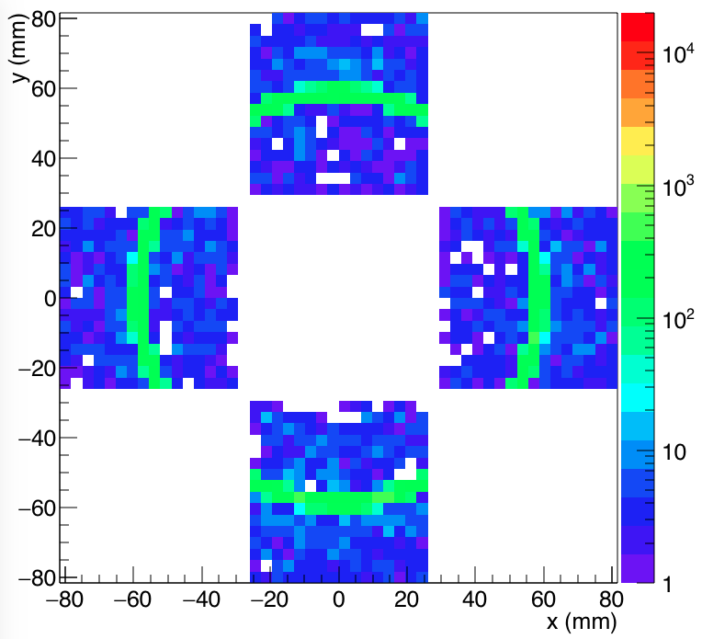
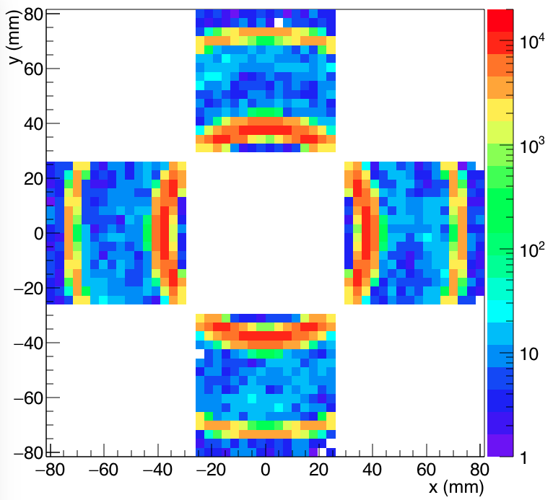
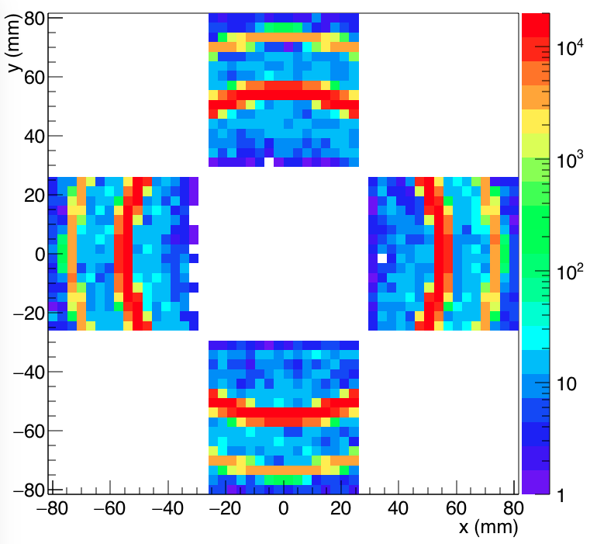
dRICH Prototype Imaging
House the same principles and readout units used for EIC eRD14 test-beams
Compatible with H13700/S12642-1616PA + CLAS12 RICH MAROC front-end
Allows to study the working principles and optical performance of the components
4 x H13700
3 x S12642-1616PA
Kaon
4 GeV/c
Kaon
15 GeV/c
Kaon
25 GeV/c
Contalbrigo M.
EIC eRD102 Meeting - 7th September 2021
8

Slide 9
dRICH Detector Box
3 versions: Detector box for S12642-1616PA matrices of large area (5x5 cm²)
Detector box for H13700 multi-anode PMTs (reference dertector)
Detector box for irradiated SiPM carriers
Obsolete SiPM sensors out of market
SiPM matrix
Adapter
Peltier
AC bias
HT Sensor
N2 Inlet
Contalbrigo M.
EIC eRD102 Meeting - 7th September 2021
9
EIC eRD102 Meeting - 7th September 2021

Slide 10
Ancillary Systems
Cooling system
Vacuum test
Detector box for
irradiated SiPM
Contalbrigo M.
EIC eRD102 Meeting - 7th September 2021
10

Slide 11
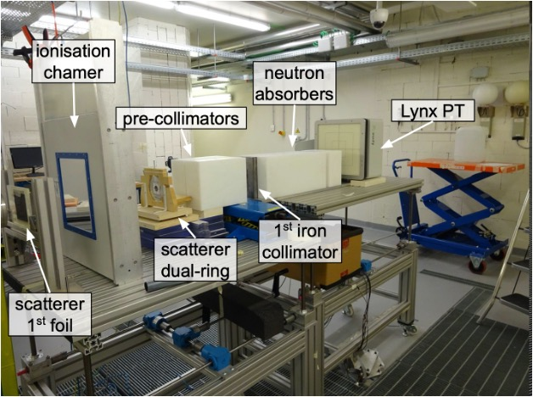
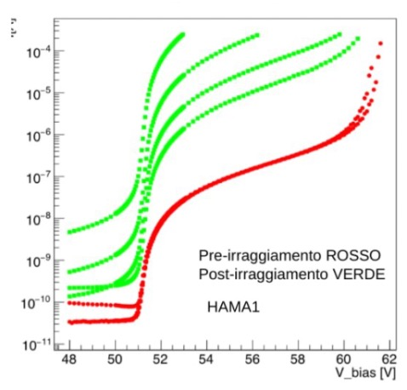
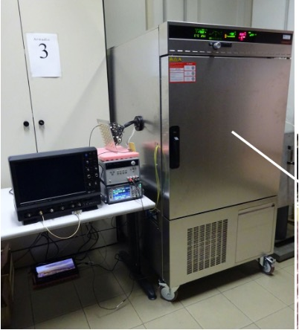
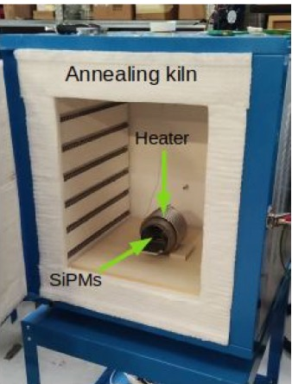
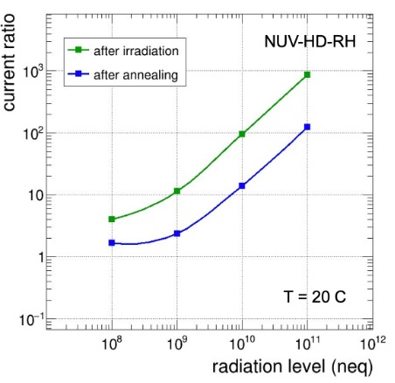
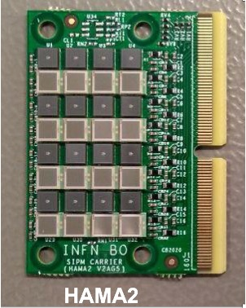
SiPM Irradiation Campaign
TIFPA
Proton
Beam
Facility
After
Before
Collimated
Beam
10⁹-10¹¹ n_{eq}
Various SiPM
Climate chamber
11

Slide 12
SiPM Radiation Damage
~ 10⁸
~ 10⁹
~ 10¹⁰
~ 10¹¹

Slide 13
Readout Electronics R&D
Custom readout solutions:
ToT readout bsed on
ALCOR (F/E) + ARCADIA (DAQ)
500 kHz per channel
50 ps time binning
AIDAinnova engineering run: RD_FCC - EIC_NET
Investigate:
- coupling with sensor
- discriminating and TDC logic
- timing performance
- streaming readout
- ………
ALCOR test board
SiPM carrier to ALCOR adapter board
KC705
EIC eRD102 Meeting - 7th September 2021

Slide 14
dRICH Key Hardware Components
Component | Function | Specs/Requirements | Critical Issues / Comments
Mechanics | Support all other components and services Keep in position and aligned | Large volume gas and light tightness; alignment of components | Technically demanding but feasible; no major challenges expected
Optics (Mirrors) | Focus (expecially for gas) and deflect photons out of particle acceptance and reduce sensor surface | sub-mrad precision reflectivity ≥ 90% low material budget | Spherical mirrors technology of CLAS12 suitable (optical fiber and/or glass skin); similar geometry; Development for cost reduction
Aerogel Radiator | Cover Low Mom. Range between TOF and Gas | ≥3σ π-K separation up to Gas region (∼13 GeV) | Procurement: currently 1 active provider (2 main producers + 1 potential) Long term stability assessment in conjunction with gas
Gas Radiator | Cover High Mom. Range above Aerogel | ≥3σ π-K separation up to ∼50 GeV and overlap to aerogel | Greenhouse gas: potential procurement issue Search for alternatives
Photon Detector | Single photon spatial detection | Magnetic field tolerant and radiation hardness; ∼ few mm spatial resolution | MCP-PMT is likely doable, but expensive. LAPPD may represent an alternative. R&D on SiPM: a promising, quicky improving, wordwide pursued, and cheap technology.
Electronics | Amplify and shape single photon analog signal, convert to digital, transfer to DAQ nodes | Low noise Time res. ∼ 0.5 ns μs signal latency | MAROC3 based readout available for prototyping; final choice will depend on sensor. ASIC development for optimised streaming readout (discrimination vs sampling)
Contalbrigo M.
EIC eRD102 Meeting - 7th September 2021
14

Slide 15
Radiators
Choice is based on EIC requirements, (current design is aerogel n=1.02, gas n=1.0008), but
needs validation and could be influenced by market availability and mass production quality.
Aerogel
Gas
Russia: Budker Institute of Novosibirsk (RAS Siberian branch)
pros: largest volume (bricks)
highest transparency at large refractive index (n=1.05)
experience from AMS, CLAS12, LHCb
cons: hygroscopic
essentially handmade
Japan: Aerogel Factory Co. (spinoff from Chiba University)
pros: hydrophobic
with industrial partners
experience from BELLE-II
cons: to be validated for massive production
USA: ASPEN (collaborating with CUA)
pros: industrial producer
cons: to be validated for transparency
Procurement issue reported
(right now: Nippon gases)
C₂F₆ 1.00082
CF₄ 1.0005
C₄F₁₀ 1.0014
Delicate gas handling
greenhouse gases
environmental restrictions
Alternative
Noble gases at high-P
Contalbrigo M.
EIC eRD102 Meeting - 7th September 2021
15
Notes:
Fare una immagine del PMT sulla risoluzione

Slide 16
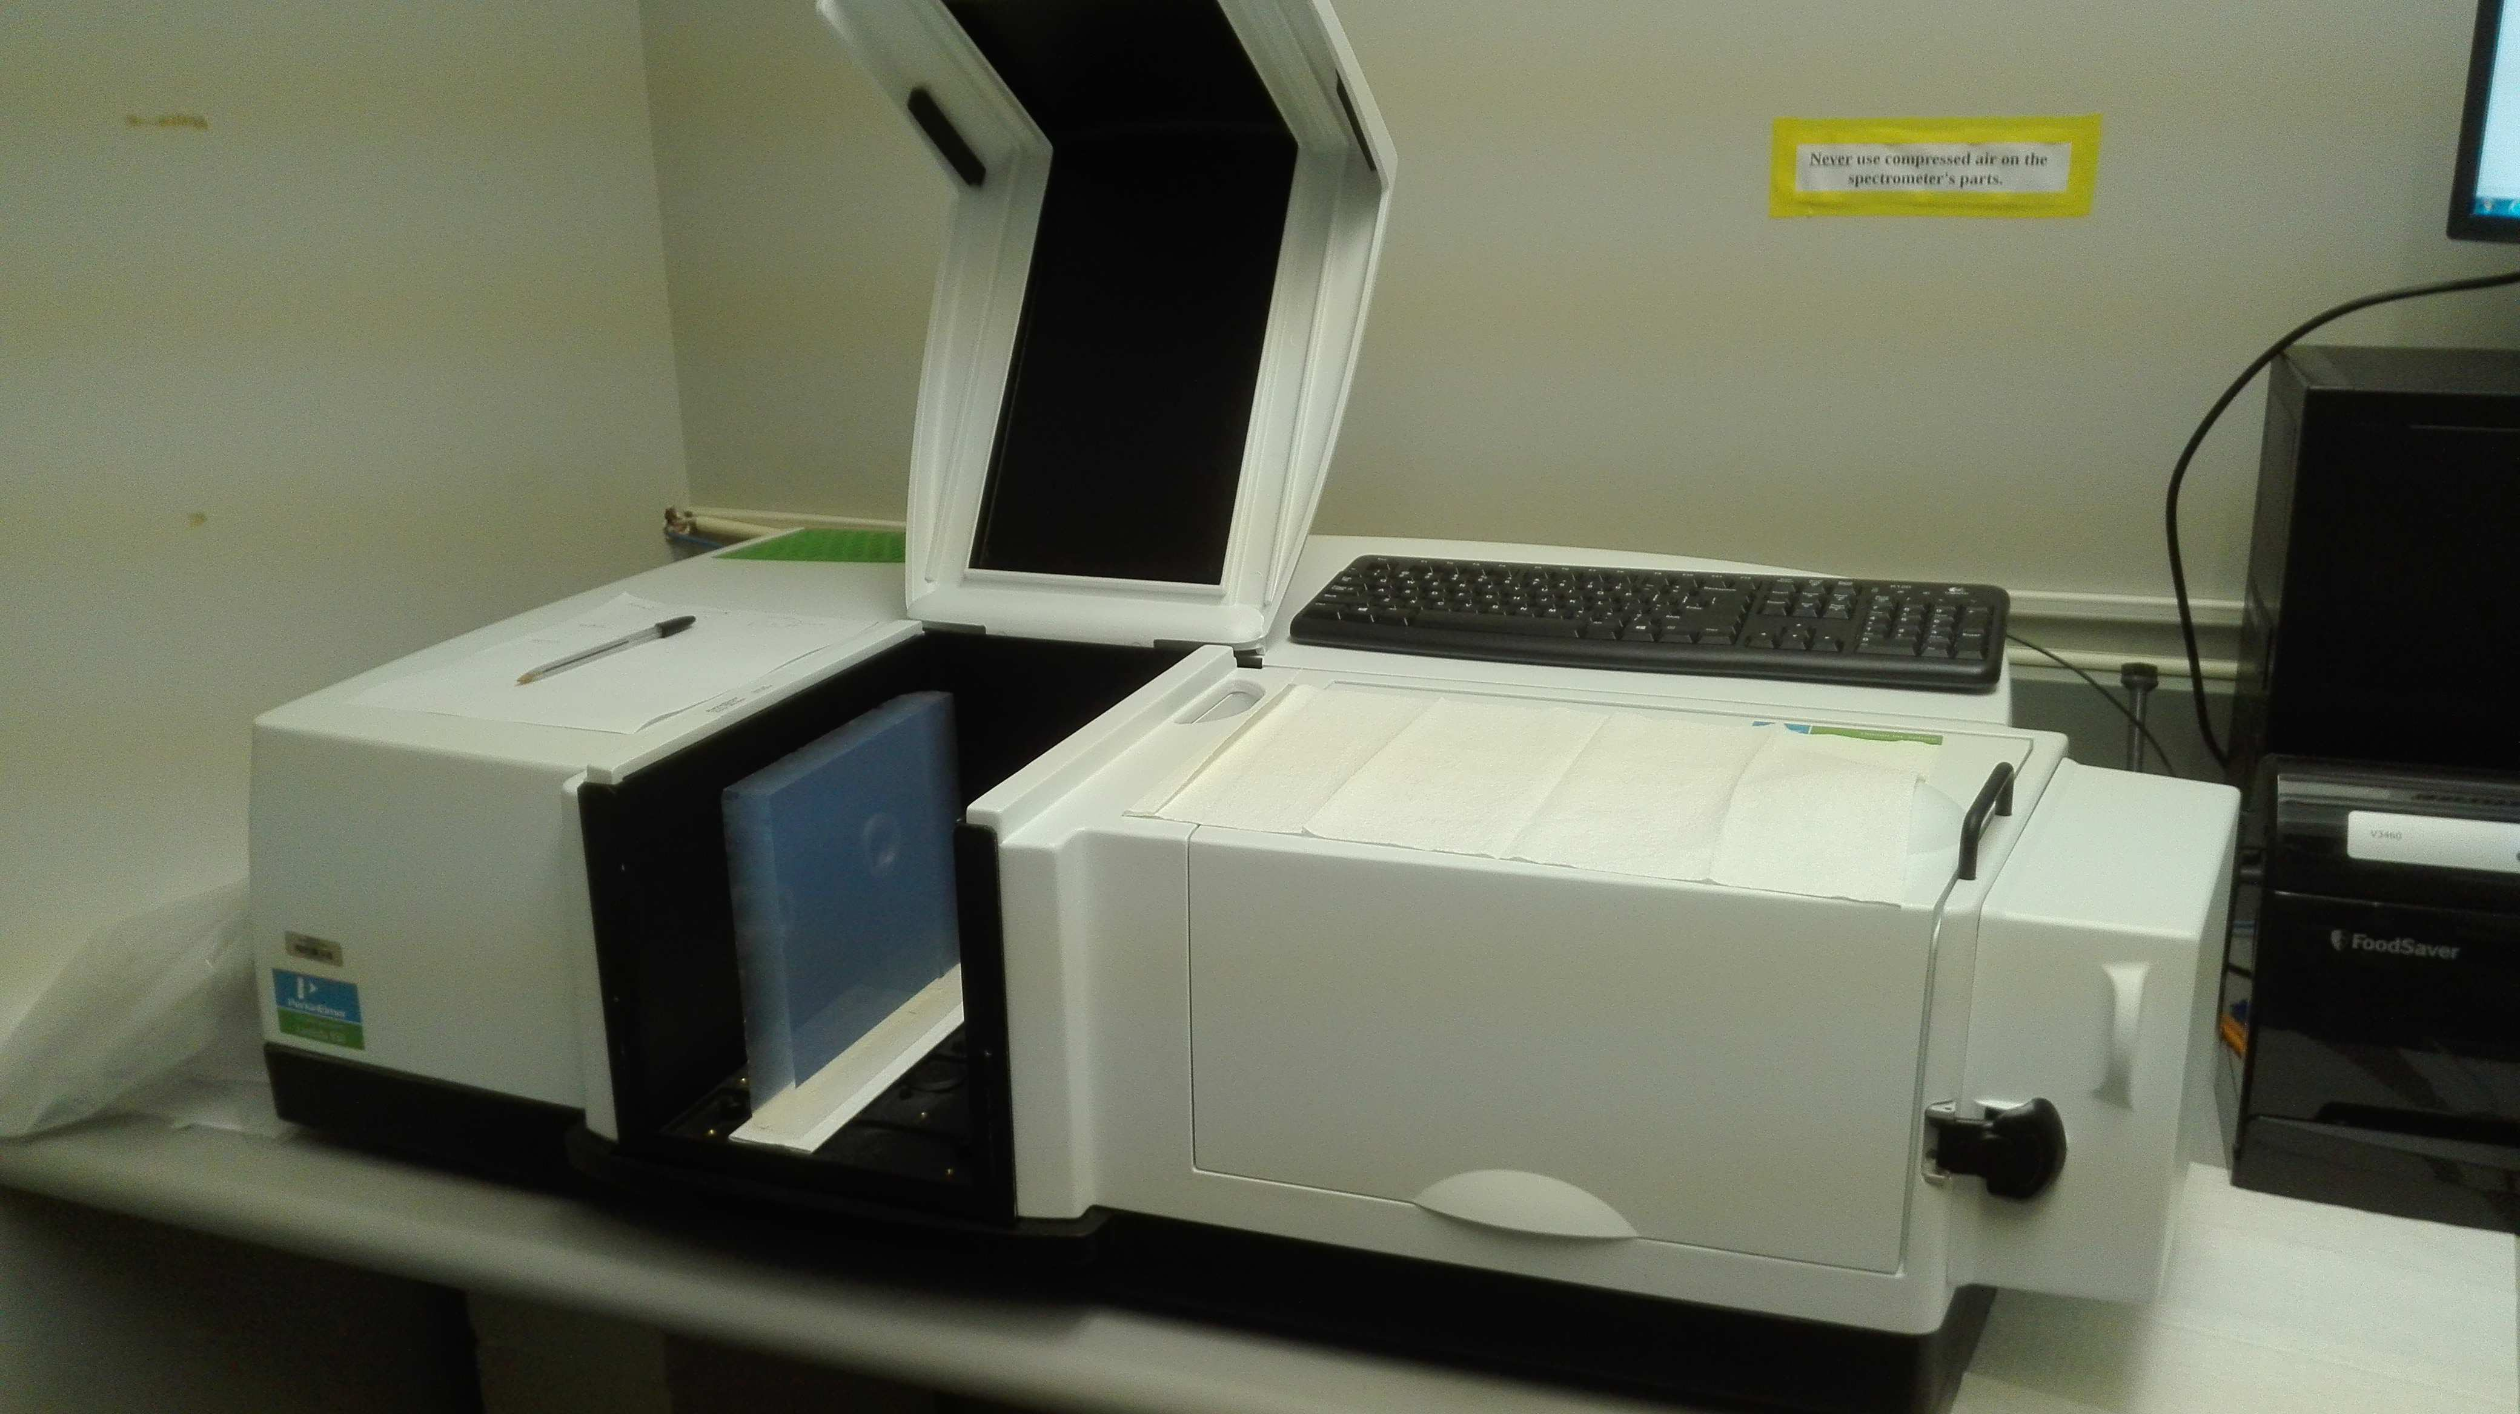
Next Steps: Optical Components
Existing facility to study detailed radiator optical properties and alternatives
Aerogel: Safe handling and characterization
(refractive index, surface planarity, forward scattering)
Budker Institute (Russia, CLAS12), Chiba University (Japan, Belle-II), Aspen (USA, R&D)
Gas: Safe handling and purging
Alternatives to greenhouse gases
Interplay between radiators: UV filters, refractive index optimization
Spectrophotometer Characterization station
Contalbrigo M.
EIC eRD102 Meeting - 7th September 2021
16
Notes:
Fare una immagine del PMT sulla risoluzione

Slide 17
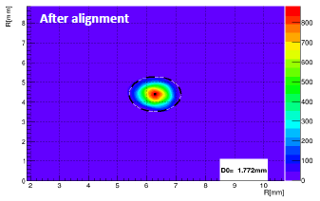
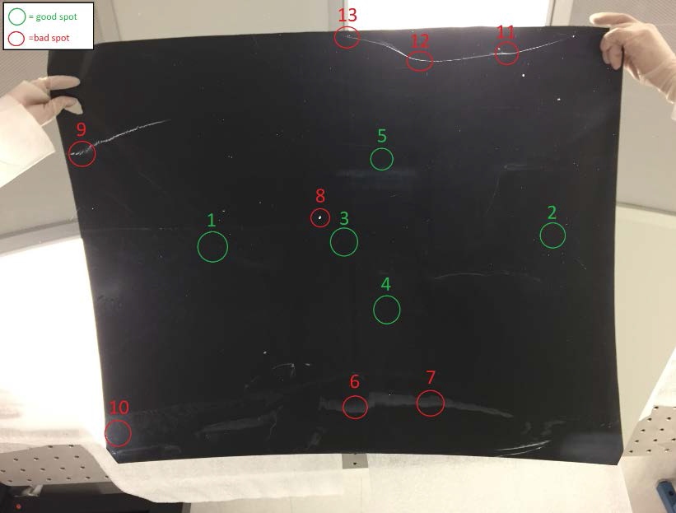
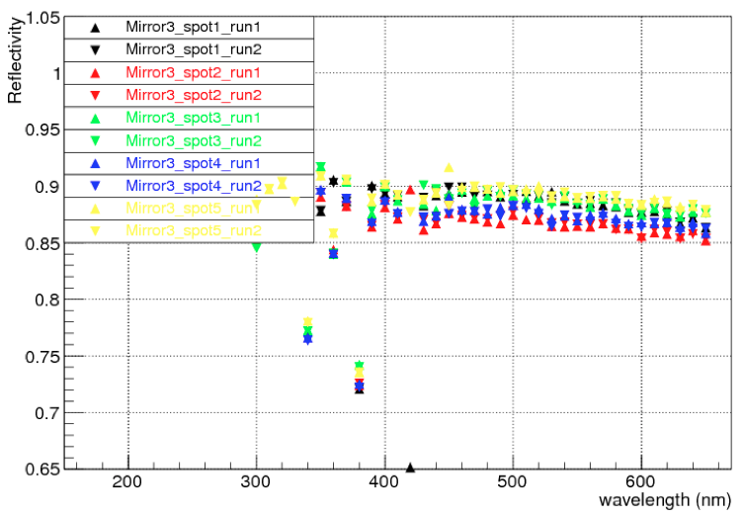
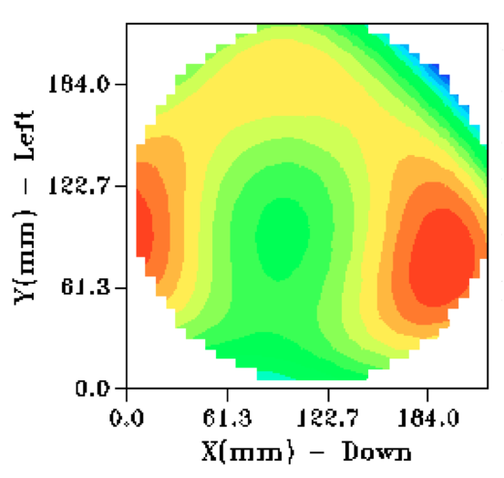
Next Steps: Optical Components
Surface Quality
Existing facility to study detailed mirror optical properties and alternatives
Mirrors: Safe handling and characterization
(surface map, radius of curvature, reflectivity)
Carbon fiber (mature) vs glass skin (cost-effective)
Mechanics: Composite materials from aeronautics technology
Stiff and light, supporting alignment
Pointlike source image
Reflectivity
Shack-Hartmann sensor
Contalbrigo M.
EIC eRD102 Meeting - 7th September 2021
17
Notes:
Fare una immagine del PMT sulla risoluzione

Slide 18
FY22 Targeted R&D
Goals:
Completion of a test-beam setup able to demonstrate dRICH performance
New test-beam to validate the dual-radiator approach and support the simulations
Study of dRICH basic integration into the EIC detector.
Milestones:
Initial assessment based on the ﬁrst test beams (3/30/22);
Realization of a suitable detector plane for the dRICH prototype (6/30/22);
Realistic implementation of dRICH into the EIC detector (9/30/22).
Contalbrigo M.
EIC eRD102 Meeting - 7th September 2021
18
Notes:
Fare una immagine del PMT sulla risoluzione

Slide 19
dRICH Timeline
Year | Detailed tasks
2021 | Development of basic prototype design, simulation and implementation Optical components: First selection and tests Basic prototype: Basic tracking, one choice per radiator, glass mirrors, reference readout Beam Test 1: Proof of principle with reference detectors and readout , ideal beam Import dRICH simulation into the supported EIC platforms
2022 | Analysis of the first test-beam Refined prototype: refined components and readout, online reconstruction, precise tracking/alignment Beam Test 2: Performance assessment with reference and custom detectors, hadron tagged beams
2023 | R&D on cooling EIC configuration engineering and integrated PID Optical components refinement and cost reduction study (e.g. glass-skin mirror
2024 | Component alternatives and optimization Final prototype: various radiators, custom mirrors, gas system, optimized readout Beam test 3: Performance assessment with optimized components
2025 | Engineering of cooling and services Beam test 4: Contingency
Assumed funding profile k$.
Contalbrigo M.
EIC eRD102 Meeting - 7th September 2021
19

Slide 20
Conclusions
Ongoing effort for the development of a forward RICH detector for particle identification at EIC
Activity plan in organized following the EIC Critical-Decision timeline
Goal:
Cost-effective compact solution for hadron PID in EIC forward region in a wide kinematic range
R&D Activity on innovative aspects and space for synergy with LHC (ALICE) and other EIC eRD
Prototyping and test-beam campaigns to address crucial PID aspects at EIC
(1st joined test-beam on October ‘21)
Optimized and alternate radiators
Aerogel of medium refractive index and high transparency, noble gas at high pressure
Novel cost-effective single-photon detector solution to be operated in high magnetic field
SiPM post-irradiation characterization and imaging tests (+LAPPDs)
Readout
Alternate ToT architecture (ALCOR chip)
Cooling, support structure ………
BNL technical support is essential
EIC eRD102 Meeting - 7th September 2021

