Slide 1
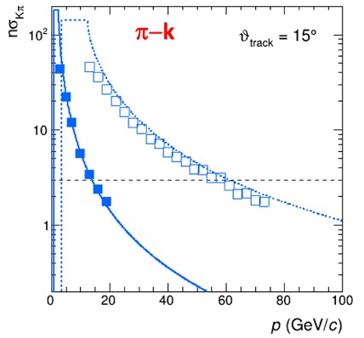
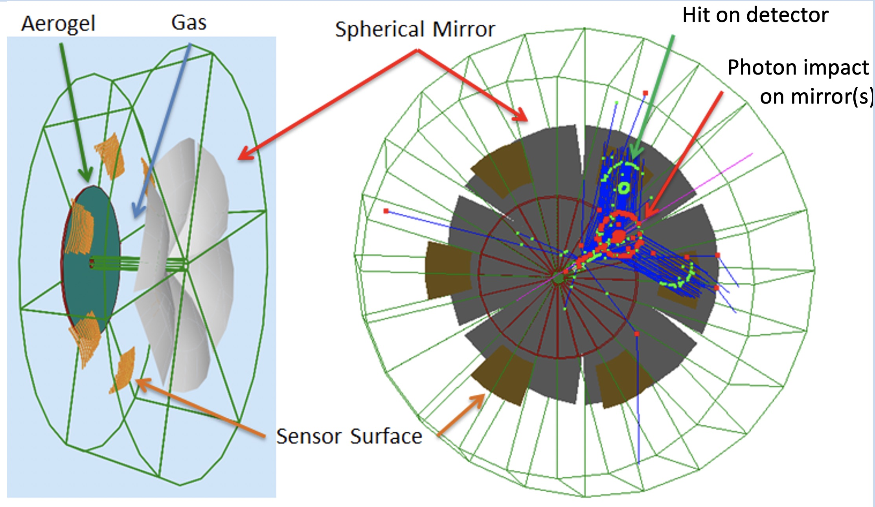
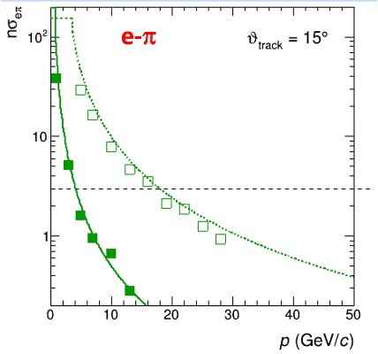
Dual Radiator RICH @ EIC
Two main : cover wide momentum range 3 - 60 GeV/c
challenges work in high (~ 1T) magnetic field
dRICH: effective solution for ePIC detector
Two radiators: Aerogel (n_{AERO}~1.02) + Gas (n_{C2F6} ~ 1.0008)
SiPM Detector: 0.5 m²/sector , 3x3 mm² pixel
Phase Space:
- Polar angle: 5-25 deg
Momentum: 3-60 GeV/c
1

Slide 2
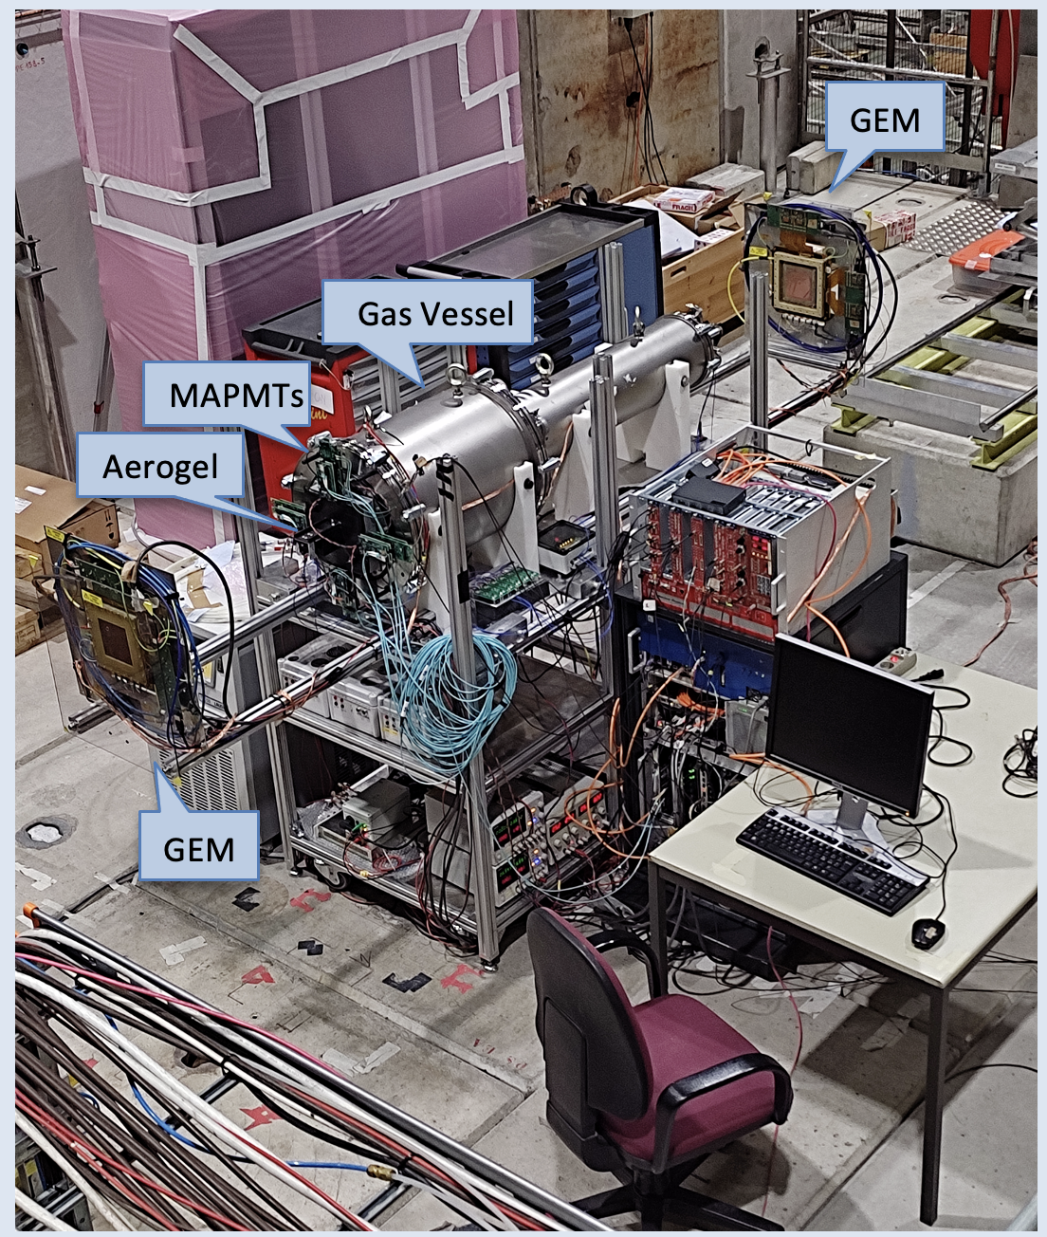
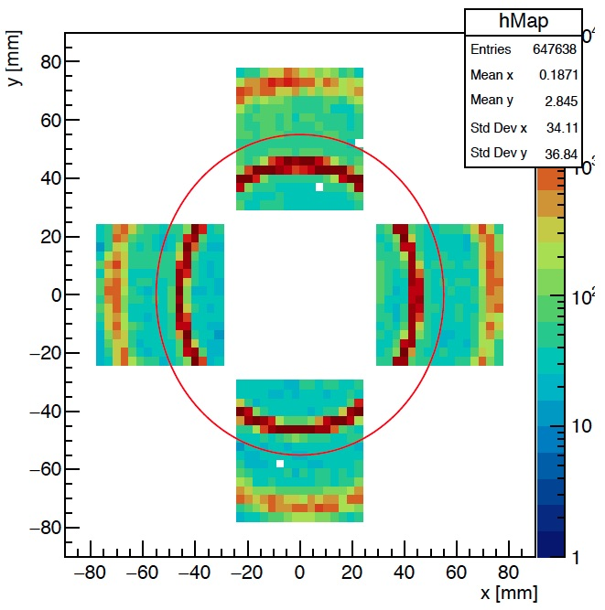
dRICH Prototype - MAPMTs
Operative prototype commissioned. Double ring imaging achieved. Performance in line
with expectations except for aerogel single-photon angular resolution (worse by a factor ~ 1.5)
Two radiator concept validation
(with a reference MAPMT readout)
Reference readout from CLAS12 RICH:
H13700 MA-PMTs + ALCOR3 ToT chip
Gas ring coverage: 60%
Aerogel ring coverage: 40 %
2

Slide 3
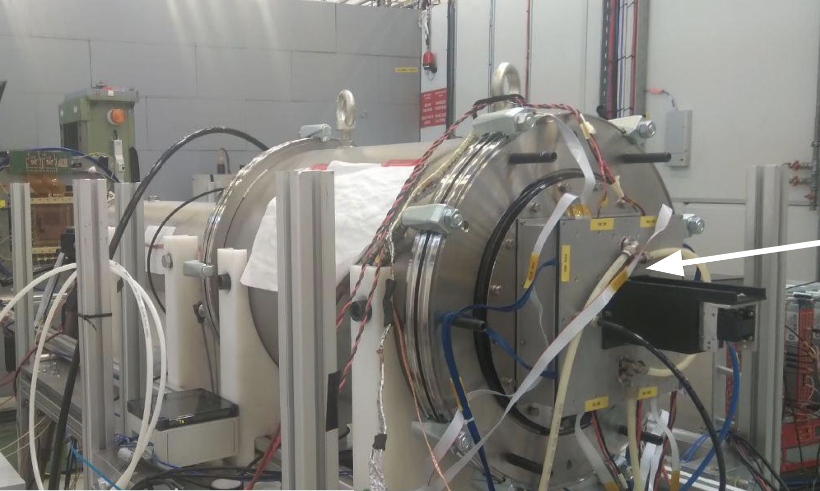
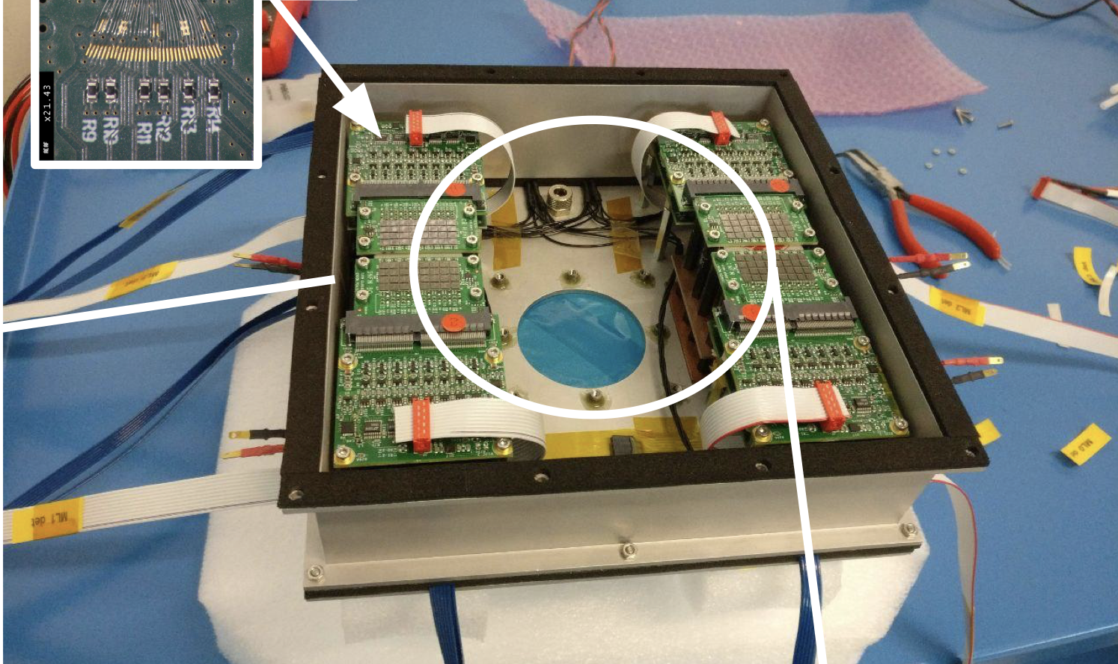
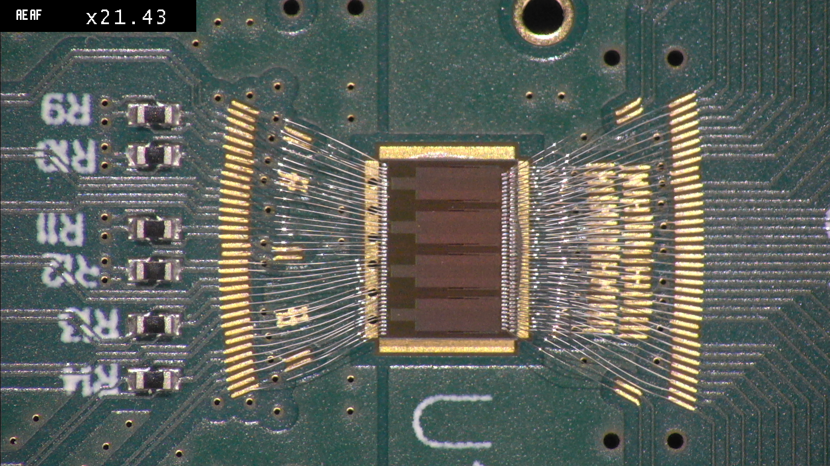
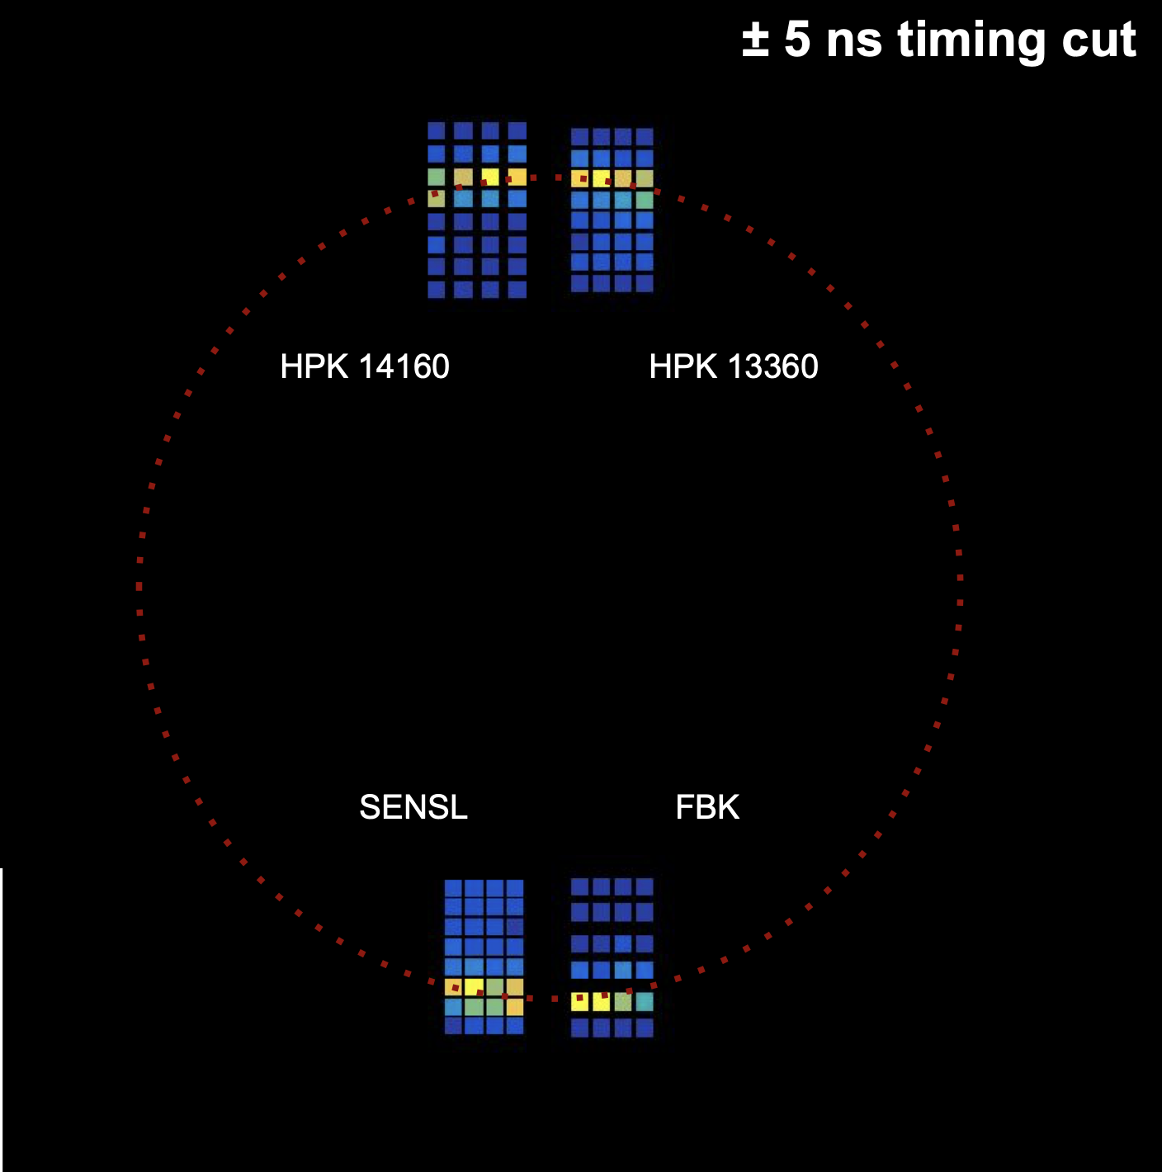
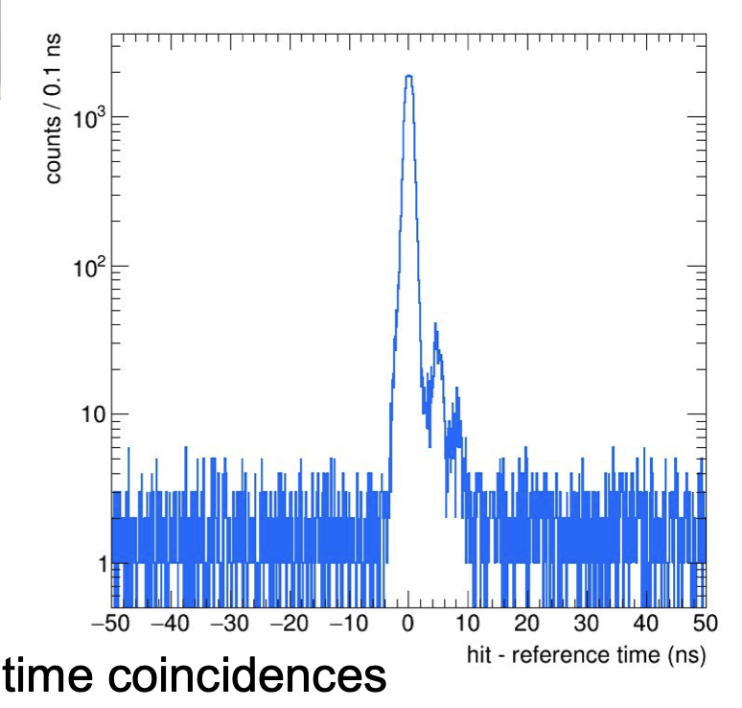
dRICH Prototype - SiPM
Irradiation and annealing campaign performed on various SiPM sensor from different manufacturers
Gas vessel
Aerogel box
Detector box
Test beam at CERN PS
dRICH prototype with SiPM+ALCOR readout
Successful Cherenkov ring detection with SiPM
- irradiated
(with protons up to 10¹⁰ n_{eq})
- annealed
(in oven at 150 C)
Aerogel rings of 8 GeV negative pions
3

Slide 4
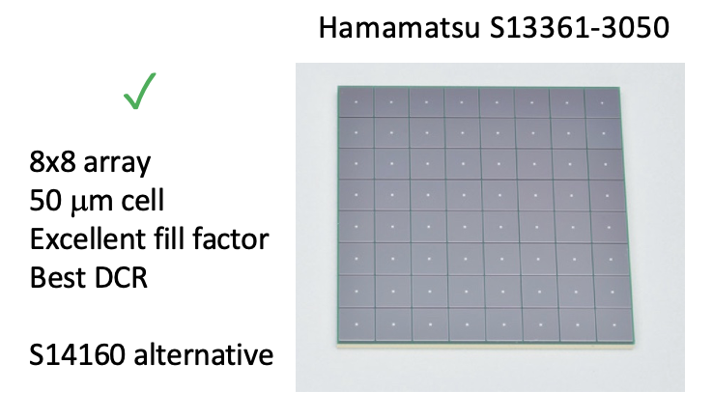
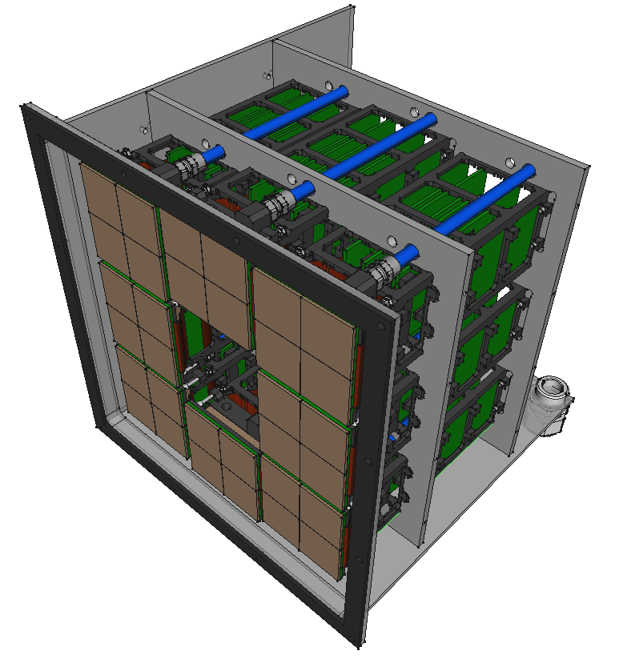
EIC-driven Readout Plane
Compact 256 ch unit with integrated cooling and annealing capability
4x SiPM matrix arrays
(256 channels)
cables and services
(not shown)
flex PCB
cooling stack
(water-cooled Peltier)
14 cm
minicrate with
fron-end electronics
(ALCOR ASIC inside)
$$✓$$
ALCOR v2
ToT architecture, streaming mode ready
50 ps time bin
500 kHz rate per channel
cryogenic compatible
aerogel tile
(not shown)
4

Slide 5
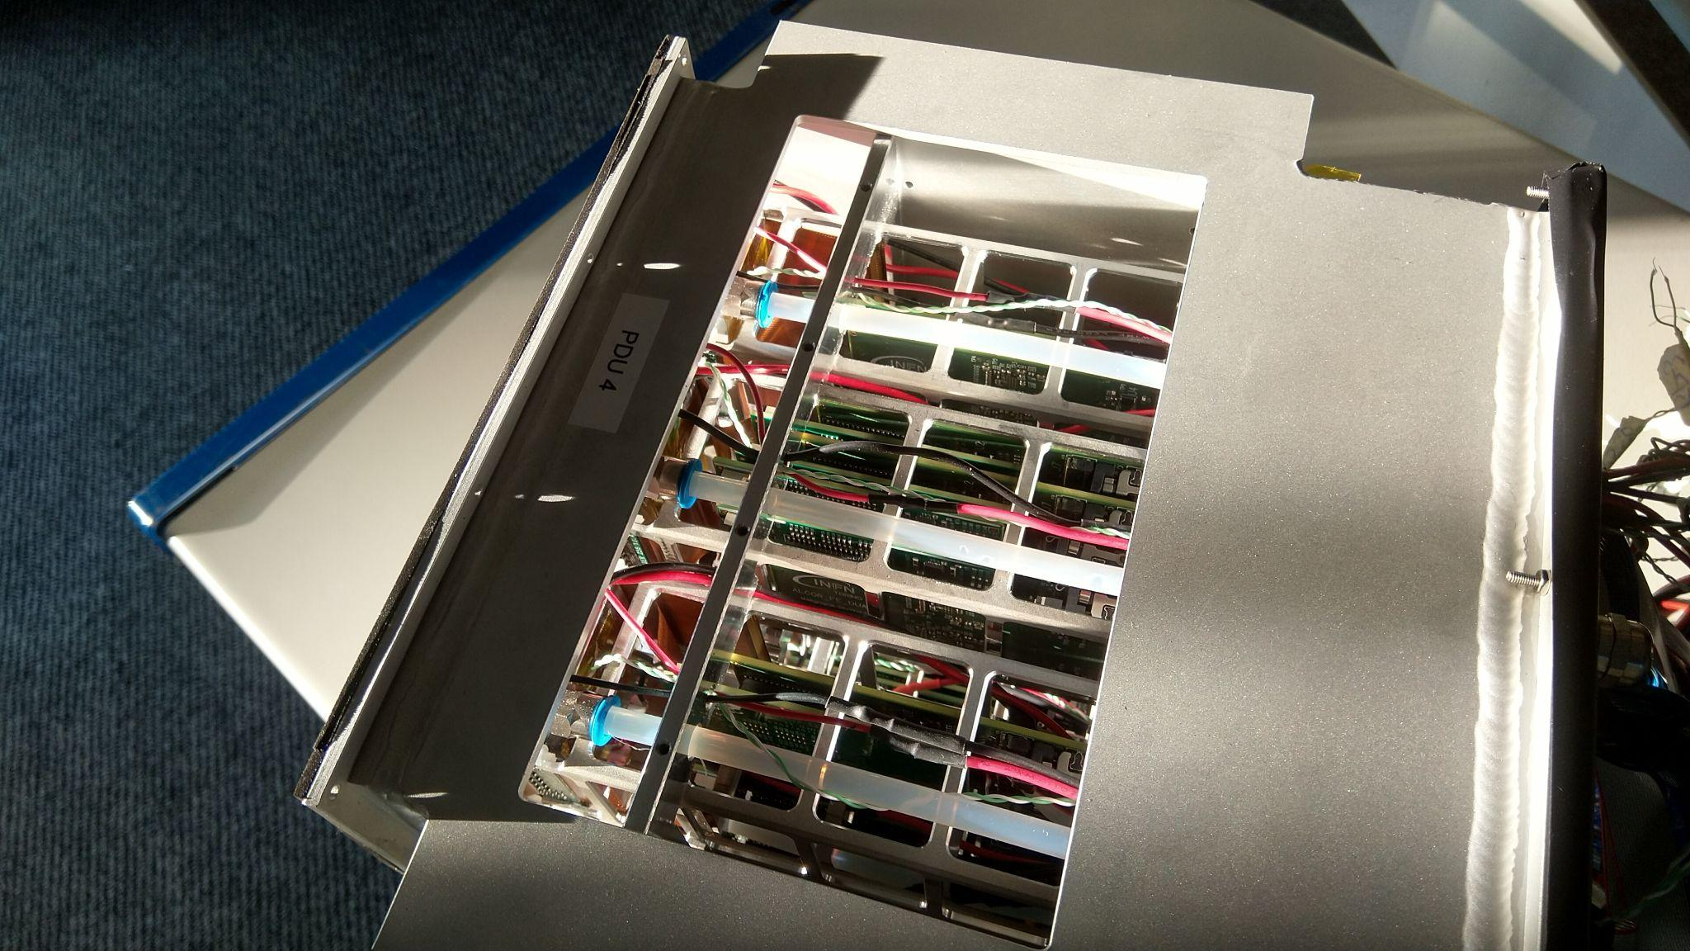
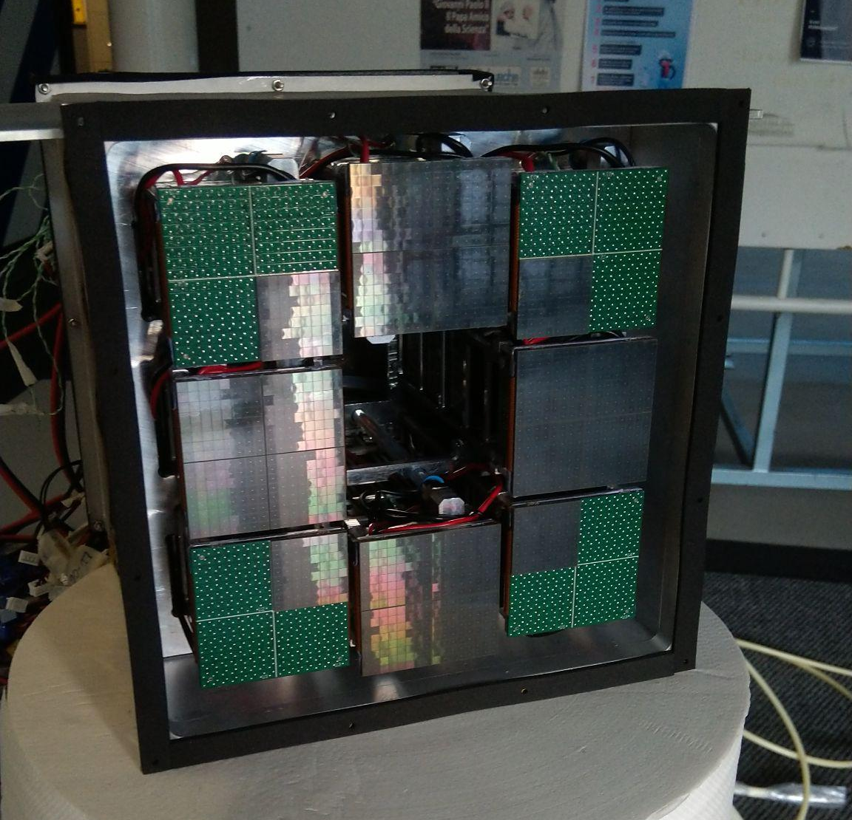
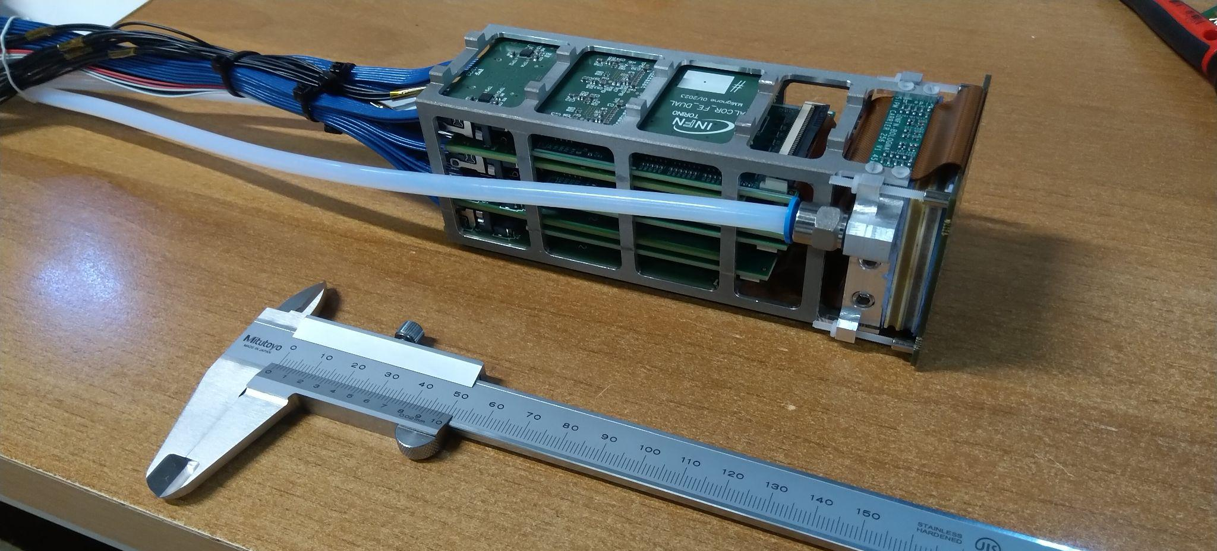
EIC-driven Readout Plane
Compact 256 ch unit with integrated cooling and annealing capability
Readout Box (front)
Instrumented with more than 1000 channels
Readout Box (top)
Photon Detector Unit (PDU)
20 x 20 x 20 cm³
14 cm long
5

Slide 6
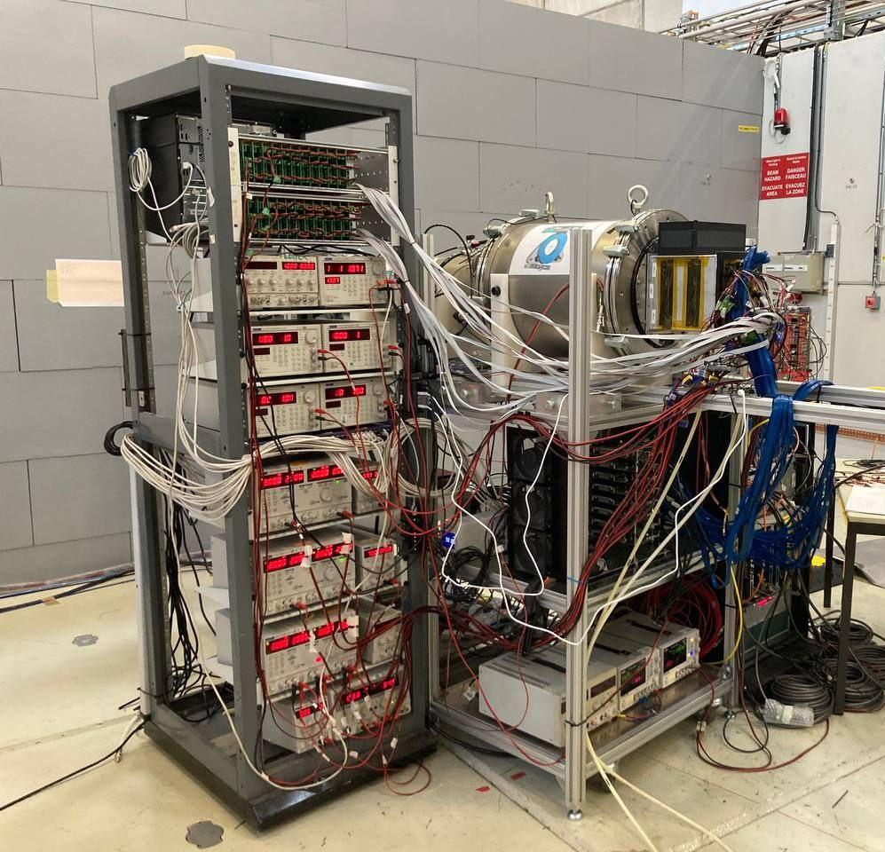
dRICH Prototype – EIC readout
Beam test at CERN PS-T10 beam line: October 2023
DAQ and DCS computers
dRICH prototype
auxiliary control electronics crates
SiPM photodetector readout box
gigabit ETH switch for DAQ and DCS
DAQ FPGAs and clock distribution
low voltage and high voltage power supplies
6

Slide 7
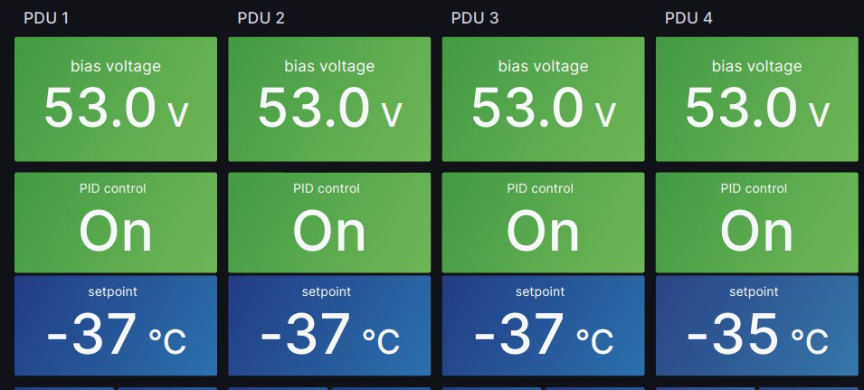
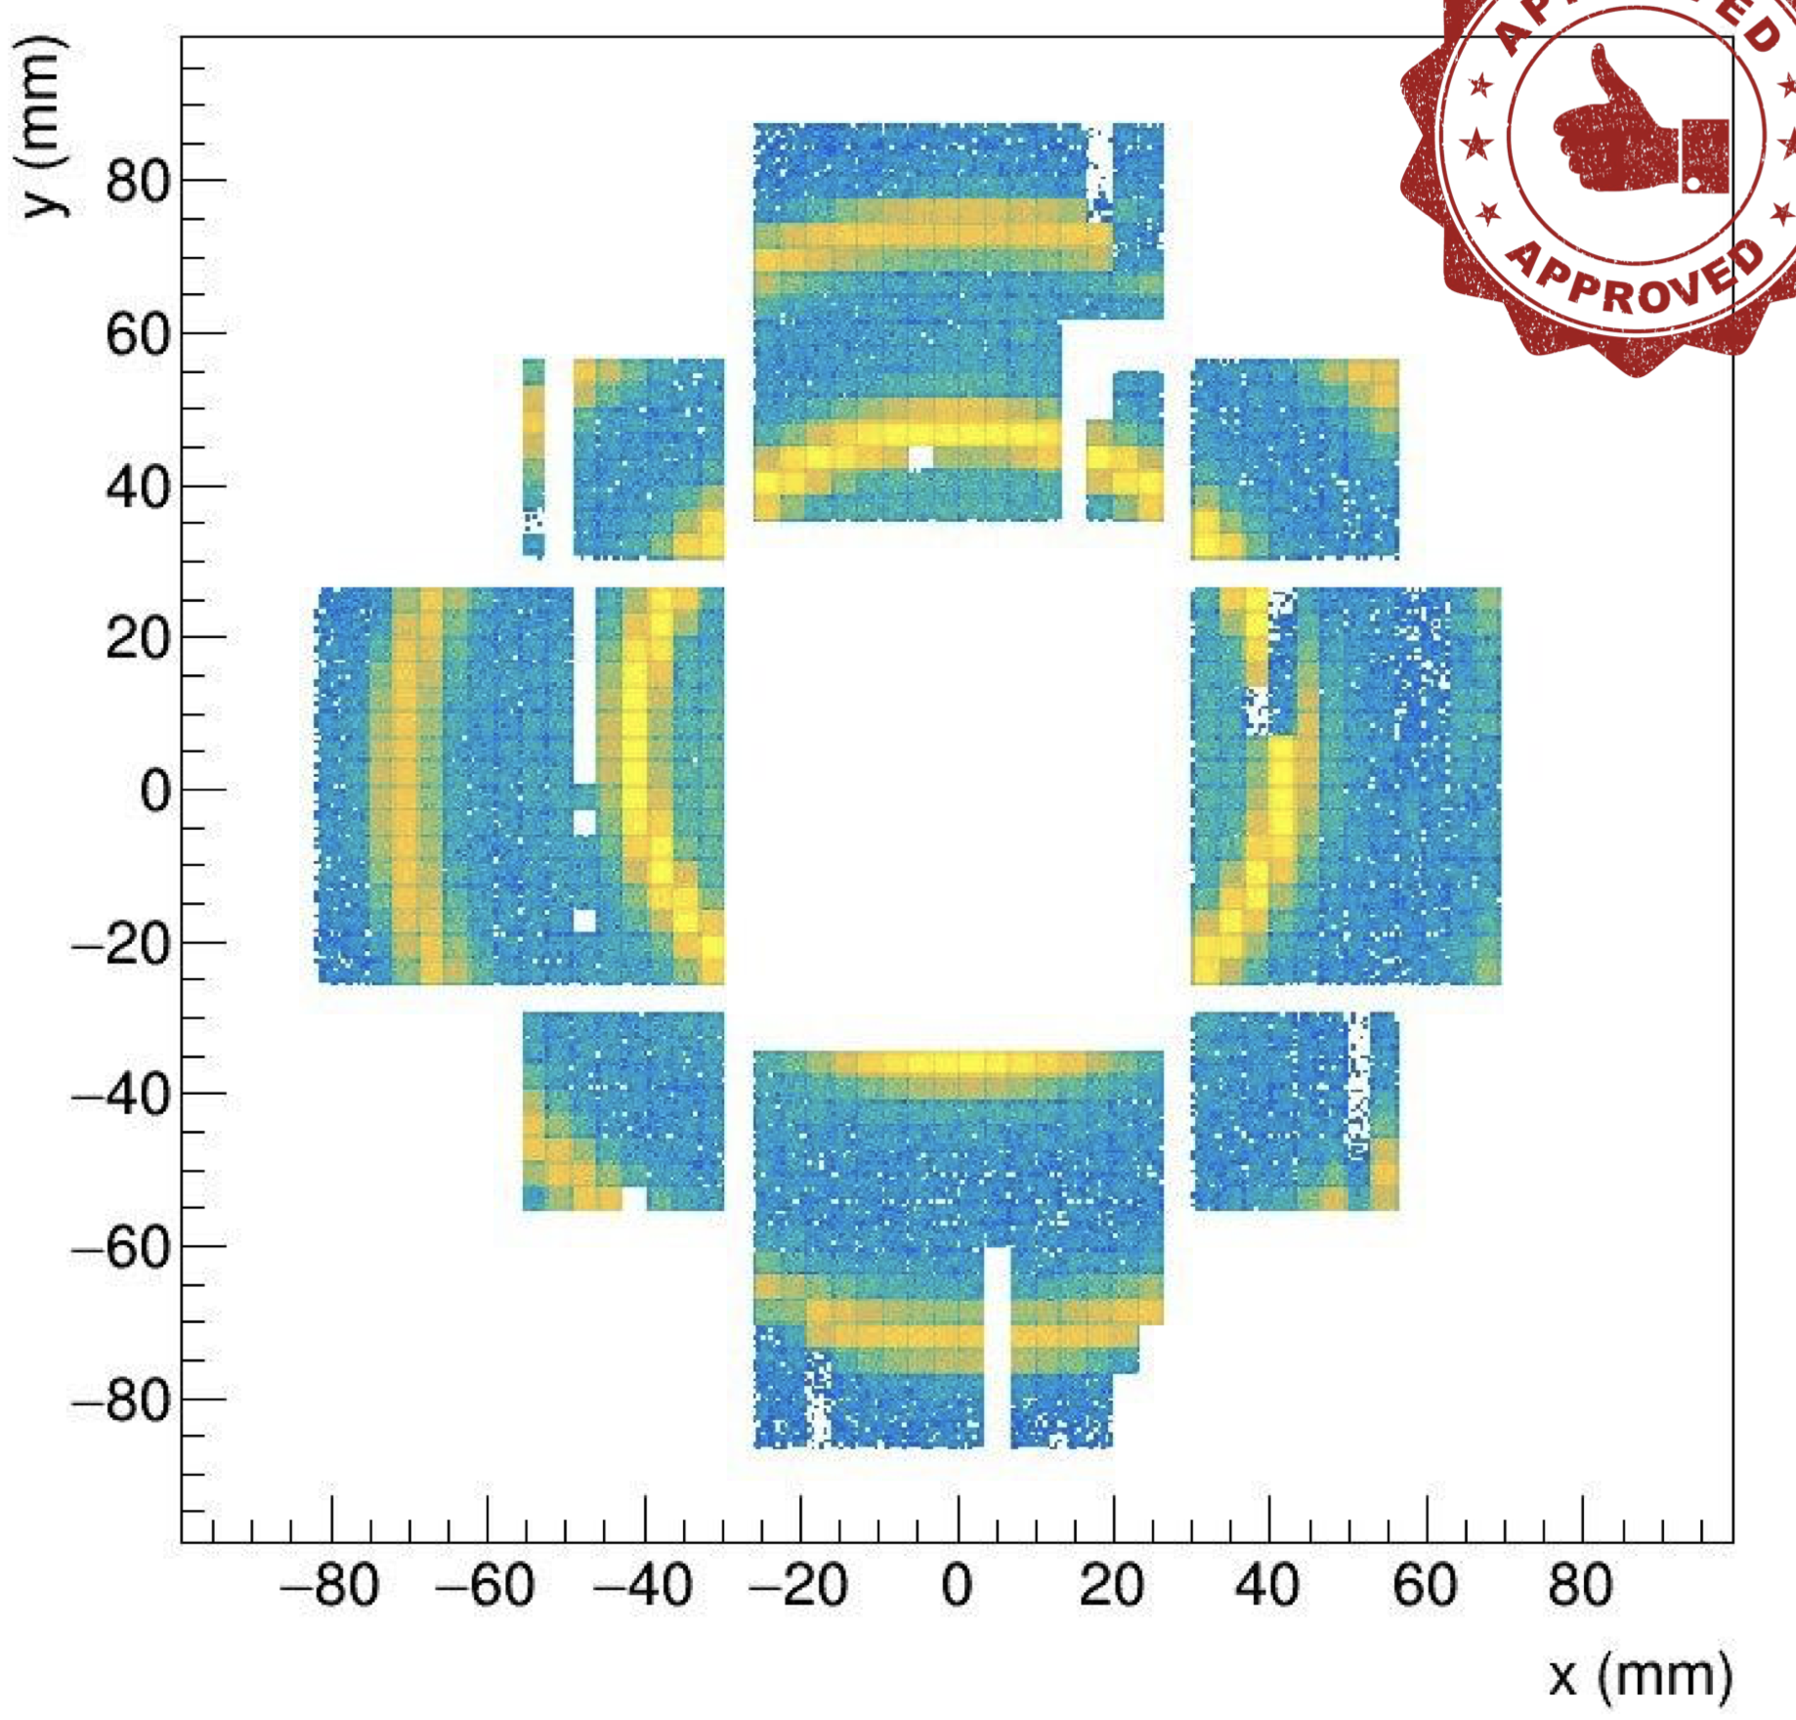
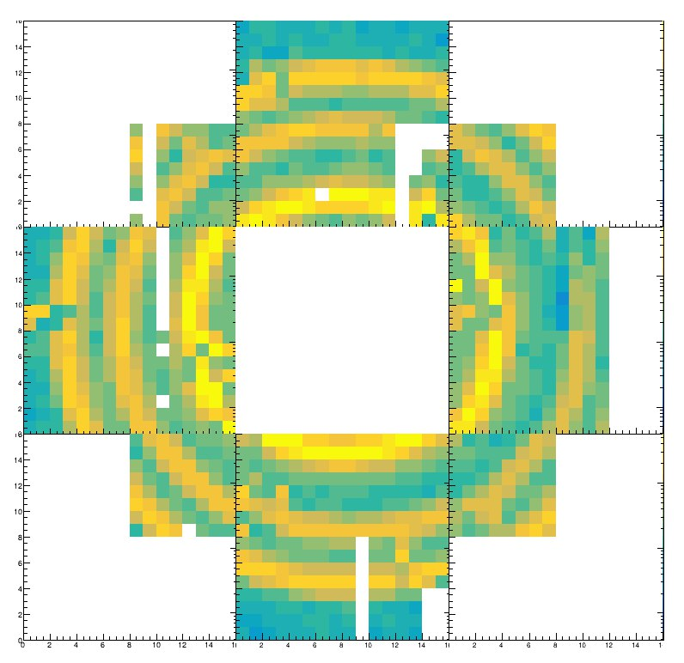
dRICH Prototype – EIC readout
Online monitors and QA plots indicate a successful beam test. Analysis is ongoing
Successful imaging with a compact
EIC-driven readout plane
based on SiPM + ALCOR
low temperature SiPM operation
10 GeV positive beam
8 GeV positive beam
aerogel
pions
aerogel
aerogel
protons
C₂F₆
pions
C₂F₆ gas
7

Slide 8
Status and Plans
2022: dRICH imaging with reference detectors
Extended SiPM irradiation + annealing campaign
Cherenkov light detection with irradiated SiPM
2023: EIC-drive photon-detector plane
dRICH imaging with EIC-driven detector plane
Outlook: Refined data analysis and simulation
Final assessment
8

