Slide 1
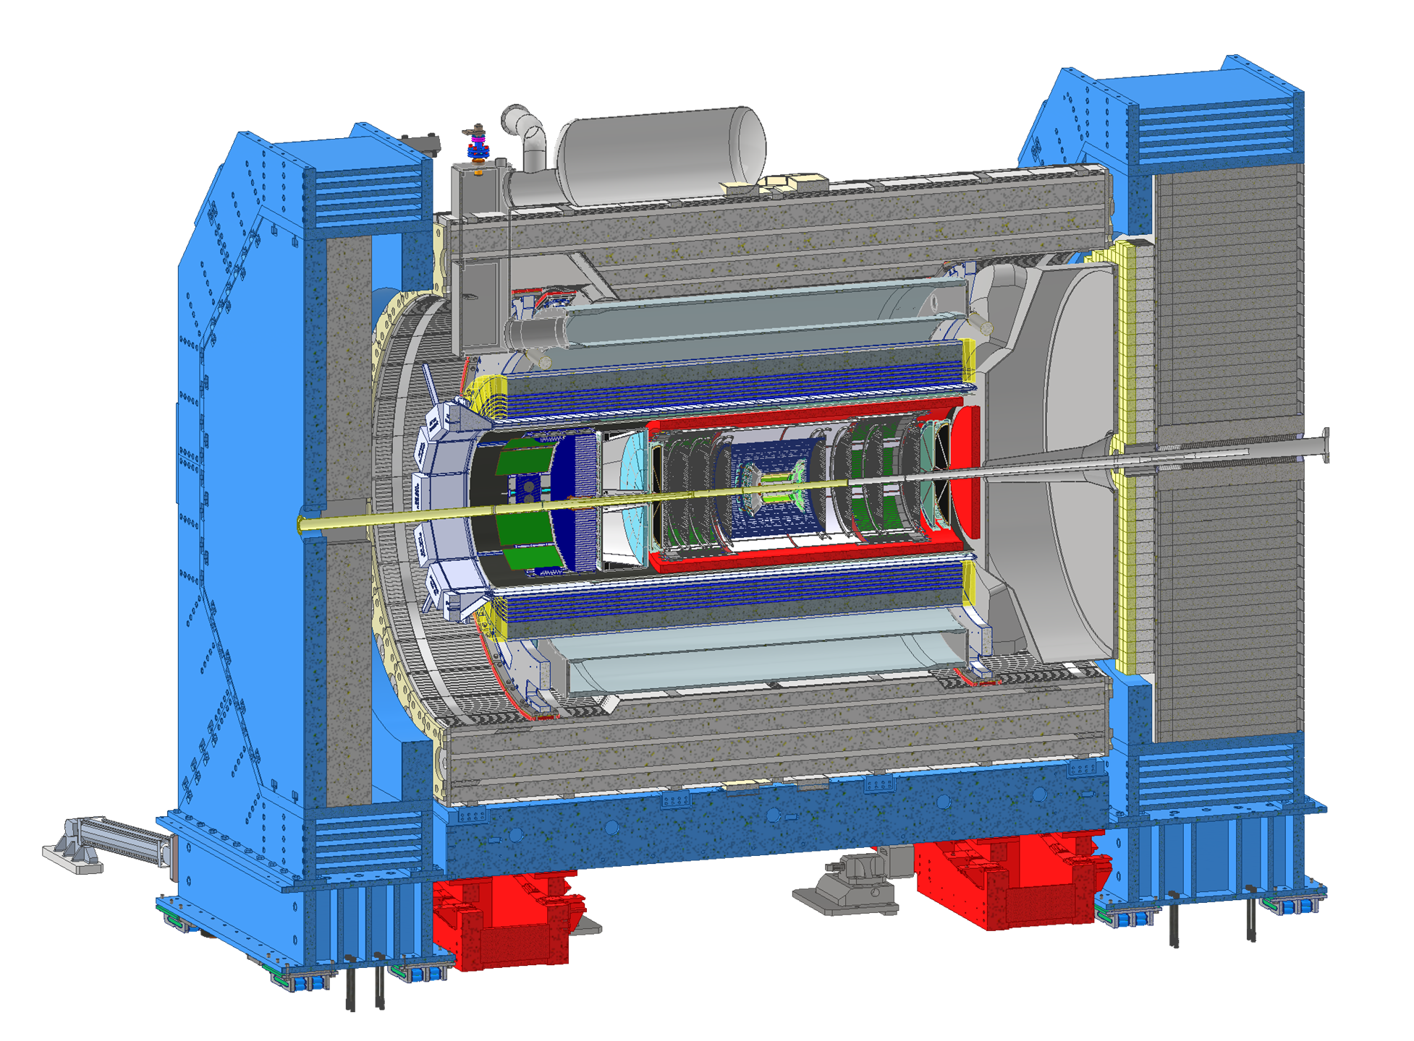
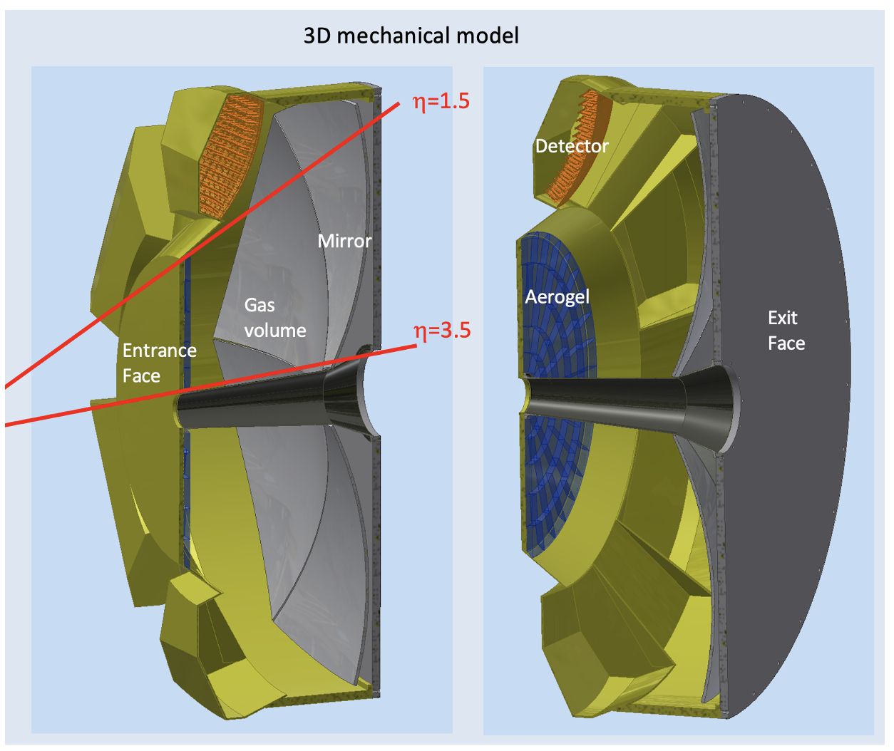
ePIC dRICH
Dual-radiator Ring-imaging Cherenkov Detector (dRICH)
Essential to access flavor information
4m
Goals: Hadron 3σ−separation between 3 - 50 GeV/c
Complement electron ID below 15 GeV/c
Cover forward pseudorapidity 1.5 (barrel) - 3.5 (b. pipe)
dRICH Features:
Extended 3-50 GeV/c momentum range --> Dual radiator
Single-photon detection in high Bfield --> SiPM
Limited space --> Compact optics with curved detector
1

Slide 2
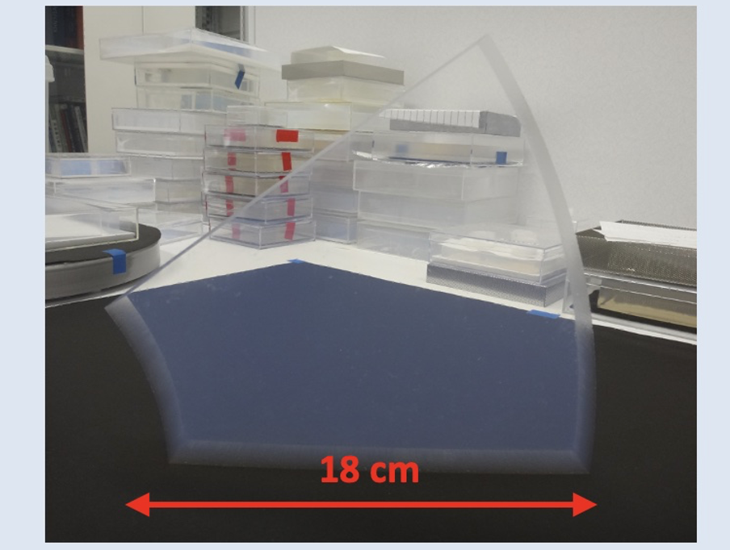
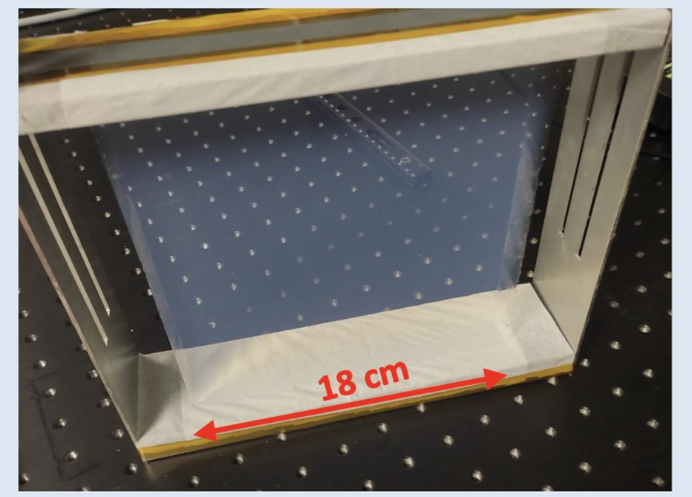
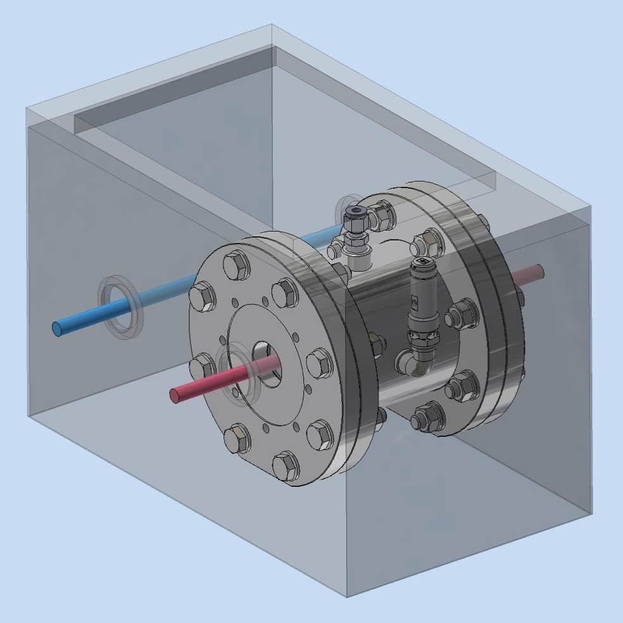
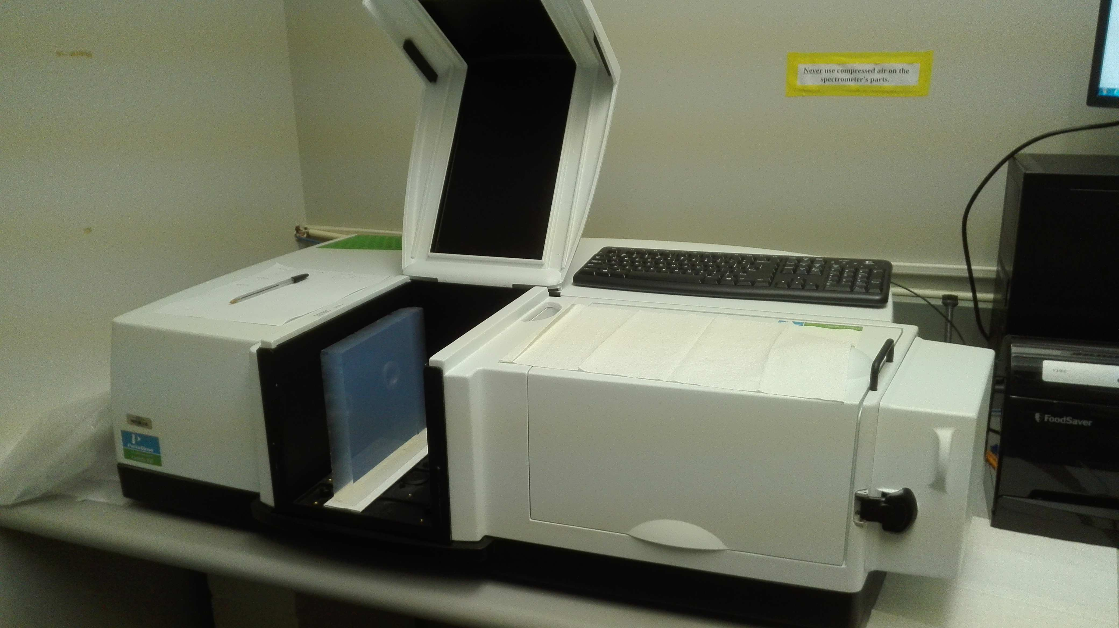
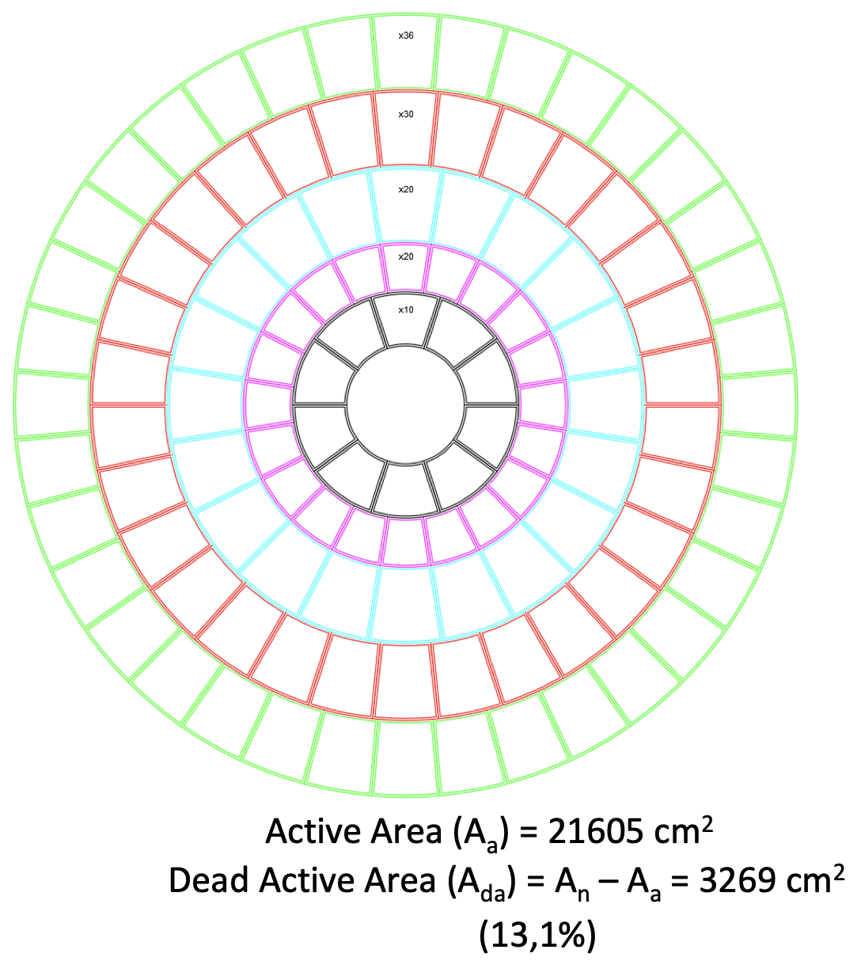
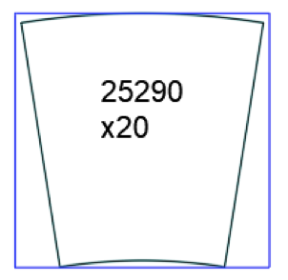
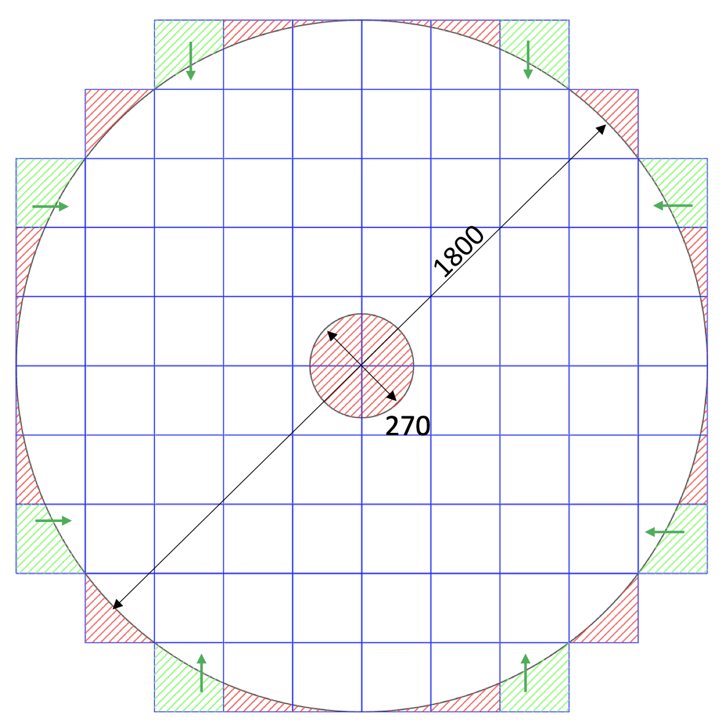
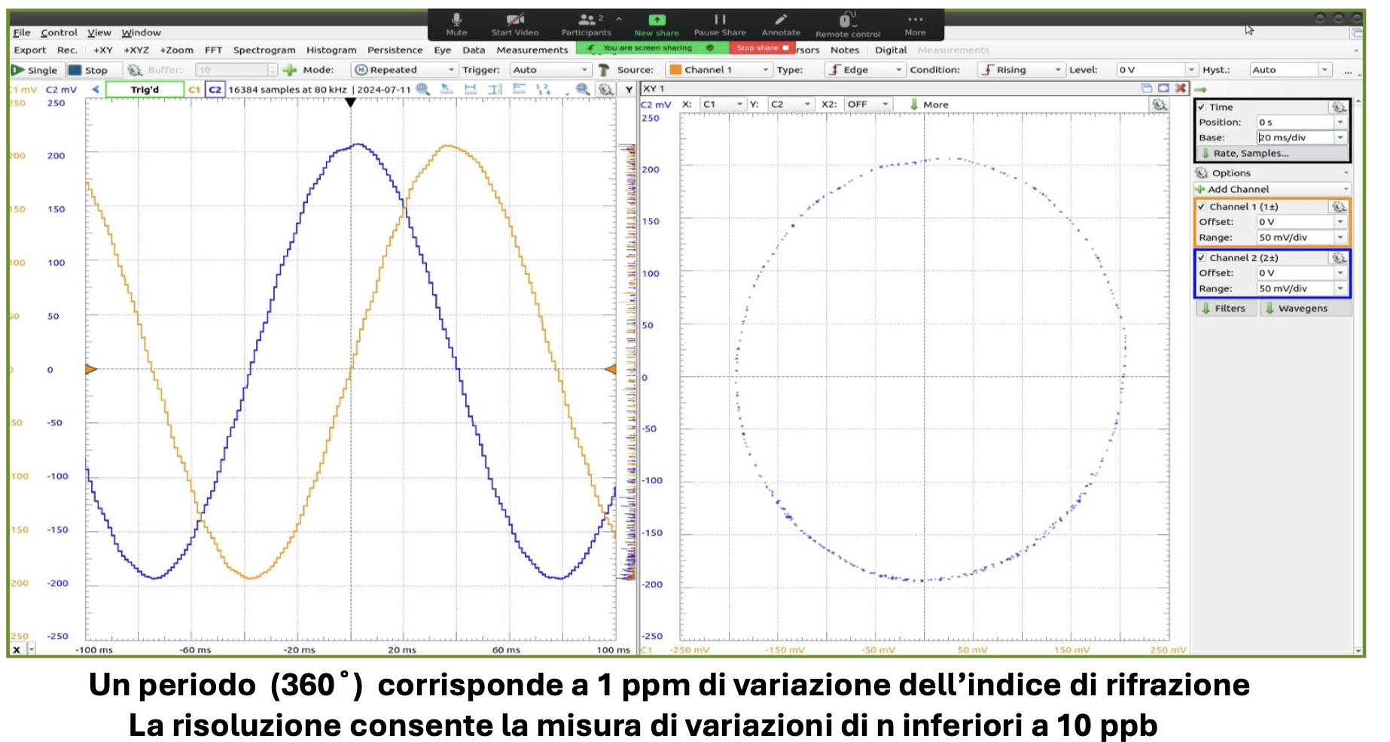
dRICH Radiators
Aerogel with n=1.026 validated with lab and prototype tests
C₂F₆ validated with lab & prototype tests
Design of online purity monitors ongoing
Sonar to measure speed of sound
10 bar chamber + specrophotometer to measure
light transmission in the visible range
Large demonstrators delivered – Wall engineering ongoing
Jamin interferometer for precise n determination
Goal
Active Area = 21605 cm²
Dead Area = 3269 cm² (13%)
Wasted Area = 9112 cm² (27 %)
Active Area = 21368 cm²
Dead Area = 3506 cm² (14%)
Wasted Area = 1868 cm² (7 %)
2
Notes:
Come si arriva ai 1.8 Tbps ? 3 KHz / 3(shutter) * 3e5 (canali) *64

Slide 3
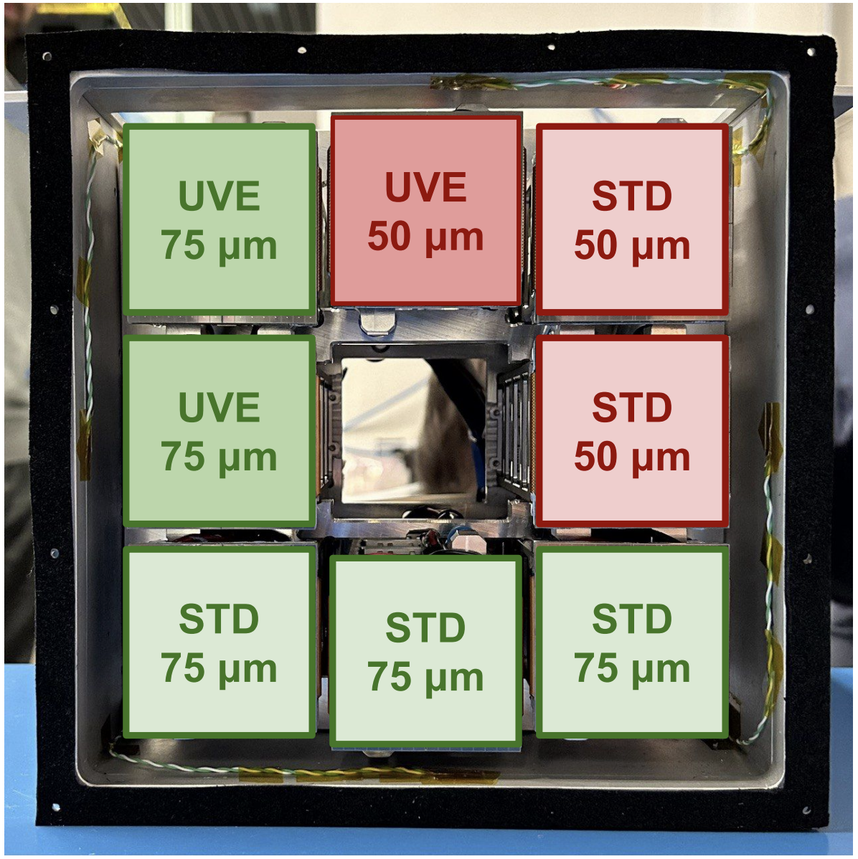
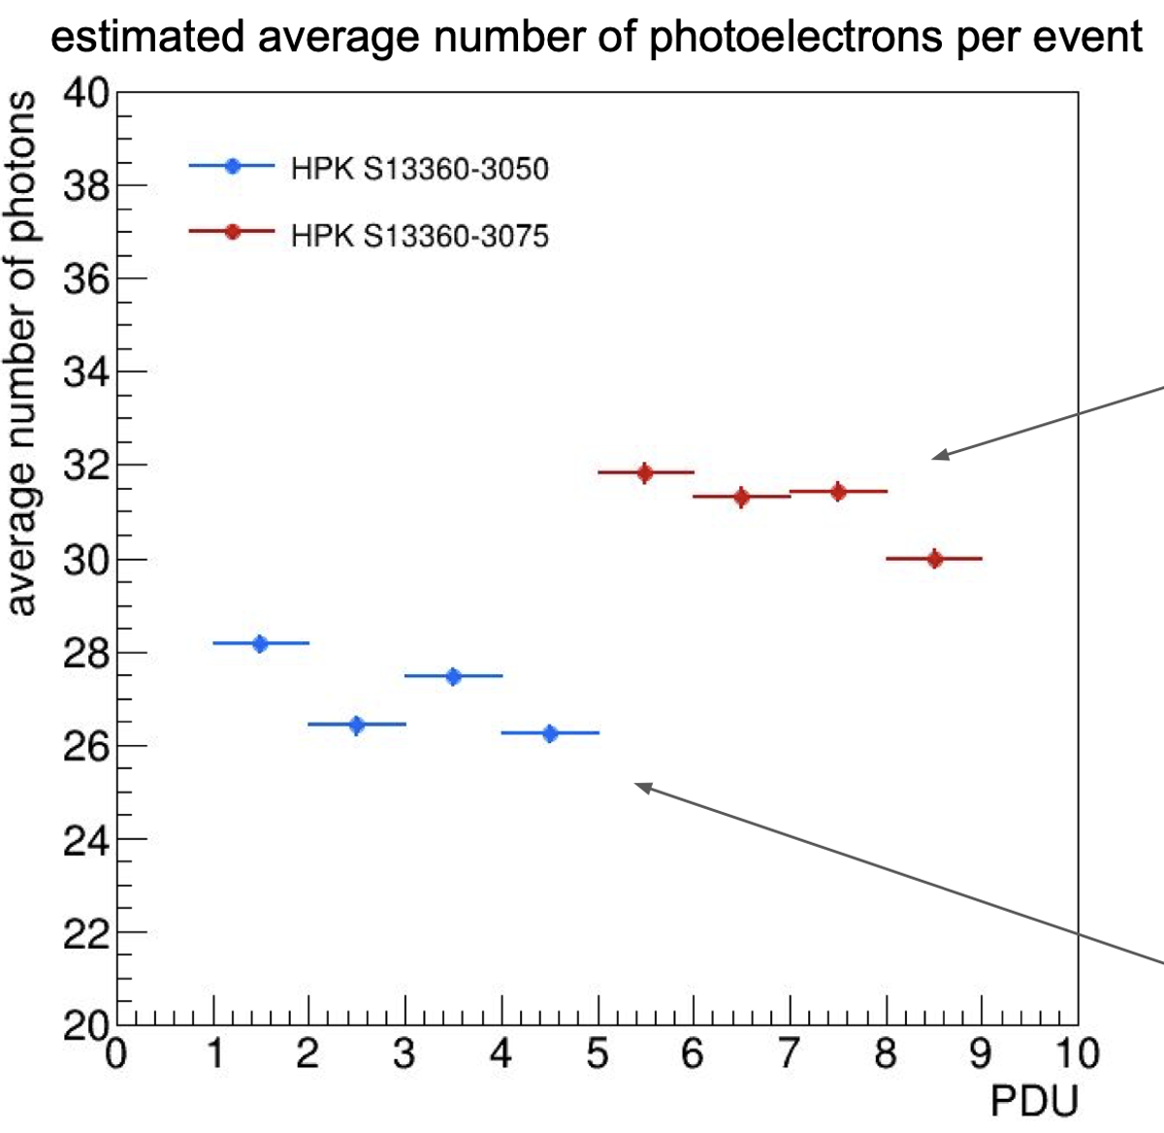
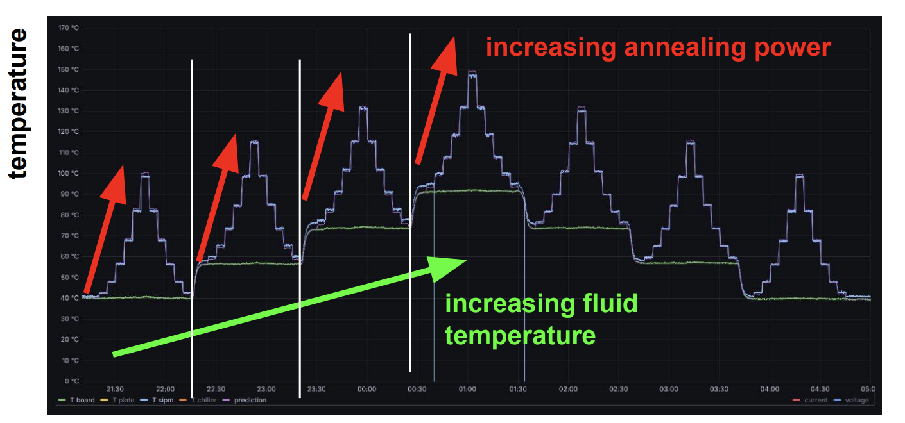
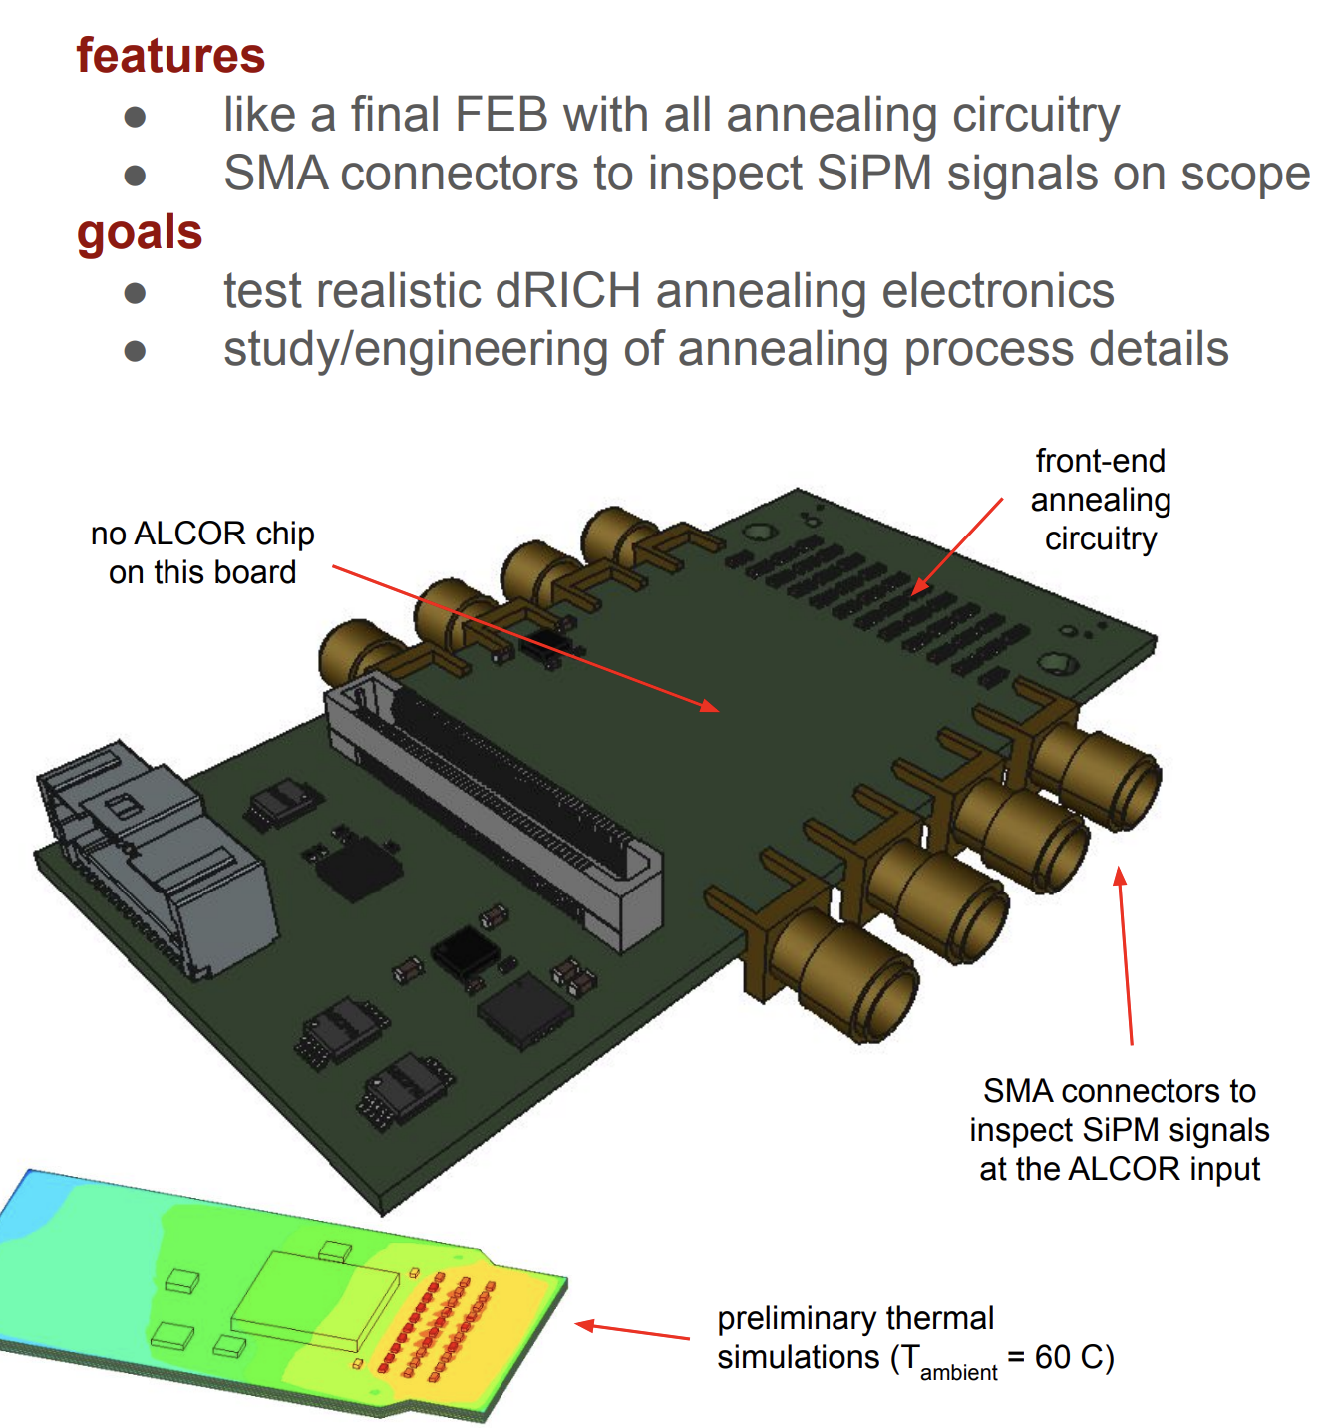
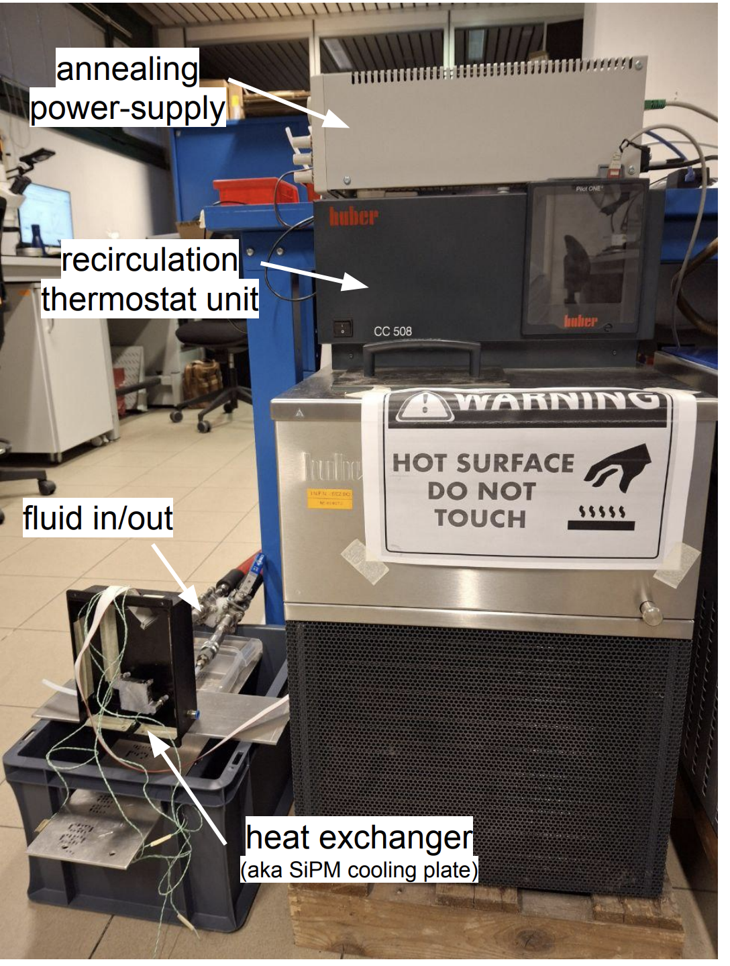
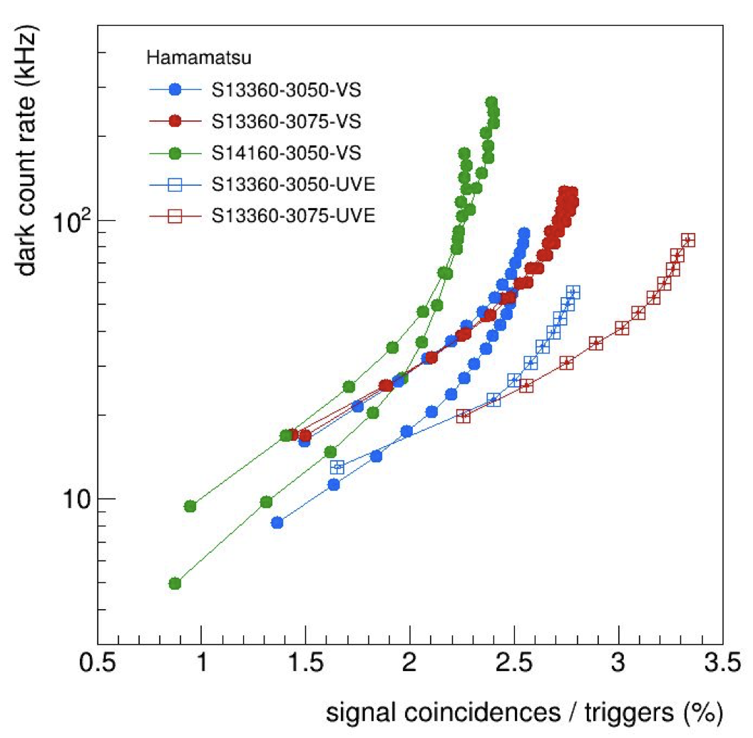
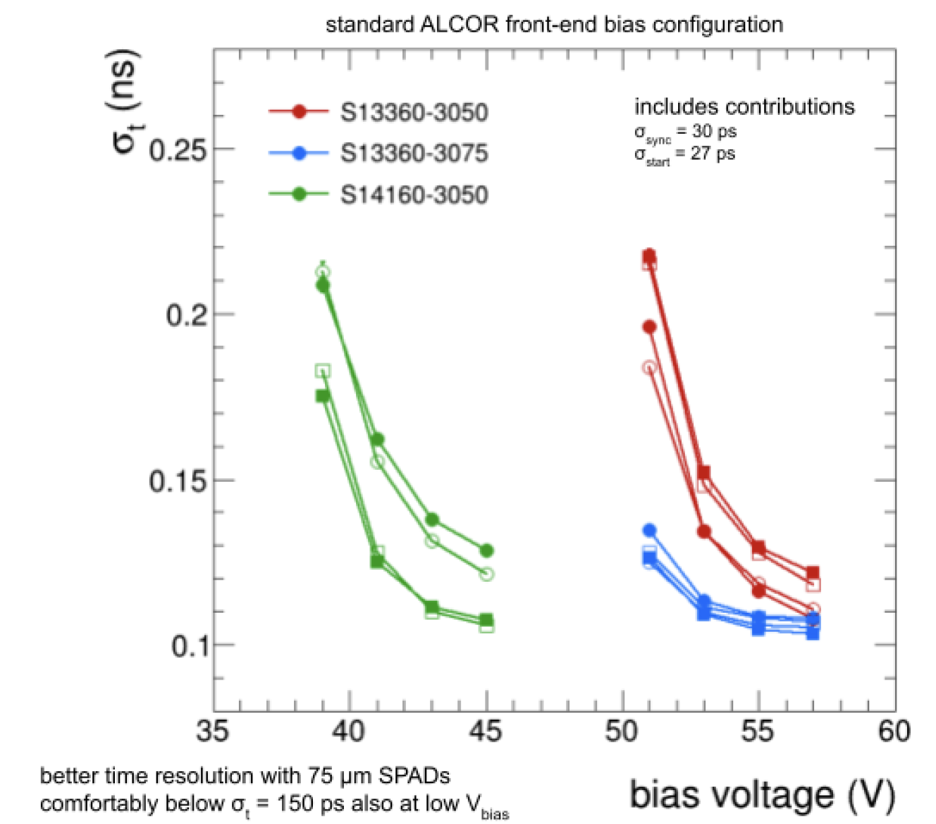
dRICH Photo Sensor Engineering
FInalization of the engineering of the SiPM optimized layout and temperature treatments ongoing
Photon yield
Details of in-situ annealing protocol based on Joule-effect
75 μm
50 μm
Testing new Hamamatsu sensors after
- 10⁹ neq
- oven annealing
Time resolution with ALCOR redout
UV enhanced
3
Notes:
Come si arriva ai 1.8 Tbps ? 3 KHz / 3(shutter) * 3e5 (canali) *64

Slide 4
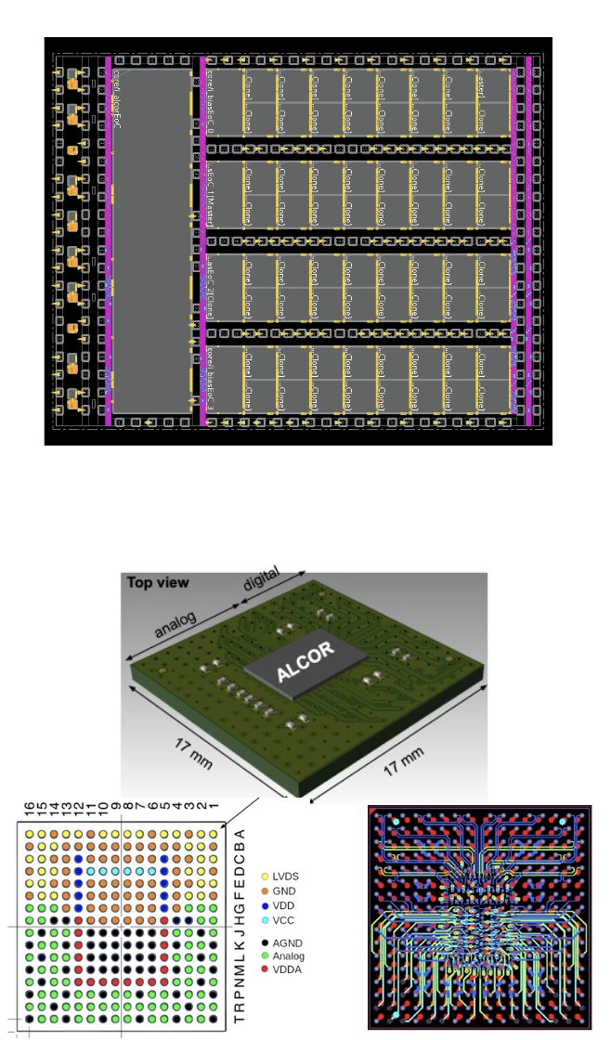
dRICH Readout Electronic
Design of the readout electronics in the “final” ePIC layout version is ready for test production.
Proton irradiation campaigns for ALCOR-32 and key RDO components showed SEU rate is within the expected manageable levels
A working DAQ scheme has been identified to support ML online data filtering at sub-detector level against pure dark-count event
ALCOR v3 – 64 channels
MPW run in March ‘25
Carrier v3
Test-production started ‘Jan 25
Front-End Board (FEB)
Silicon die layout
Readout Board (RDO)
Delivery imminent
Compact ball-grid array (BGA) package with interposer
4
Notes:
N ties smaller than ePIC!

Slide 5
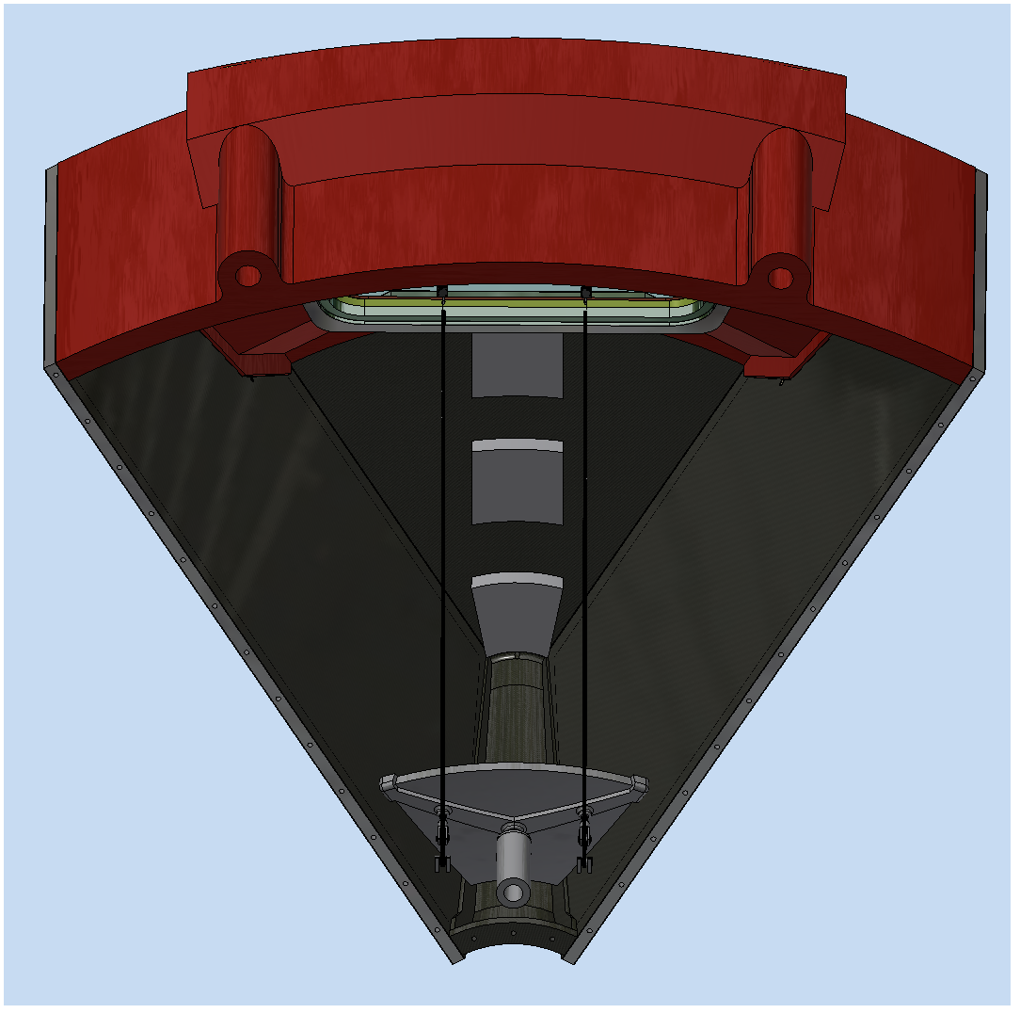
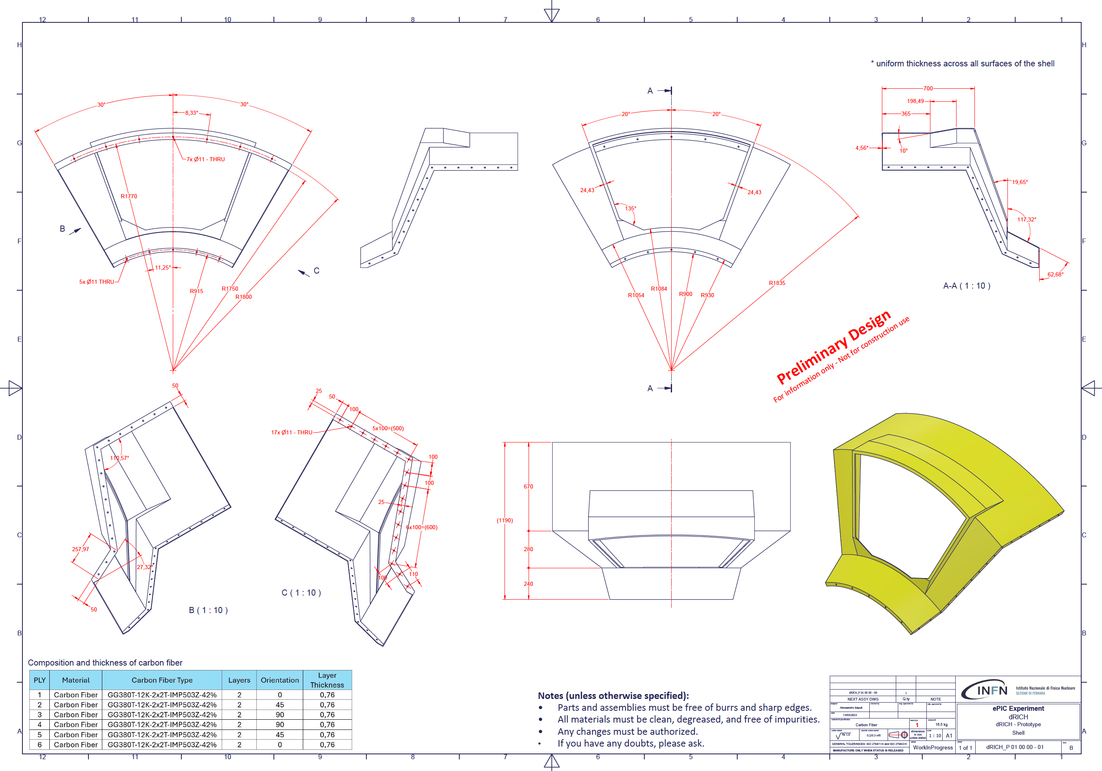
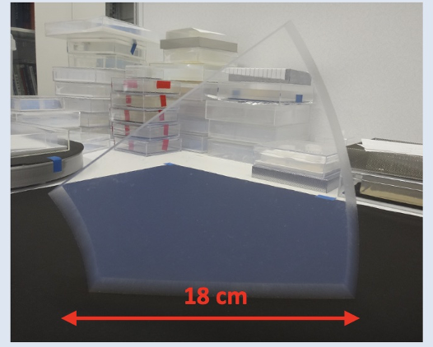
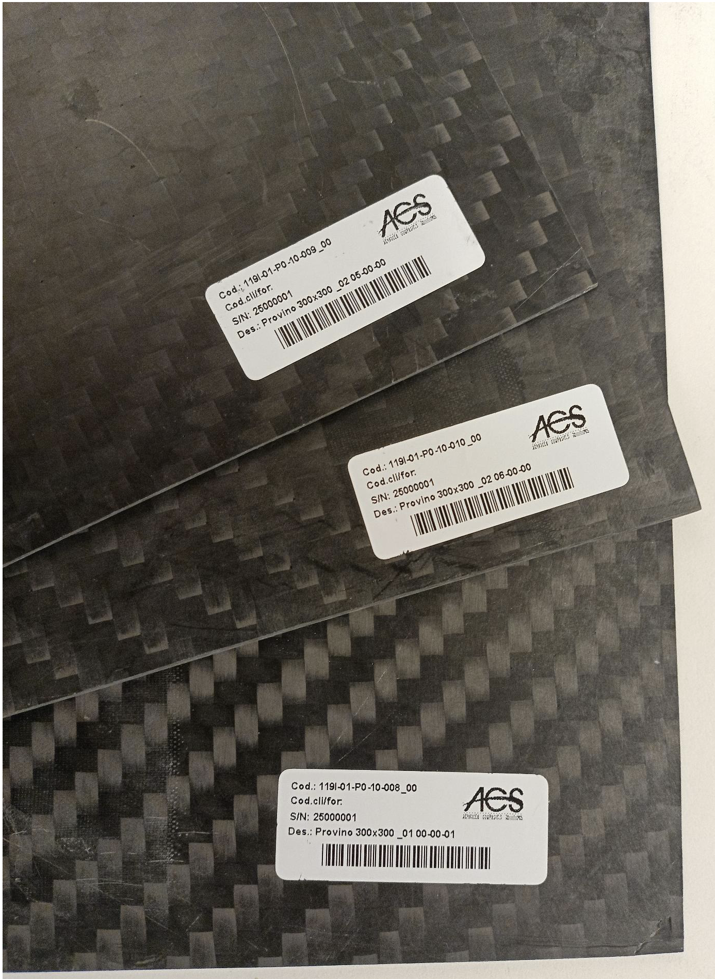
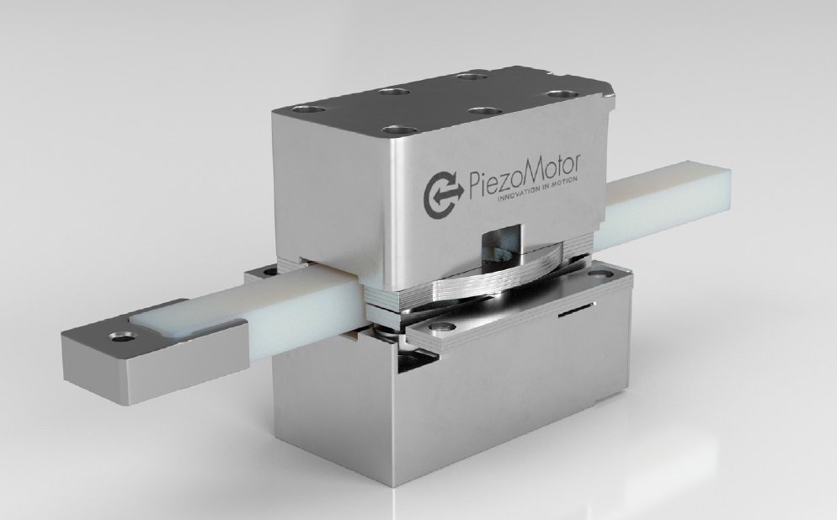
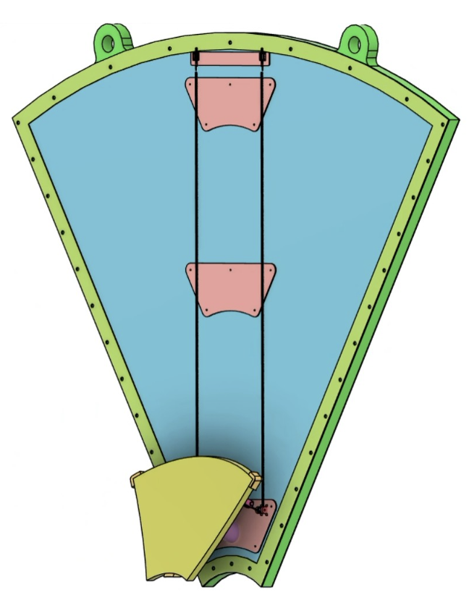
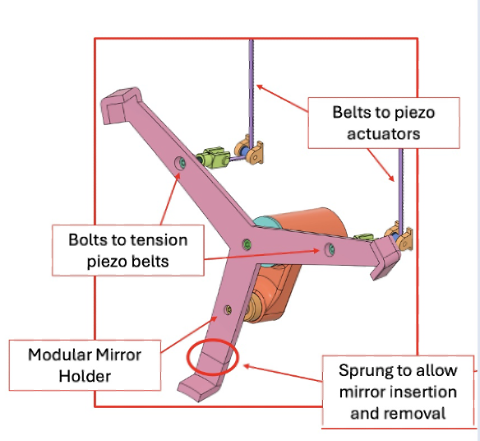
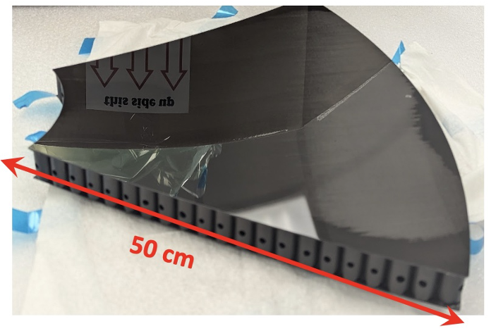
Real Scale Prototype
Engineering of all the mechanical details pursued with the real-scale prototype and component demonstrators
Aerogel support
Mirror mounting and alignment (aka NA62)
Vessel
PO issued
CFRP Layer
composition
5

Slide 6
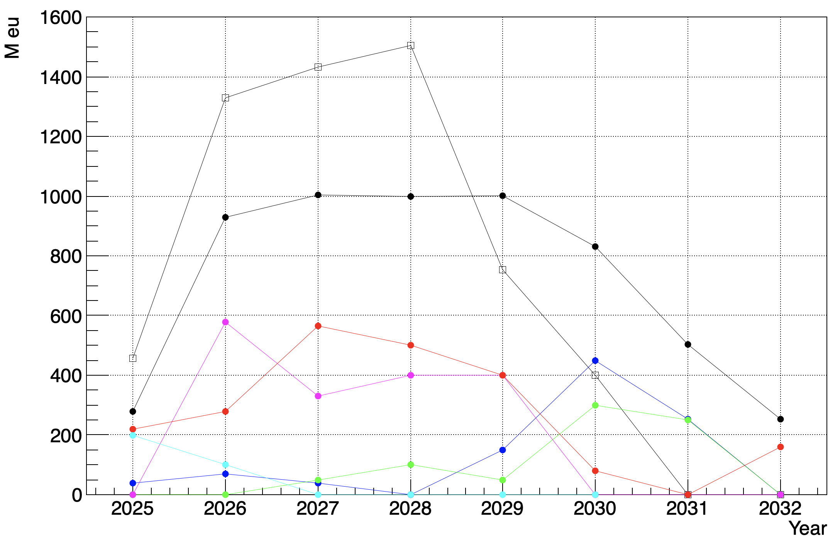
INFN Funding Profile
60% Preliminary Design Review passed. A construction and QA plan is outlined accounting for lead, assembling and commissioning time
Assumptions: - Installation in 2032
- possibility to split the major procurements in batches/years
Potential risk: - sub-optimal spreading of vendor effort for SiPM
- late investment on aerogel
Peak investment being mitigated with respect 2024 anticipation
2024
Sensors
Electronics
Radiators
Mechanics
R&D
6

Slide 7
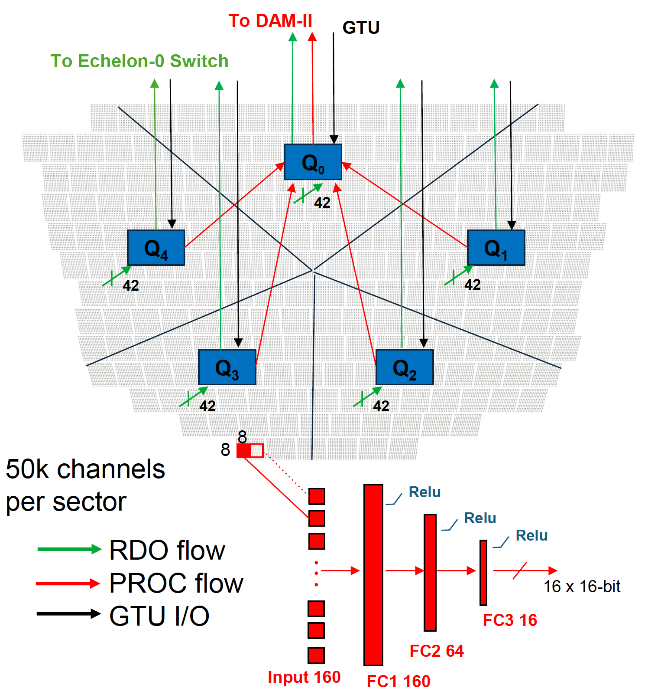
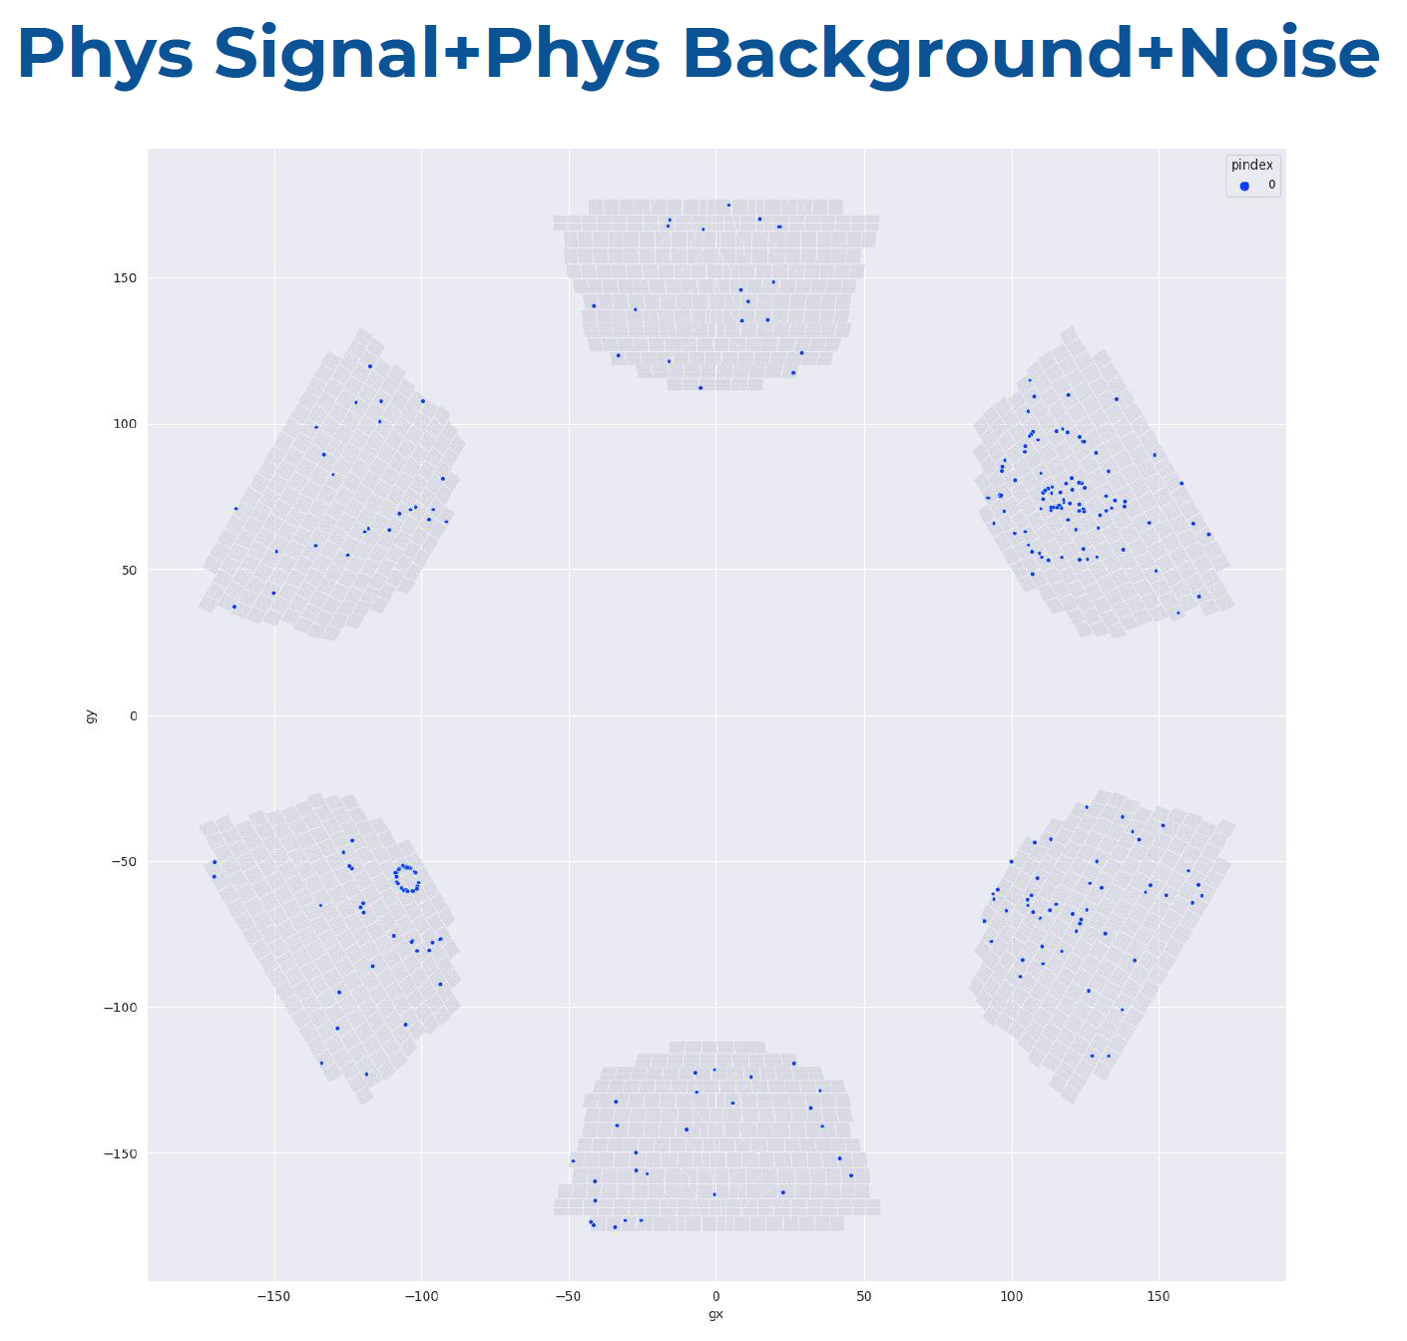
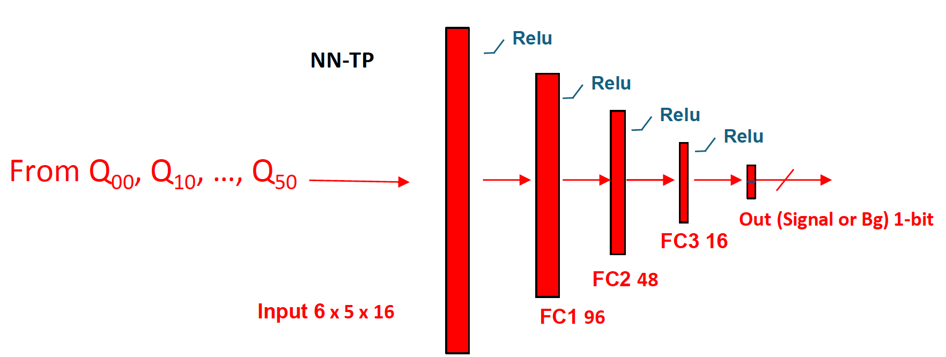
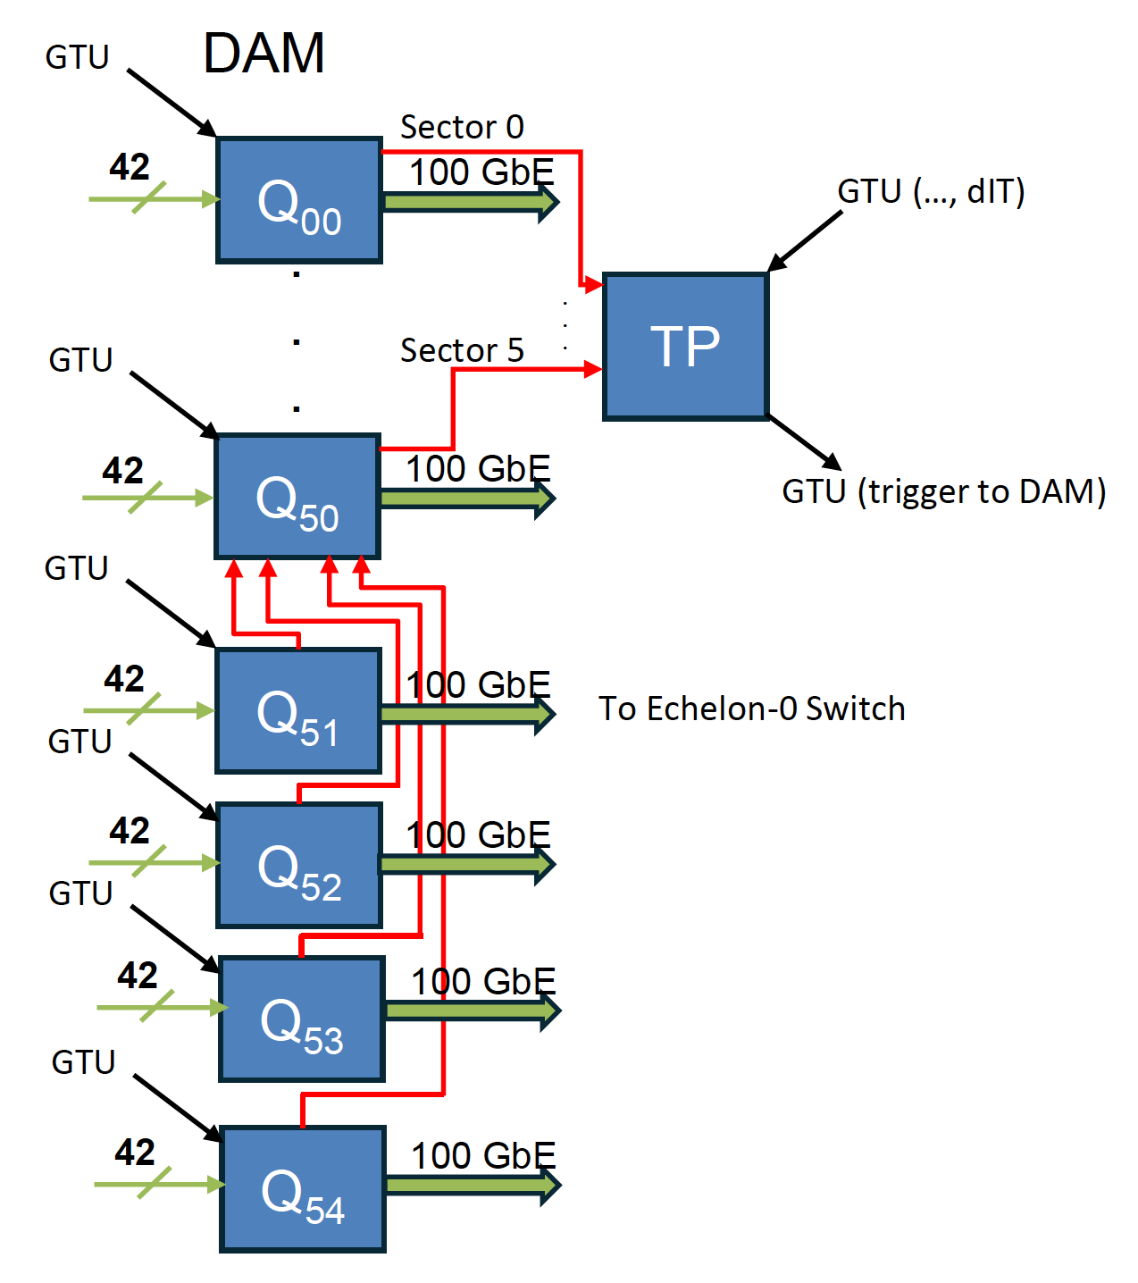
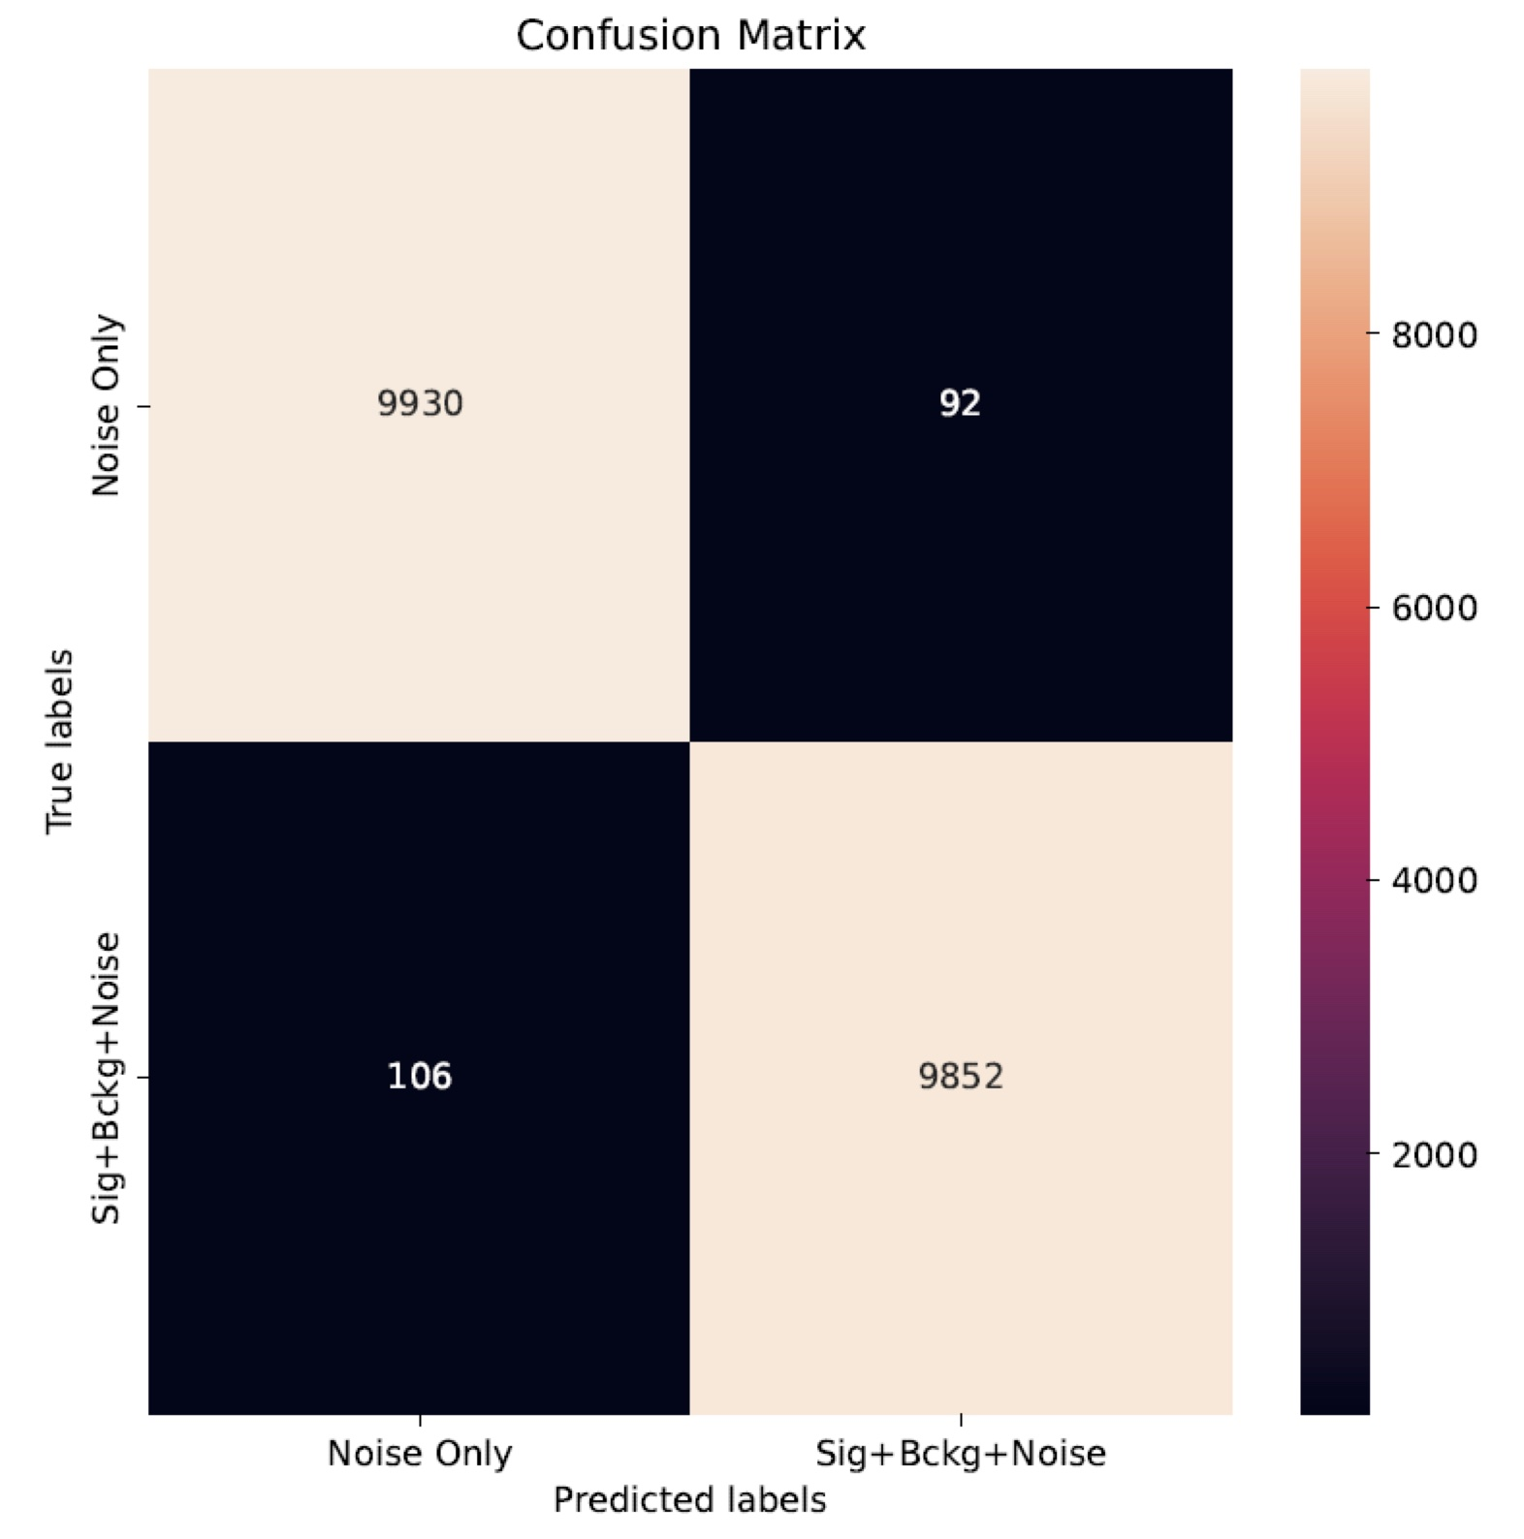
dRICH Online Filtering
A working DAQ scheme has been identified to support ML online data filtering at sub-detector level against pure dark-count event
The feasibility of a scintillating fiber layer operated as a charged particle tagger is being studied
Scheme based on ePIC DAM (Felix) &
APEIRON communication network (INFN)
sub-sector integrated analysis
detector integrated analysis
Preliminary tests
Classifier
7
Notes:
Farsi spieare la latenza. Bisogna sapere ul data rate a cui sono arrivati (factor 2?)

Slide 8
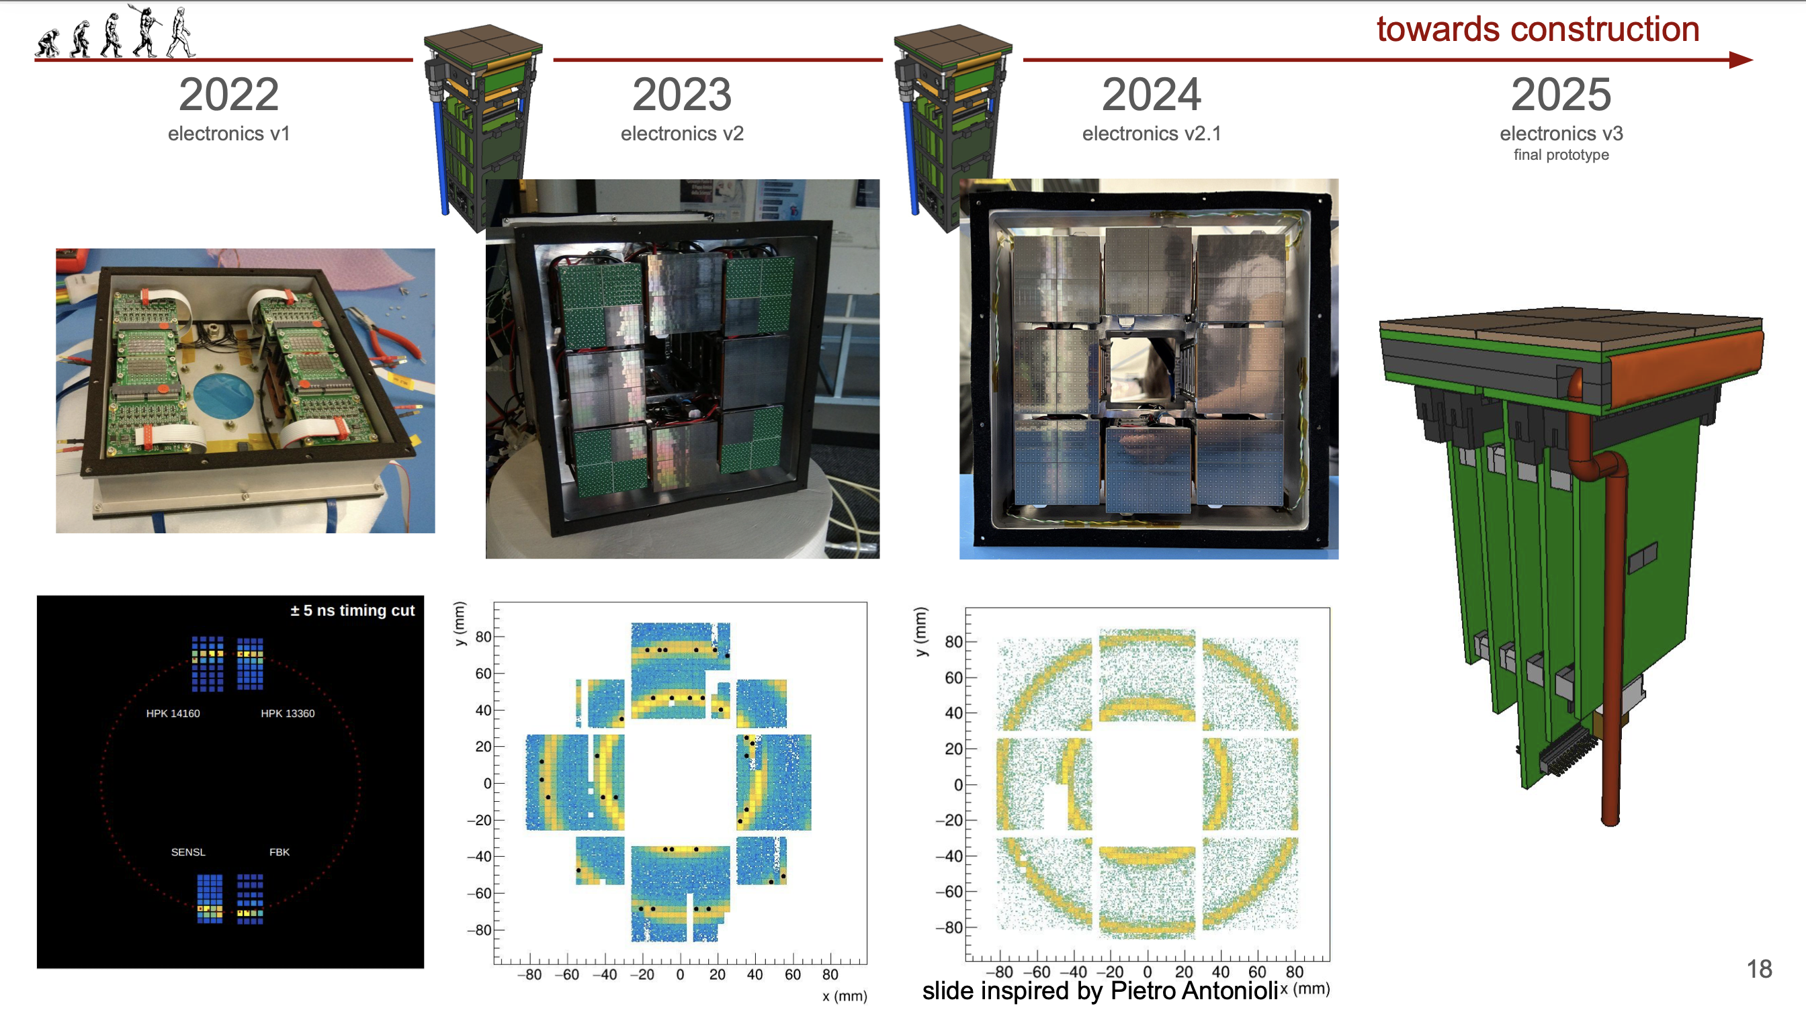
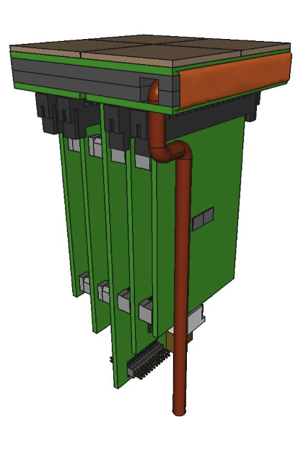
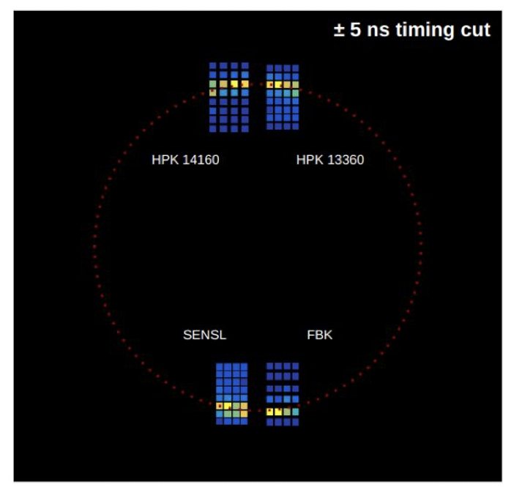
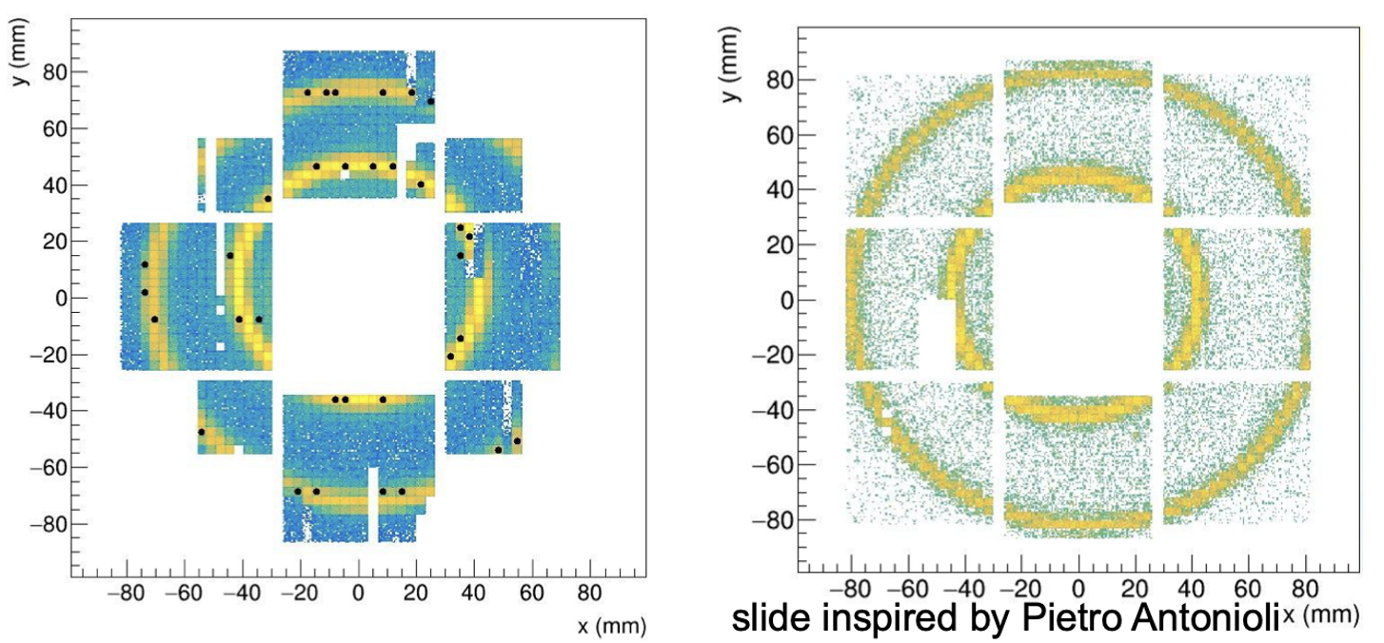
Photon Detector Unit
Steadly progress of photodetector towards integrated design completion in 2026
/26
50 μm
75 μm
ALCOR 32 ch
Full size engineering
test article
2025
+ SiPM carrierv3
+ RDO
2026
+ ALCOR 64ch
+ FEB 64
8
Notes:
Come si arriva ai 1.8 Tbps ? 3 KHz / 3(shutter) * 3e5 (canali) *64

Slide 9
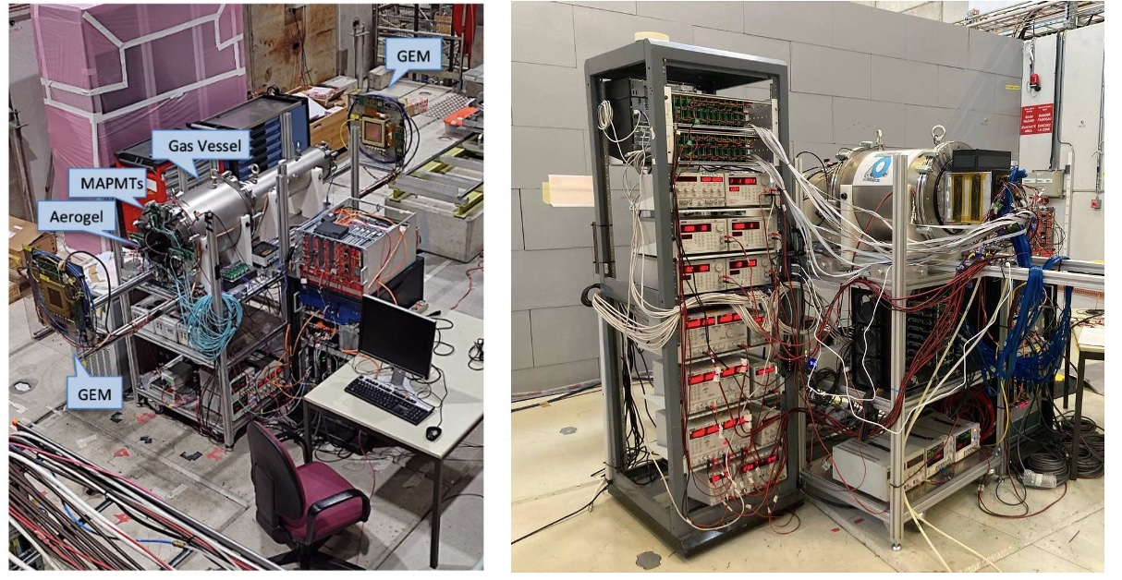
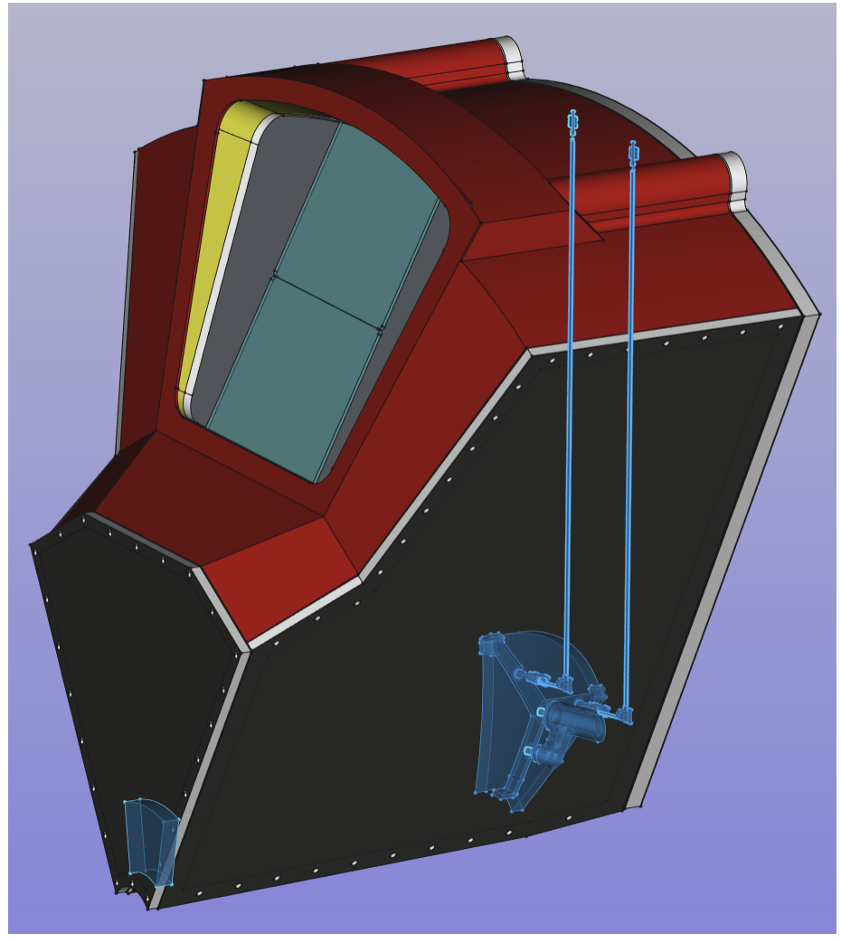
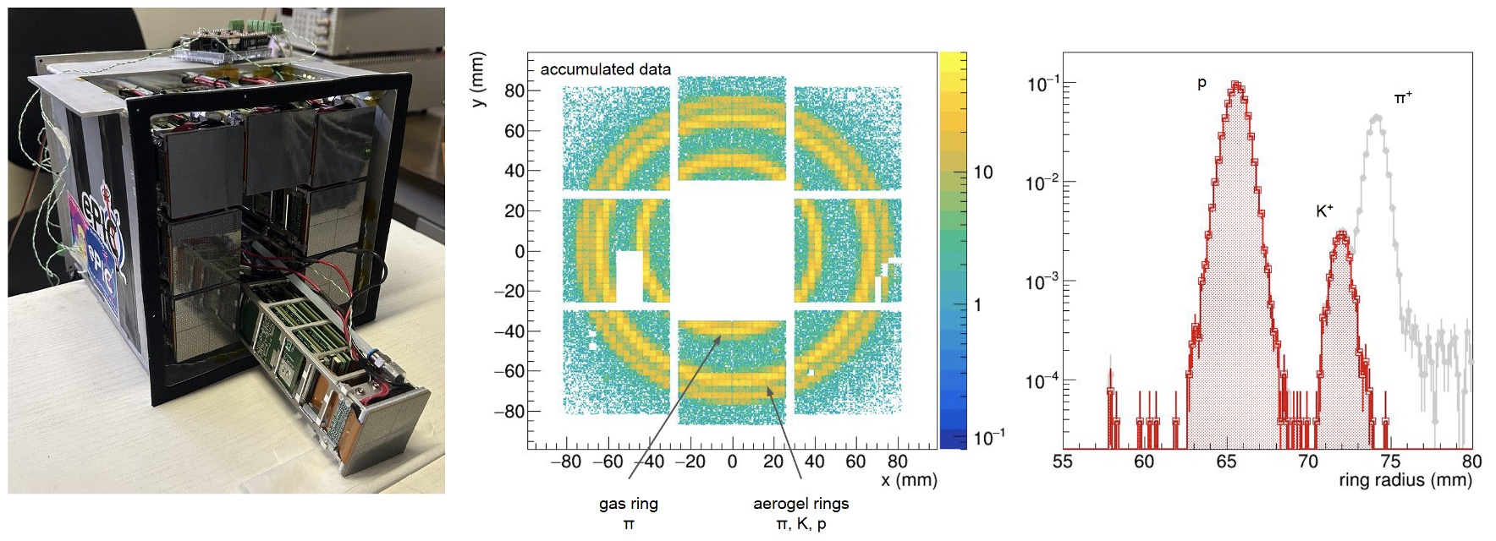
Test Beams
Previous validations:
Dual-radiator concept
C₂F₆ radiator gas performance
Aerogel rafractive index
SiPM-ALCOR readout chain
EIC-drive readout plane
Temperature gradients
2025
2025 main goals:
Real scale 1-sector prototype
with demo components
ALCOR readout with RDO
Slot at SPS H8 in November
9

