Slide 1
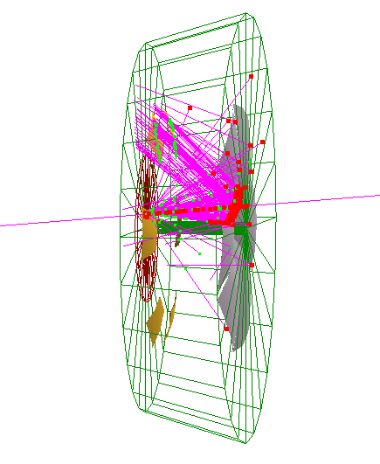
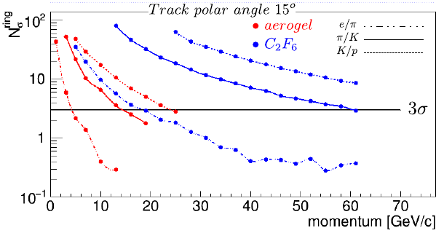
EIC Dual-Radiator RICH
Geant4 (GEMC) simulation
Contribution of INFN-Roma to eRD14 - PID
(background: HERMES and CLAS12 RICH)
Feasibility study:
4 cm aerogel (n=1.02) & 160 cm C₂F₆ (or CF₄) gas
Focusing mirror configuration
(focal­plane away from the beam,
reduced area and background)
- RICH is in magnetic field (3T in the simulation)
Discrimination power for particle types
mirror R = 2.8 m
Photo-detector: spherical shape,
8500 cm² (per sector), pixel size 3 mm
6 sectors of 60° in azimuthal angle
Reconstruction by Inverse Ray Tracing algorithm. Improved clarity
of aerogel and n = 1.02 allow pi/K separation up to 13 GeV/c at 3 sigma
1
Notes:
Pubblicazione ?

Slide 2
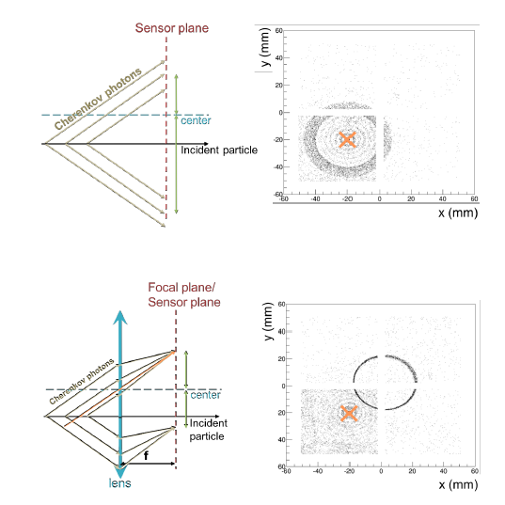
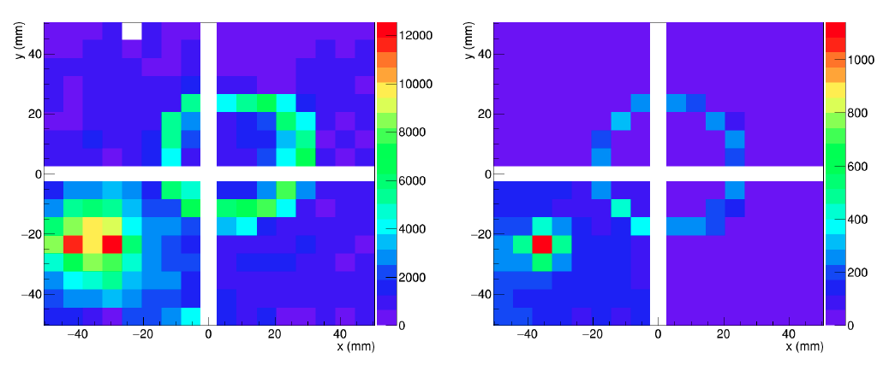
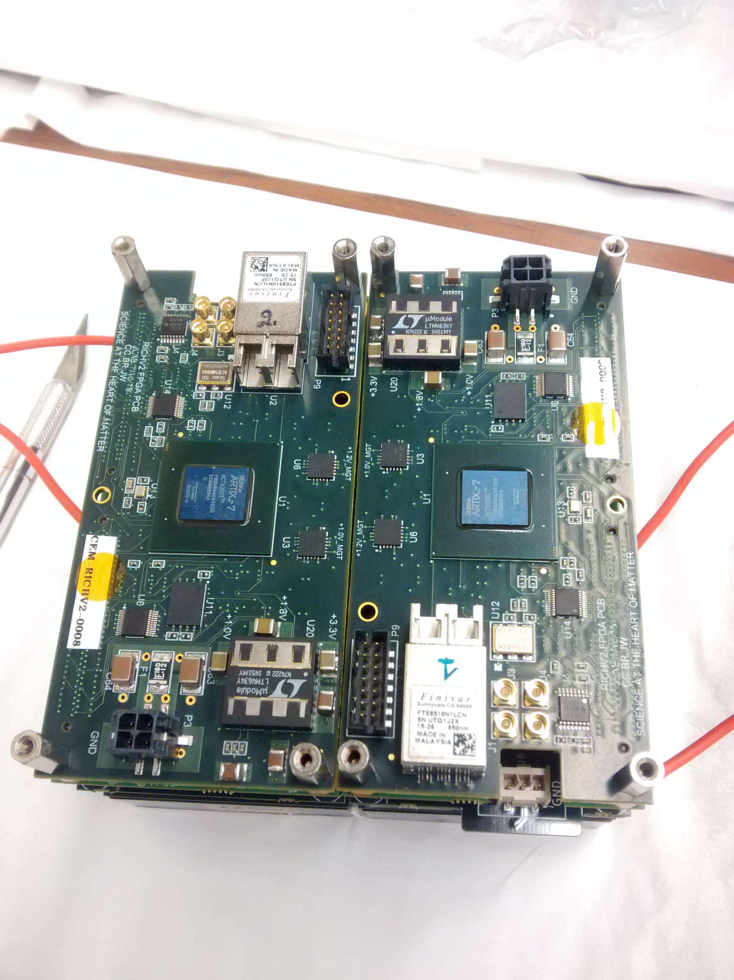
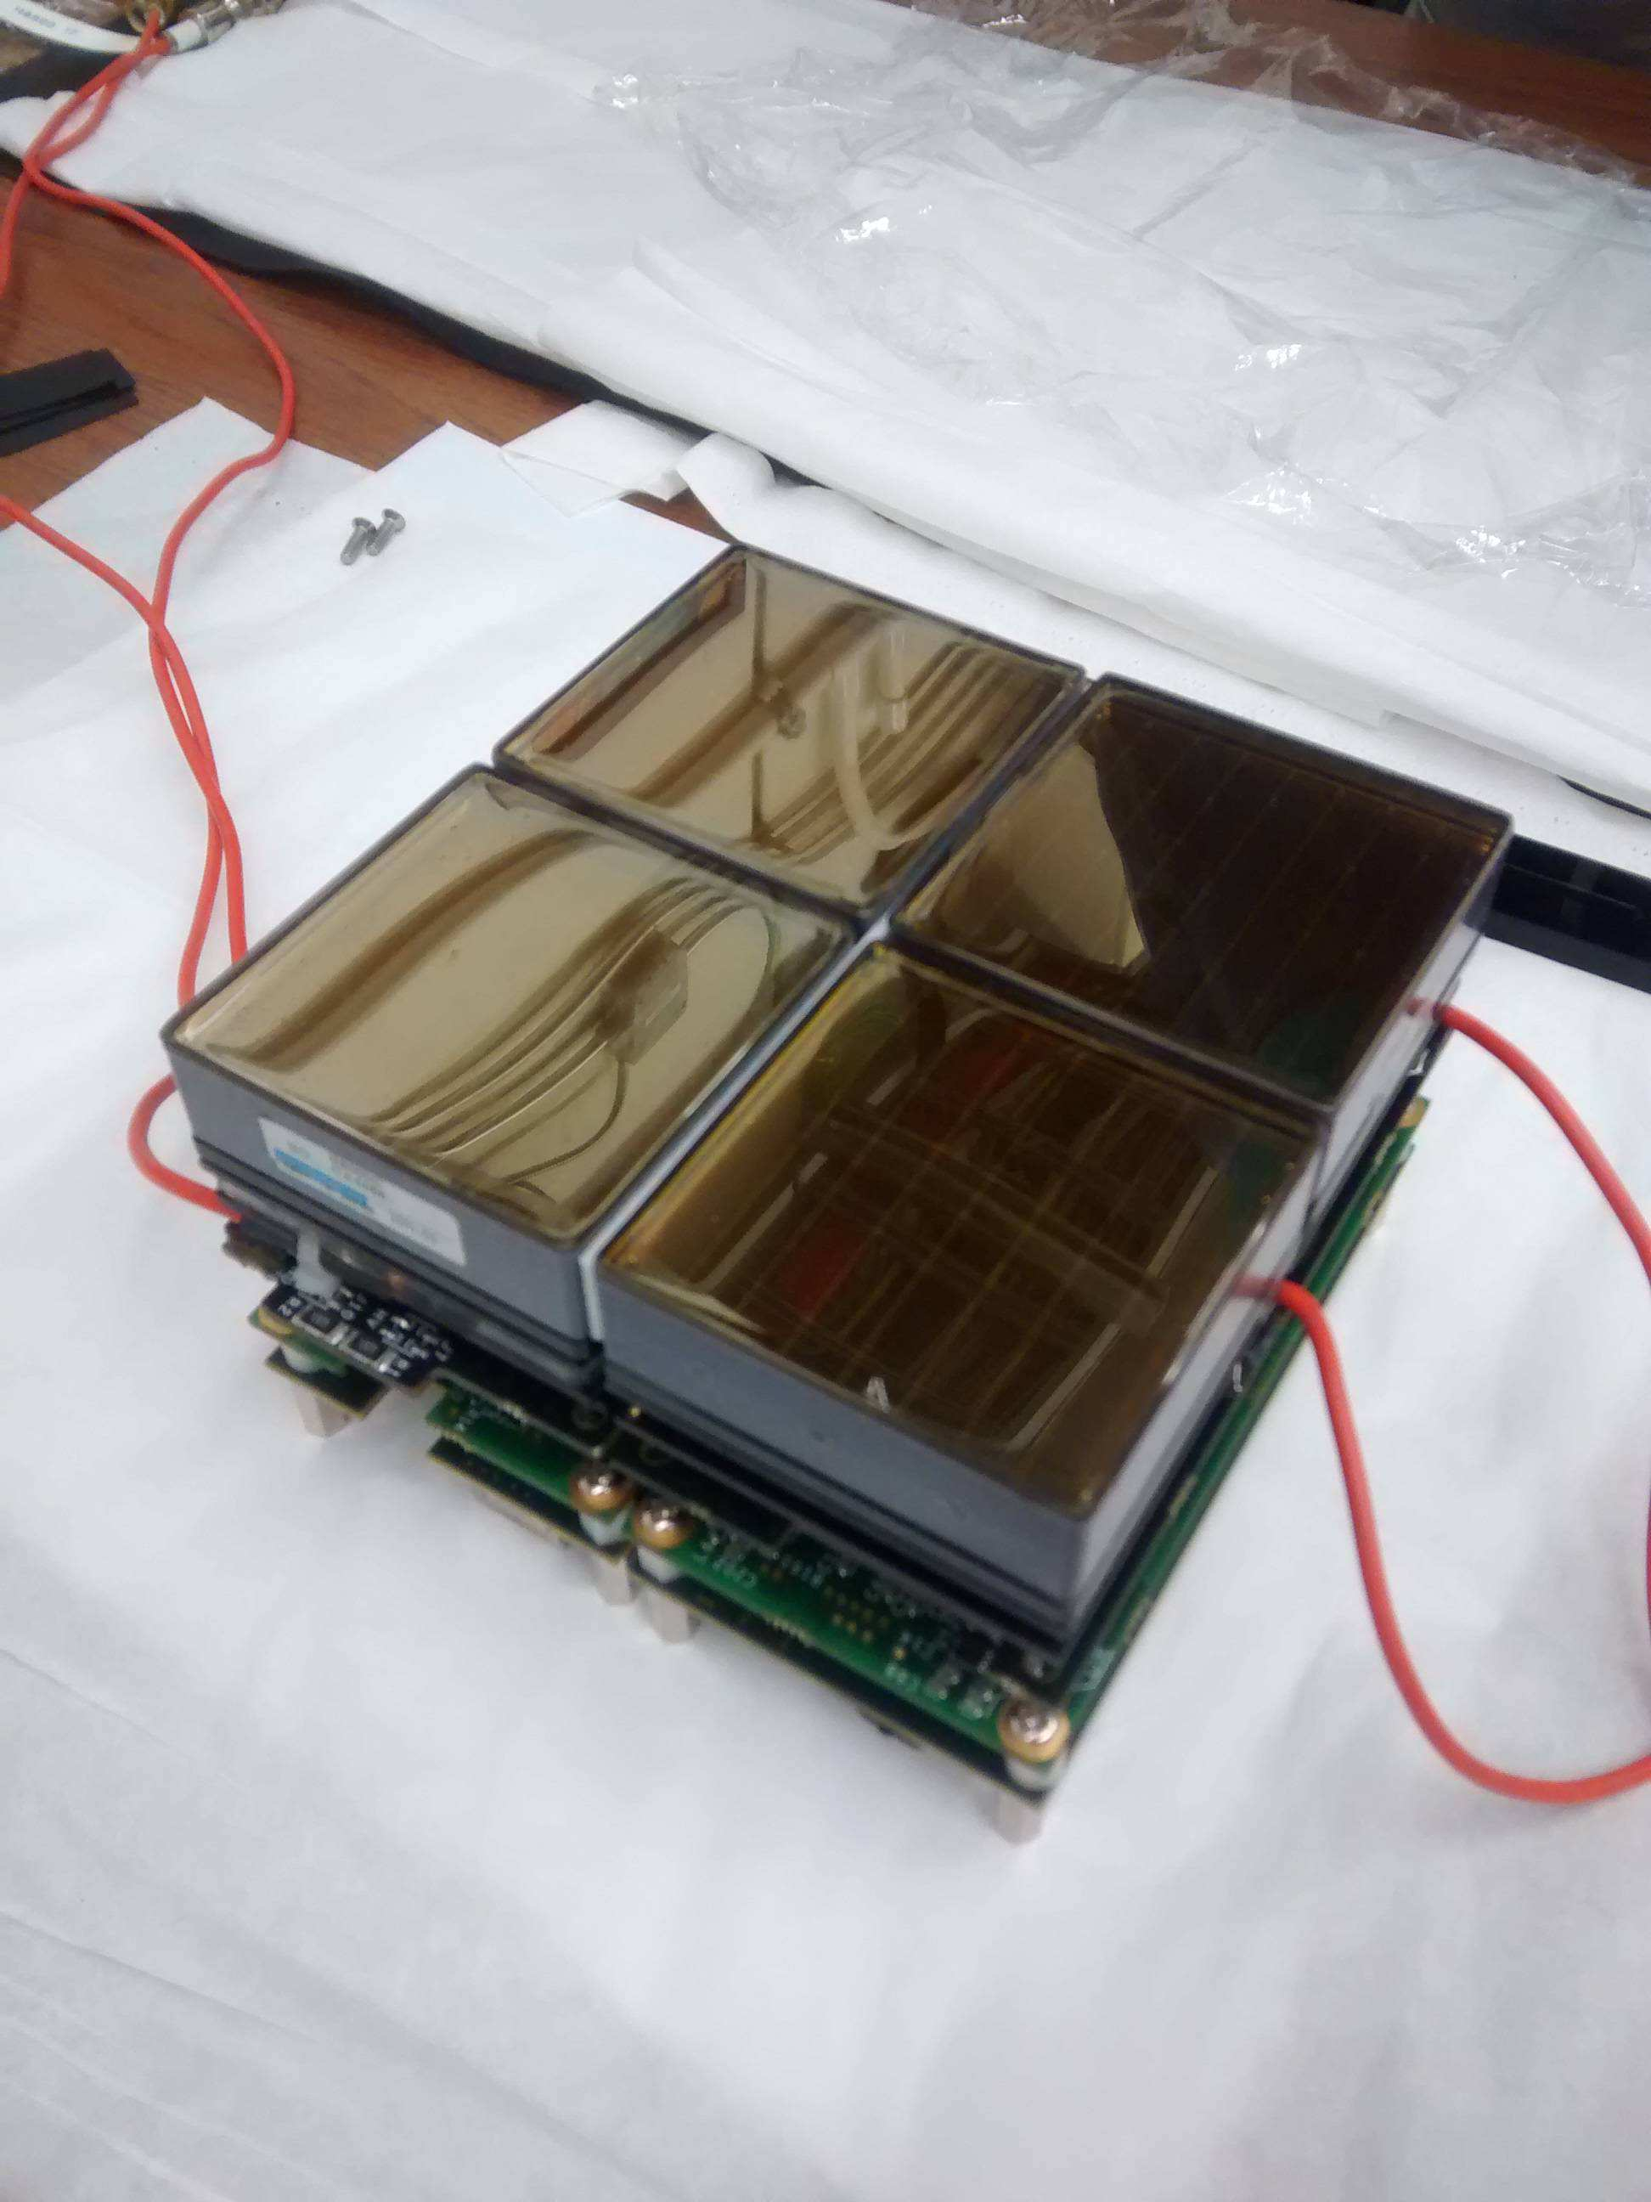
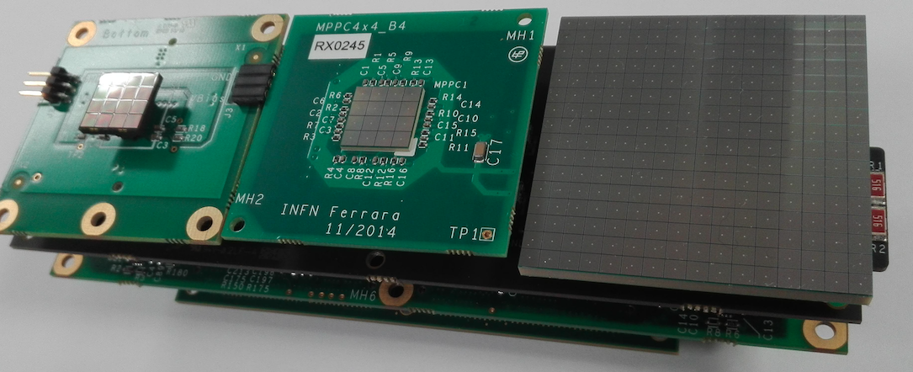
EIC Modular RICH
Fresnel lens focalization concept for
a compact (short gap) device
Contribution of INFN-FE to eRD14 - PID
(background: CLAS12 RICH)
Test beam of small EIC mRICH prototype Fermilab – April 16
DATA
MC
Impinging
particles
Working on aerogel radiator, photo-sensors, readout electronics
2

Slide 3
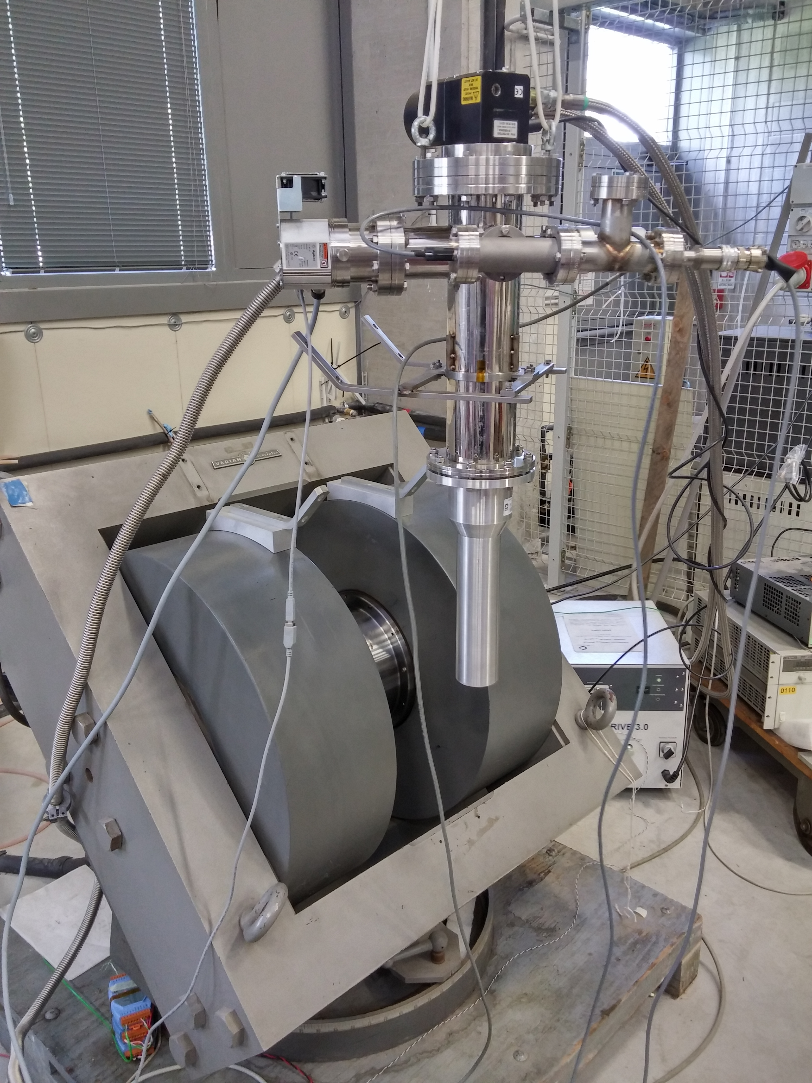
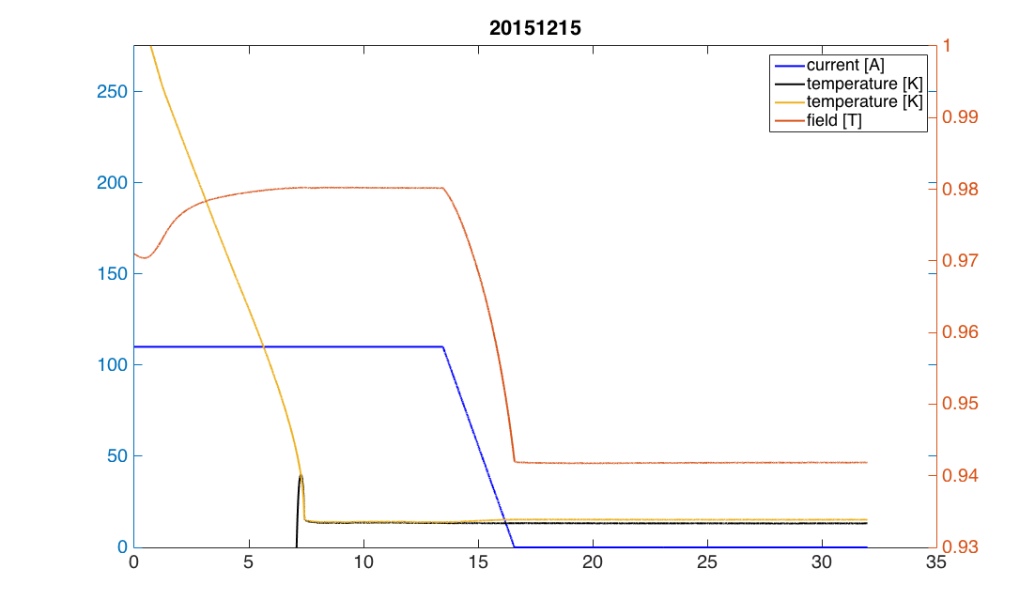
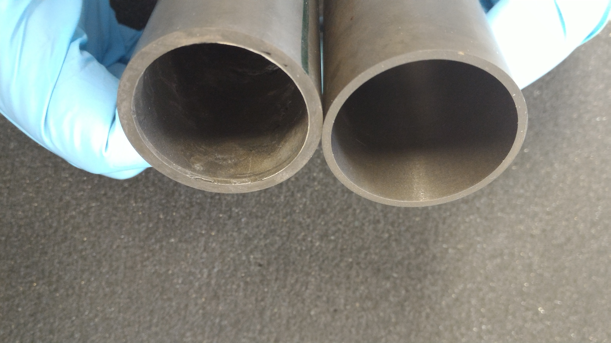
Magnet Field Cloaking Devices
MgB₂ bulk magnets
Development at INFN-FE complementary to eRD2
(background HERMES target)
[K]
[A]
T
hours
Magnetization test @ 1 T
✔ Dipole field obtained from a solenoid
✔ High efficiency
✔ Negligible degradation with time (~ month)
3
Notes:
Aggiungere range di validita’ per fattorizzazione GPDs

