Slide 1
JLab12 (R.N. & R.L.: Marco Contalbrigo)
Nucleon structure and spin physics
Transverse momentum phenomena (TMDs) & 3D imaging
GPDs & EM Form Factors of the nucleon
M. Contalbrigo elected in the Chair line of the JLab User Organization
(1900 users from US and all over the World)
M. Contalbrigo PI of the CLAS12 RICH detector
M. Contalbrigo contact person for RGH group of experiment
with transversely polarized target
L. L. Pappalardo - C.d.S. INFN Ferrara – 04/07/2024

Slide 2
Jlab12 Italia (R.N. & R.L. M. Contalbrigo)
L. L. Pappalardo - C.d.S. INFN Ferrara – 04/07/2024

Slide 3
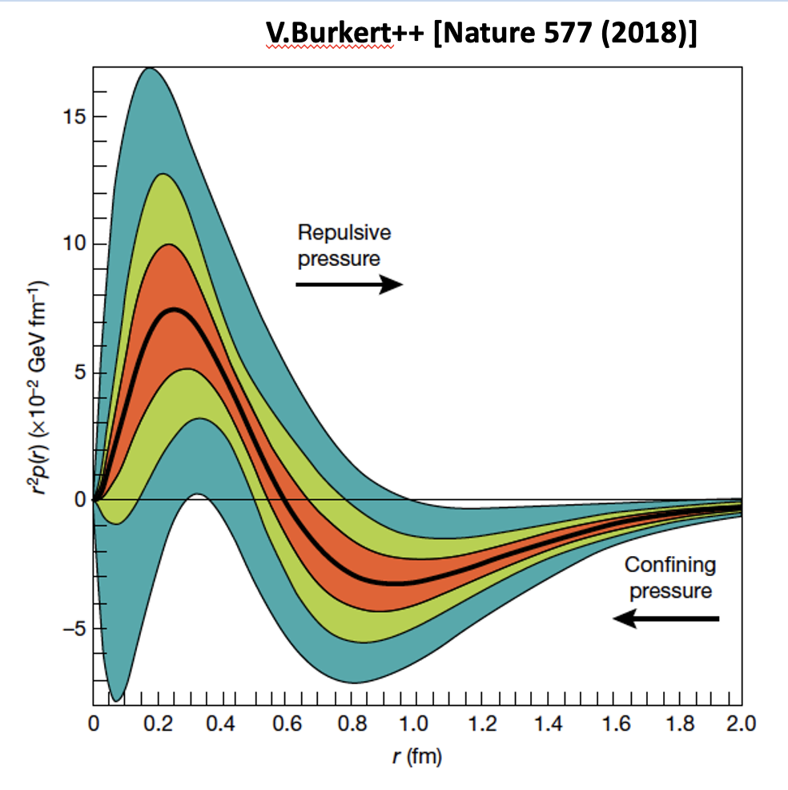
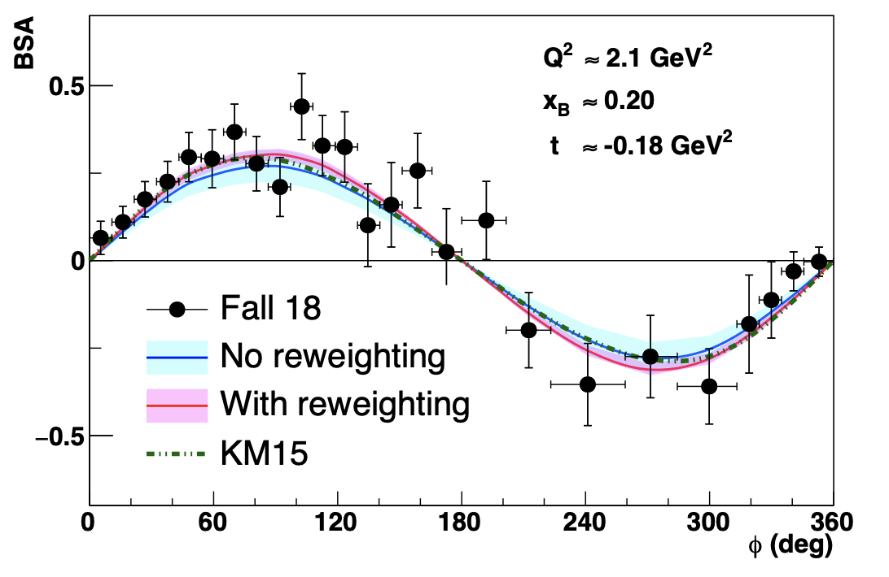
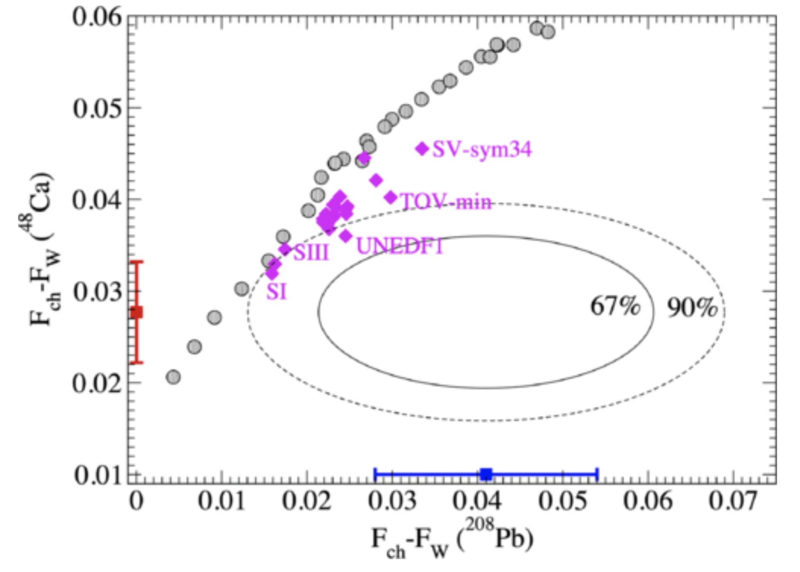
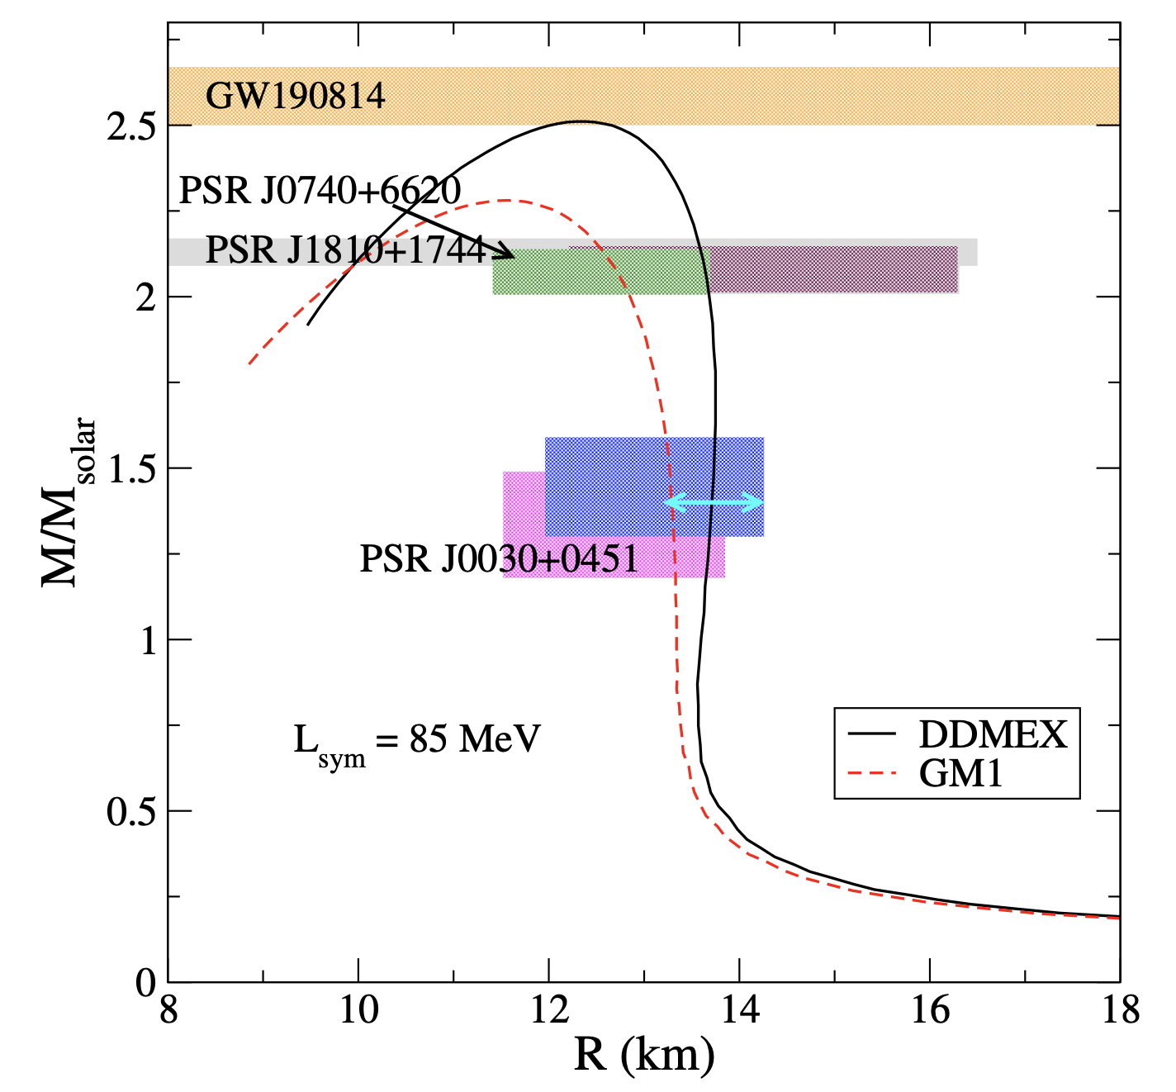
JLab Highlights
Nucleon structure and mechanical properties
First CLAS12 Measurement of DVCS Beam-Spin Asymmetries in the Extended Valence Region.
The first CLAS12 measurement of the DVCS beam-spin asymmetry off unpolarized proton targets, greatly extends the x and Q² phase space beyond the existing data in the valence region with unprecedented statistical precision.
Unprecedent access to pressure and share forces within the nucleon.
CLAS12: PRL 130 (2023) 21, 211902
Neutron rich matter equation of state
Precise determination of the neutral weak form factor of ⁴⁸Ca and ²⁰⁸Pb.
PREX and CREX have performed a precise determination of the neutron skin thickness of the ⁴⁸Ca and ²⁰⁸Pb nuclei. They provides constraints on the density dependence of the symmetry energy of neutron rich nuclear matter and thus neutron stars.
Unprecedented constraints complementary to gravitational wave interferometry.
PREX: PRL 106 (2021) 172502
CREX: PRL 129 (2022) 042501
T.Sarkar++ [PRC 108 (2003) 3]
L. L. Pappalardo - C.d.S. INFN Ferrara – 04/07/2024

Slide 4
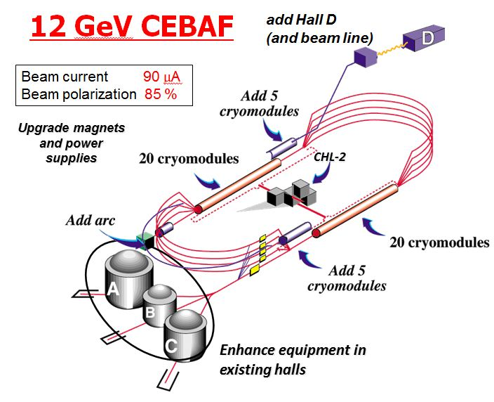
CLAS12 Experiment in Hall-B
L. L. Pappalardo - C.d.S. INFN Ferrara – 04/07/2024

Slide 5
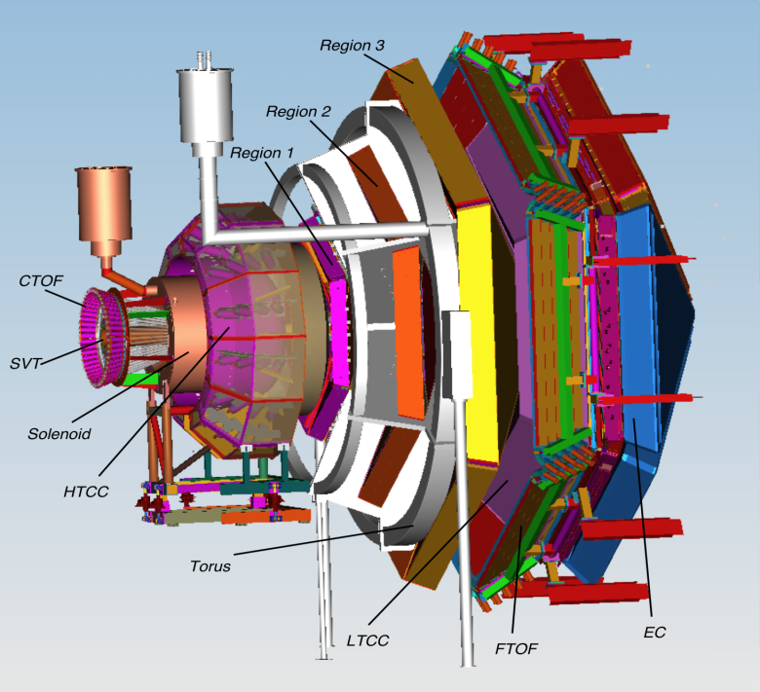
CLAS12 Experiment in Hall-B
CLAS12 detector
Lumi up to ${10}^{35} {cm}^{−2}s^{−1}$
High polarized electron beams
H and D polarized target
Broad kinematic range
Very good PID
L. L. Pappalardo - C.d.S. INFN Ferrara – 04/07/2024

Slide 6
CLAS12 Experiment in Hall-B
CLAS12 detector
Lumi up to ${10}^{35} {cm}^{−2}s^{−1}$
High polarized electron beams
H and D polarized target
Broad kinematic range
Very good PID
Physics program:
Hadron spectroscopy
Nuclear effects in hadronization
Nucleon structure (TMDs, GPDs)
L. L. Pappalardo - C.d.S. INFN Ferrara – 04/07/2024

Slide 7
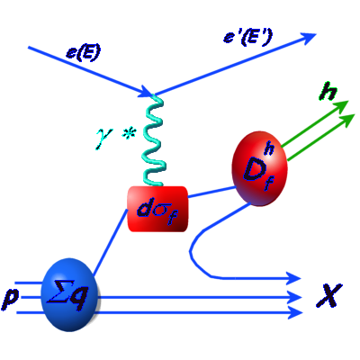
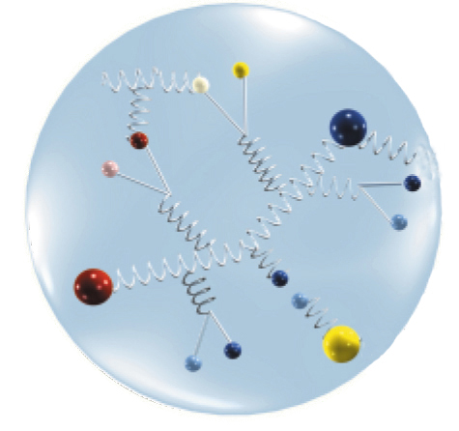
CLAS12 Experiment in Hall-B
TMDs depend on $x$ and $p_{T}$
Describe correlations between $p_{T}$ and quark or nucleon spin (spin-orbit correlations)
Provide a 3-dim picture of the nucleon in momentum space (nucleon tomography)
FF
L. L. Pappalardo - C.d.S. INFN Ferrara – 04/07/2024

Slide 8
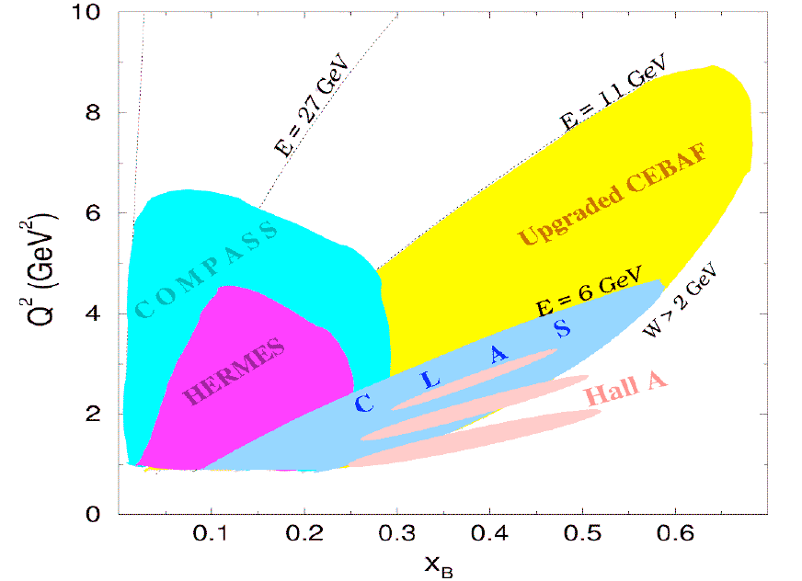
CLAS12 Experiment in Hall-B
TMDs depend on $x$ and $p_{T}$
Describe correlations between $p_{T}$ and quark or nucleon spin (spin-orbit correlations)
Provide a 3-dim picture of the nucleon in momentum space (nucleon tomography)
FF
L. L. Pappalardo - C.d.S. INFN Ferrara – 04/07/2024

Slide 9
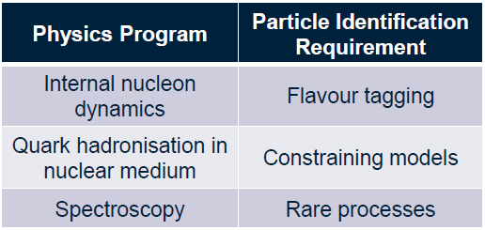
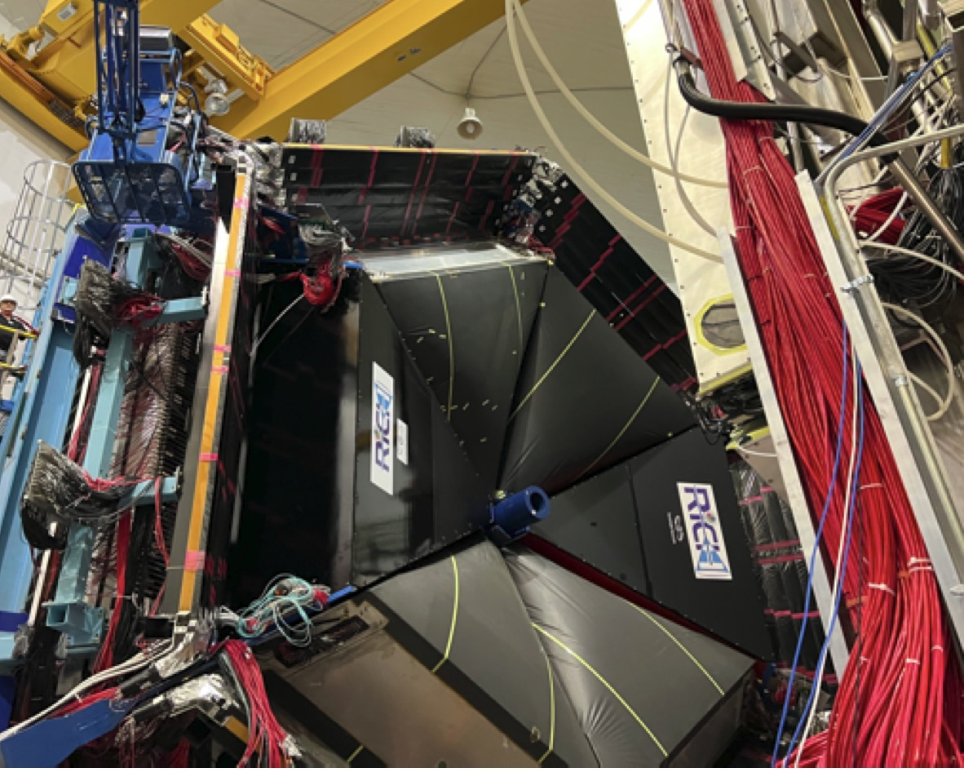
The RICH detector project (INFN)
Completed with 2nd module in June 2022
INSTITUTIONS
INFN (Italy) Bari, Ferrara, Genova, L.Frascati, Roma/ISS
Jefferson Lab (Newport News, USA)
Argonne National Lab (Argonne, USA)
Duquesne University (Pittsburgh, USA)
George Washington University (USA)
Glasgow University (Glasgow, UK)
J. Gutenberg Universitat Mainz (Mainz, Germany)
Kyungpook National University, (Daegu, Korea)
University of Connecticut (Storrs, USA)
UTFSM (Valparaiso, Chile)
L. L. Pappalardo - C.d.S. INFN Ferrara – 04/07/2024

Slide 10
The RICH Front-End electronics
Compact and modular electronics to readout multi-anode PMTs
FPGA Board (JLab)
ASIC Board (Ferrara)
Adopted by other experiments:
Gluex, SOLID, EIC R&D...
Adapted to different sensors:
Multi-anode PMT H12700, H13700
SiPM array S12642, H13361
Developed thanks to Roberto M., L. Barion
L. L. Pappalardo - C.d.S. INFN Ferrara – 04/07/2024

Slide 11
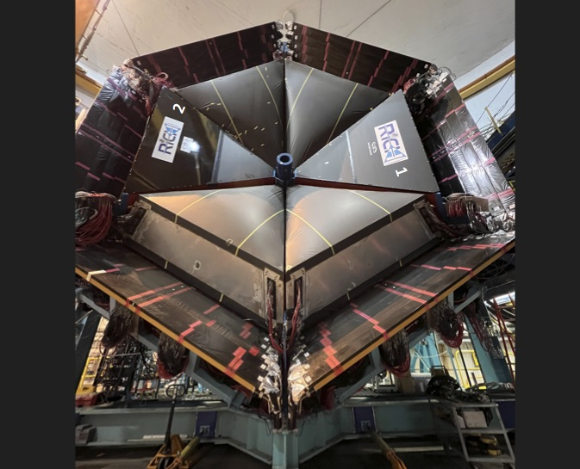
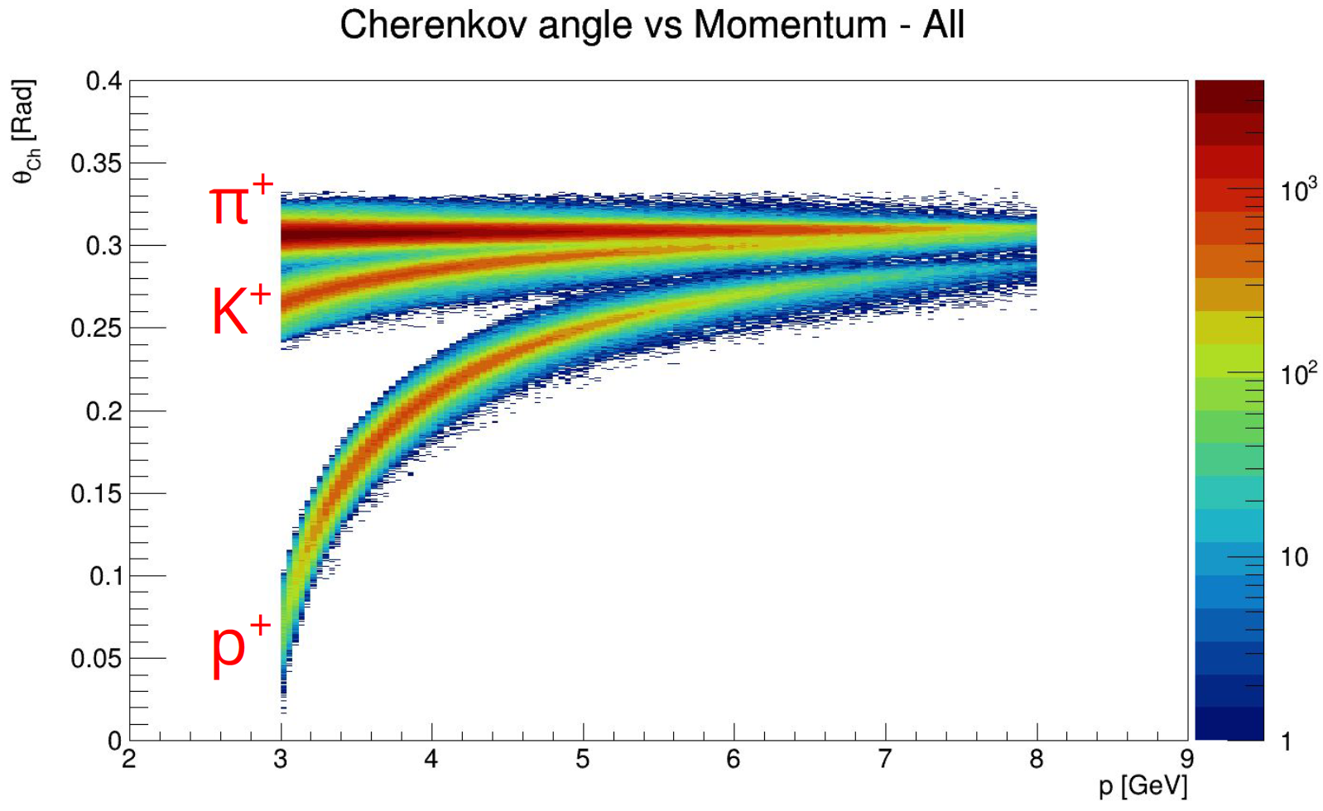
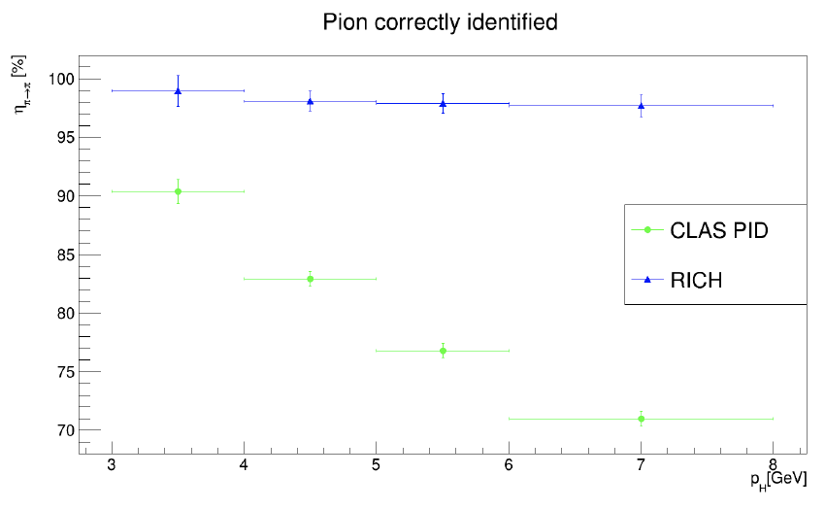
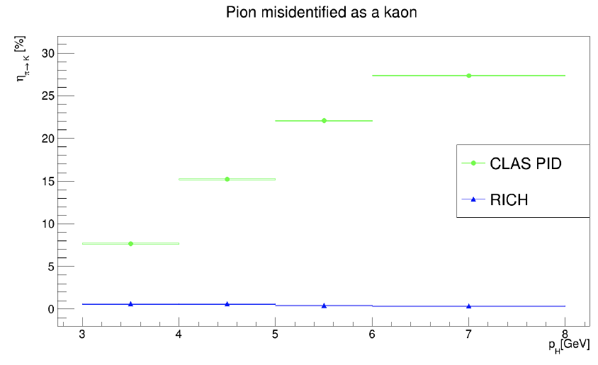
The RICH Reconstruction
S. Vallarino PhD theis
L. L. Pappalardo - C.d.S. INFN Ferrara – 05/07/2023

Slide 12
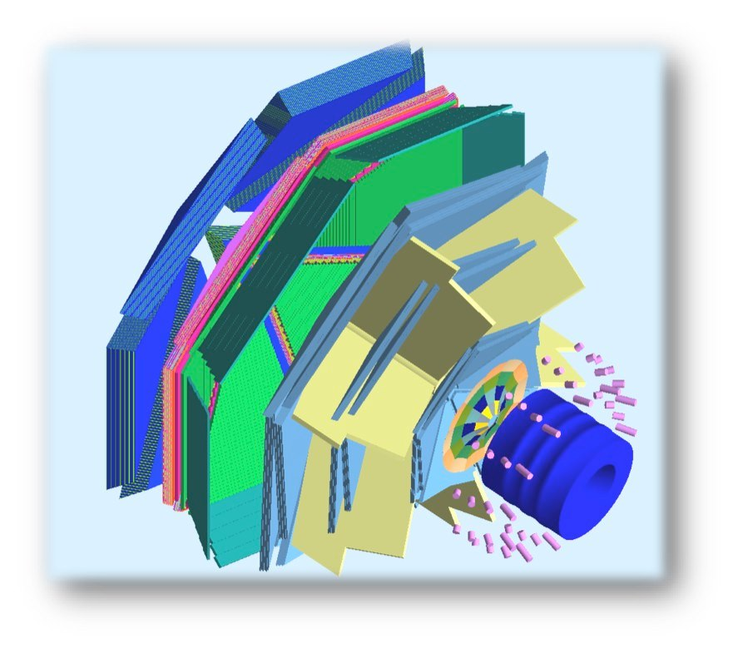
The Transverse target
Internal Target
To maintain transverse spin polarization
within the CLAS12 solenoid and preserve wide acceptance for the final-state particles, new magnetic solutions are required.
target
superconducting
solenoid
polarized
e⁻ beam
superconducting
torus
L. L. Pappalardo - C.d.S. INFN Ferrara – 05/07/2023

Slide 13
The Transverse target
Internal Target
To maintain transverse spin polarization
within the CLAS12 solenoid and preserve wide acceptance for the final-state particles, new magnetic solutions are required.
Tracking solenoid
design up to 5 T longitudinal
4K L-He cryostat
length 1500 mm
target
Transverse Target:
high polarization
d 25 mm – Length 10 mm
transverse field up to 2 T
superconducting
solenoid
polarized
e⁻ beam
superconducting
torus
L. L. Pappalardo - C.d.S. INFN Ferrara – 05/07/2023

Slide 14
Transverse target: bulk transverse magnet
Alternative to the use of a massive 5 T magnet to increase acceptance (for recoil)
A hollow bulk superconductor is able to provide a transverse holding field inside, while adjusting its internal currents to shield any outside field, without the need of a current supply!
magnetization
L. L. Pappalardo - C.d.S. INFN Ferrara – 05/07/2023

Slide 15
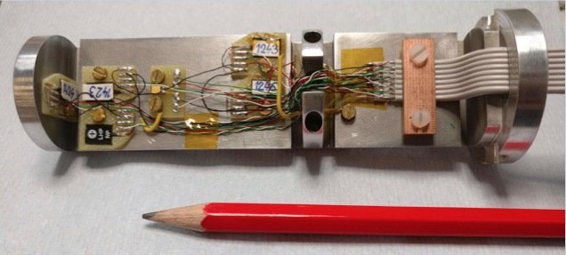
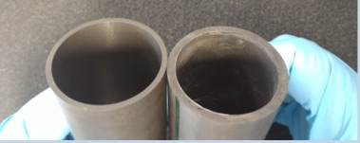
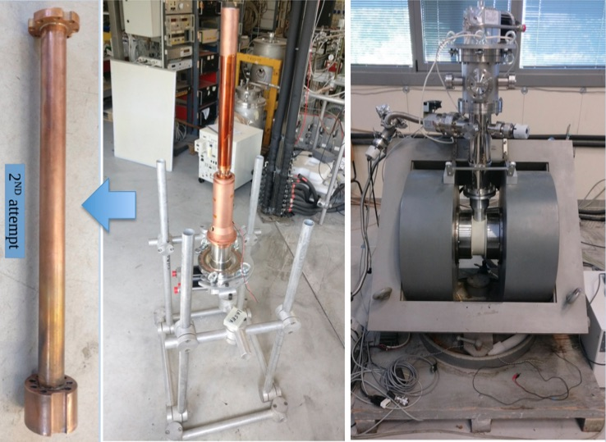
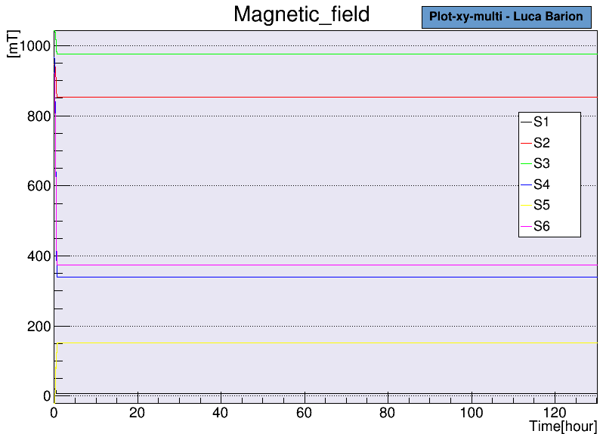
Transverse target: the new cryostat
New concept:
pre-conditioned bulk superconductor
- new cryostat
- new holder probe (6x)
- smart MgB2 sample exchange
Magnetization @ 1 T
Developed thanks to L. Barion, M. Cavallina
L. L. Pappalardo - C.d.S. INFN Ferrara – 05/07/2023

Slide 16
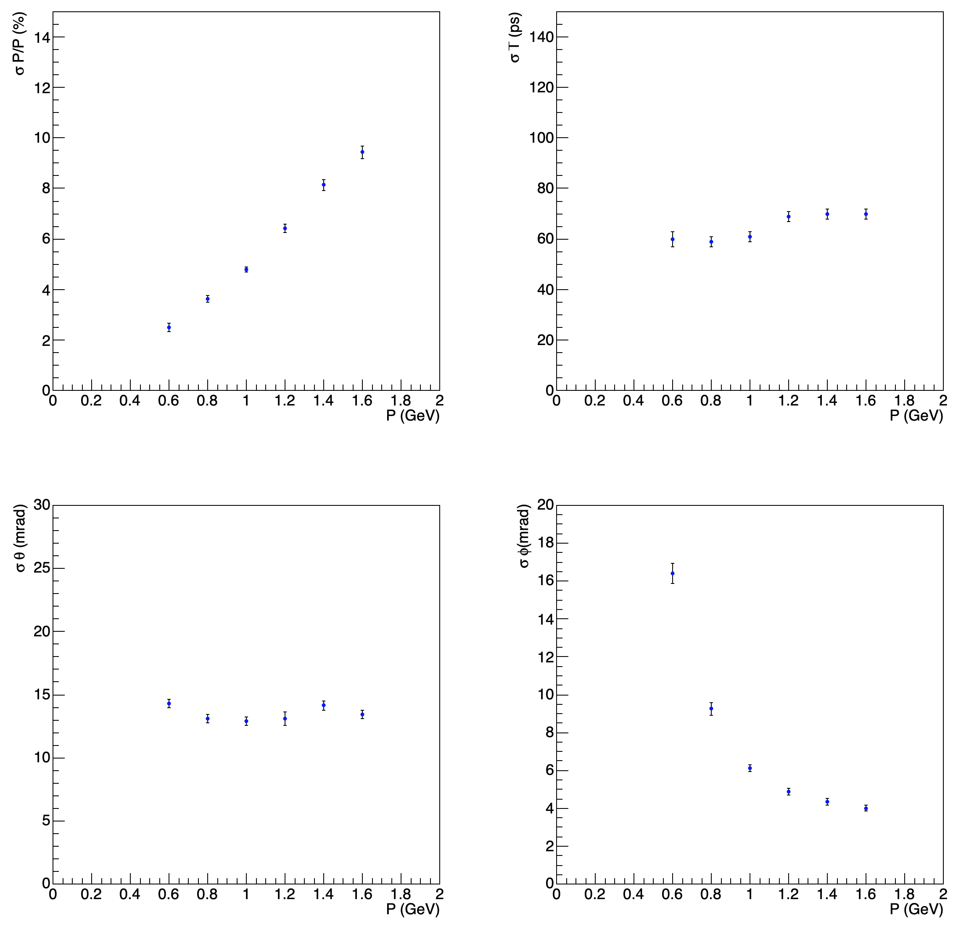
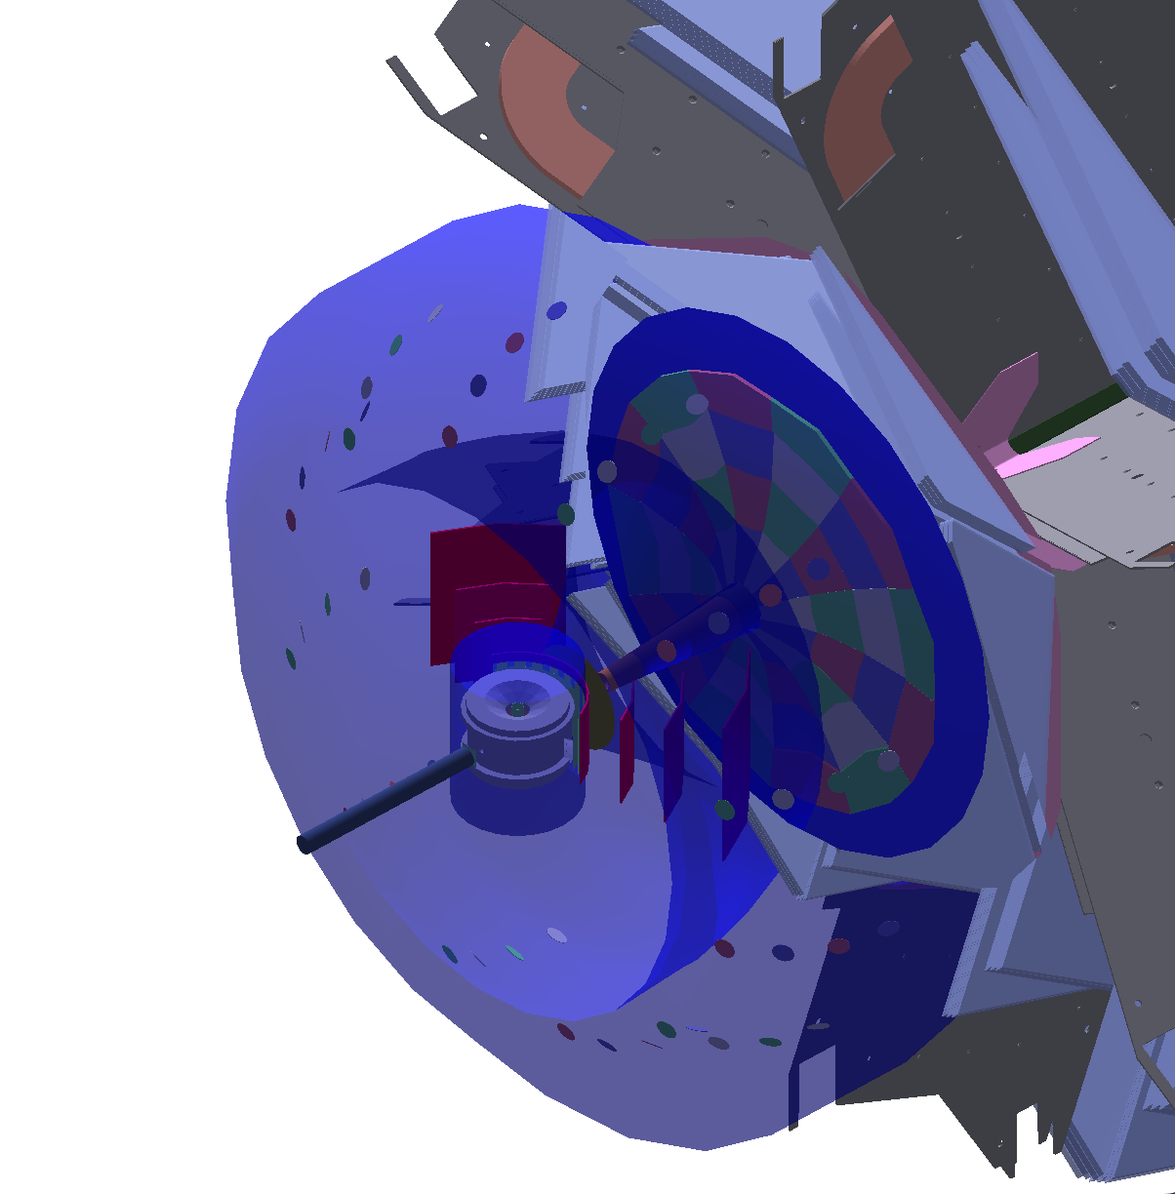
Recoil Reconstruction
Simulated RGH recoil resolution
based on ongoing tech. development
and CLAS12 FD tracking resolution
CLAS12 Standard
Recoil concept
L. L. Pappalardo - C.d.S. INFN Ferrara – 05/07/2023

Slide 17
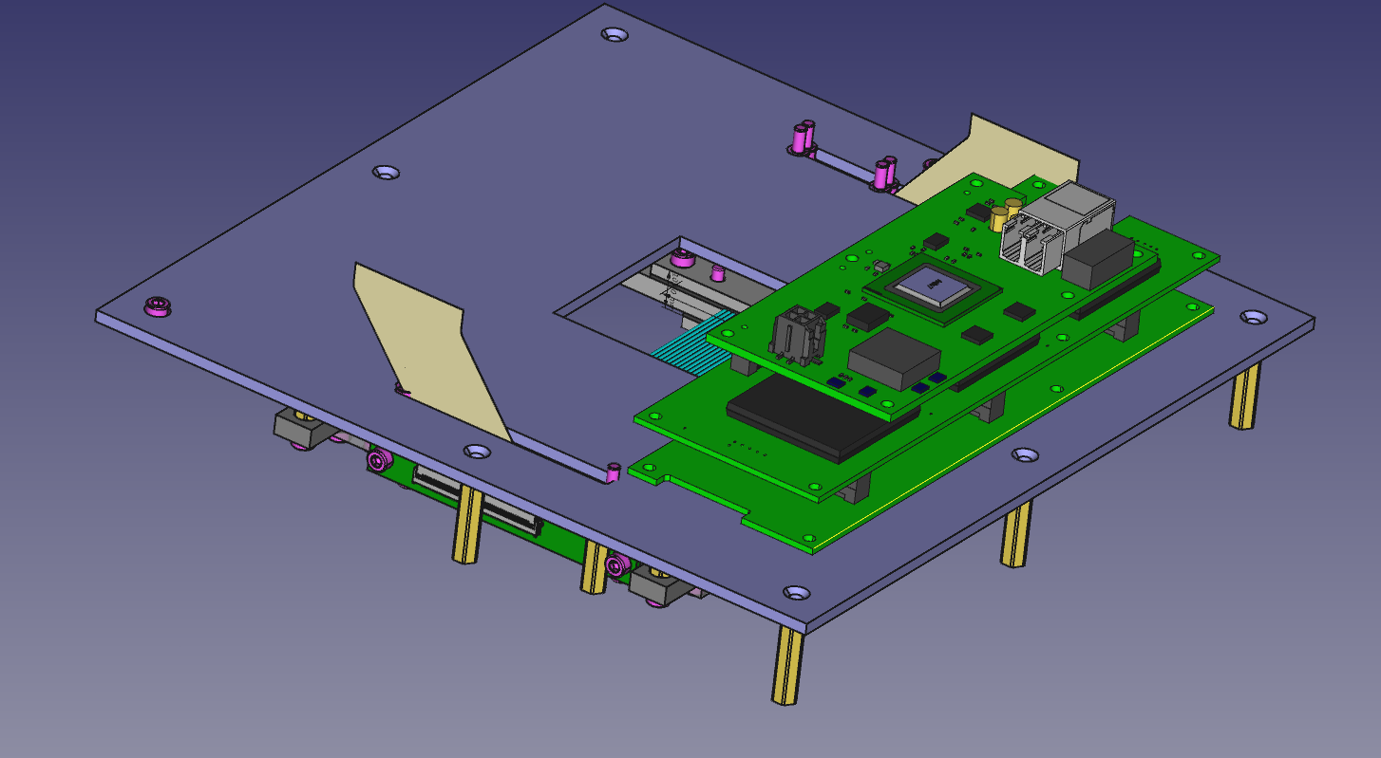
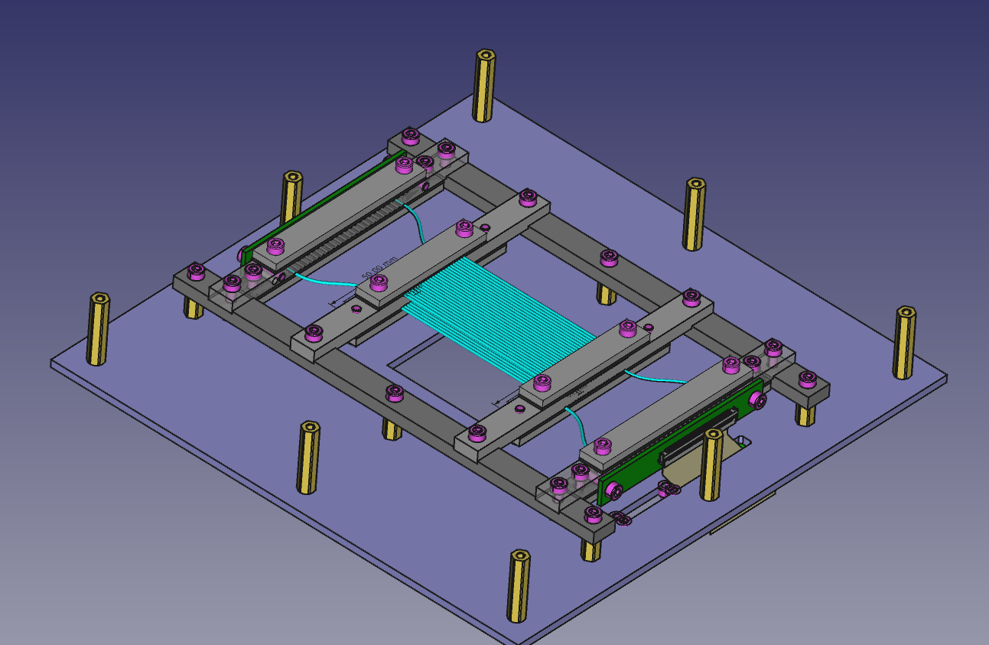
Sintillating Fiber Detector
New potential application of the CLAS12 RICH Electronics reading SiPM
To be used as fast beam particle tracking with RICH prototypes
Potential use as recoil detector for CLAS12 – RGH (transversely polarized targets)
Developed thanks to L. Barion, M. Roberto, M. Cavallina
L. L. Pappalardo - C.d.S. INFN Ferrara – 05/07/2023

Slide 18
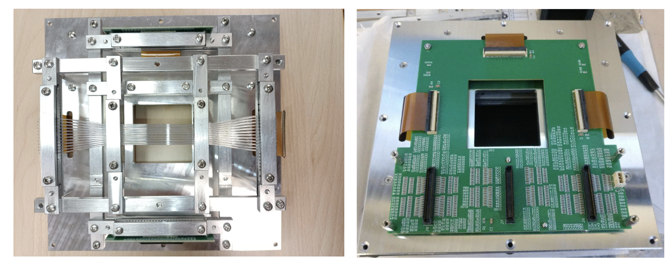
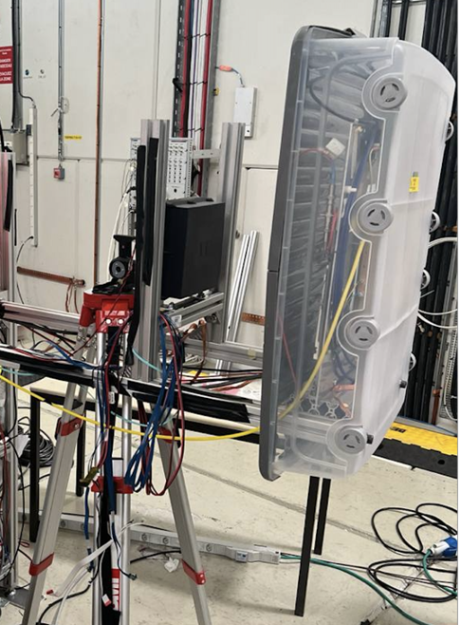
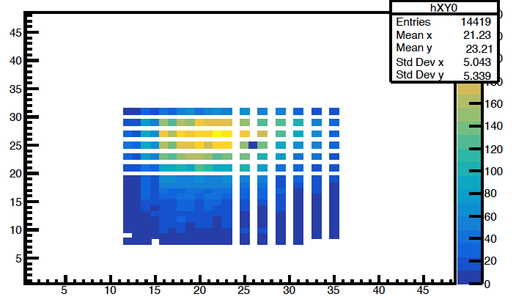
Sintillating Fiber Detector
Beam profile
y (mm)
Sci-Fi
detector
GEM
chamber
x (mm)
L. L. Pappalardo - C.d.S. INFN Ferrara – 05/07/2023

Slide 19
Il gruppo di Ferrara @ JLab
Responsabilita’:
M. C.: responsabile locale e nazionale di JLab12 (till June ‘24)
M. C. : chair of the Jlab User Organization (till June ‘24)
M. C.: contact person for the RGH experiments with transversely polarized target
M. C. responsabile progetto RICH
M. C. & L.P. Co-spokesperson di diverse proposte di esperimento (PAC34,37,38,39)
Contributi principali del gruppo:
Data analysis
- Data analysis on kaon SIDIS
RICH detector
- Reconstruction and alignment algorithms
Magneti superconduttori
- Configurazione magnetica per transverse target
- Frozen field con magneti a bulk di superconduttore
- Recoil detector design
Esperimenti con bersagli trasversi
- Study scintillating-fiber (time) tagger
L. L. Pappalardo - C.d.S. INFN Ferrara – 05/07/2023

Slide 20
EIC-NET (R.L.: Marco Contalbrigo)
INFN Network for preliminary studies on the EIC project
M. Contalbrigo is dRICH detector subsystem lead
co-coordinator of the dRICH R&D EIC Program (eRD102)
A. Saputi is Contact Person for dRICH mechanics
dRICH: Dual-radiator RICH for the EIC hadron end-cap (project led by INFN)
L. L. Pappalardo - C.d.S. INFN Ferrara – 05/07/2023

Slide 21
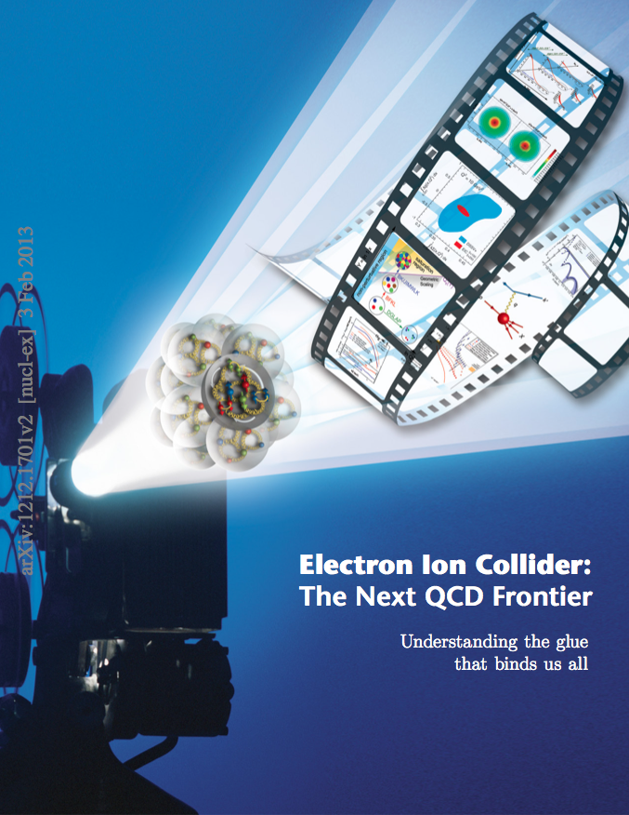
EIC_NET
Electron Ion Collider:
Strong interest in Italian nuclear physics
community (theory and experiment)
CD1 approval in June 2021
EPIC Coll. for 1st detector start in fall 2022
Detector subsystems defined in spring 2023
pre-TDR expected at the end of 2024
CD2 & 3 expected in spring 2025
(start of construction)
INFN Ferrara leading the dRICH subsystem
L. L. Pappalardo - C.d.S. INFN Ferrara – 05/07/2023

Slide 22
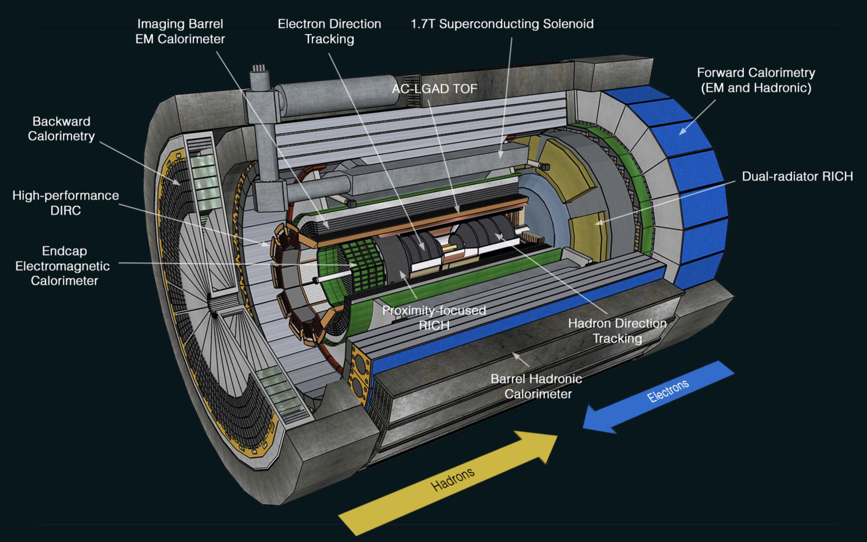
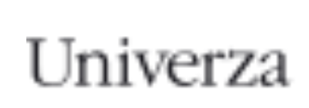
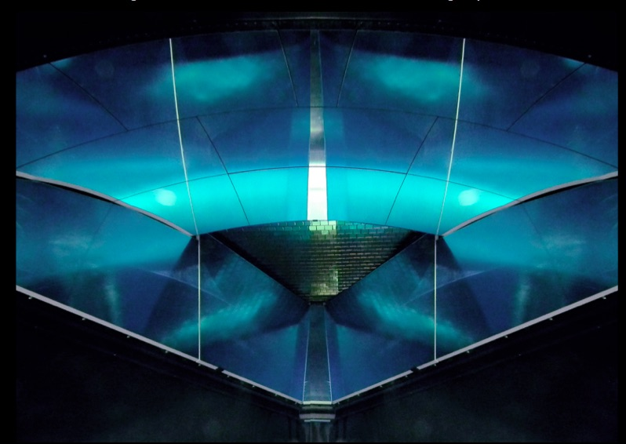
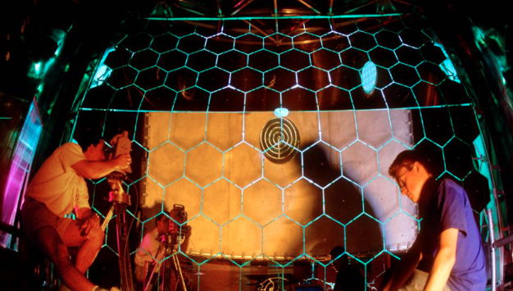
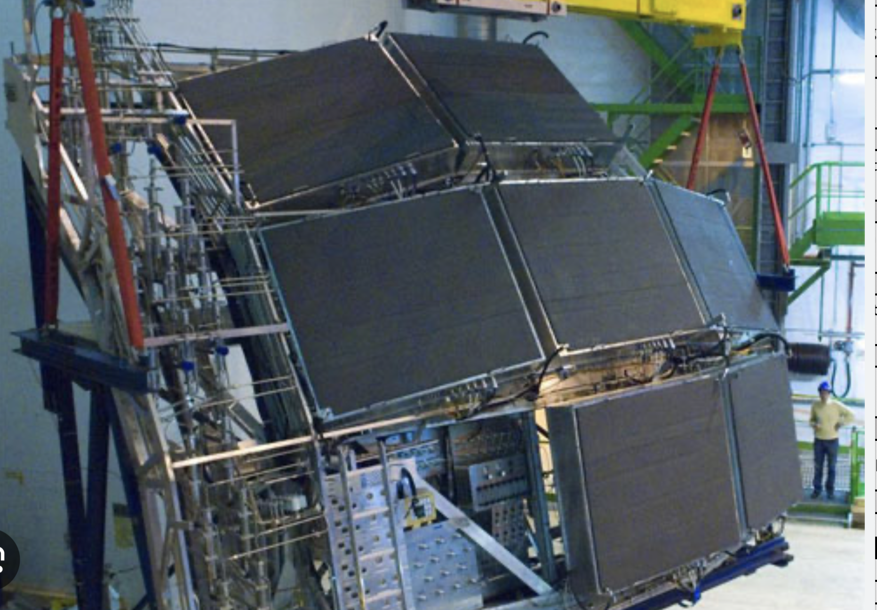
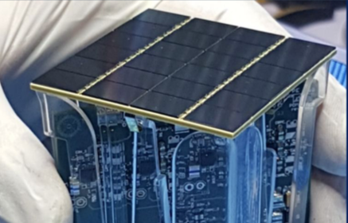
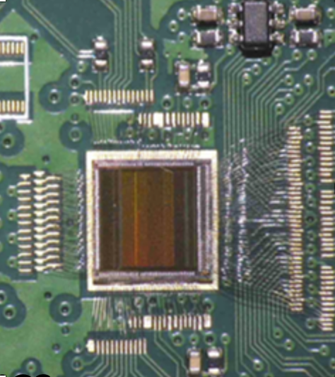
EIC_NET: The dual RICH
Compact cost-effective solution for particle identification in the high-energy endcap at EIC
dRICH
EPIC
EIC RICH Consortium
BA, BO, CS, CT, FE ,
GE, LNS, RM1,
RM2, SA, TO, TS
…..
…..
p: 41 GeV, 100 to 275 GeV
p/A beam
e beam
e: 5 GeV to 18 GeV
Background Expertise:
CLAS12 RICH COMPASS RICH ALICE HMPID DARKSIDE ALCOR
L. L. Pappalardo - C.d.S. INFN Ferrara – 05/07/2023

Slide 23
EIC_NET: dRICH Organization Chart
6.10.04 Particle Identification Level-3
CAM from DOE EIC Project
6.10.04.03 dRICH Level-4
CAM from Project + DSTC from EPIC (M. Contalbrigo)
Work packages lead from EPIC
Photo-Detector Level-5
R. Preghenella, INFN-BO, INFN-FE, INFN-CS, INFN-SA, INFN-LNF, INFN-CT, NISER
F. Cossio, INFN-TO, INFN-BO
P. Antonioli, INFN-BO, INFN-FE
A. Saputi, INFN-FE, INFN-CT, INFN-GE, JLAB, BNL
F. Tessarotto, INFN-TS, BNL
A. Vossen, DUKE, INFN-FE
G. Volpe, INFN-BA, INFN-FE, RICH Consortium
INFN-TS, DUKE, INFN-FE
Front-end Asics Level-5
Data-acquisition Level-5
Mechanics Level-5
Gas radiator Level-5
Mirror Level-5
Aerogel Radiator Level-5
Simulation
L. L. Pappalardo - C.d.S. INFN Ferrara – 05/07/2023

Slide 24
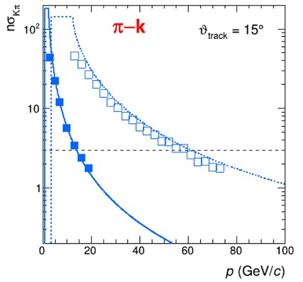
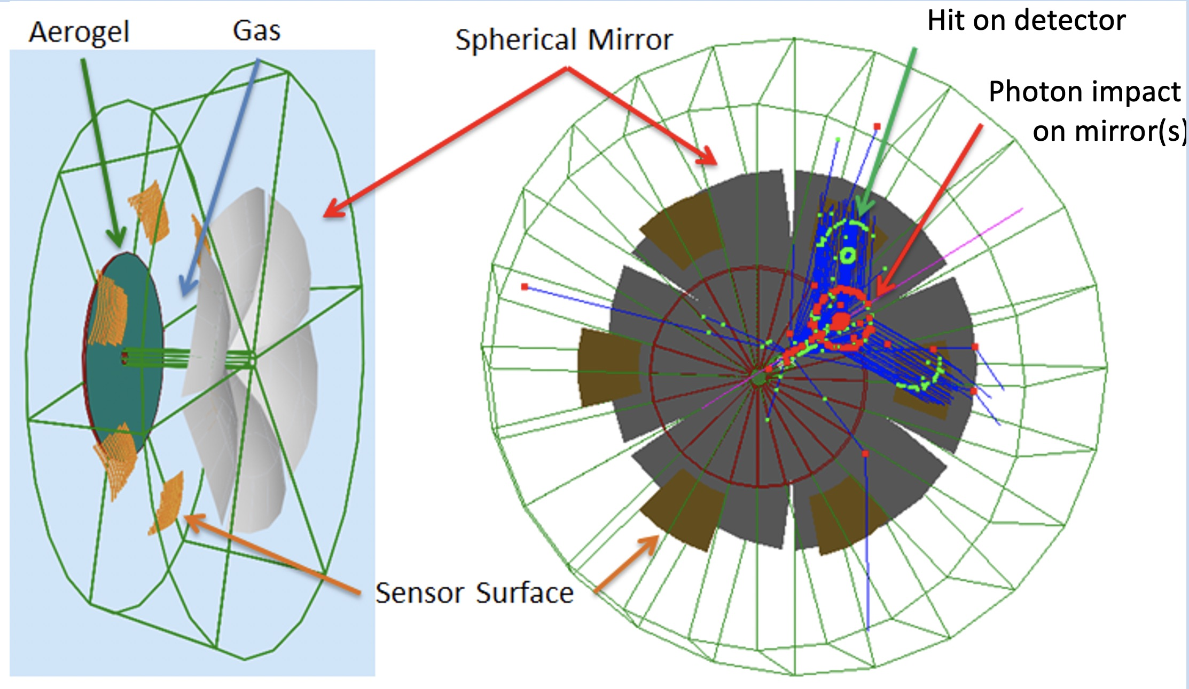
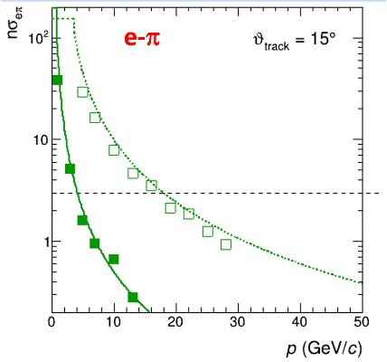
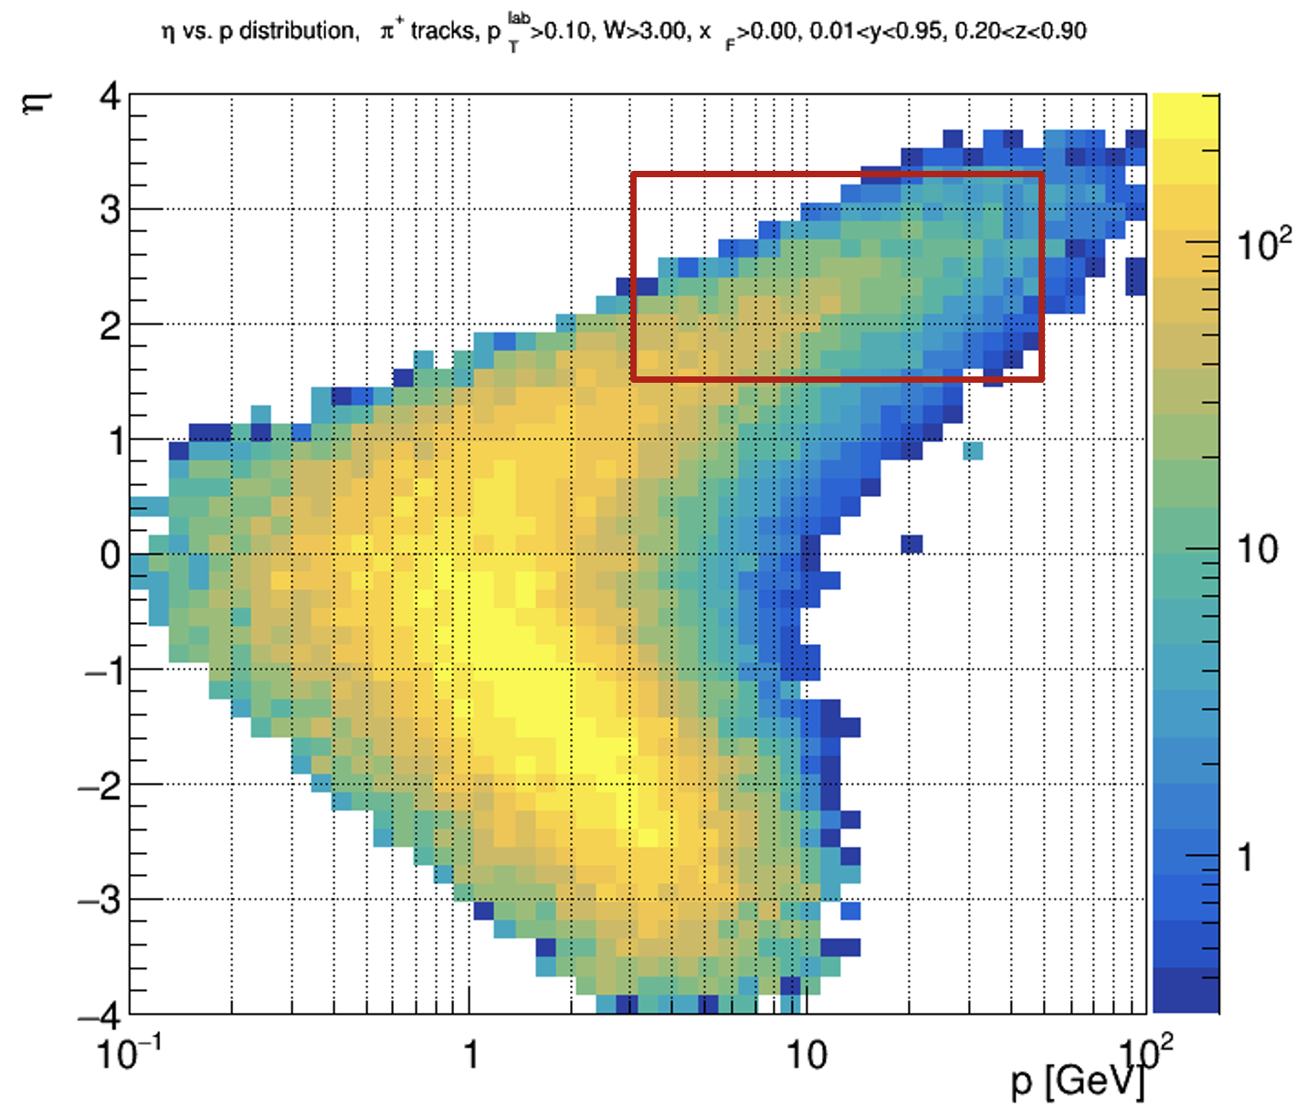
EIC_NET: Baseline Design
Main cover wide momentum range 3 - 50 GeV/c
features work in high (~ 1T) magnetic field
fit in a quite limited (for a gas RICH) space
ATHENA case
Essential for semi-inclusive physics
due to absence of kinematics constraints at event-level
dRICH: cost-effective compact solution
Radiators: Aerogel (n_{AERO}~1.02) + Gas (n_{C2F6} ~ 1.0008)
Detector: 0.5 m²/sector, 3x3 mm² pixel → SiPM option
L. L. Pappalardo - C.d.S. INFN Ferrara – 05/07/2023

Slide 25
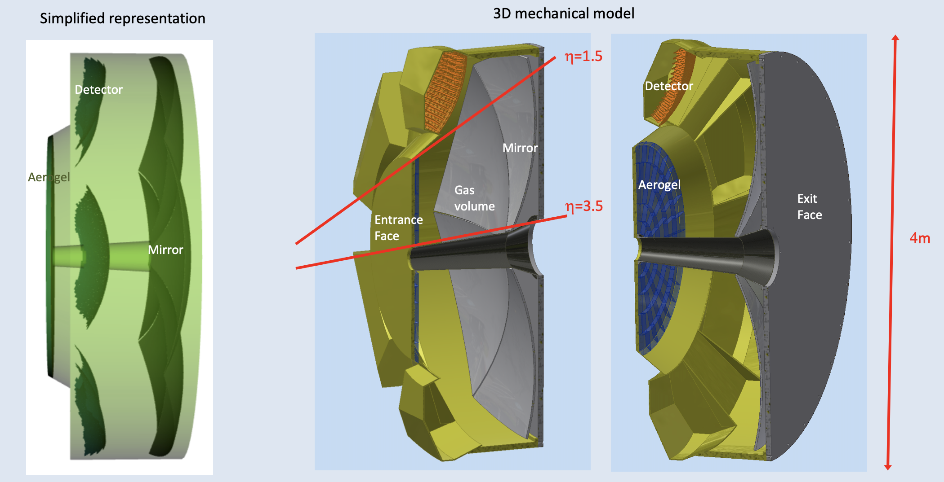
EIC_NET: Mechanics
Design thanks to A. Saputi, L. Barion
Windows: sandwich panel made of two ~1 mm carbon fiber reinforced epoxy skins separated by 30 mm PMI foam or Al honeycomb (~ 1% X₀)
Shells: 3 mm (inner tube) to 8 mm (outer tube) thick carbon fiber epoxy composite (~ 4% X₀)
Skins formed with two layers of balanced weave laminate with fibers at 0º/90º and +/- 45º for uniform stiffness
L. L. Pappalardo - C.d.S. INFN Ferrara – 05/07/2023

Slide 26
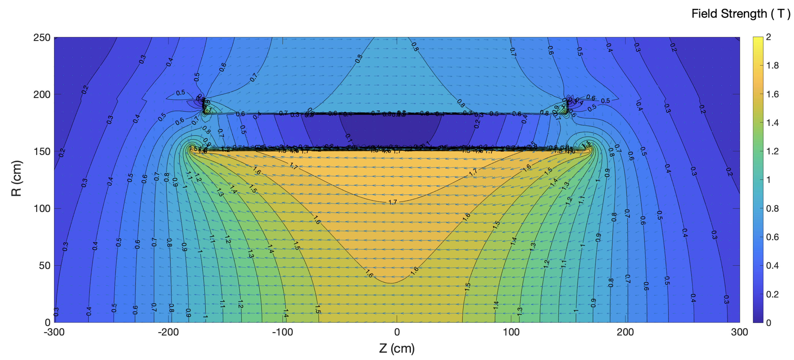
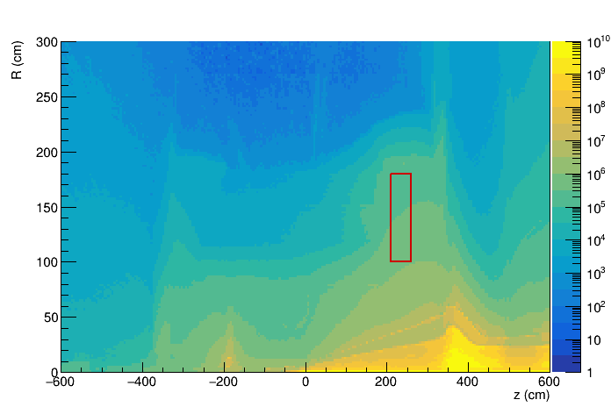
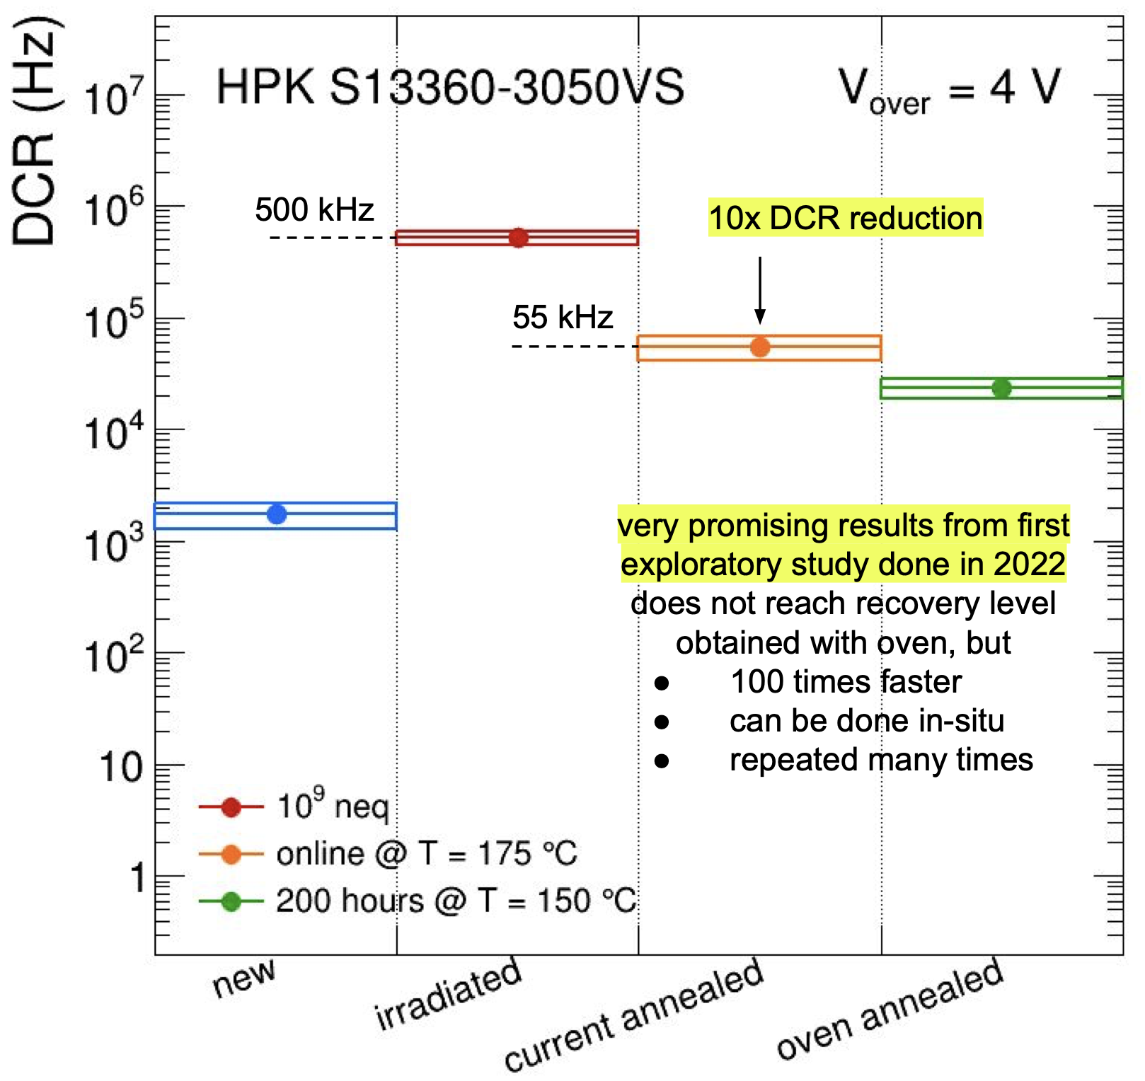
EIC_NET: SiPM
1.7 T field
1-MeV neutron equivalent fluence (1 fb⁻¹ ep running)
ePIC background group
beam-beam interactions only
dRICH
dRICH
Benchmark fluence (10 x)
~ 10⁷ 1-MeV n_{eq}/cm² / fb⁻¹
R. Preghenella, NIIMA 1046 (2023) 167661
Strong and not-uniform magnetic field
Moderate radiation levels (up tp 10¹¹ n_{eq}/cm²)
Usage of SiPM with
- low temperature working point
- periodic annealing at high temperature
(in-site by Joule effect)
L. L. Pappalardo - C.d.S. INFN Ferrara – 05/07/2023

Slide 27
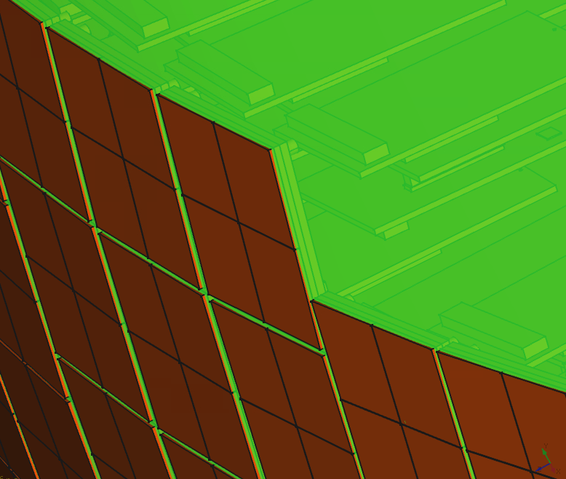
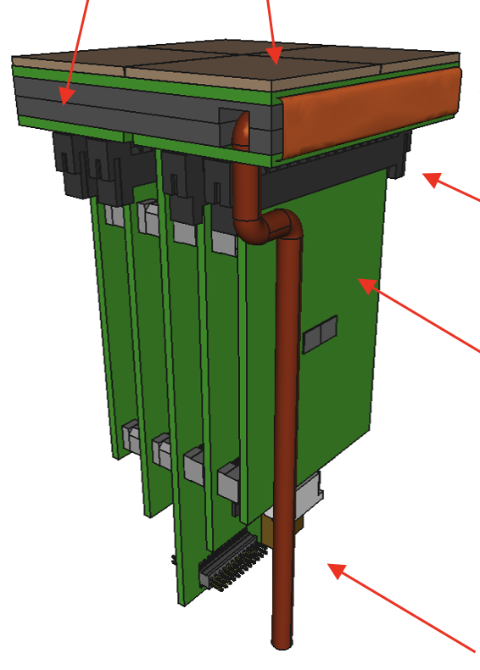
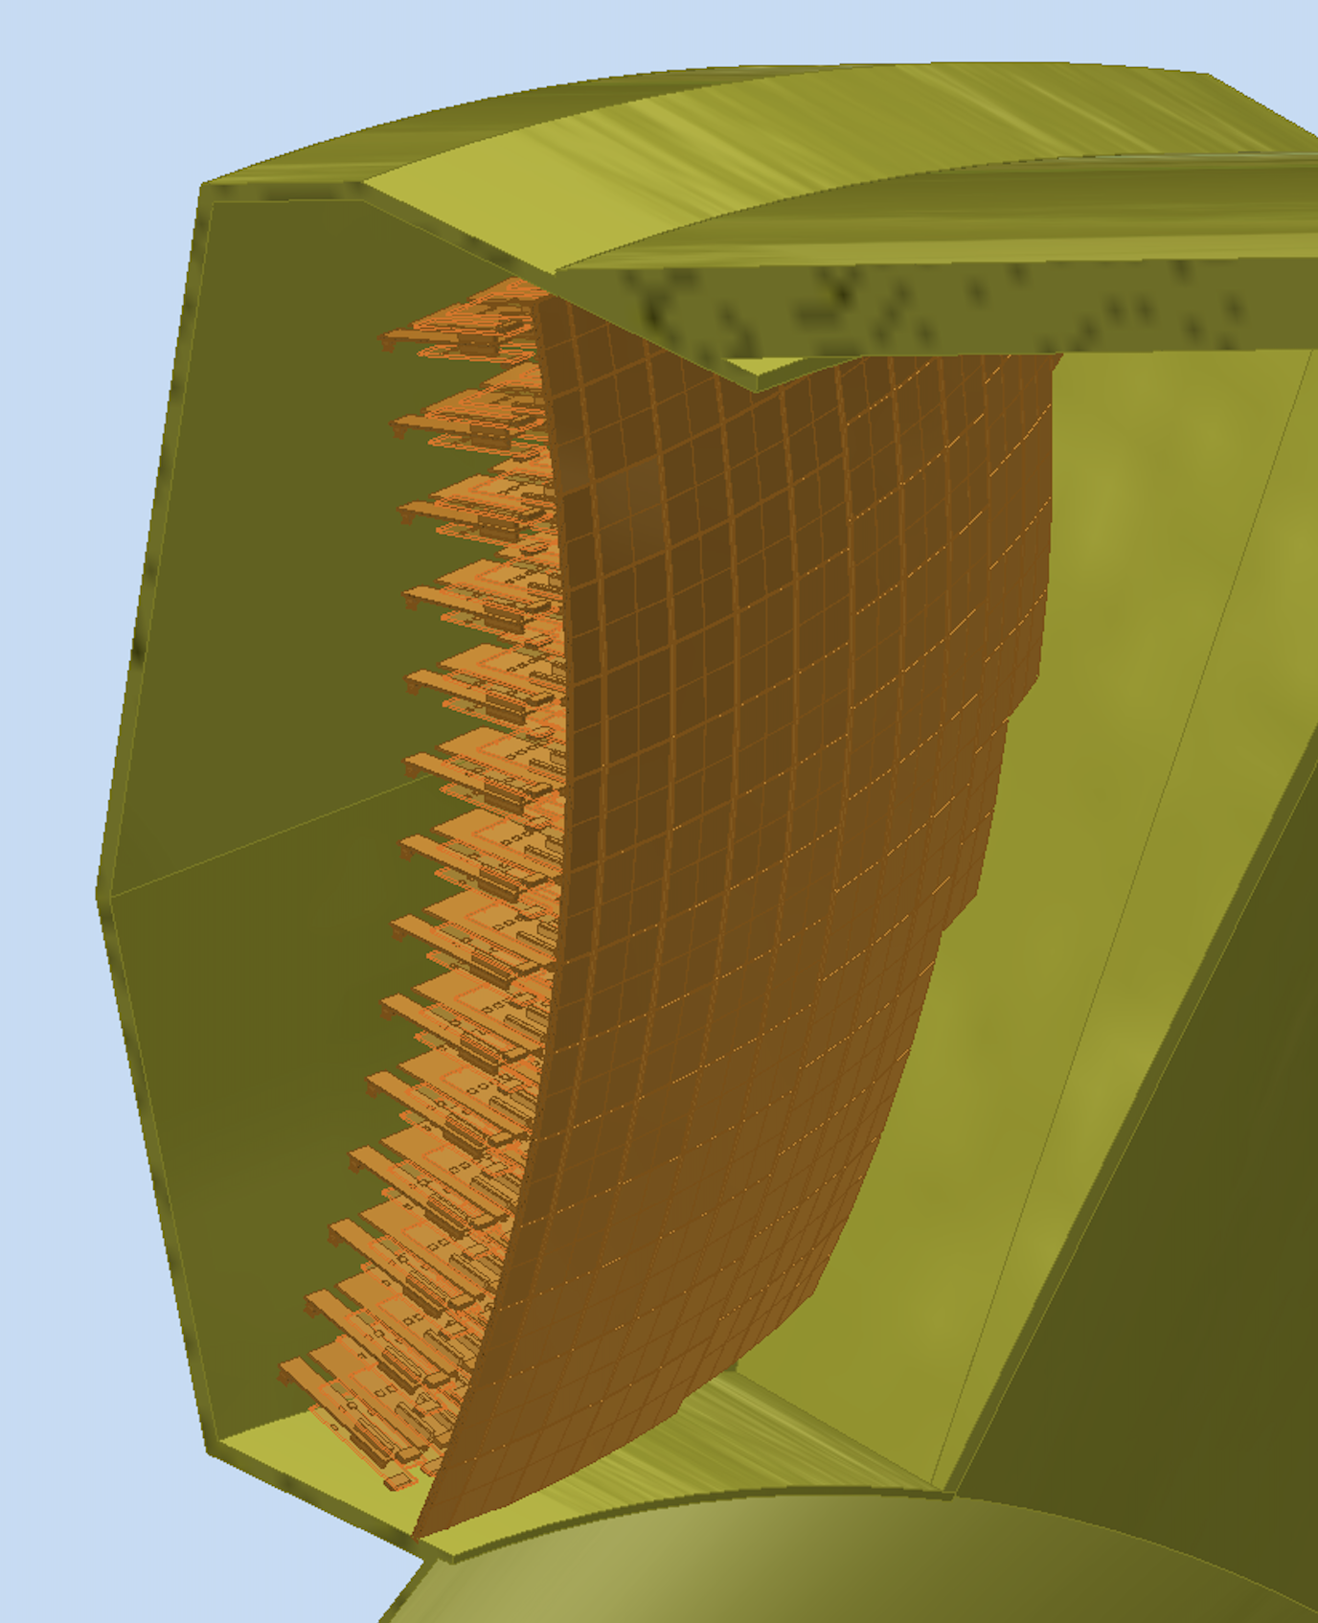
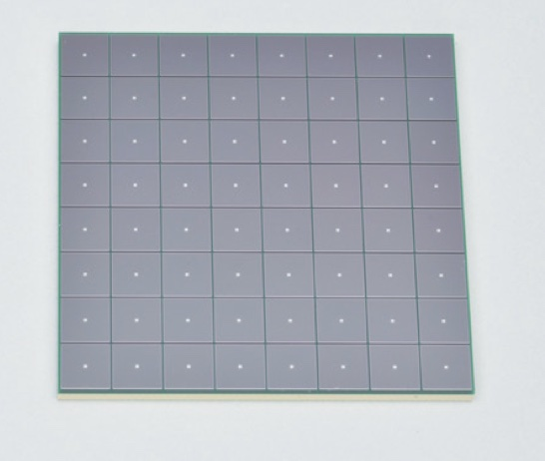
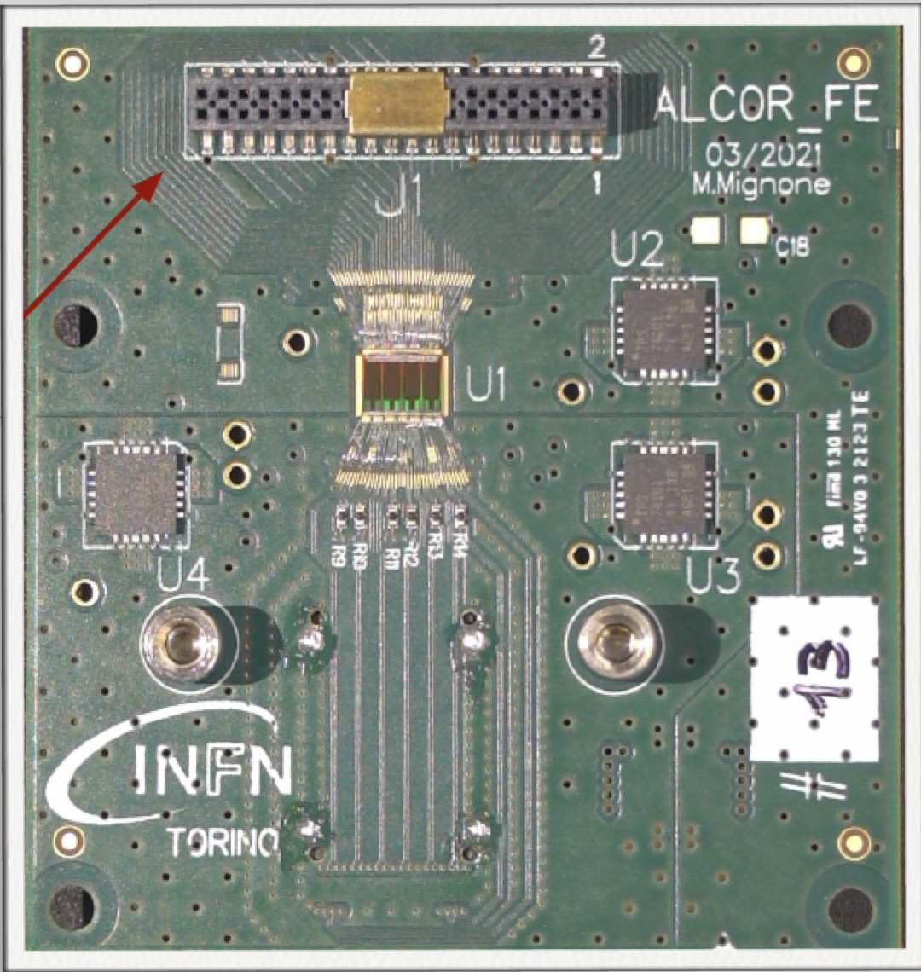
EIC_NET: Photo-Detector
Active area is shaped to resemble the focal surface and best exploits the focalization.
Electronics is minimized to fit the limited available space.
Heat exchanger
Cold plate
SiPM array
Photon Detector Unit (PDU):
Compact to minimize space
4x Hamamatsu S13361-3050HS SiPM arrays
4x Front-End Boards (FEB)
4x ALCOR chip (ToT discrimination)
1x Read-Out Board (RDO)
1x Cooling plate (< -30 C)
Flex PCB
Back-side
connectors
12 cm
FEB
(ALCOR)
Service
connections
RDO
Detector box:
Shaped to fit the space
Quartz window
Cooling for sensors and electronics
Power distributing patch panel
Heat insulation
SiPM array
ALCOR chip
L. L. Pappalardo - C.d.S. INFN Ferrara – 05/07/2023

Slide 28
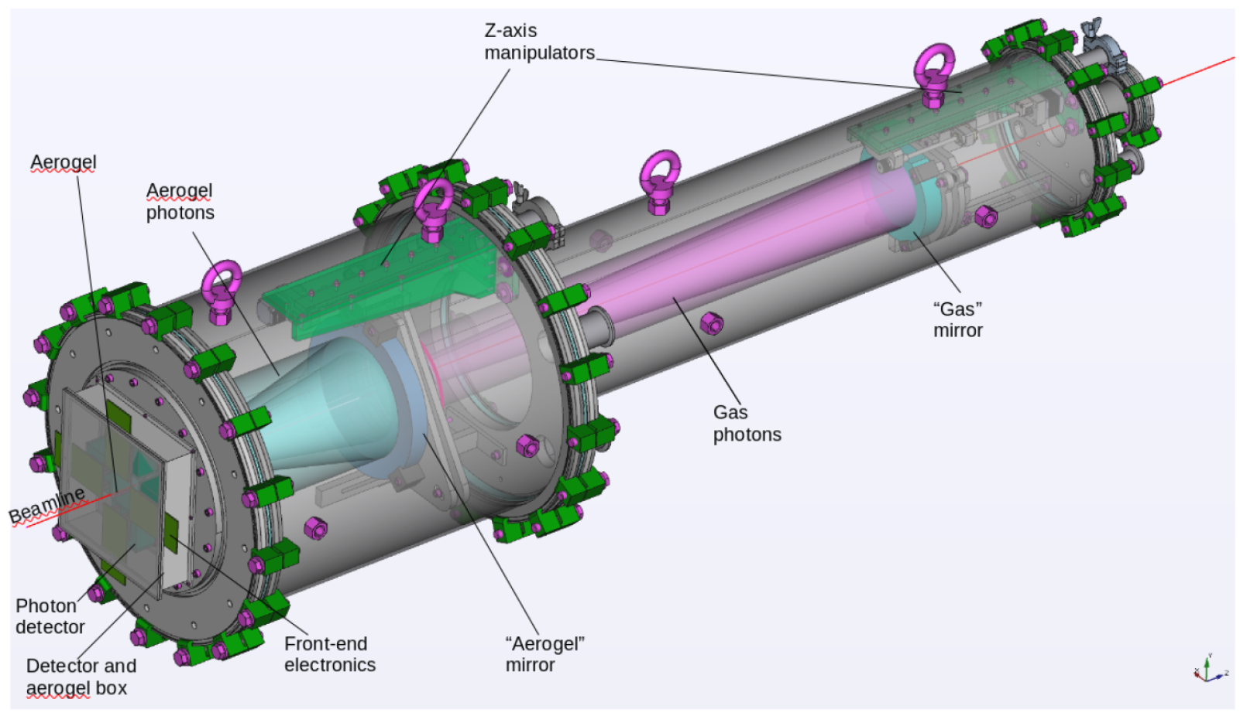
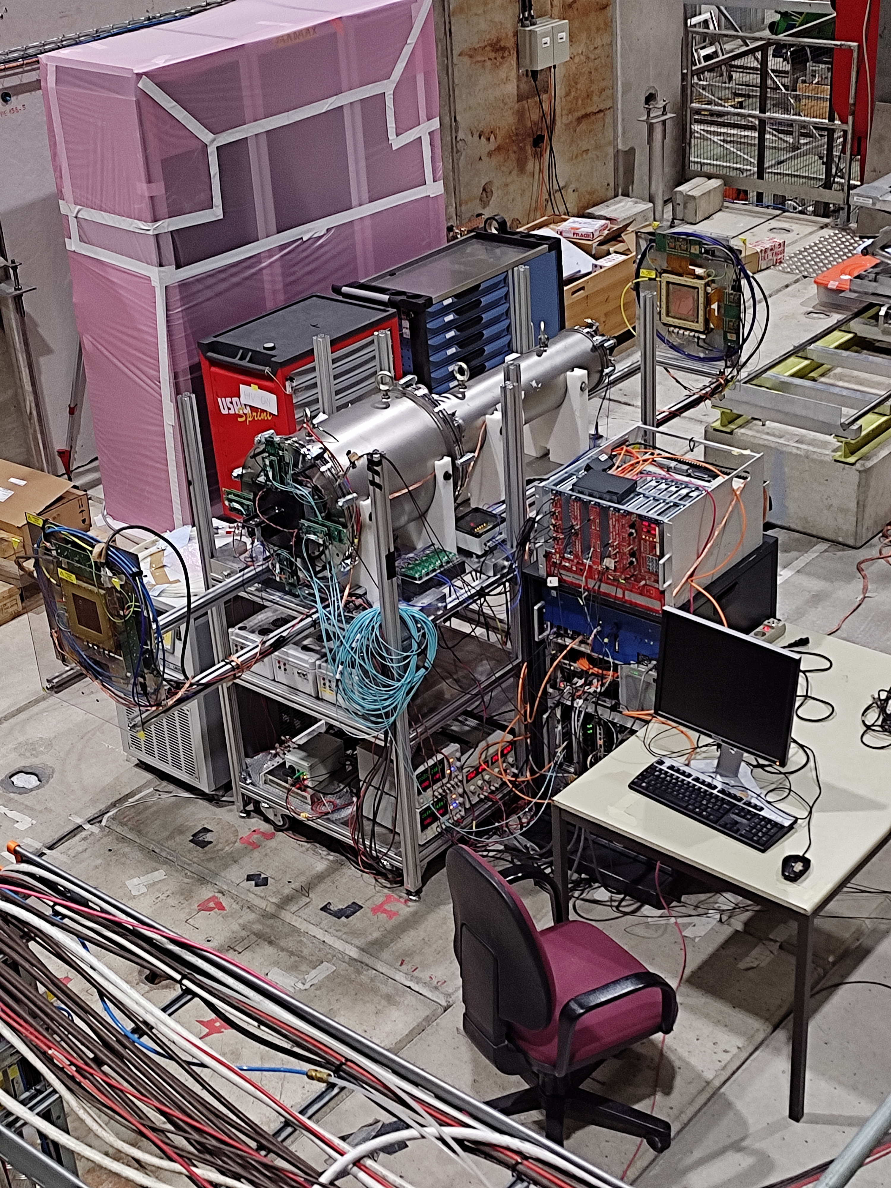
EIC_NET: dRICH Prototype
Operative prototype commissioned. Double ring imaging achieved. Performance in line
with expectations except for aerogel single-photon angular resolution (worse by a factor ~ 1.5)
GEM
Gas Vessel
MAPMTs
Aerogel
GEM
Realization thanks to L. Barion, M. Cavallina, R. Malaguti
L. L. Pappalardo - C.d.S. INFN Ferrara – 05/07/2023

Slide 29
EIC_NET: dRICH Prototype Highlight
Realization of a suitable detector plane for the dRICH prototype (23/10): Design ready, procurement aligned to 2023 test-beam campaign.
Photon Detection Unit
Streaming readout mode
Readout Box
8 PDUs, 2048 channels
Prototype
Working Pooint -40:-20 C
Realization thanks to L. Barion, M. Cavallina, R. Malaguti
L. L. Pappalardo - C.d.S. INFN Ferrara – 05/07/2023

Slide 30
EIC_NET: dRICH Prototype Highlight
Realization of a suitable detector plane for the dRICH prototype (24/05): completed readout plane.
Photon Detection Unit Insertion
Realization thanks to L. Barion, M. Cavallina, R. Malaguti
L. L. Pappalardo - C.d.S. INFN Ferrara – 05/07/2023

Slide 31
EIC_NET: dRICH Prototype Highlight
Realization of a suitable detector plane for the dRICH prototype (24/05): completed readout plane.
Aerogel + C₂F₆ radiators, positve beam, 8 GeV/c
π
p
gas ring
as π veto
π
e
Realization thanks to L. Barion, M. Cavallina, R. Malaguti
L. L. Pappalardo - C.d.S. INFN Ferrara – 05/07/2023

Slide 32
EIC_NET: Induced Temperature Gradients
Temperature in the gas volume induced by the SiPM surface at -30º
Realization thanks to L. Barion
L. L. Pappalardo - C.d.S. INFN Ferrara – 05/07/2023

Slide 33
EIC_NET: dRICH Aerogel
Aerogel Factory (BELLE-II)
Initial evaluation & Reproducibility
on small samples in sinergy with ALICE
Lab char.
Improving traparency
Test-beam
CLAS12 RICH quality assurance laboratory @ INFN-FE being refurnished
Realization thanks to L. Barion
L. L. Pappalardo - C.d.S. INFN Ferrara – 05/07/2023

Slide 34
EIC_NET: dRICH Mirror
Small demonstrator:
CMA Carbon fiber mirrors (HERMES, AMS, LHCb, CLAS12)
cost-effective light & stiff solution:
roughness driven by mandrel 1-2 nm rms
surface accuracy better than 0.2 mrad
radius reproducibility better than 1 %
Mid-size demonstrator:
Mirror aberrations
CLAS12 RICH quality assurance laboratory @ JLab being
refurnished in collaboration with DUKE University
Realization thanks to A. Saputi
L. L. Pappalardo - C.d.S. INFN Ferrara – 05/07/2023

Slide 35
EIC_NET: dRICH Prototype Milestones
2025: Real-scale prototype for TDR (1 sector)
Mechanical structure
Realistic optics (off-axis)
ALCOR64 FEB + RDO
Aerogel and mirror demonstrator
New EIC-driven readout unit
2025++: Detector box
Mechanical structure
Quartz windows
Cooling
Thermal models
Realization thanks to L. Barion, M. Cavallina, R. Malaguti
L. L. Pappalardo - C.d.S. INFN Ferrara – 05/07/2023

Slide 36
EIC_NET: responsabilità
Responsabilita’:
M. C.: responsabile locale EIC_NET
M. C.: responsabile dRICH
A. S.: contact for dRICH mechanics
M. C.: co-coordinator eRD102
M. C.: IAC POETIC (Physics Opportunities at EIC) Conference
Contributi principali:
dRICH detector
- dRICH mechanics
- Prototyping
- Optical component characterization
- SiPM irradiation program
Electronics
- MAROC (reference) + ALCOR (INFN development)

Slide 37
Richieste ai Servizi
Servizio Meccanico
FE laboratory: supporto per misure e stazioni di test, preparazione test-beam
JLAB12
TTarget: supporto per test con doppio campo magnetico al LASA di Milano
Recoil: contributo meccanica tracciatore recoil
EIC_NET
dRICH: progettazione meccanica del rivelatore dRICH
dRICH: meccanica del prototipo dRICH
Servizio Elettronico
FE laboratory: supporto per misure e stazioni di test, preparazione test-beam
JLAB12
TTarget: piccoli contributi alle misure con magneti superconduttori
TTarget: contributo per recoil detector (fibre scintillanti)
EIC_NET
dRICH: contributo piano di rivelazione curvo basato su SiPM + ALCOR
dRICH: master panel di controllo rivelatore

Slide 38
Manpower e richieste finanziarie per 2025
Anagrafica e afferenze (Ric. + Tecnol.)
Servizio meccanico ed elettronico
Name | JEDI | JLab12 | EIC_NET
N. Canale (dottorando) | 100
G. Ciullo (staff) | 70 | 20
M. Contalbrigo (staff) |  | 50 | 50
S. Dymov (post-doc) | 100
L. Del Bianco (staff) |  | 100
A. Kononov (dottorando) | 100
P. Lenisa (staff) | 75 | 20
A. Maragno (dottoranda) | 100
L. Pappalardo (RTD-B) |  | 30
A. Pesce (post-doc) | 100
A. Seleev (assegnista) | 100
R. Shankar (dottorando) | 100
F. Spizzo (staff) |  | 70 | 30
S. Plavully (assegnista) |  | 80 | 20
A. Saputi |  |  | 10
A. Cotta Ramusino (staff) | 10
TOTALE/100 | 8.6 | 3.7 | 1.1
Name | JEDI | JLab12 | EIC_NET
L. Barion |  | 25 | 75
M. Cavallina | 10 | 10
M. Gambetti | 10
R. Malaguti |  | 20
M. Melchiorri |  |  | 10
S. Squerzanti |  | 20
TOTALE/100 | 0.2 | 0.5 | 0.1
Richieste finanziarie (k€)
Name | JEDI | JLab12 | EIC_NET | Dot.3
Missioni | 57 | 45 | 25 | 8
Trasp. |  | 5
Inv. | 9 |  |  | 15
Consumi | 34.5 | 15 | 40 | 6
Apparati |  | 10
Altro |  |  |  | 3
TOTALE | 100.5 | 75 | 65 | 32

