Slide 1
JLab12
Nucleon structure and spin physics
Transverse momentum phenomena (TMDs) & 3D imaging
GPDs & EM Form Factors of the nucleon
M. Contalbrigo PI of the CLAS12 RICH detector
M. Contalbrigo Contact Person for RGH group of experiment (RGH)
with transversely polarized target
INFN-FE: RICH detector for particle–identification
Transversely polarized target
Recoil Detector
G. Ciullo - C.d.S. INFN Ferrara – 02/07/2026

Slide 2
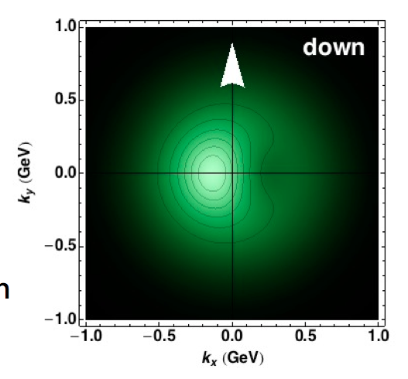
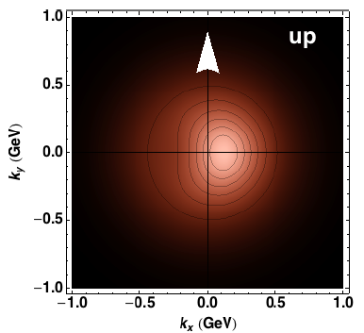
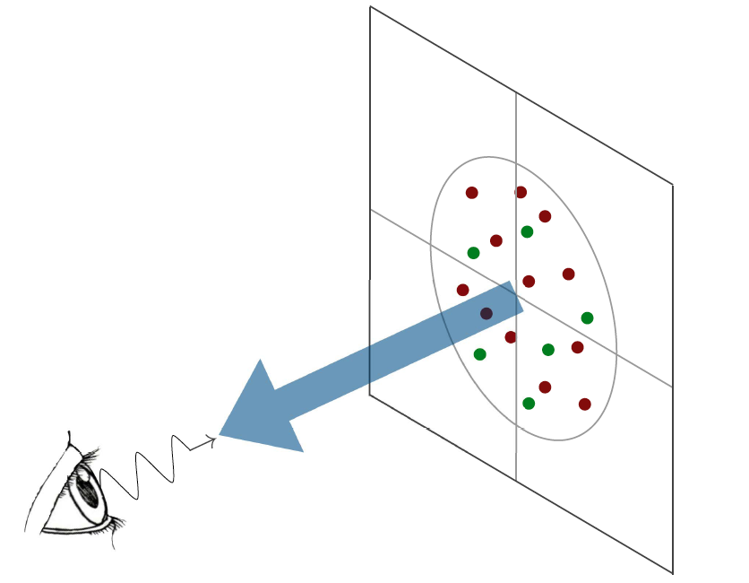
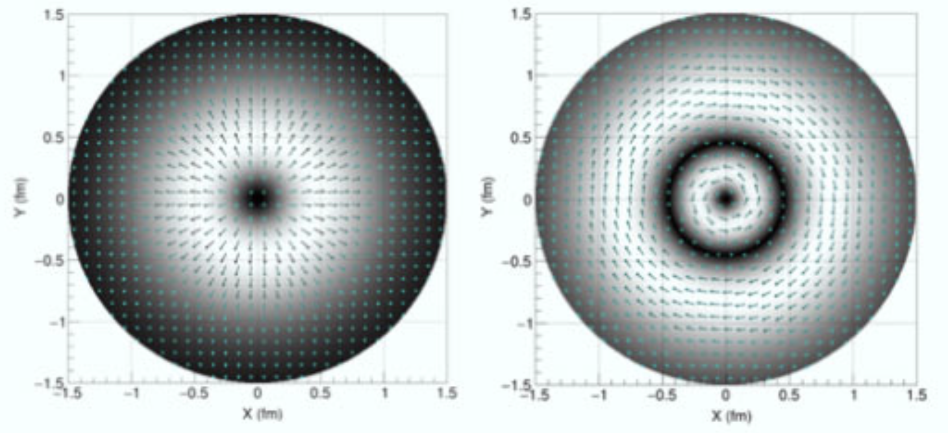
3D Nucleon Structure
Access to the strong-force dynamics
at the scale of confinement
TMD (x, k_{T})
Confinement Scale
Transverse momentum
GPD (x, b_{T})
k_{T}
b_{T}
Transverse position
Longitudinal momentum
k⁺=xP⁺
Spin
l
High Energy Probe
Hard Scale
Photon Virtuality
Q²
Transverse plane
l
Credit: A. Bacchetta
G. Ciullo - C.d.S. INFN Ferrara – 02/07/2026

Slide 3
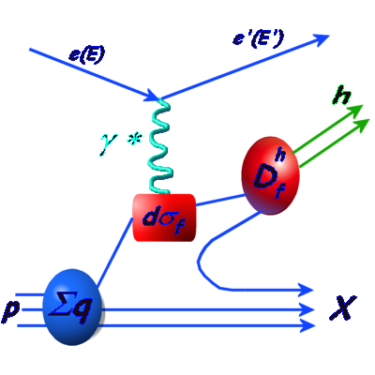
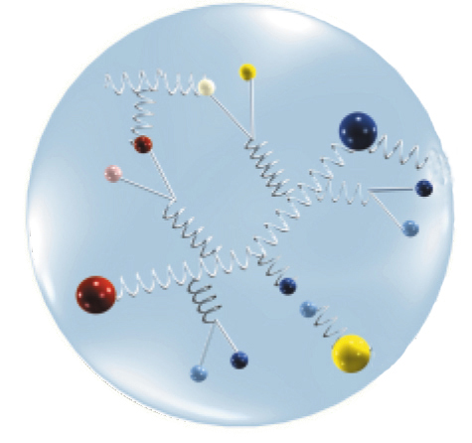
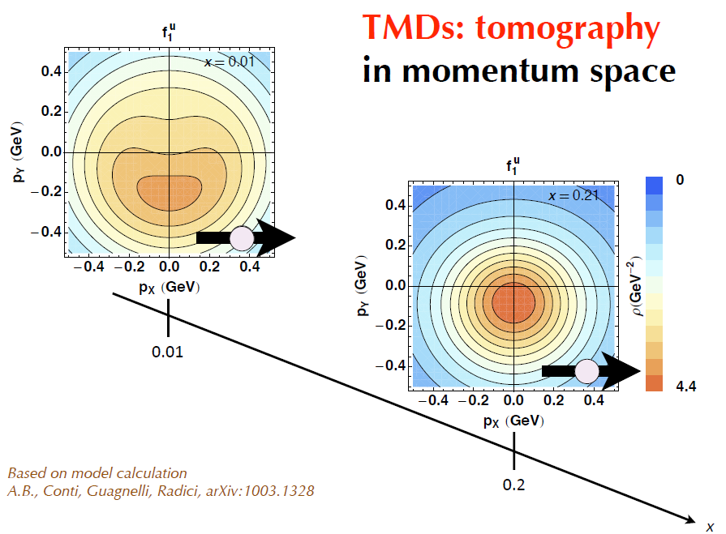
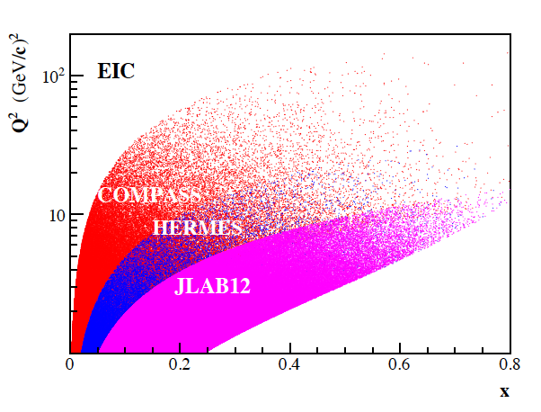
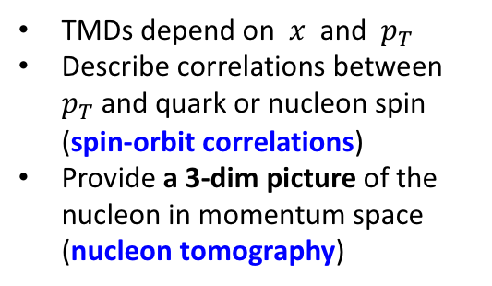
Semi-Inclusive DIS
TMDs depend on $x$ and $p_{T}$
Describe correlations between $p_{T}$ and quark or nucleon spin (spin-orbit correlations)
Provide a 3-dim picture of the nucleon in momentum space (nucleon tomography)
FF
G. Ciullo - C.d.S. INFN Ferrara – 02/07/2026

Slide 4
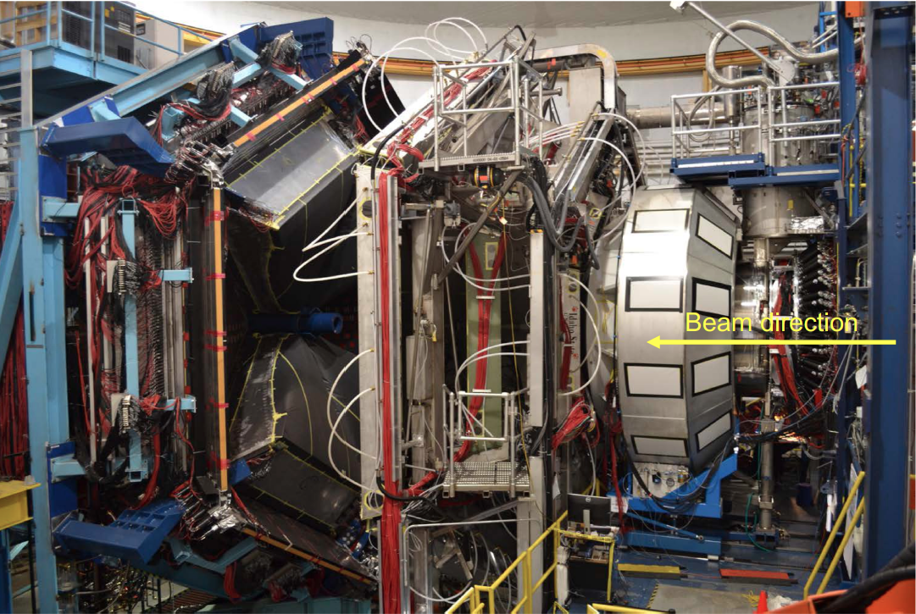
CLAS12 Experiment
RICH
Target / Recoil
10 m
Luminosity up to 10³⁵ cm⁻² s⁻¹
Highly polarized electron beam
Polarized targets
Broad kinematic range coverage
(current to target fragmentation)
Available or well-known technology
No specific R&D required
G. Ciullo - C.d.S. INFN Ferrara – 02/07/2026

Slide 5

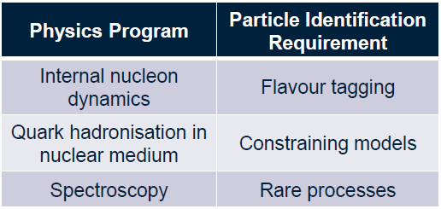

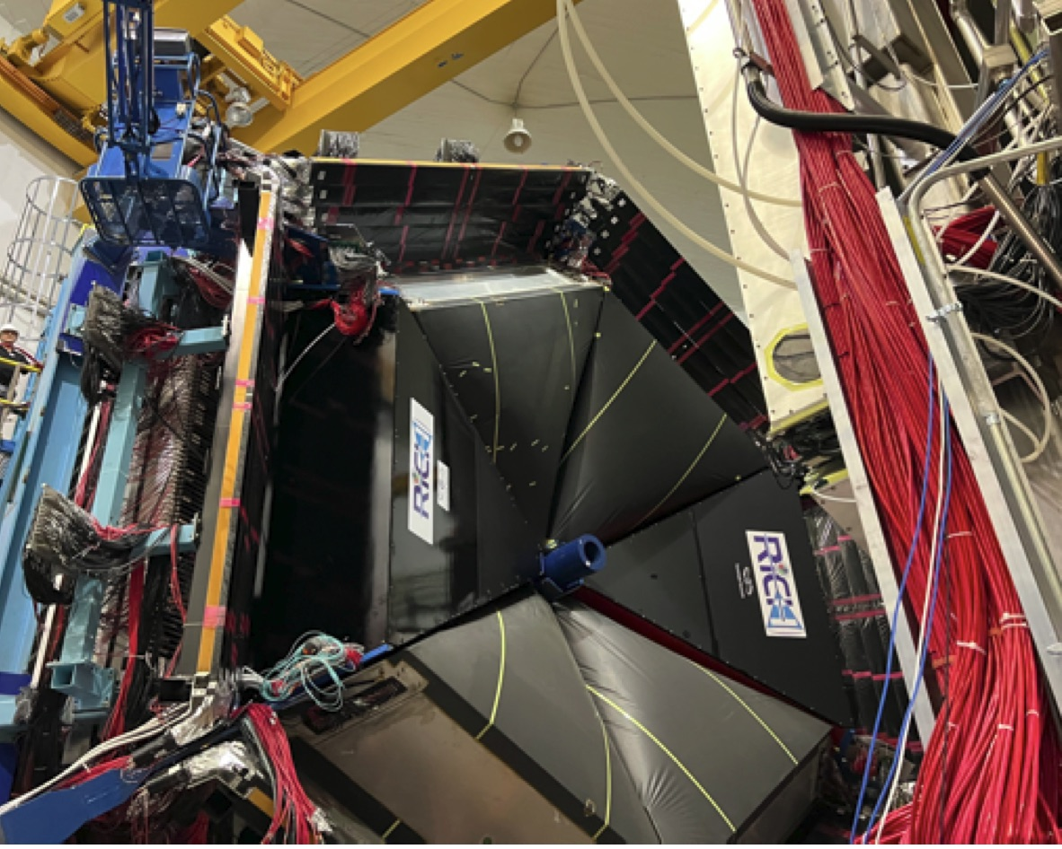
The RICH Detector Project
Goal:
Completed with 2nd module in June 2022
Ognoing: data-taking & calibration
alignment finalization
INSTITUTIONS
INFN (Italy) Bari, Ferrara, Genova, L.Frascati, Roma/ISS
Jefferson Lab (Newport News, USA)
Argonne National Lab (Argonne, USA)
Duquesne University (Pittsburgh, USA)
George Washington University (USA)
Glasgow University (Glasgow, UK)
J. Gutenberg Universitat Mainz (Mainz, Germany)
Kyungpook National University, (Daegu, Korea)
University of Connecticut (Storrs, USA)
UTFSM (Valparaiso, Chile)
G. Ciullo - C.d.S. INFN Ferrara – 02/07/2026

Slide 6
The RICH Front-End electronics
Compact and modular electronics to readout multi-anode PMTs
FPGA Board (JLab)
ASIC Board (Ferrara)
Several applications
Adopted by other experiments:
Gluex, SOLID, EIC R&D, RGH Recoil, …
Adapted to different sensors:
Multi-anode PMT H12700, H13700
SiPM array S12642, H13361
Developed thanks to R. Malaguti, L. Barion
G. Ciullo - C.d.S. INFN Ferrara – 02/07/2026

Slide 7
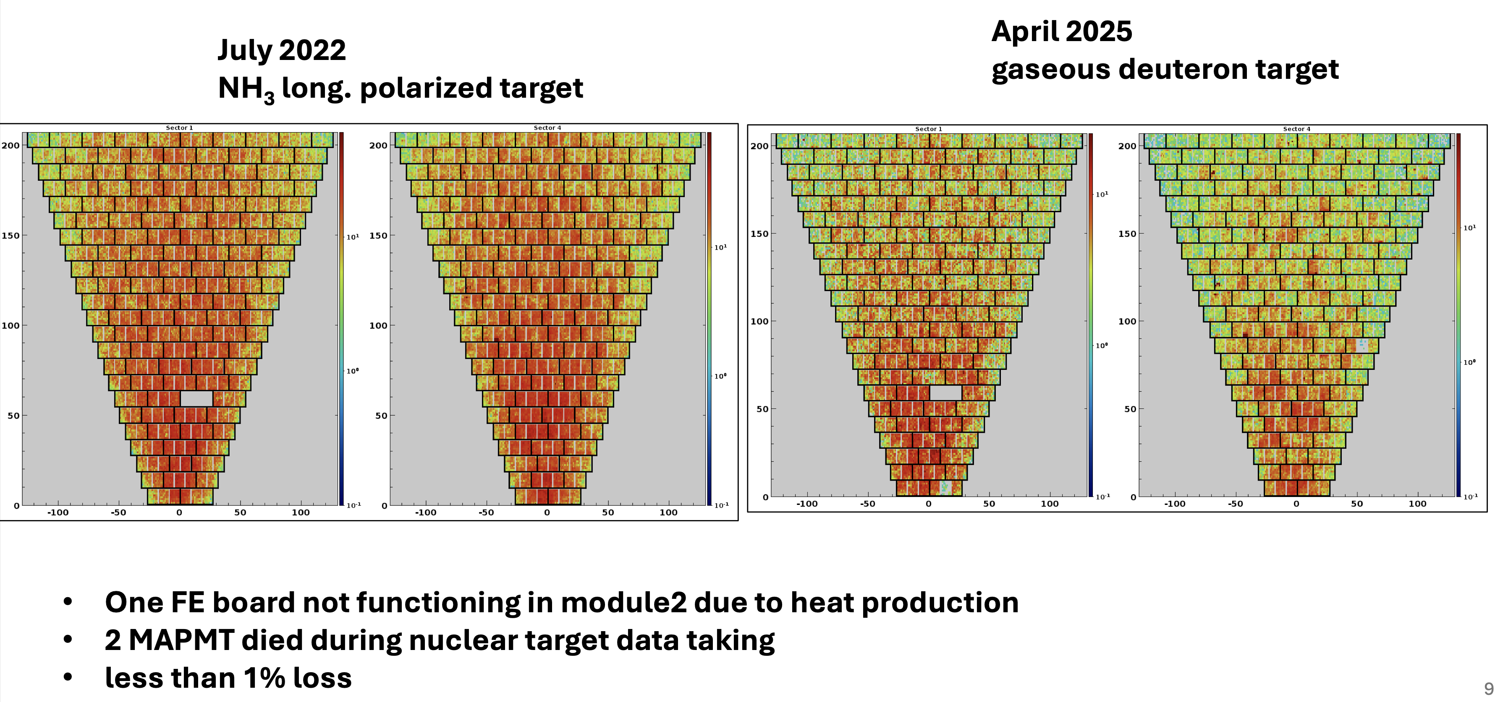
The RICH Stability in Time
G. Ciullo - C.d.S. INFN Ferrara – 02/07/2026

Slide 8
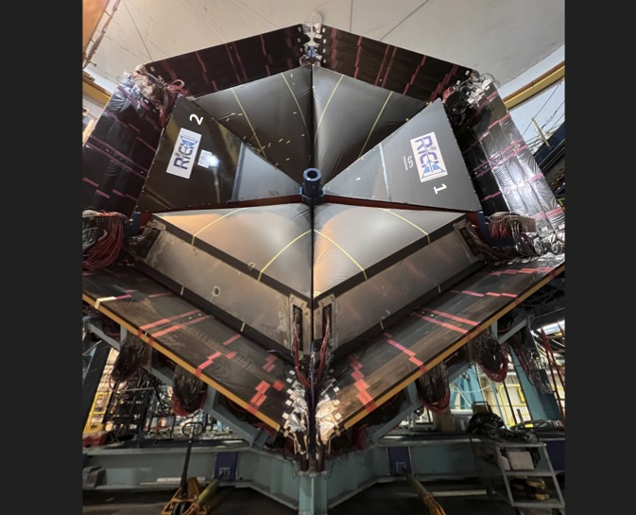
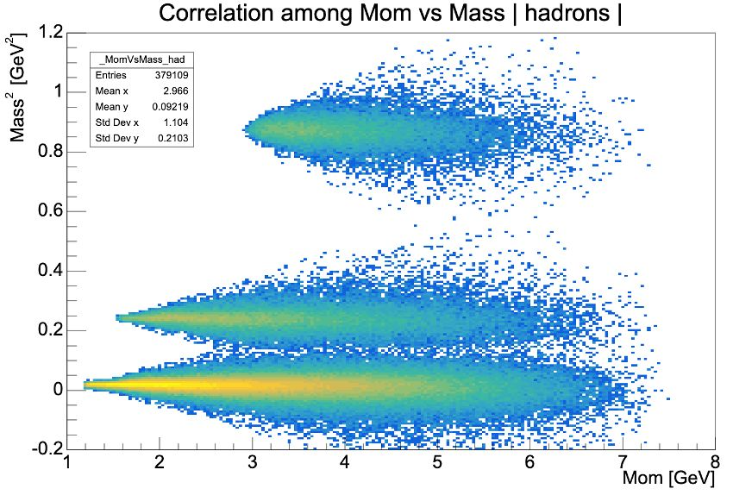
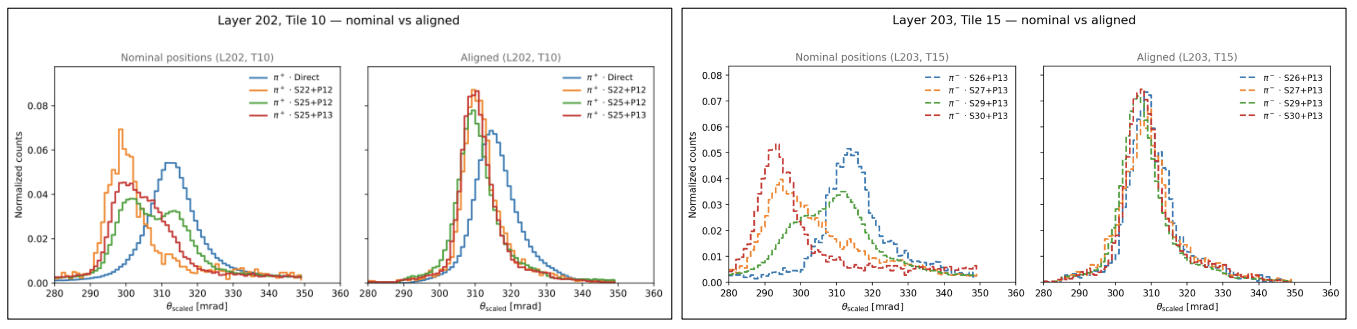
The RICH Performance
Ognoing: data taking & calibration
alignment finalization of 2nd module
2025 Highlight:
Alignment of all the components (17 mirror / sector) and full acceptance achieved thanks to AI methods
G. Ciullo - C.d.S. INFN Ferrara – 02/07/2026

Slide 9
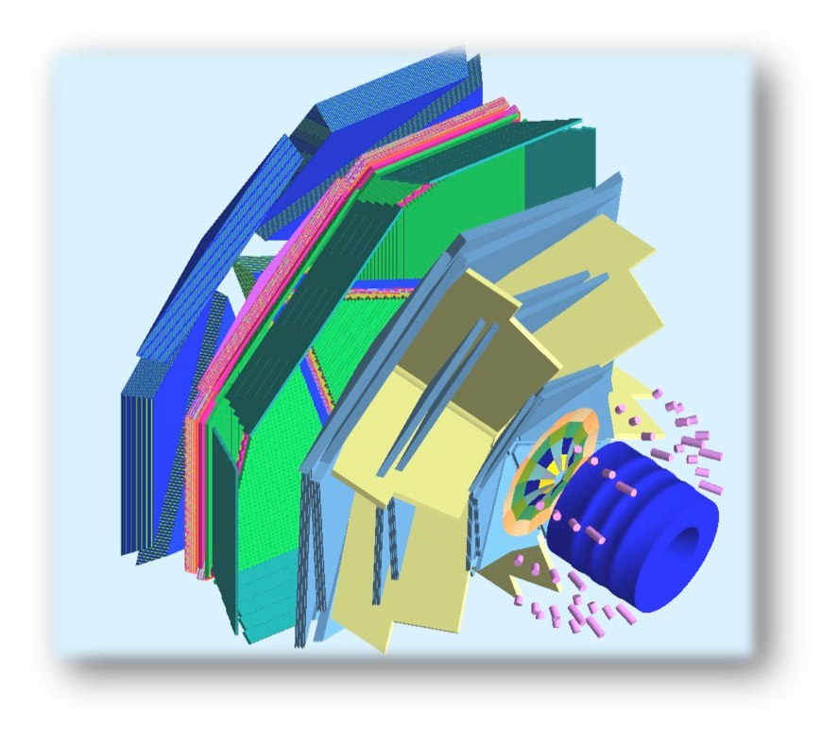
The Transverse target
Run-Group H
Transverse Target:
high polarization
d 25 mm – Length 10 mm
transverse dipole field up to 5 T
new recoil detector
Fully approved in summer 2025
Identified as High-Impact
experiment by JLab PAC
Baseline solenoid
design up to 5 T longitudinal
4K L-He cryostat
Length 1500 mm
Unpolarized and longitudinally polarized target only
To be removed
target
superconducting
solenoid
polarized
e⁻ beam
superconducting
torus
G. Ciullo - C.d.S. INFN Ferrara – 02/07/2026

Slide 10
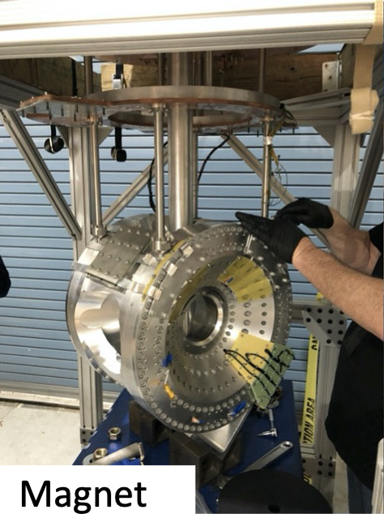
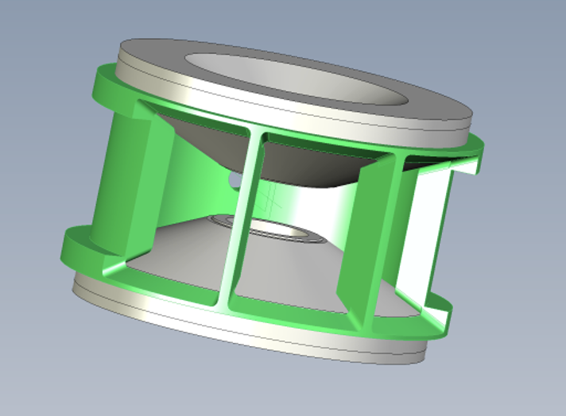
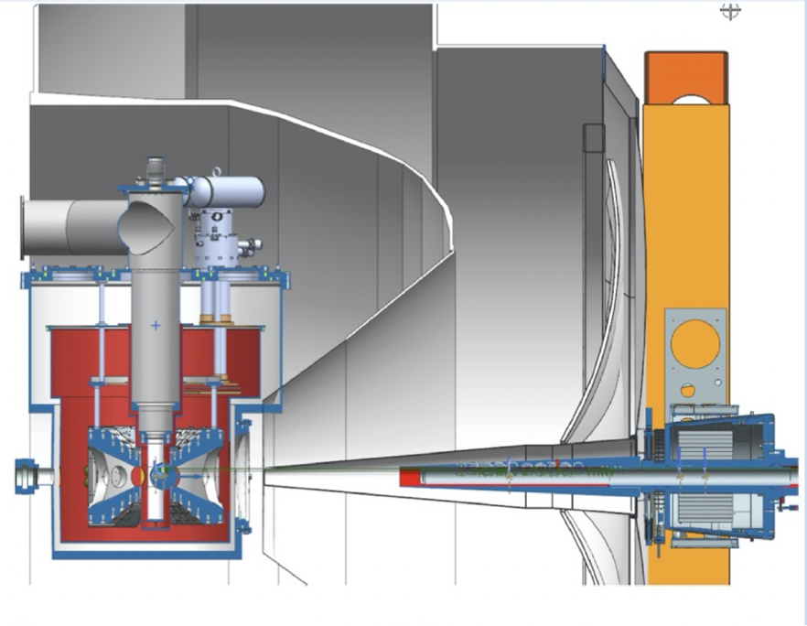
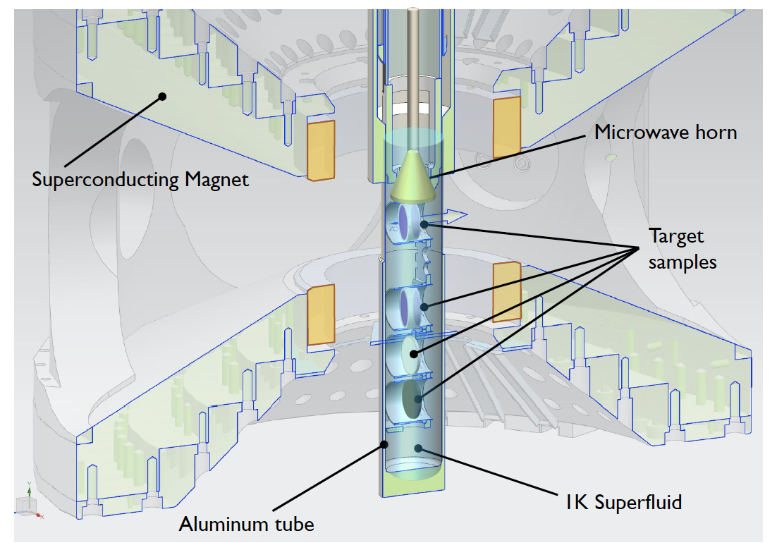

RGH Target
HDice (frozen-spin) has not meet RGH specifications
Most viable solution to prioritize physics vs R&D
Consolidated dynamically polarized NH₃ technology
Designed based on already successful realizations
Hall-A G2p-Gep target (copy optimized for HTCC )
Hall-C E12-15-005 magnet (copy optimized for recoil detection)
5T dipole
acceptance:
$± 25o$ horizontal
$$± 65o. horizontal$$
JLab is already committed to initiate the target magnet procurement.
G. Ciullo - C.d.S. INFN Ferrara – 02/07/2026

Slide 11
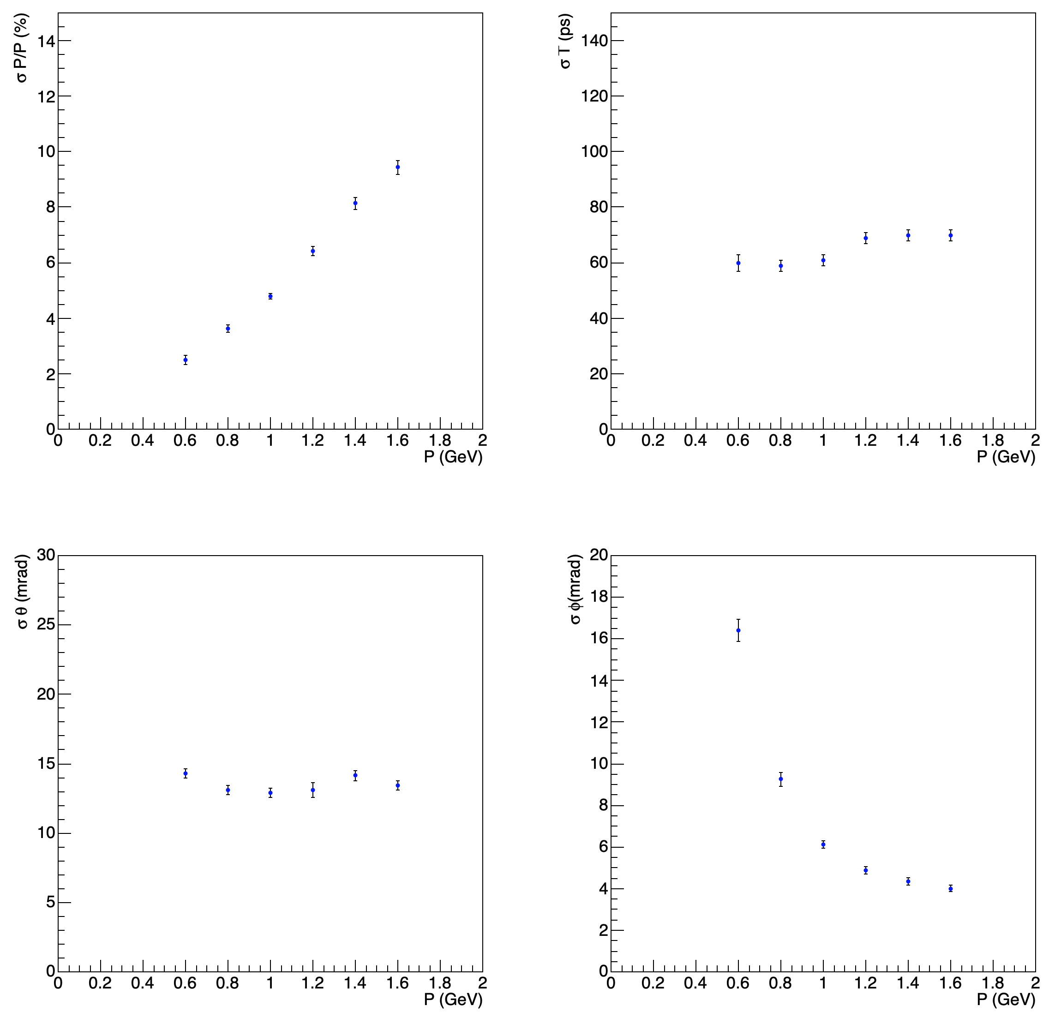
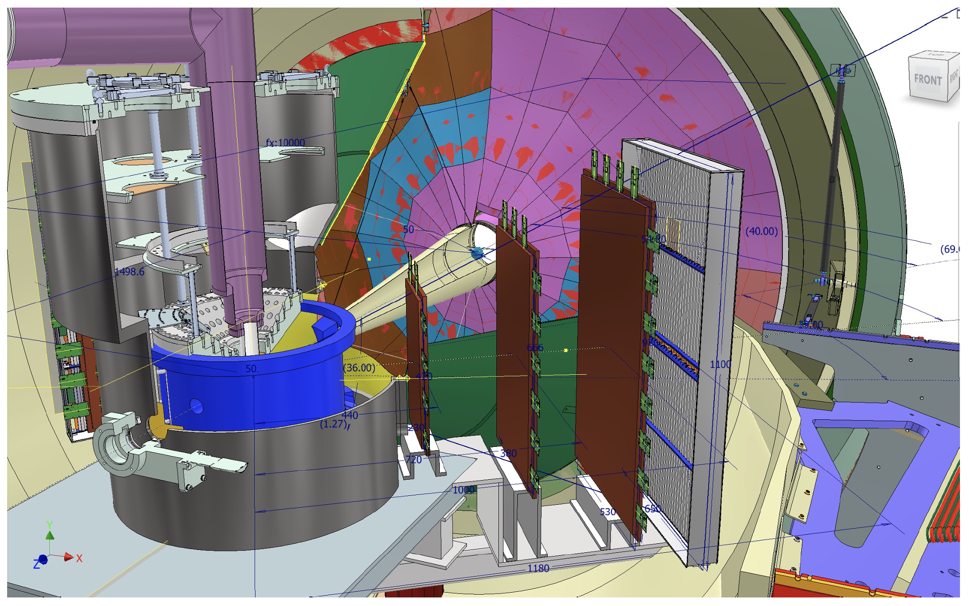
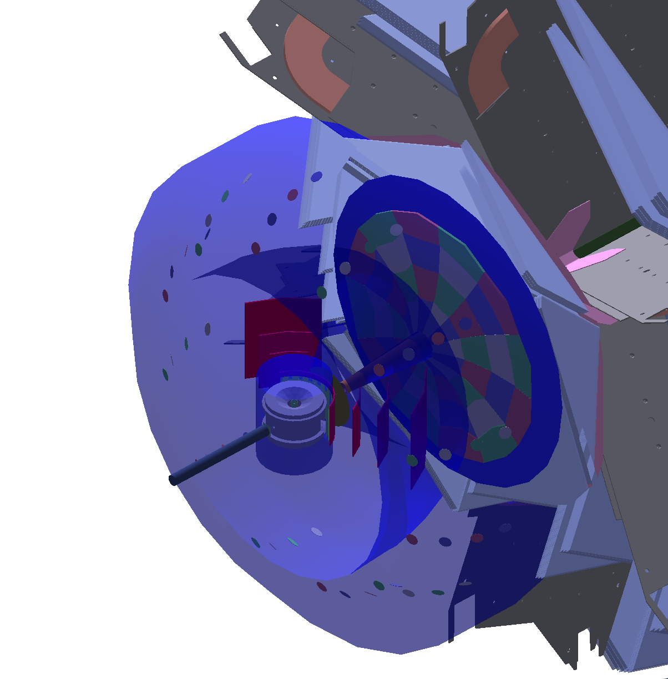
RGH Recoil
Simulated RGH recoil resolution
based on ongoing tech. development
and CLAS12 baseline tracking resolution
CLAS12 Standard
Recoil concept
TOF
u-Rwell
G. Ciullo - C.d.S. INFN Ferrara – 02/07/2026

Slide 12
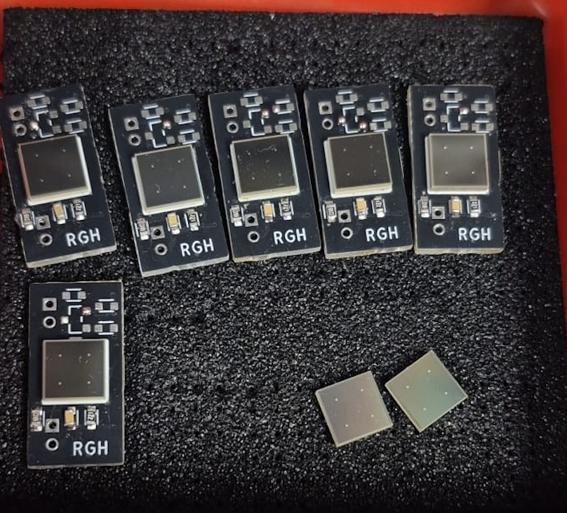
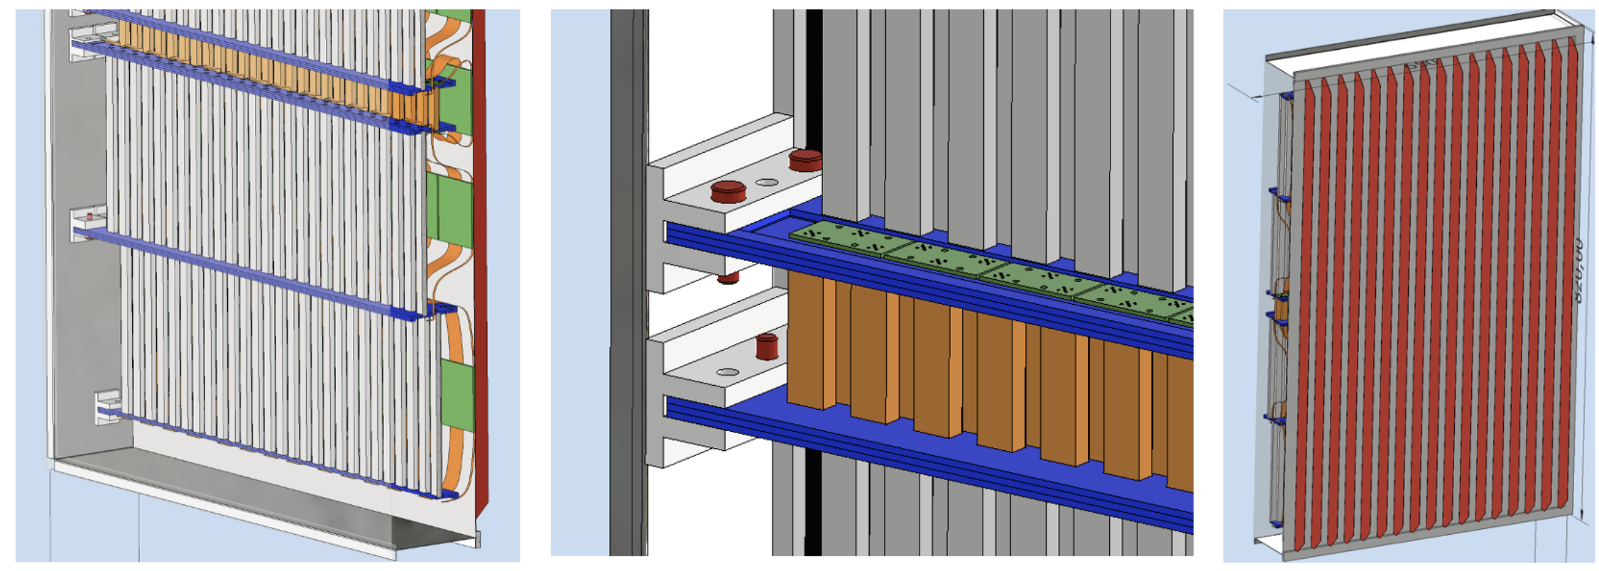
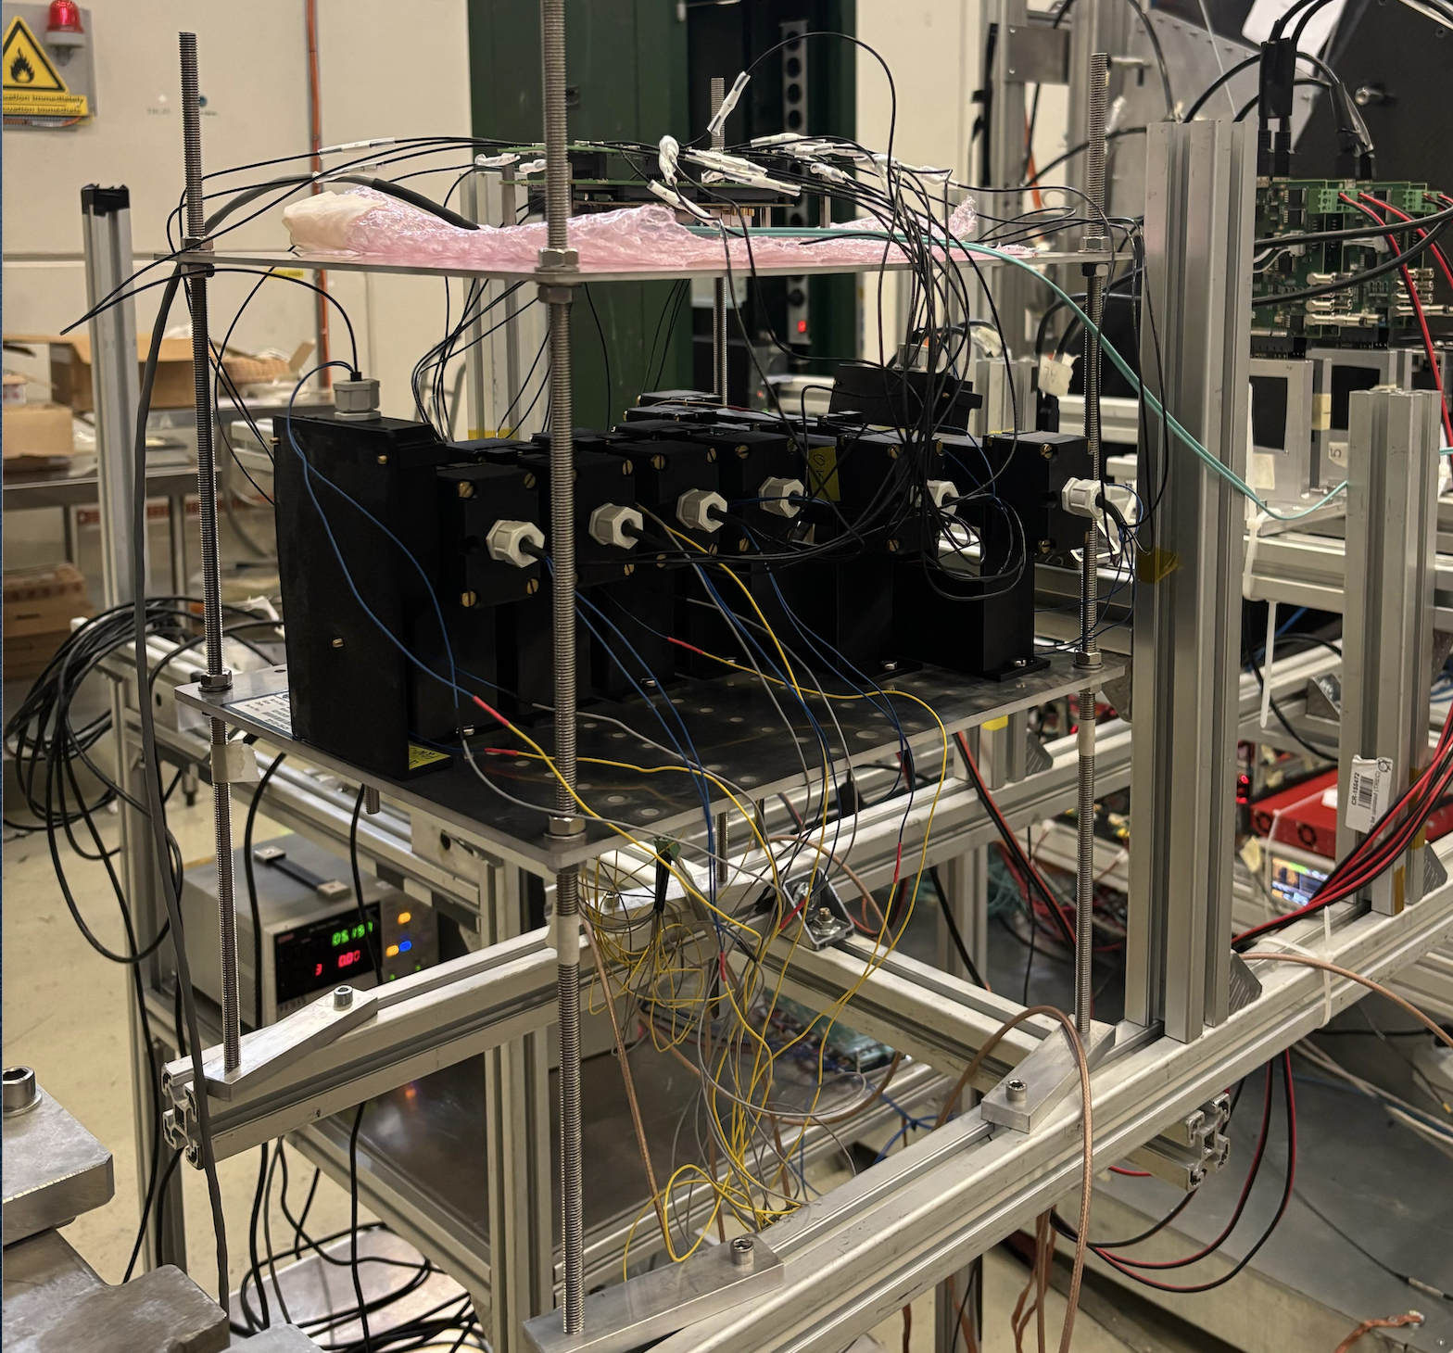
RGH Recoil: TOF Detector
Scintillating bars readout by SiPM Synergy with ePIC (dRICH tagger)
Proven to match 100 ps, e.g. by PANDA and MUSE.
✓ Flexible geometry to provide spatial matching and control of accidentals
✓ Compact layout
Small demonstrator realized in 2026
Developed thanks to R. Malaguti, L. Barion
G. Ciullo - C.d.S. INFN Ferrara – 02/07/2026

Slide 13
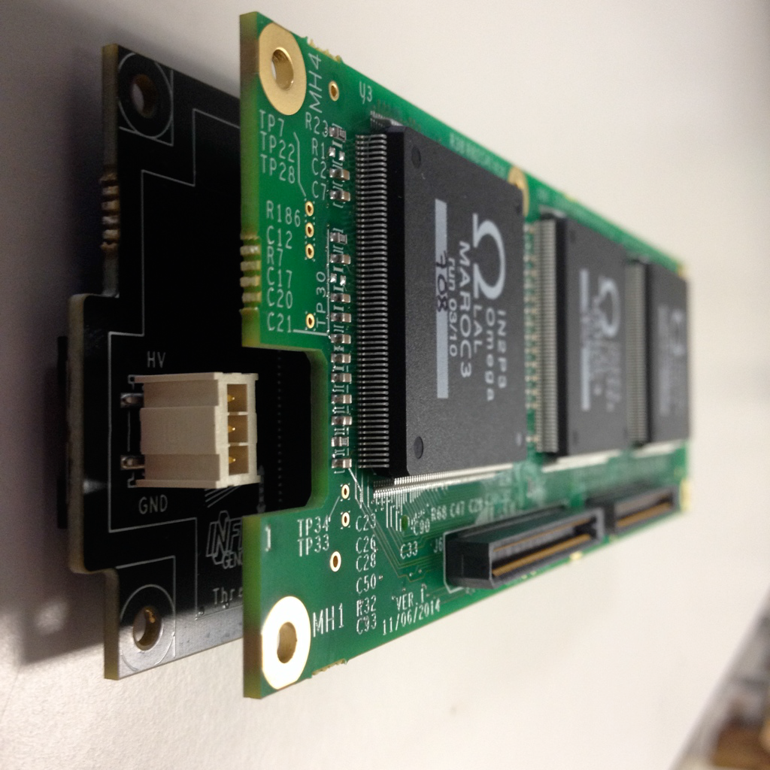
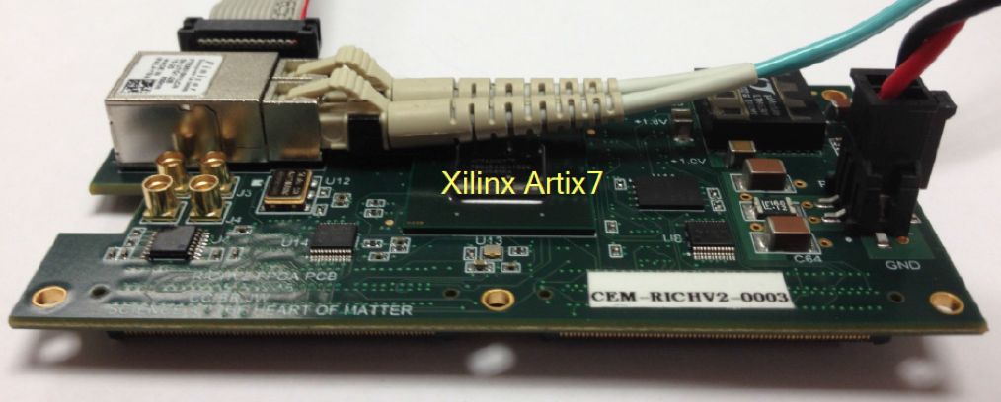
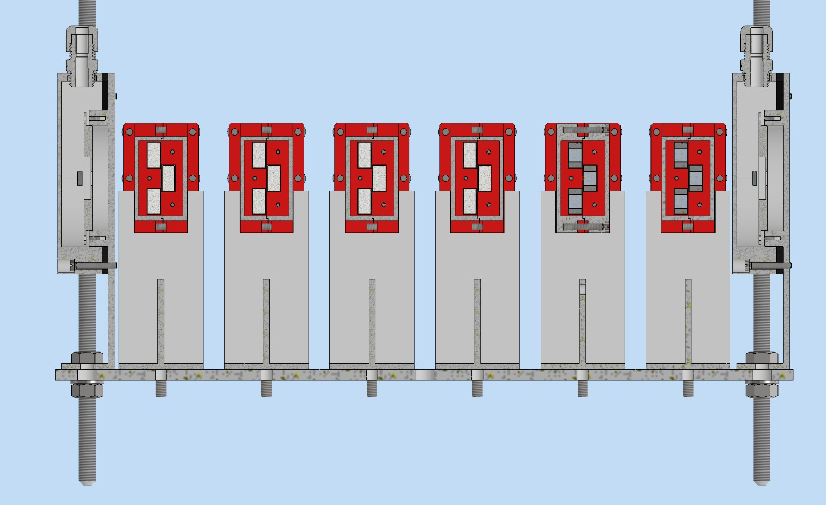
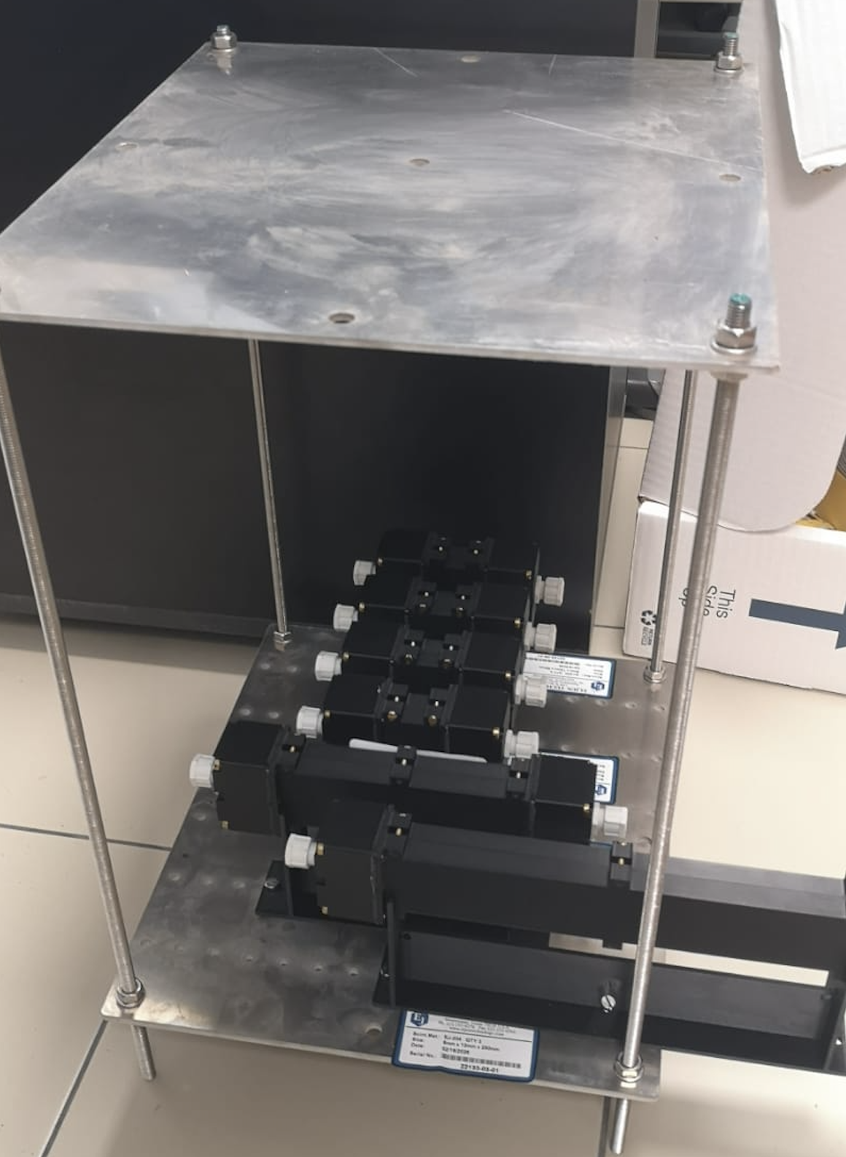
RGH Recoil in 2027: Timing Tests
New potential application of the CLAS12 RICH Electronics reading SiPM
RICH readout
✓ MAROC dynamic range can
cope with multi-photon signals
✓ Clock distribution supports
100 ps readout precision
Particle
Development thanks to R. Malaguti, L. Barion
G. Ciullo - C.d.S. INFN Ferrara – 02/07/2026

Slide 14
Bulk Magnet
Alternative to the use of a massive 5 T magnet to increase acceptance (for recoil)
A hollow bulk superconductor is able to provide a transverse holding field inside, while adjusting its internal currents to shield any outside field, without the need of a current supply!
Last step: double-filed test (magnetization and shielding together)
Spin-off: Polarized Fusion (Polfusion & PREFER)
magnetization
Development thanks to L. Barion
G. Ciullo - C.d.S. INFN Ferrara – 02/07/2026

Slide 15
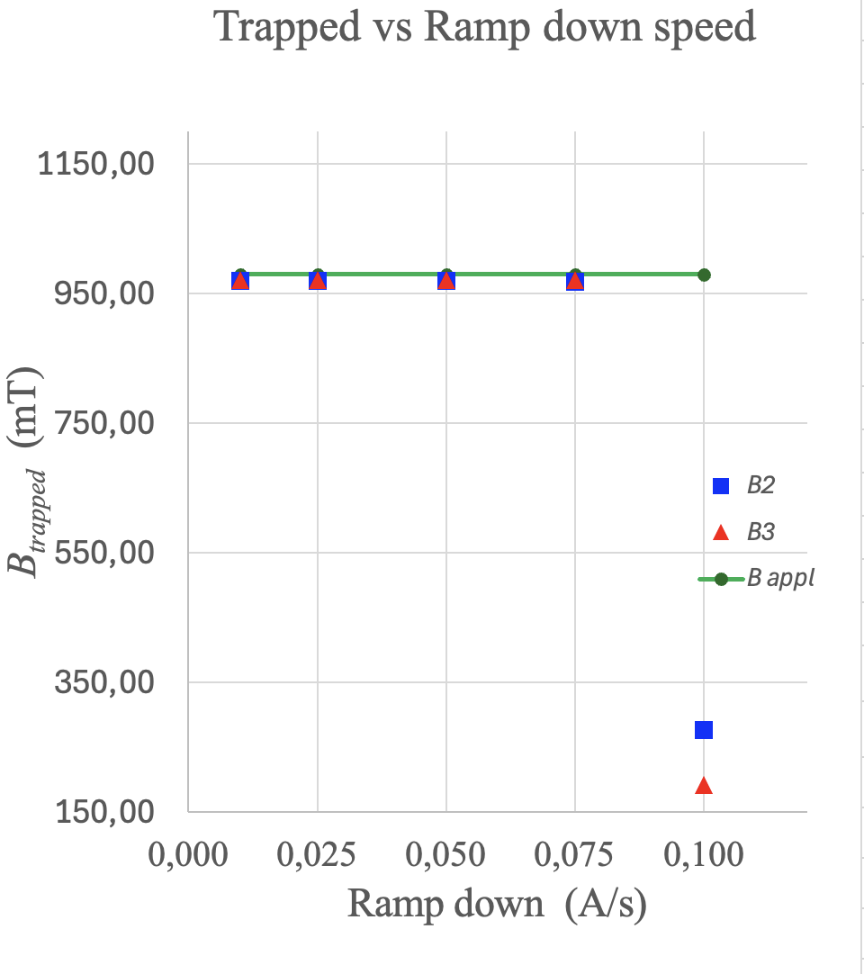
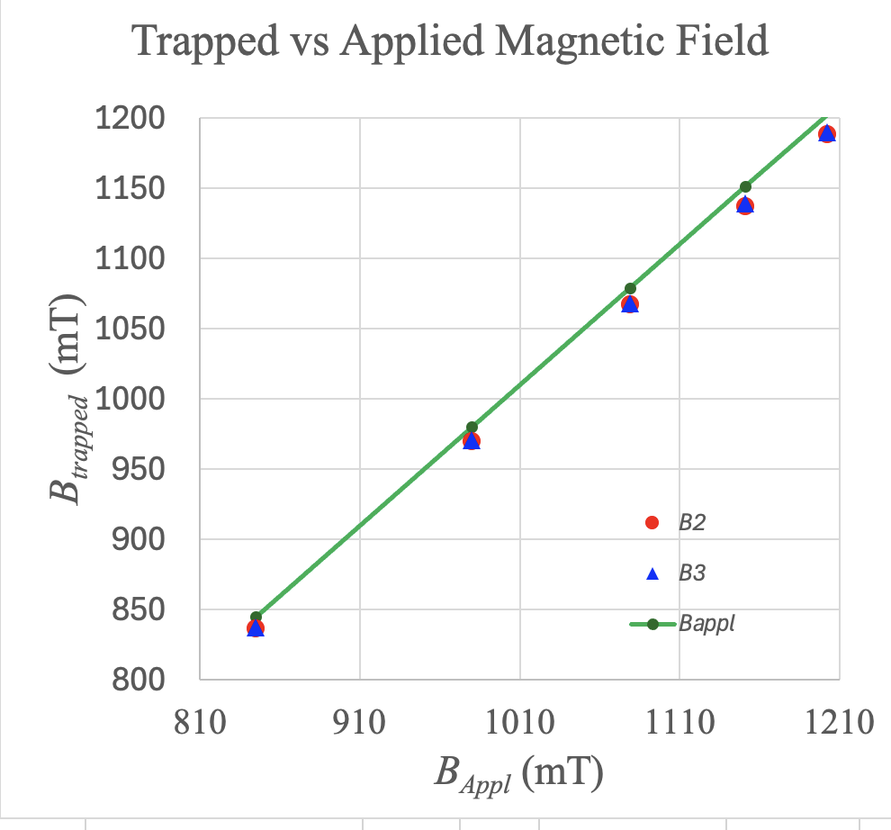
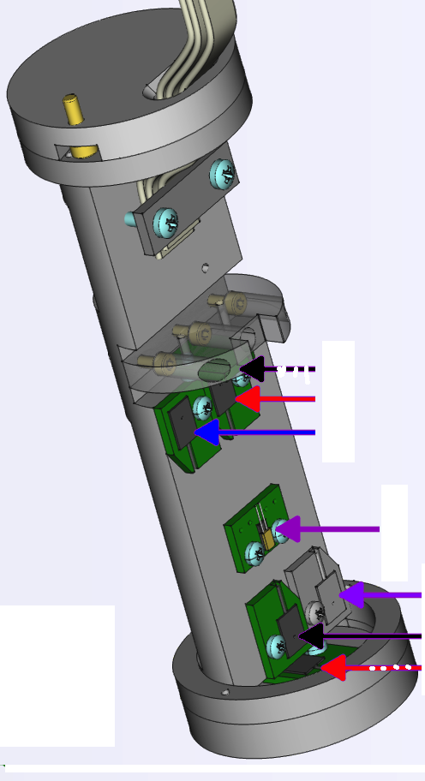
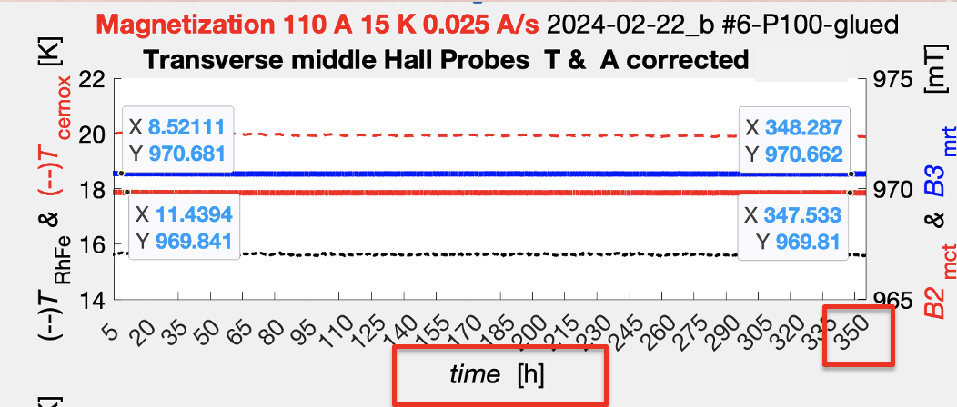
Bulk Magnet: Systematic Studies
B₂
B₃
G. Ciullo - C.d.S. INFN Ferrara – 02/07/2026

Slide 16
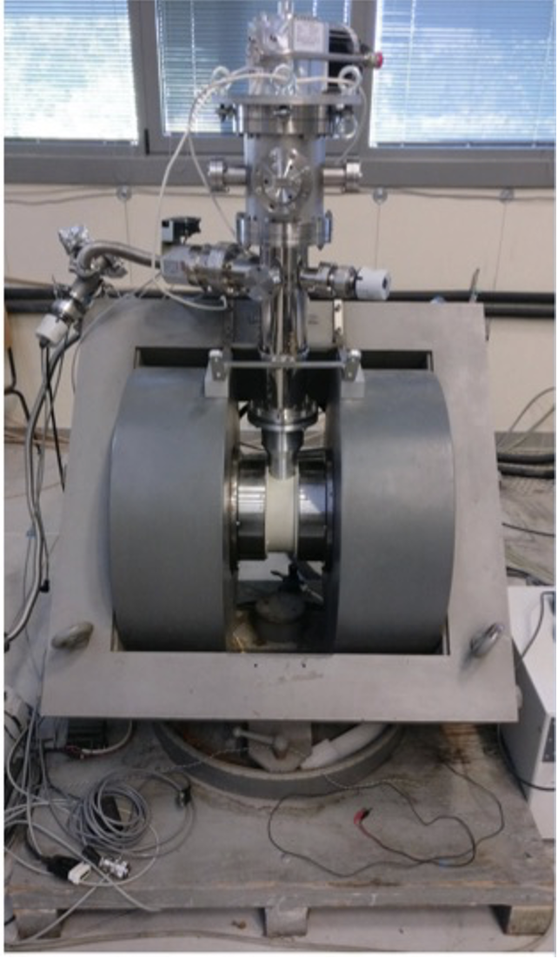
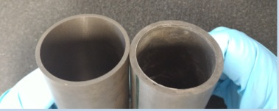
Bulk Magnet in 2027: Double field test
Final milestone: dipole field preservation even inside a growing solenoidal field
Development thanks to L. Barion
G. Ciullo - C.d.S. INFN Ferrara – 02/07/2026

Slide 17
Il gruppo di Ferrara @ JLab
Responsabilita’:
M. C.: responsabile locale
M. C. : past-chair of the Jlab User Organization (till June ‘25)
M. C.: contact person for the RGH experiments with transversely polarized target
M. C. responsabile progetto RICH
M. C. & L.P. Co-spokesperson di diverse proposte di esperimento (PAC34,37,38,39)
Contributi principali del gruppo:
Data analysis
- Data analysis on kaon SIDIS
RICH detector
- Reconstruction and alignment algorithms
Magneti superconduttori
- Configurazione magnetica per transverse target
- Frozen field con magneti a bulk di superconduttore
Esperimenti con bersagli trasversi
- Recoil detector design
- R&D on time-of-flight system
G. Ciullo - C.d.S. INFN Ferrara – 02/07/2026

Slide 18

ePIC
Nucleon structure and spin physics
Transverse momentum phenomena (TMDs) & 3D imaging
GPDs & mechanical properties of the nucleon
M. Contalbrigo Lead of dRICH detector subsystem
Responsible of EIC dRICH R&D - eRD102 (till 2026)
A. Saputi Responsabile for dRICH mechanics
INFN-FE: Dual-radiator RICH (dRICH) in ePIC hadron end-cap
(project led by INFN)
G. Ciullo - C.d.S. INFN Ferrara – 02/07/2026

Slide 19

EIC
Electron Ion Collider:
Strong interest in Italian nuclear physics
community (theory and experiment)
CD1 approval in June 2021
EPIC Coll. for 1st detector start in fall 2022
Detector subsystems defined in spring 2023
EIC_NET moved into ePIC in June 2024
ePIC pre-TDR completed in 2025
CD2 expected in 2027
INFN Ferrara leading the dRICH subsystem
We recommend the expeditious completion of the EIC as the highest priority for facility construction.
G. Ciullo - C.d.S. INFN Ferrara – 02/07/2026

Slide 20

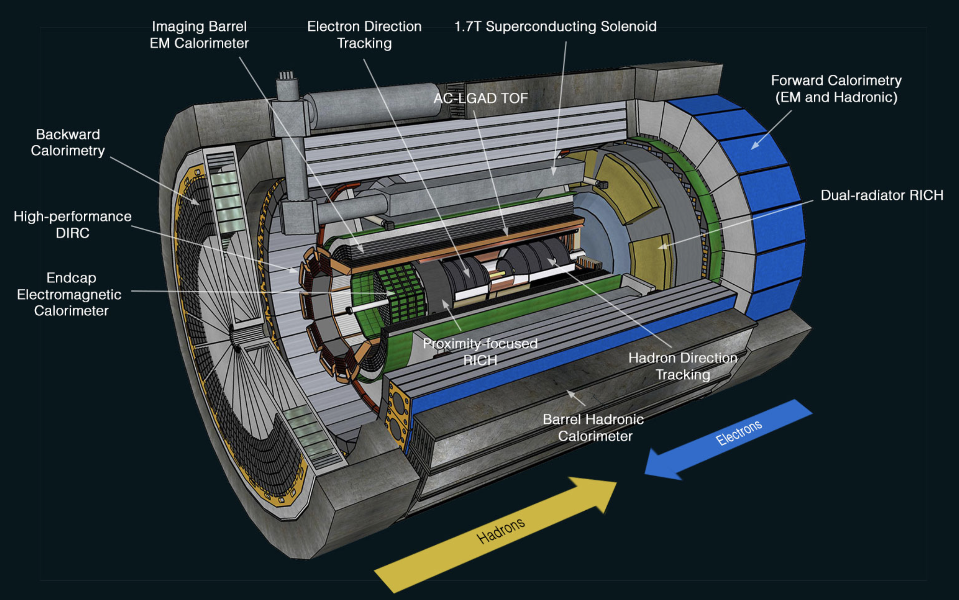
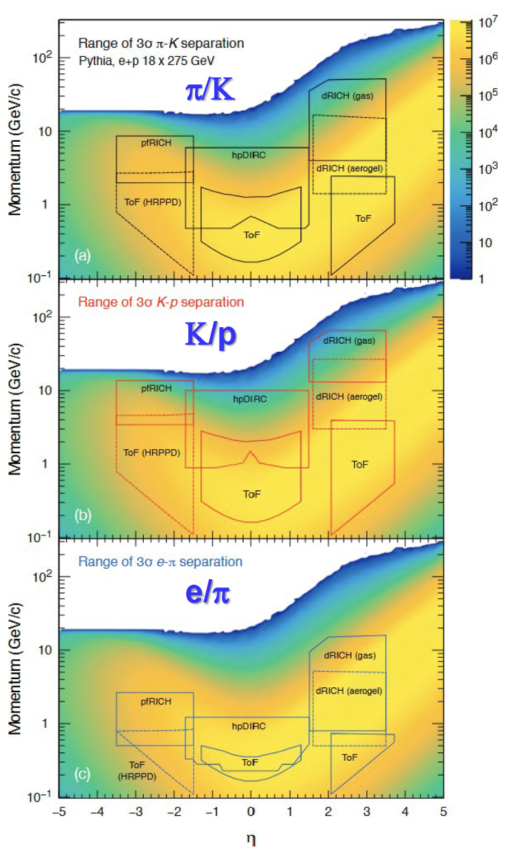
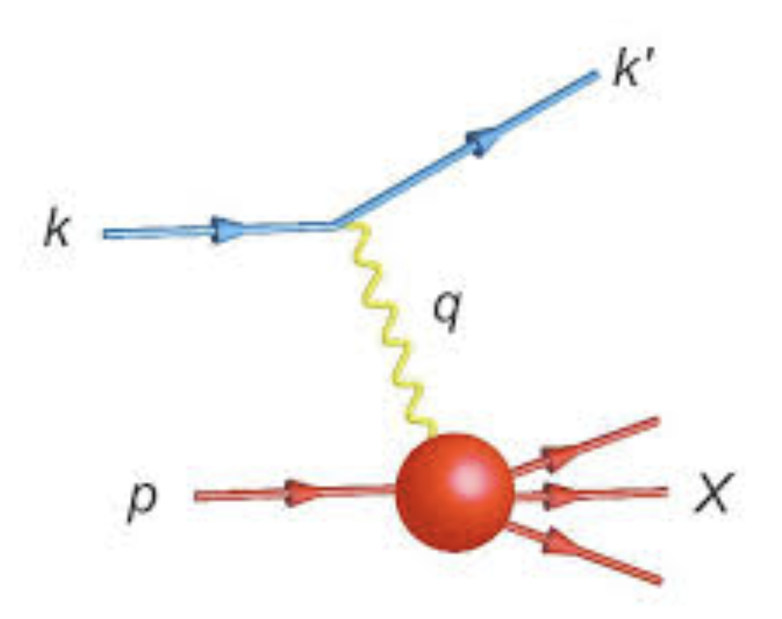
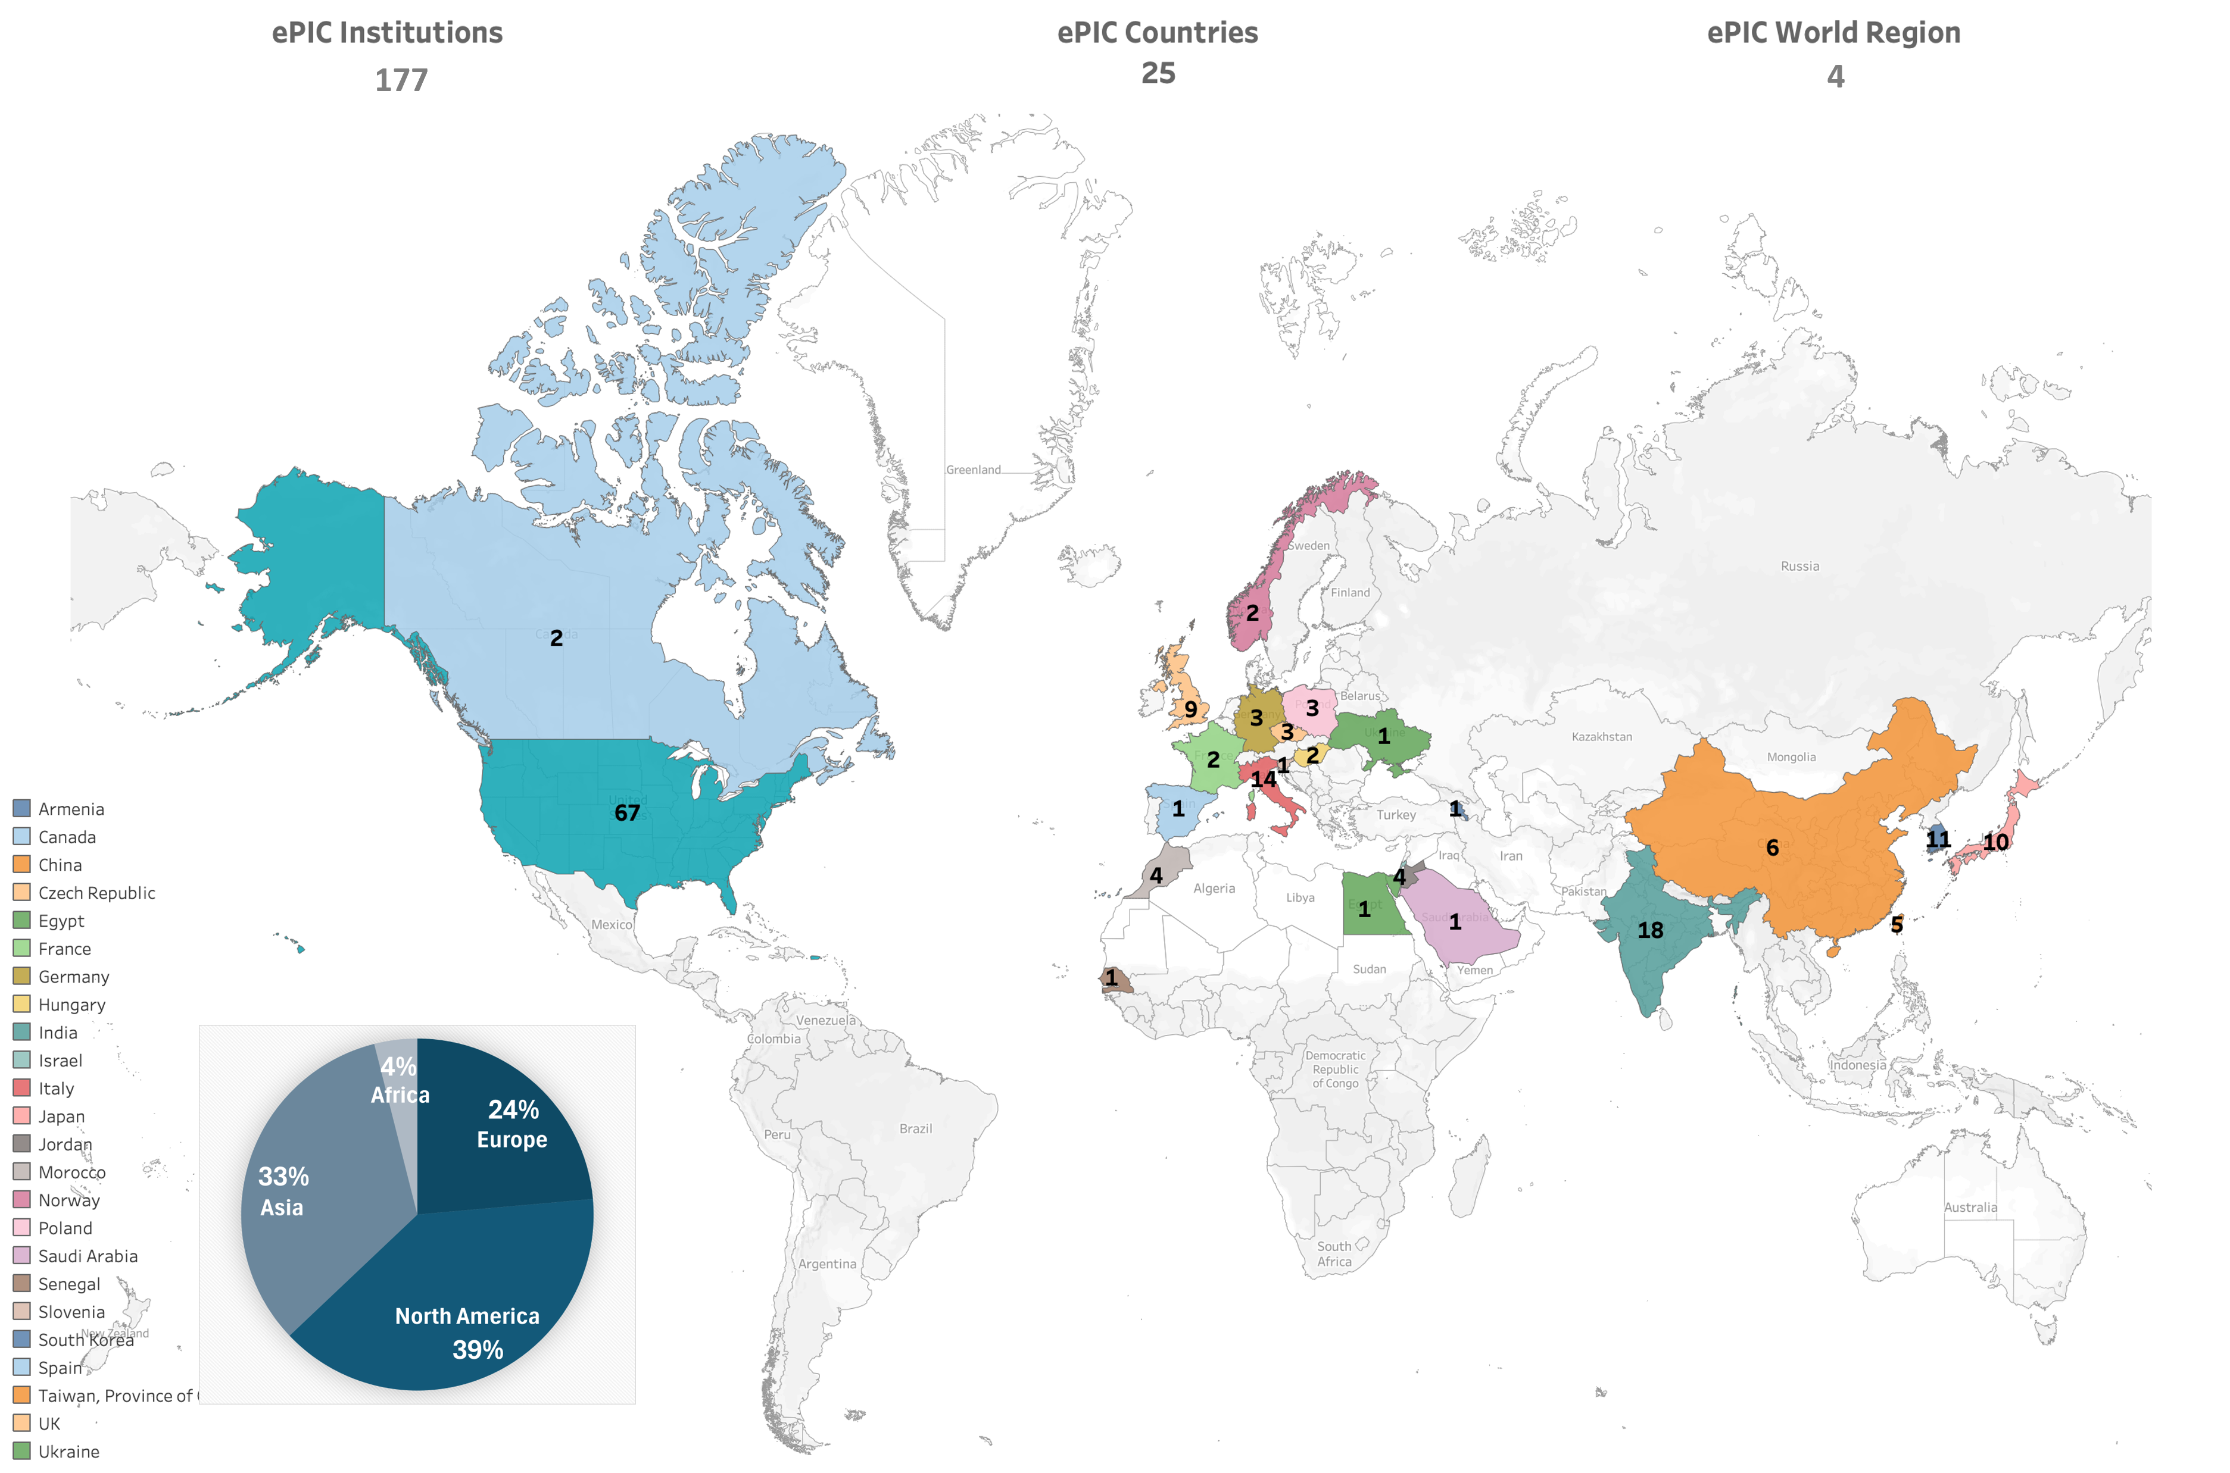
ePIC: The Collider Experiment
5-18 GHeV
41-275 GHeV
ePIC Collaboration
https://www.epic-eic.org
~1031collaborators, 25 countries, 177 institutions
US: 8 National Labs + 59 Universities
G. Ciullo - C.d.S. INFN Ferrara – 02/07/2026

Slide 21
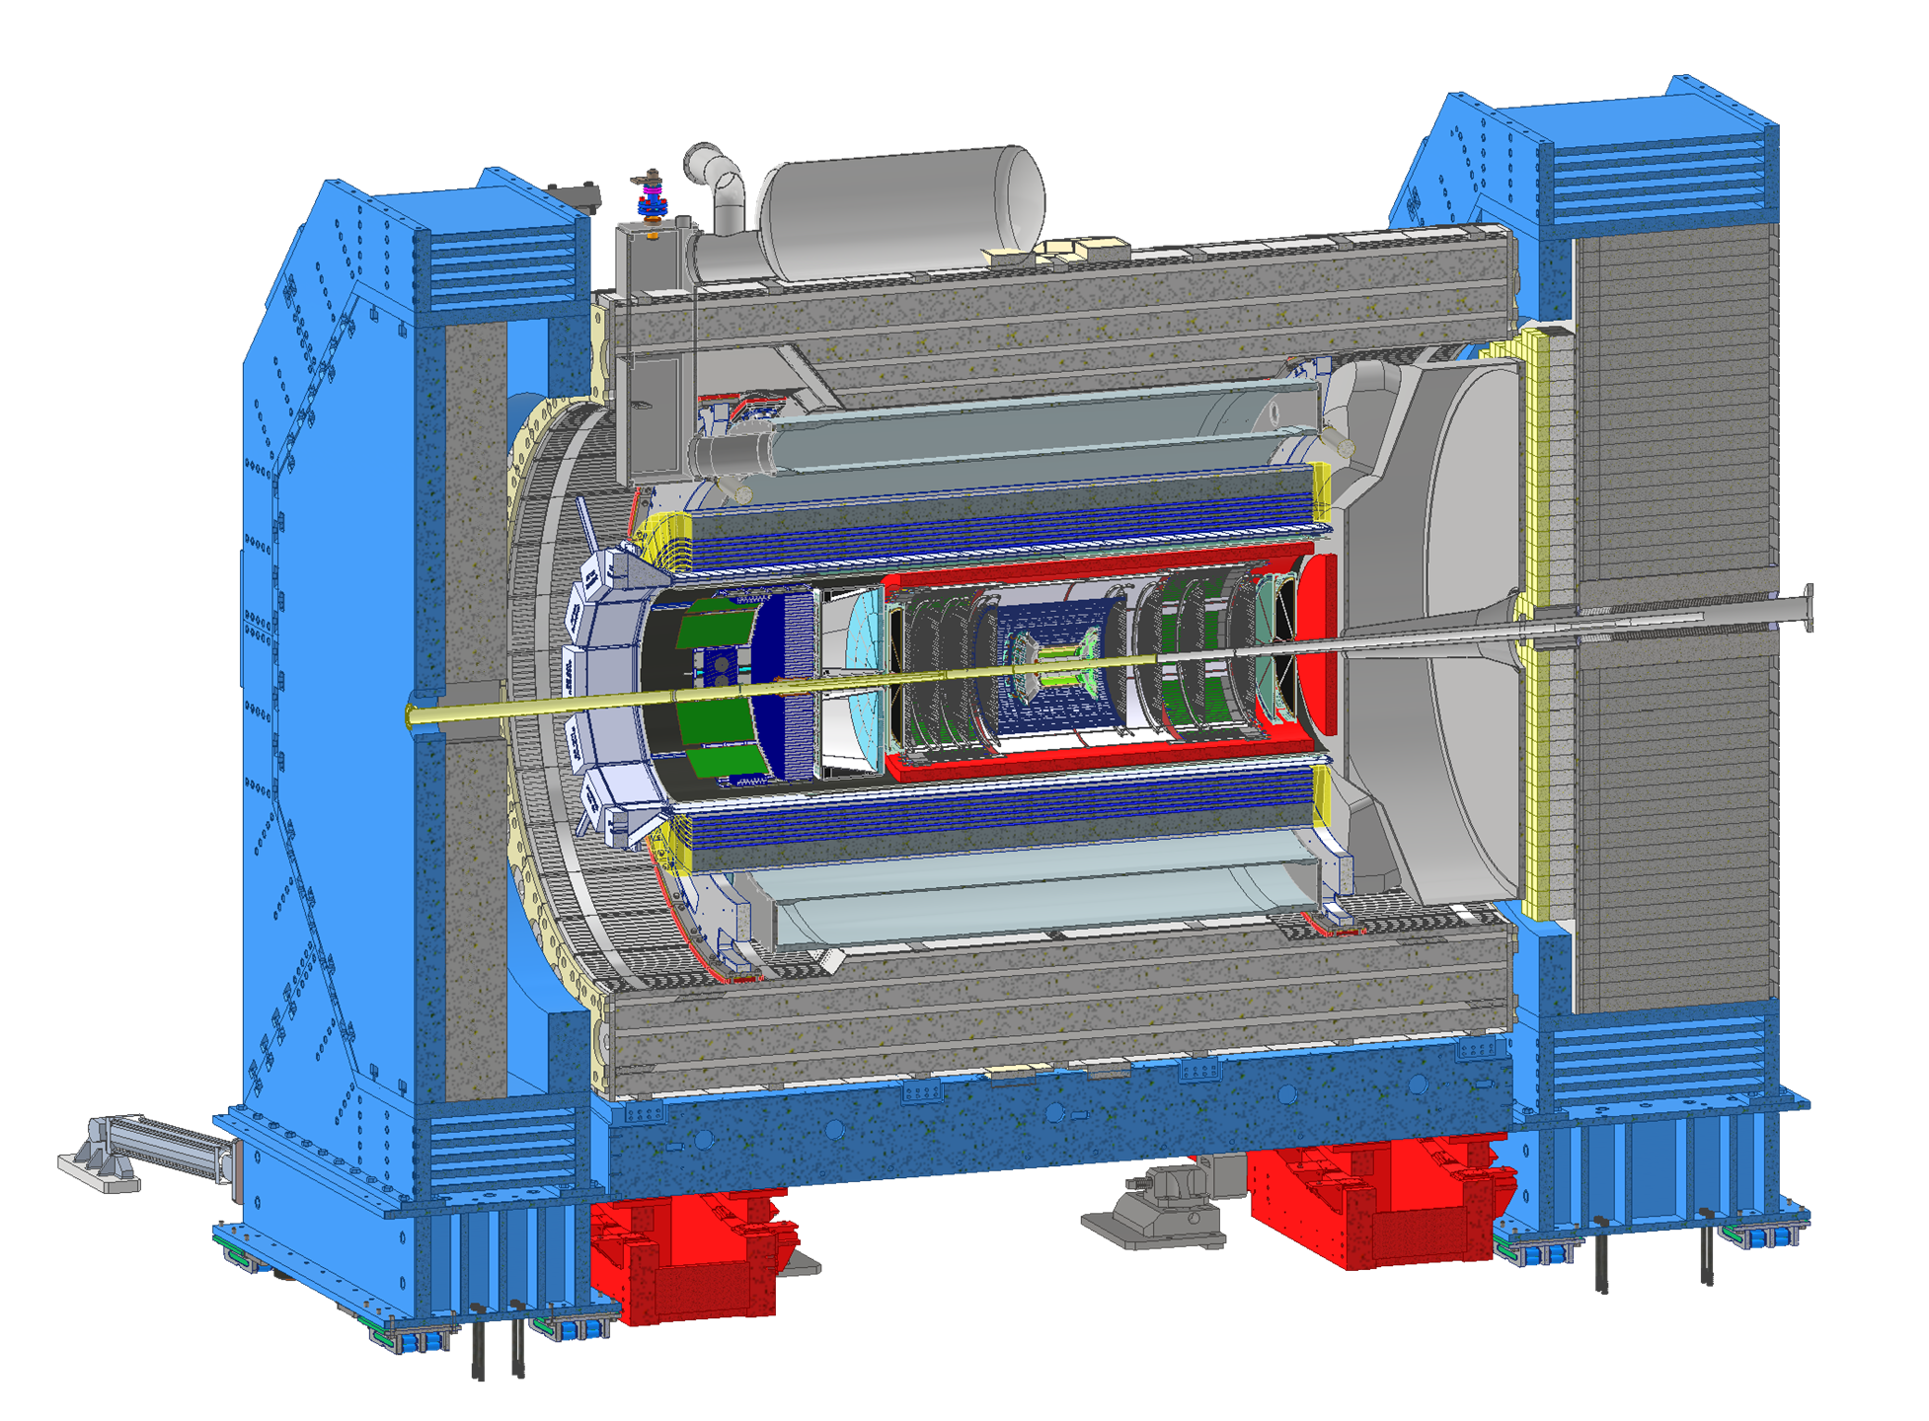
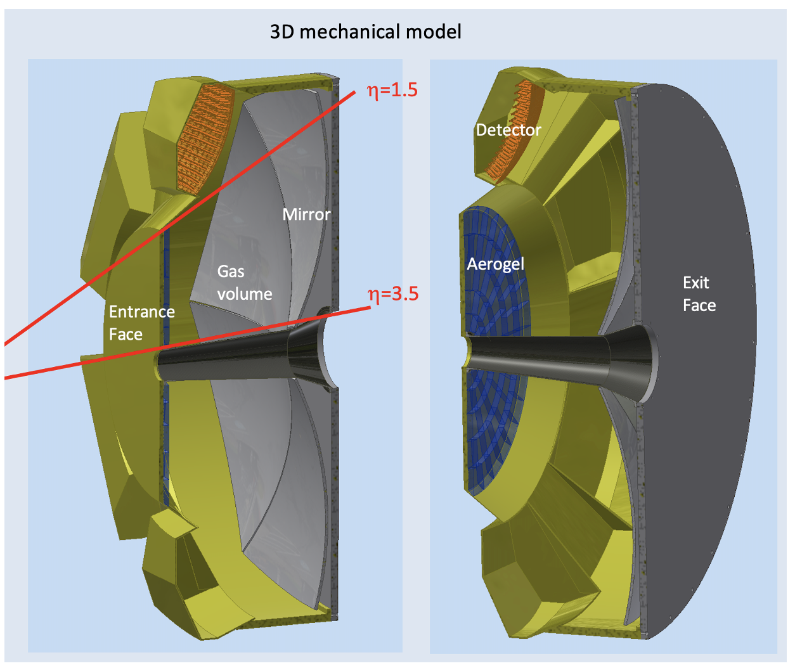
Dual-Radiator RICH
Goals:
Hadron 3σ−separation between 3 - 50 GeV/c
Complement electron ID below 15 GeV/c
Cover forward pseudorapidity 1.5 (barrel) - 3.5 (b. pipe)
Essential to access flavor information
4m
dRICH Features:
Extended 3-50 GeV/c momentum range --> Dual radiator
Single-photon detection in high Bfield --> SiPM
Limited space --> Compact optics with curved detector
G. Ciullo - C.d.S. INFN Ferrara – 02/07/2026

Slide 22
dRICH Organization Chart
6.10.04 Particle Identification Level-3
CAM from DOE EIC Project
6.10.04.03 dRICH Level-4
CAM from Project + M. Contalbrigo (DSTC from EPIC )
Work packages lead from EPIC
Photo-Detector Level-5
R. Preghenella, INFN-BO, INFN-FE, INFN-CS, INFN-SA, INFN-LNF, INFN-CT, INFN-TS, NISER
F. Cossio, INFN-TO, INFN-BO
P. Antonioli, INFN-BO, INFN-FE
A. Saputi, INFN-FE, INFN-CT, INFN-GE, JLAB, BNL
F. Tessarotto, INFN-TS, BNL
A. Vossen, DUKE, JLab, INFN-FE
G. Volpe, INFN-BA, INFN-FE, Temple U., RICH Consortium
S. Dalla Torre, INFN-FE, INFN-TS, DUKE, INFN-FE
C. Chatterjee, INFN-TS, INFN-CS, INFN-GE, INFN-LNS, DUKE, CUK, CUH, Ramaiah U.
Front-end Asics Level-5
Data-acquisition Level-5
Mechanics Level-5
Gas radiator Level-5
Mirror Level-5
Aerogel Radiator Level-5
Pressurized RICH Level-5
Simulation
G. Ciullo - C.d.S. INFN Ferrara – 02/07/2026

Slide 23
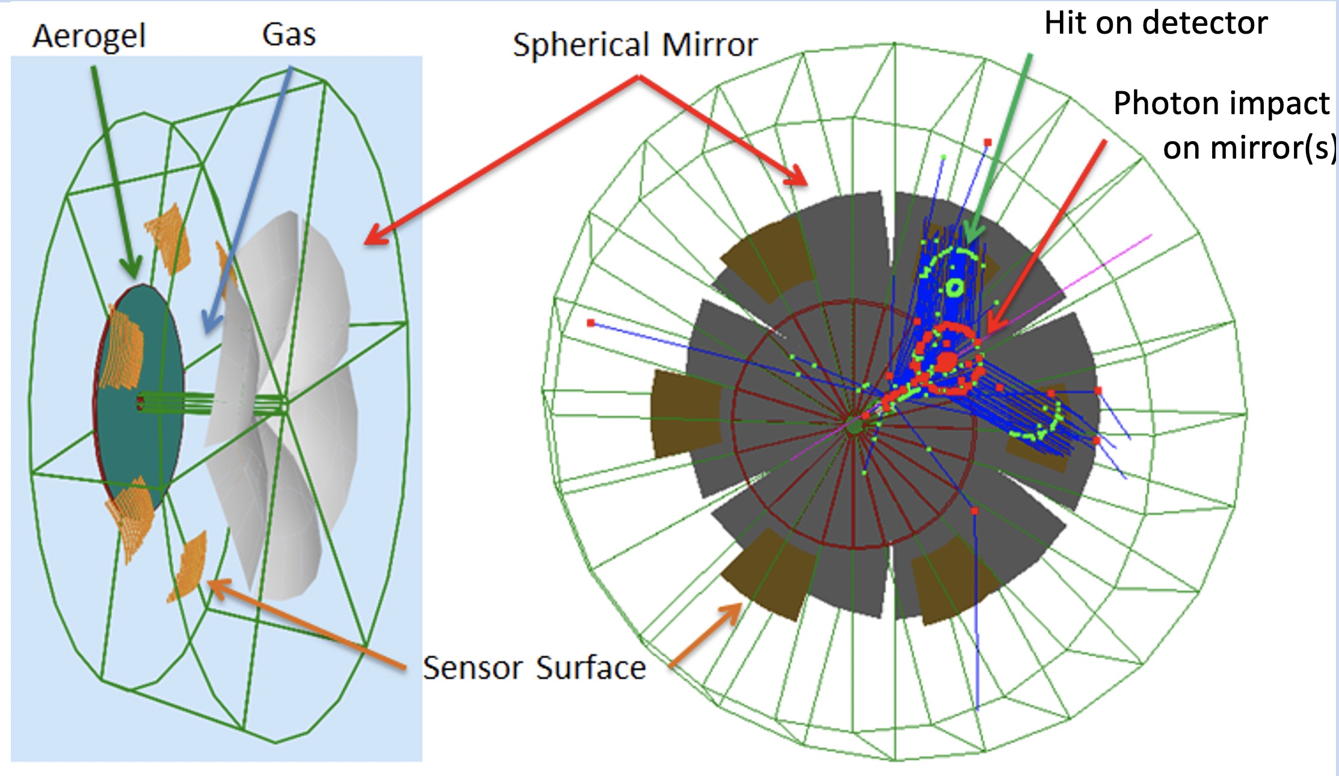
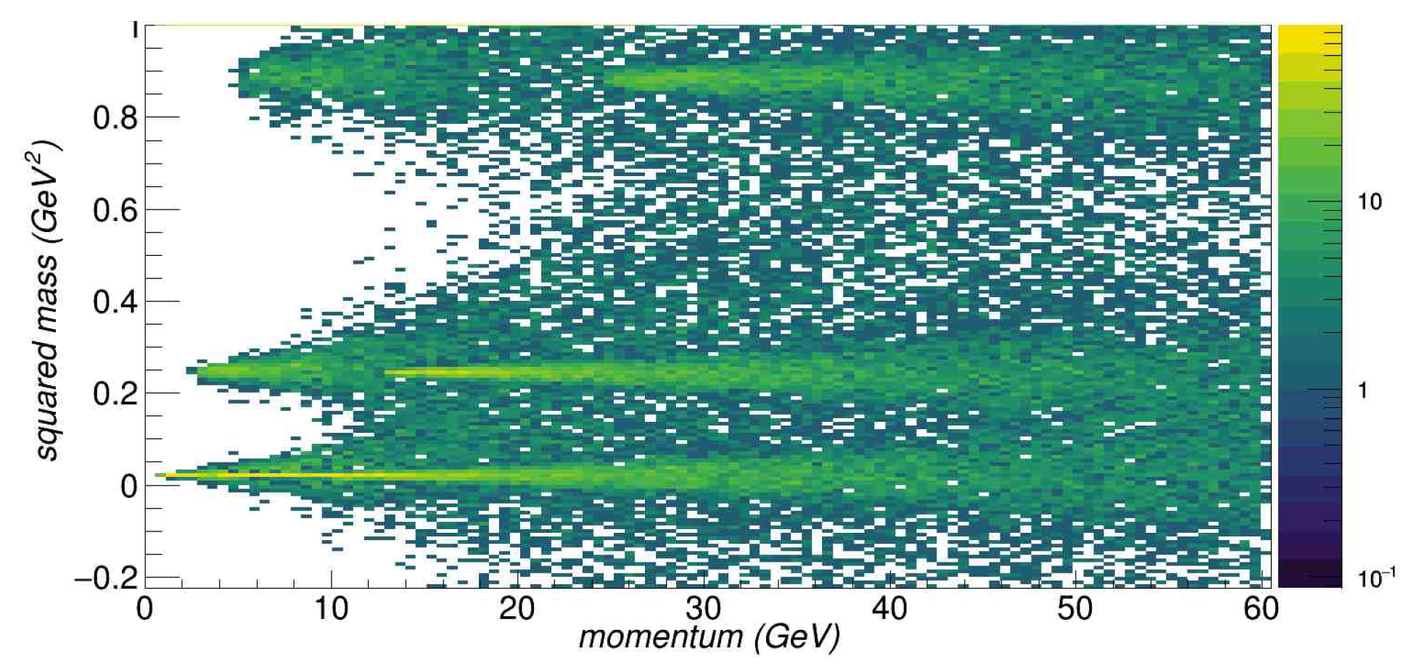
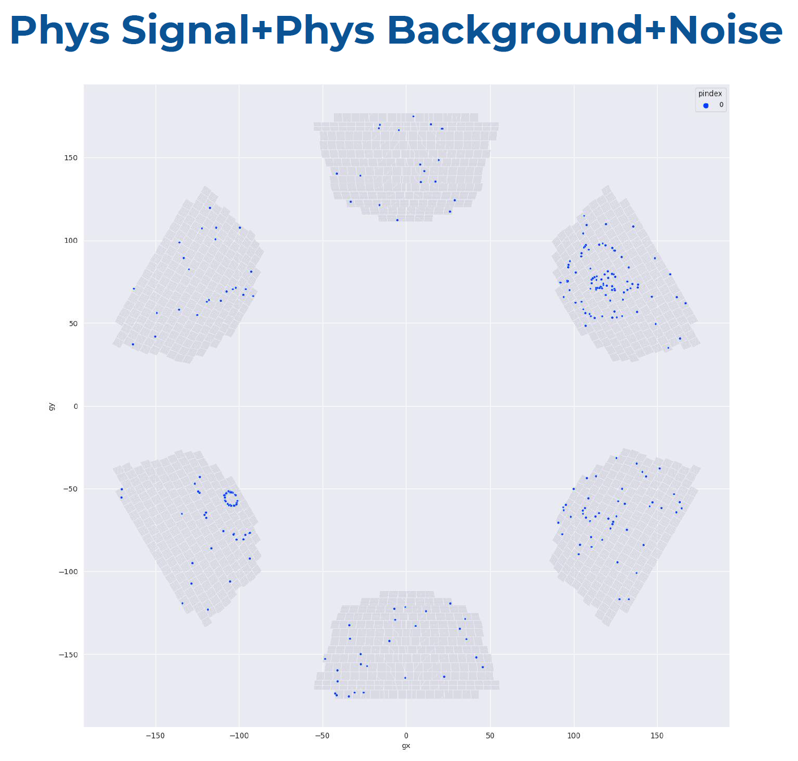
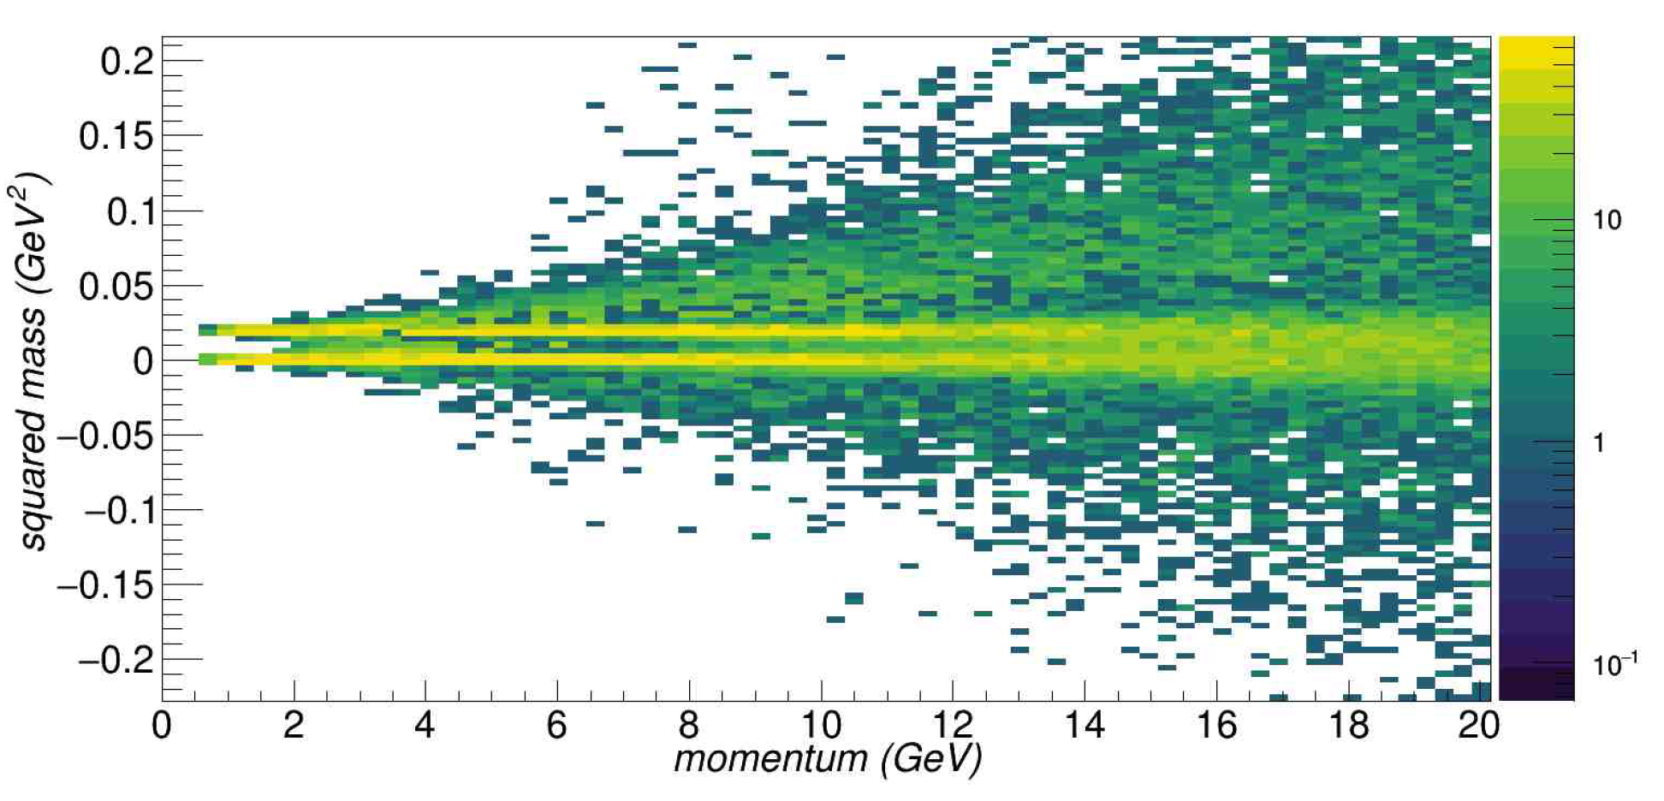
dRICH Performance
p
k
π
π
e
G. Ciullo - C.d.S. INFN Ferrara – 02/07/2026

Slide 24
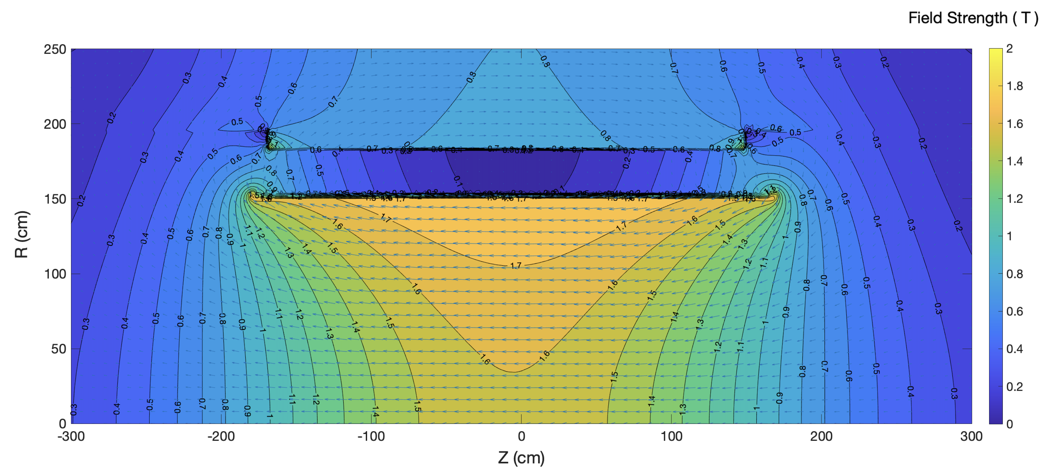
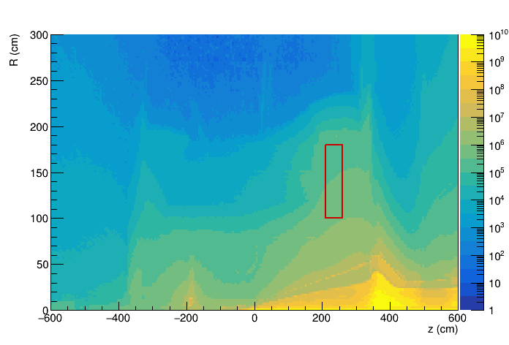

dRICH SiPM Sensors
1.7 T field
1-MeV neutron equivalent fluence (1 fb⁻¹ ep running)
ePIC background group
beam-beam interactions only
dRICH
dRICH
Benchmark fluence (10 x)
~ 10⁷ 1-MeV n_{eq}/cm² / fb⁻¹
Strong and not-uniform magnetic field
Moderate radiation levels (up tp 10¹¹ n_{eq}/cm²)
Usage of SiPM with
- low temperature working point
- periodic annealing at high temperature
(in-site by Joule effect)
G. Ciullo - C.d.S. INFN Ferrara – 02/07/2026

Slide 25




dRICH Photon Detection Unit
Steadly progress of photodetector towards integrated design completion in 2026
/26
50 μm
75 μm
ALCOR 32 ch
Full size engineering
test article
2025
+ SiPM carrierv3
+ RDO
2027
+ ALCOR 64ch
+ FEB 64
Contributions by L. Barion, M. Cavallina, R. Malaguti
G. Ciullo - C.d.S. INFN Ferrara – 02/07/2026

Slide 26






dRICH Mechanics
A detailed mechanical model of the single-vessel detector is outlined with composite materials
Shell
(CFRP bulk)
Recomm. (DAC): Provide material for the pending decision
on the single vs two vessel version of the detector.
Detector box
(aluminum)
Exit window
(CFRP sandwich)
Pipe
(bulk)
Entrance window
(CFRP sandwich)
Composite materials
Total wieght: ~ 2 ton
PDU detector
Quartz window
Detector box
Off-axis bore
Design thanks by A. Saputi
G. Ciullo - C.d.S. INFN Ferrara – 02/07/2026

Slide 27






dRICH Real-Scale Prototype
eRD102 Final Milestone (achieved)
Real-Scale Prototype (1 sector) with support saddle + platform for safe operations (ePIC pseudorapidity scan)
ALCOR v64
RDO
“Final” Photon Detector Units
Mirror
Test Article
Aerogel
Test Article
γ
Beam
Development thanks to A. Saputi, M. Melchiorri, F. Evangelisti, M. Cavallina, A. Forlani
R. Malaguti, L. Barion
G. Ciullo - C.d.S. INFN Ferrara – 02/07/2026

Slide 28



dRICH Real Prototype: Mechanics
Safety requires specail attention (transport & assembling)
Development thanks to A. Saputi, M. Melchiorri, F. Evangelisti, M. Cavallina, A. Forlani
G. Ciullo - C.d.S. INFN Ferrara – 02/07/2026

Slide 29


dRICH Real Prototype: Slow Control
Monitor of pressures,
temperature gradients,
gas contaminants (H₂O, CO₂) and
gas stratification / mixing
CO₂
Open
T
H/T
T
H/T
H/T
T
T
T
T
H/T
Development thanks to R. Malaguti, L. Barion
G. Ciullo - C.d.S. INFN Ferrara – 02/07/2026

Slide 30



dRICH Test-Beam: Installation
Evangelisti F.
Cavallina M.
Saputi A.
Contalbrigo M.
Many thanks to A. Saputi, F. Evangelisti, M. Cavallina
G. Ciullo - C.d.S. INFN Ferrara – 02/07/2026

Slide 31






dRICH Test-Beam: Installation
SPS – 1.5 week
PS – 2 weeks
M. Contalbrigo
31
Big installation, repeated twice in one month in two different beam lines
Many thanks to A. Saputi, F. Evangelisti, M. Cavallina
G. Ciullo - C.d.S. INFN Ferrara – 02/07/2026

Slide 32




dRICH Test-Beam Optical Components
SiPM detector box and carbon fiber mirror
Aerogel demonstrator
Quartz window and curved active surface mockup
Development thanks to A. Saputi, M. Melchiorri, M. Cavallina, A. Forlani, L. Barion
G. Ciullo - C.d.S. INFN Ferrara – 02/07/2026

Slide 33




dRICH Test-Beam HighLights
Highlight SPS: gas performance (MaPMTs) in the ball-park of ePIC simulations
Highlight PS: 2% kaons ID on aerogel after tagging pions/electrons with gas
PRELIMINARY
Beam | N. photoelectrons | Singl-photon resolution | Track resolution
180 GeV/c proton | 20 | 1.3 | 0.45
ePIC | 18 | 1.2 | 0.3
PRELIMINARY
Before tagging
After tagging
Projection
p
K
G. Ciullo - C.d.S. INFN Ferrara – 02/07/2026

Slide 34





dRICH in 2027: Detector Box Engineering
Engineering of detector box
planned in 2026-2027
Master Panel
Cooling plates chained in a supporting coloumn
Divide SiPM (low T) and electronics (high power, high T) circuits
Development thanks to
A. Saputi, M. Melchiorri, M. Cavallina, A. Forlani
G. Ciullo - C.d.S. INFN Ferrara – 02/07/2026

Slide 35



dRICH in 2027: Detector Box Engineering
Master Panel
Power distribution optimization (SiM bias + annealing)
Master Panel
Master Logic
Development thanks to R. Malaguti, L. Barion
G. Ciullo - C.d.S. INFN Ferrara – 02/07/2026

Slide 36
ePIC: responsabilità
Responsabilita’:
M. C.: responsabile locale ePIC
M. C.: responsabile dRICH
A. S.: responsabile dRICH mechanics
M. C.: Coordinator eRD102 (till 2026)
M. C.: IAC POETIC (Physics Opportunities at EIC) Conference
Contributi principali FE:
dRICH detector
- dRICH mechanics
- Prototyping
- Optical component characterization
- Sensor & electronics irradiation program
Electronics
- Control boards: Power distribution and temperature control
- MAROC (reference) + ALCOR (INFN development)
G. Ciullo - C.d.S. INFN Ferrara – 02/07/2026

Slide 37
Richieste ai Servizi
Servizio Meccanico
FE laboratory: supporto per misure e stazioni di test, preparazione test-beam
JLAB12
TTarget: supporto per test con doppio campo magnetico (Ferrara + LASA Milano)
Recoil: contributo meccanica tracciatore recoil
EIC_NET
dRICH: progettazione meccanica del rivelatore dRICH
dRICH: meccanica del prototipo dRICH e ingegnerizzazione detector box
Servizio Elettronico
FE laboratory: supporto per misure e stazioni di test, preparazione test-beam
JLAB12
TTarget: piccoli contributi alle misure con magneti superconduttori
TTarget: contributo lettura recoil detector (MAROC)
ePIC
dRICH: contributo piano di rivelazione curvo basato su SiPM + ALCOR
dRICH: master panel di controllo rivelatore
G. Ciullo - C.d.S. INFN Ferrara – 02/07/2026

