Slide 1
A laser beam pass through a 10x10x3 cm3 aerogel tile with 43 mm transmission length.

Slide 2
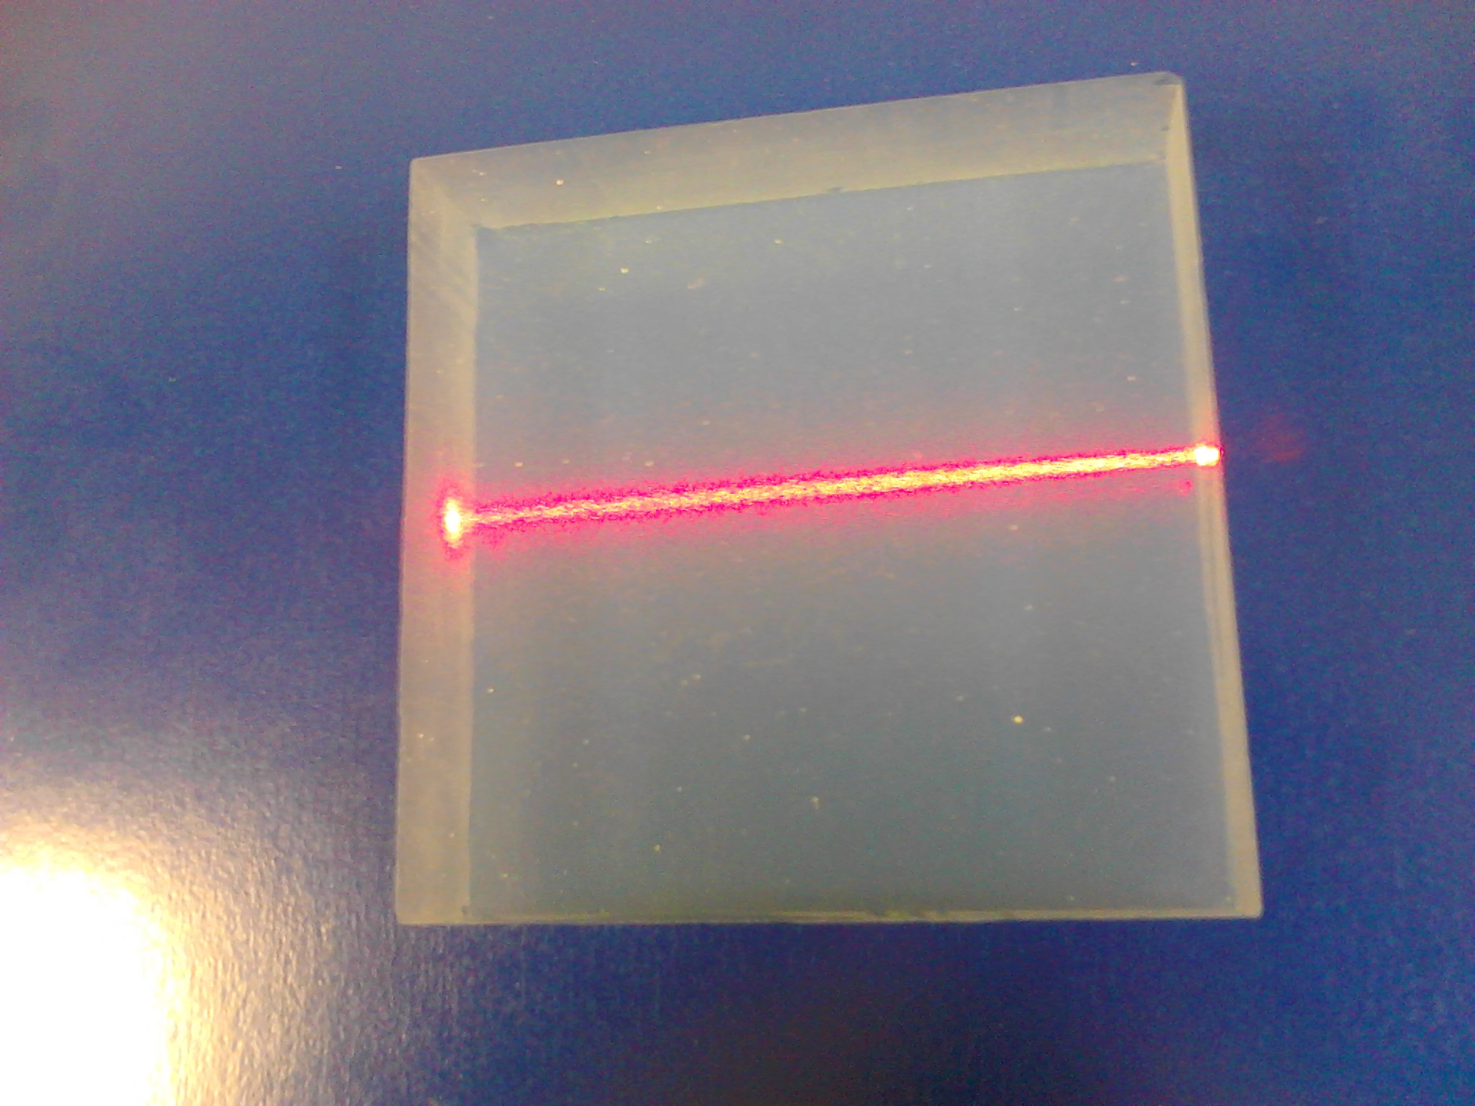

Slide 3
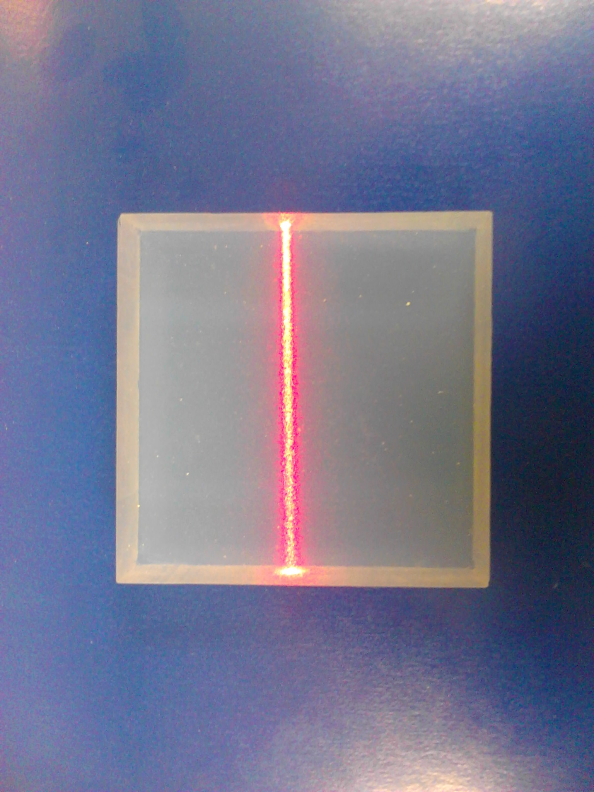

Slide 4
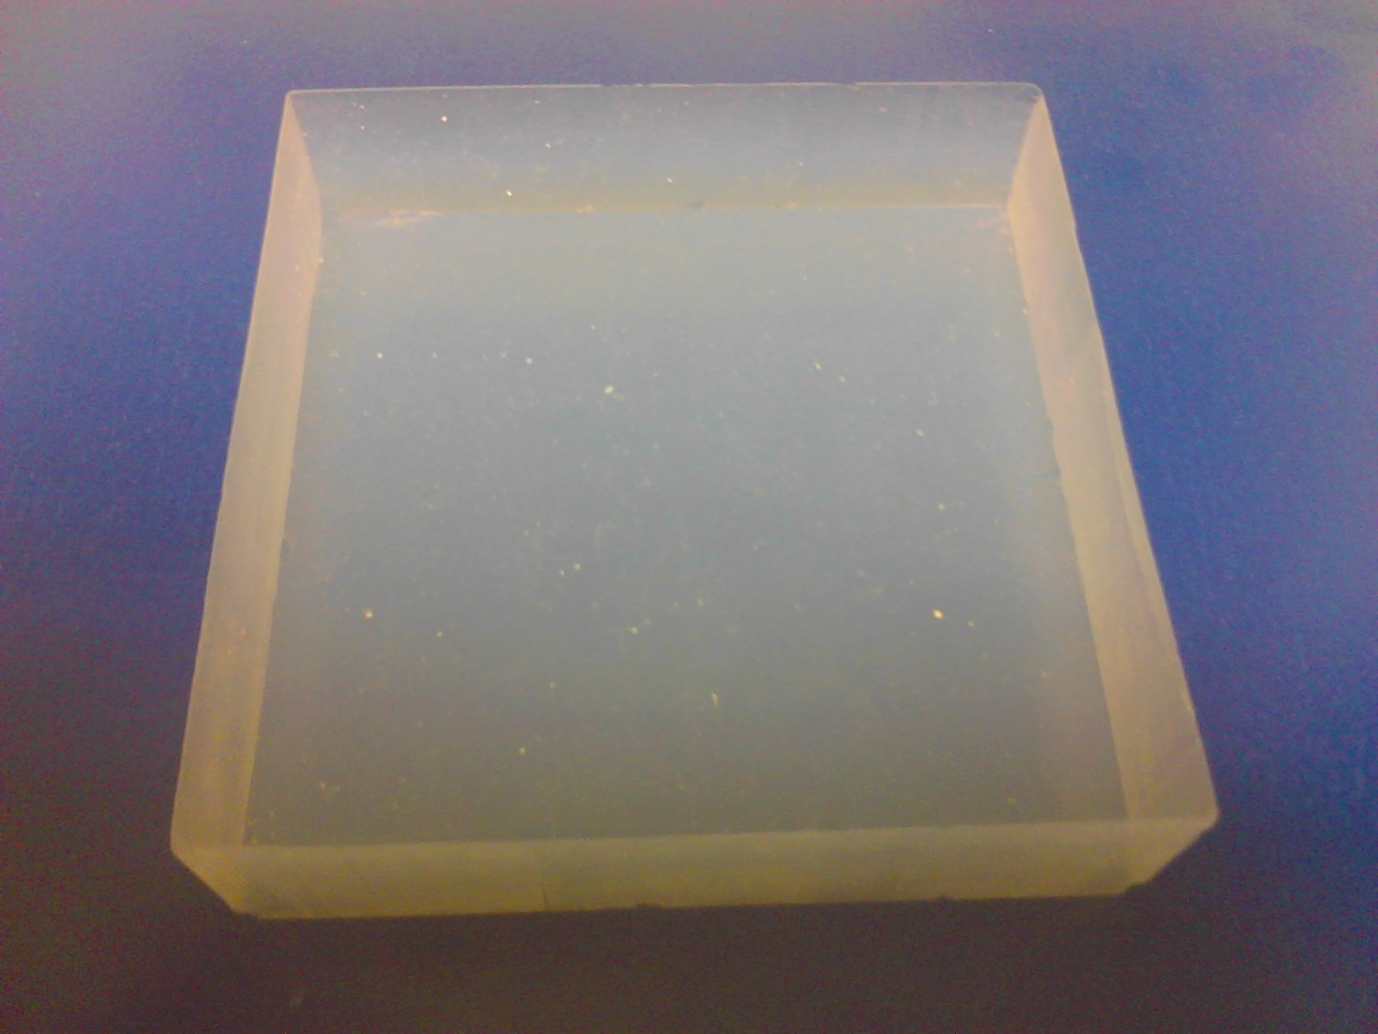

Slide 5
A monolithic SiPM array which minimizes the not-active area. It demonstrates the
flexibility and compactness of such devices in fast progress.

Slide 6
