Slide 1
Next-DIS Program
Innovative PID solutions based on Cherenkov detectors
and imaging techniques for Medical Diagnostic
INFN Ferrara
INFN Frascati
ISS (Italian National Institute of Health)
FTE (Estimated)
Permanent Staff:
- Senior Scientist (Nuclear Physics Detector) 4 * 30%
- Senior Scientist (Radiation Detector) 1 * 20 %
- Senior Scientist (Imaging) 1 * 30 %
- Senior Technicians 2 * 30%
Non Permanent:
- PostDoc 100%
Note: PostDoc from the Project
Actual FTE will depend on detailed project and funding

Slide 2
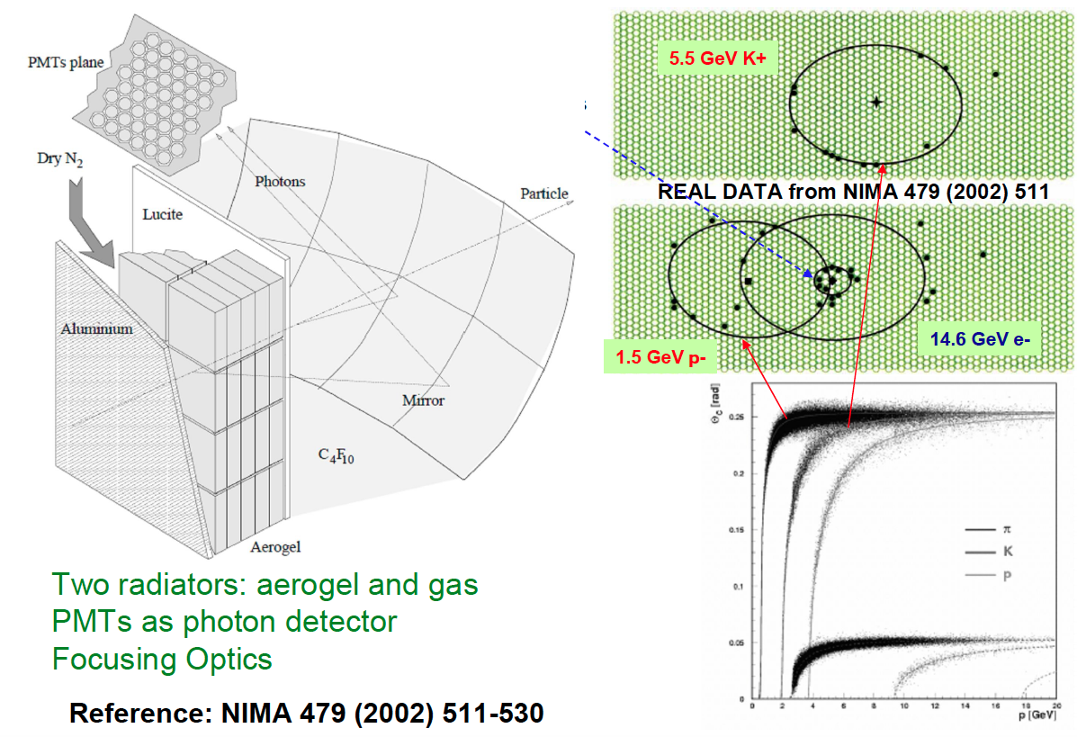
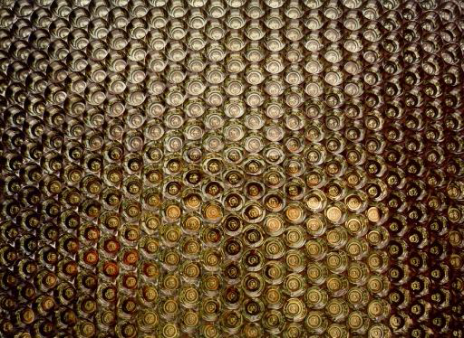
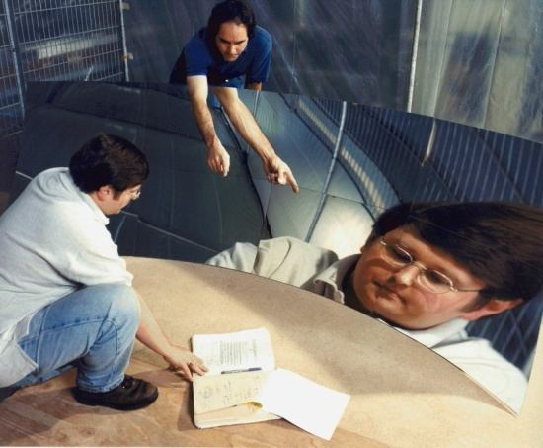
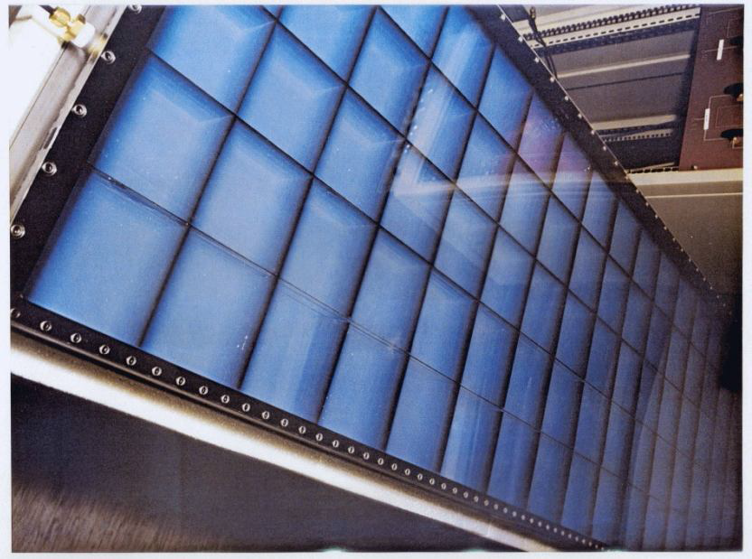
Background: HERMES RICH
P_{T} dependence
P_{h}
T
Spin-Orbit effect
Reused in Hall-A at JLab
Notes:
Va detto che ora sta al Jlab….

Slide 3
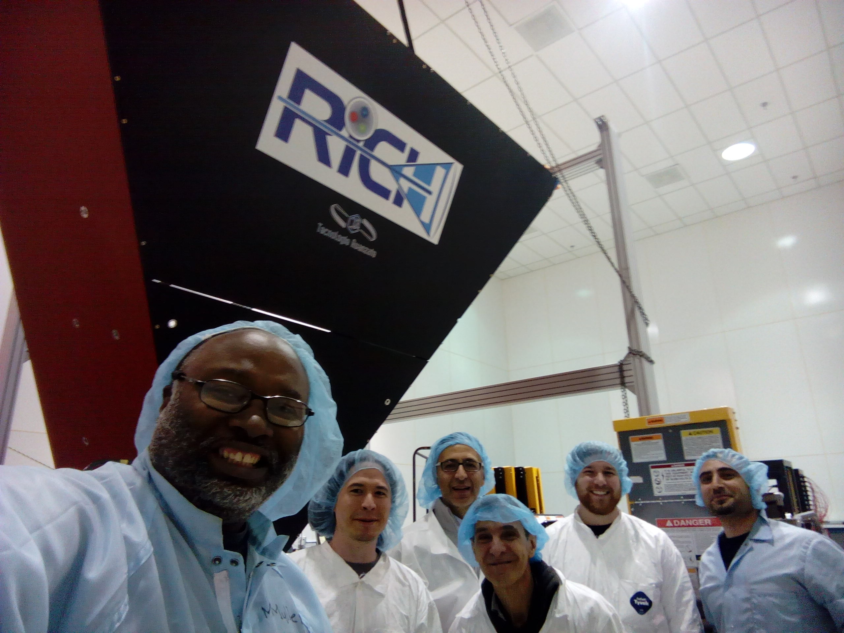
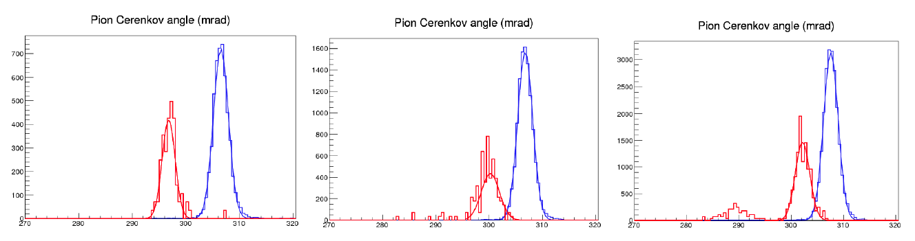
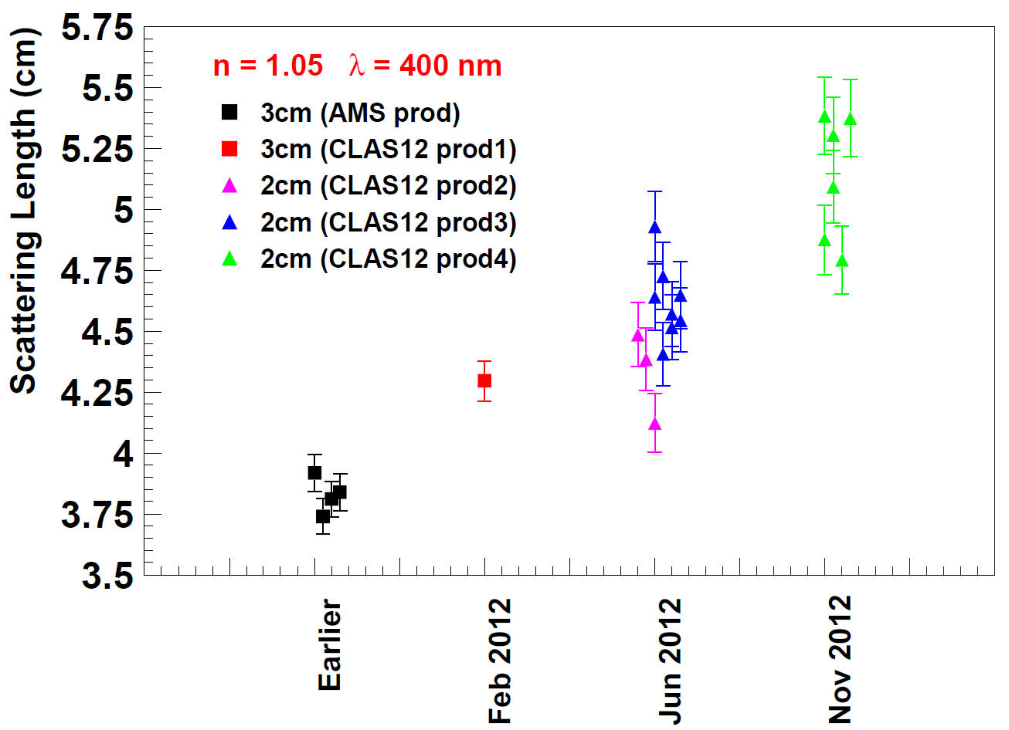
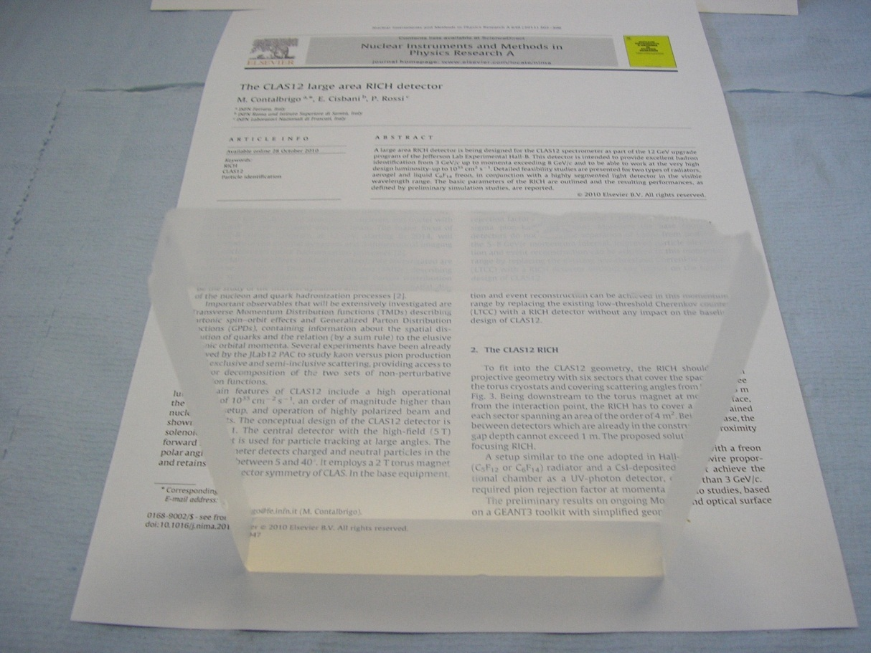
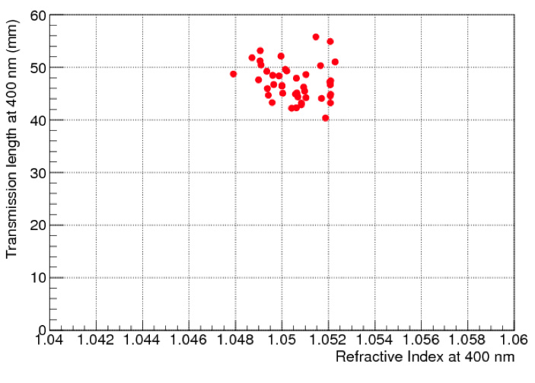
Background: CLAS12 RICH
Large-area hybrid-optic design
A DOE-INFN join-venture
Supported by CLASMED Priority Project
of Italian Research Ministry (MIUR)
Particle ID in the 3-8 GeV/c momentum
6 Gev/c
π
7 Gev/c
8 Gev/c
k
Cherenkov angle (mrad)
High-transmittance Aerogel
World record of transparency at high refractive index and large thickness
CLAS12 (n=1.05)
<L_{sc}> ~ 50 mm
HERMES (n=1.03)
Notes:
Vanno messi studi innovativi e pubblicazioni

Slide 4
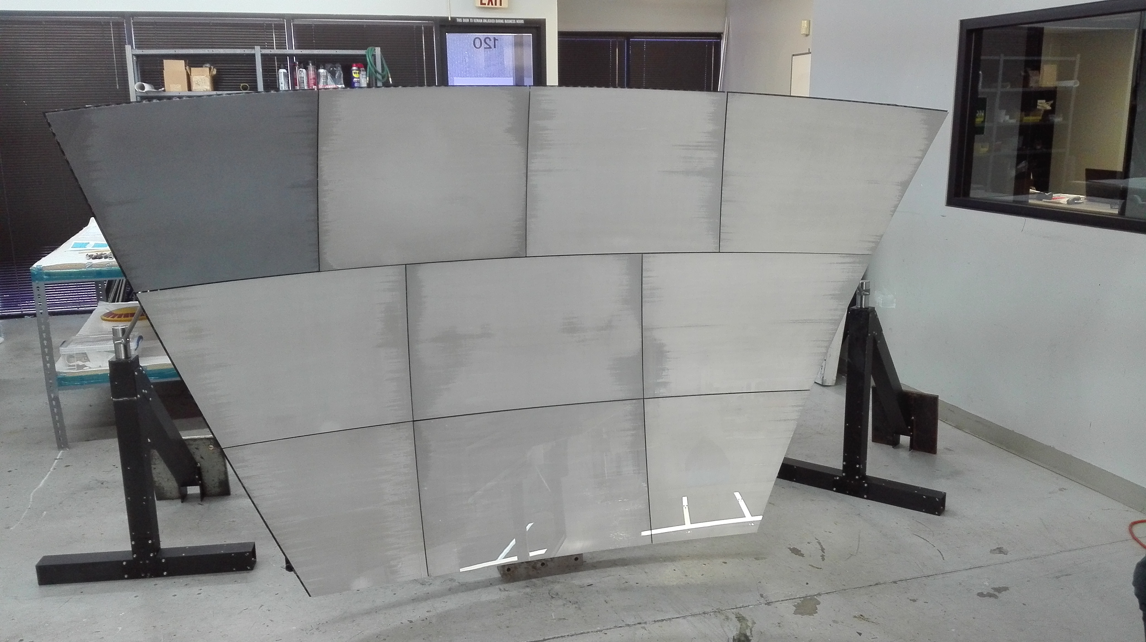
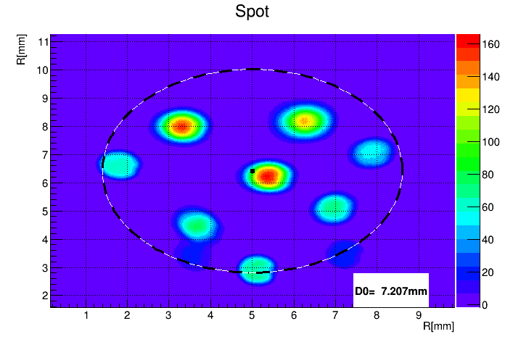
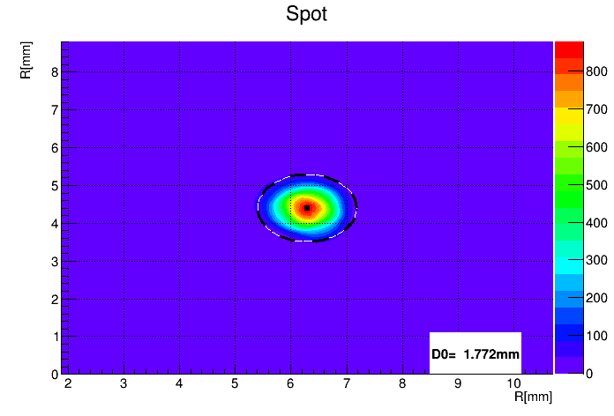
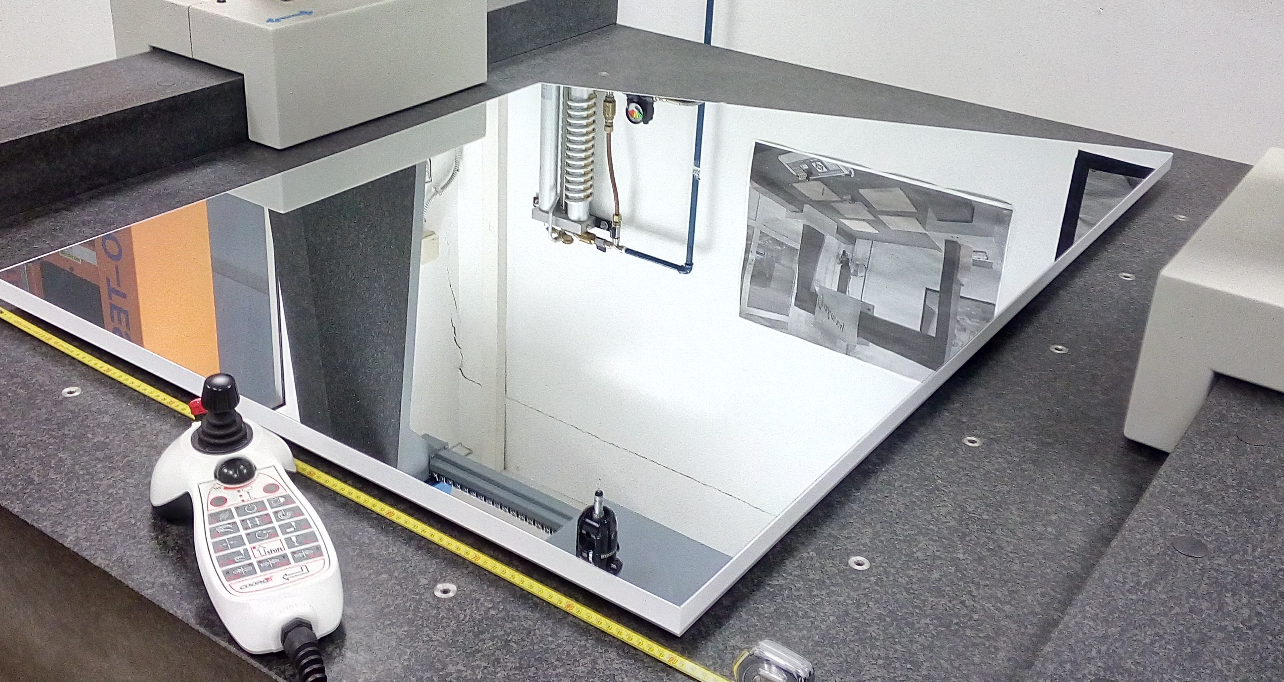
Background: CLAS12 RICH
CFRP Spherical Mirrors
Density reduced by 30 % vs LHCb
Uncoated 3.5 m² composite mirror
Achieved a point-like image << 5 mm specs
Uncoated
Before alignment
Glass-skin Planar Mirrors
NEW: 0.7 mm glass + Al honeycomb
Derived from terrestrial telescopes
~ 1 % X₀ (comparable to carbon fiber CFRP)
After alignment
Notes:
Vanno messi studi innovativi e pubblicazioni

Slide 5
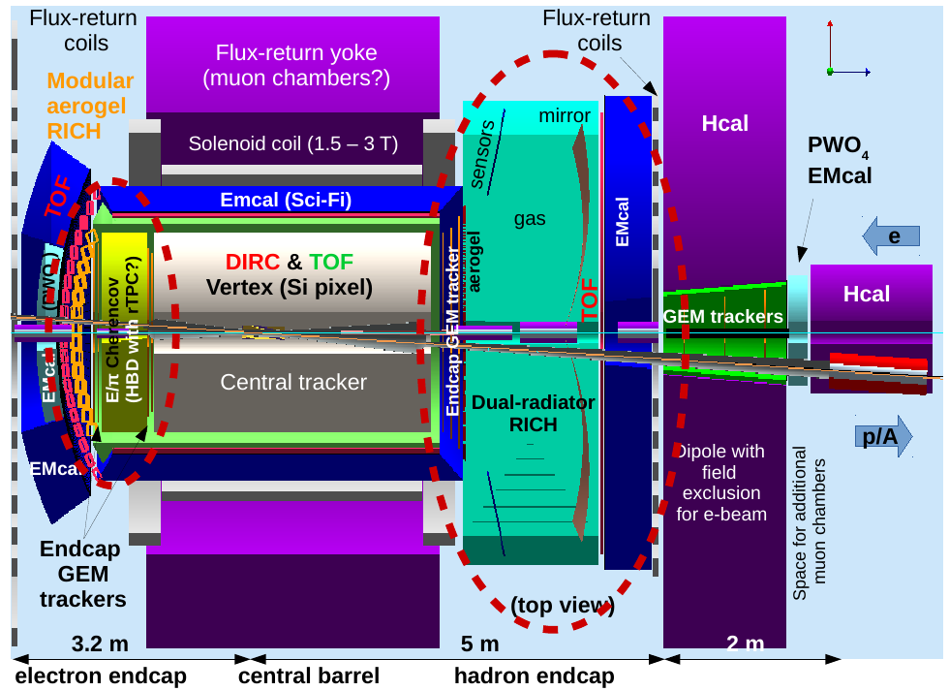
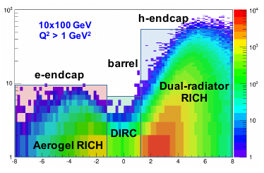
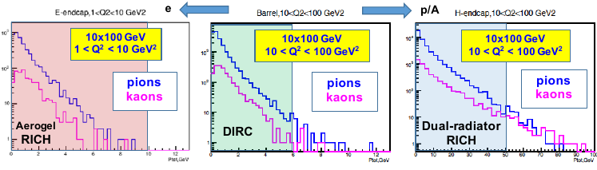
Next-DIS PID Detectors
Innovative PID solutions
based on Cherenkov detectors
Part of EIC PID Consortium:
10 GeV e and 100 GeV p is a
common JLab/BNL setting
Maximum momentum coverage is
Important for physics (i.e. SIDIS)
e-endcap: compact aerogel RICH to cover
1-10 GeV/c momentum range
h-endcap: combined gas and aerogel RICH
to cover 1-60 GeV/c momentum range

Slide 6
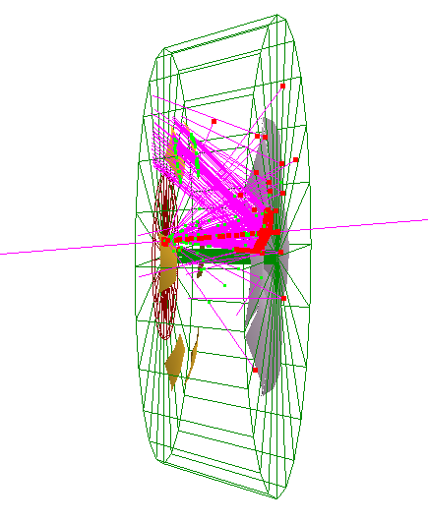
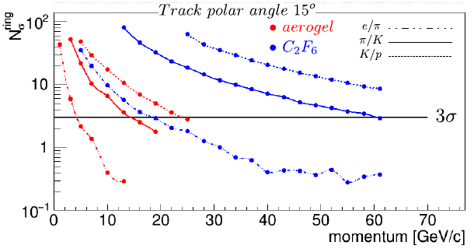
Example: Dual-Radiator RICH
Geant4 (GEMC) simulation
Large area RICH covering 1-60 GeV/c momentum
Conceptual design, ready to move to prototype phase
4 cm aerogel (n=1.02) & 160 cm C₂F₆ (or CF₄) gas
Focusing mirror configuration
(focal­plane away from the beam,
reduced area and background)
Discrimination power for particle types
mirror R = 2.8 m
Photo-detector: spherical shape,
6 sectors of 60° in azimuthal angle
pixel size 3 mm
RICH is in magnetic field (3T in the simulation)
Reconstruction by Inverse Ray Tracing algorithm.
Notes:
Dire che Alessio deve arrivare a definire il prototipo, vedere ultimi aggiornamenti

Slide 7
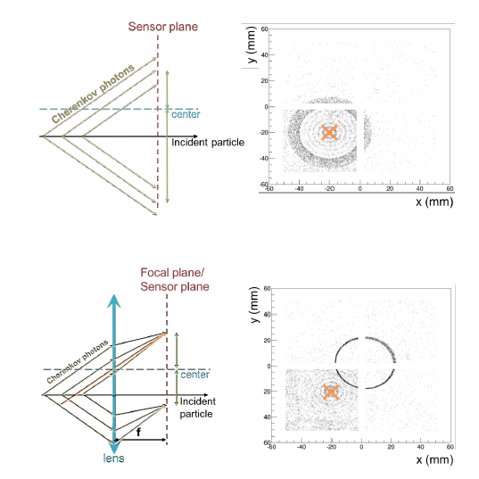
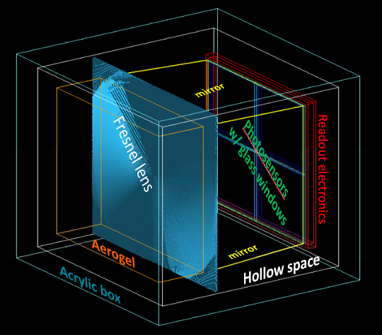
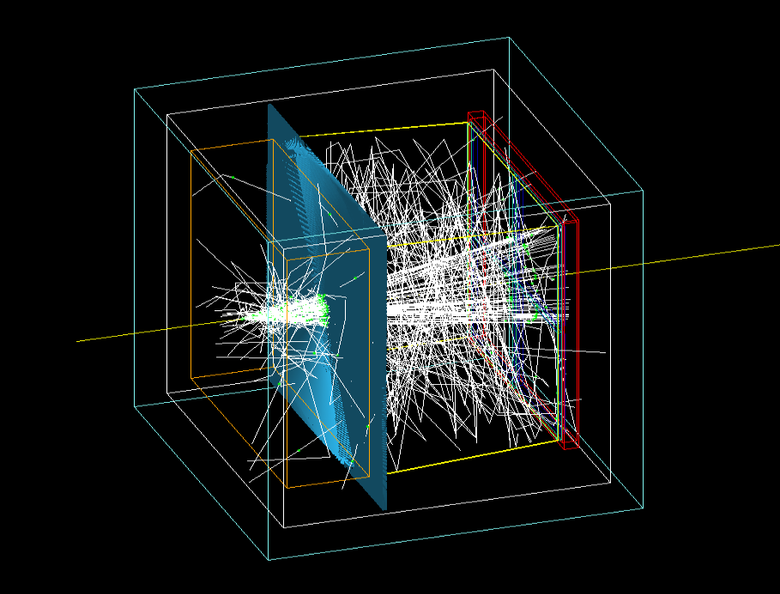
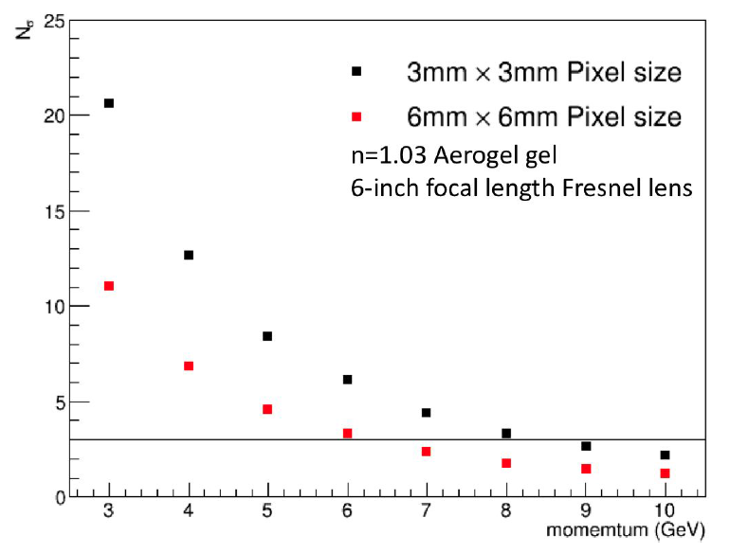
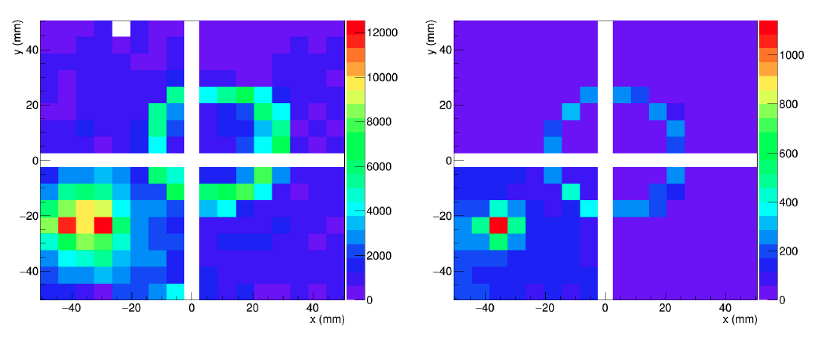
Example: Modular RICH
Fresnel lens focalization concept for
a compact (short gap) device
Compact and Modular RICH
covering 1-10 GeV/c momentum
Proof of principle with a small EIC mRICH prototype
Test beam at Fermilab – April 16
DATA
MC
Impinging
particles

Slide 8
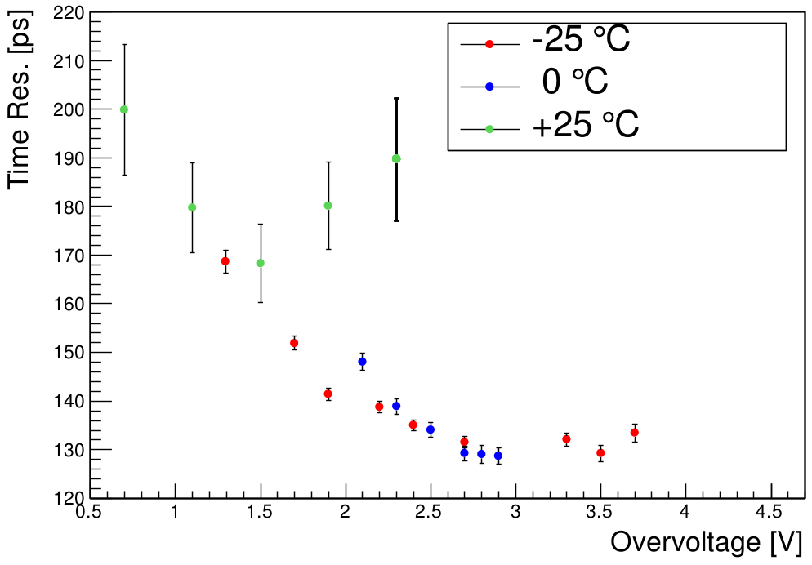
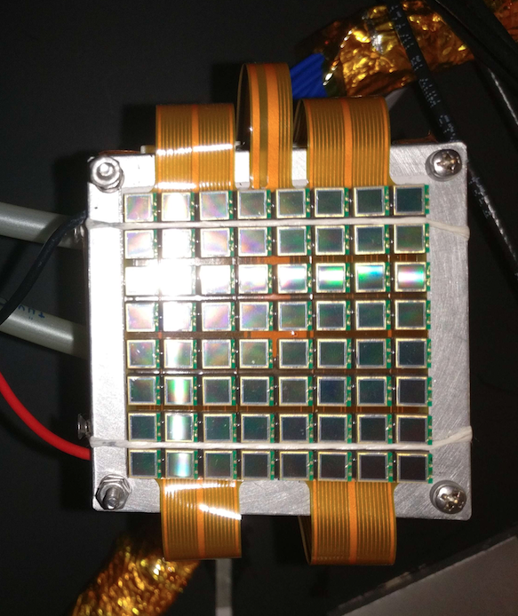
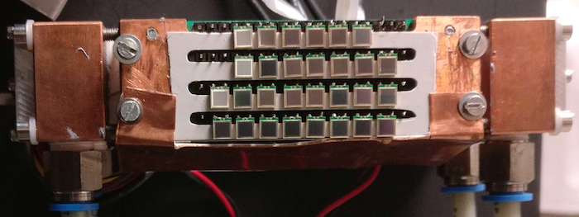
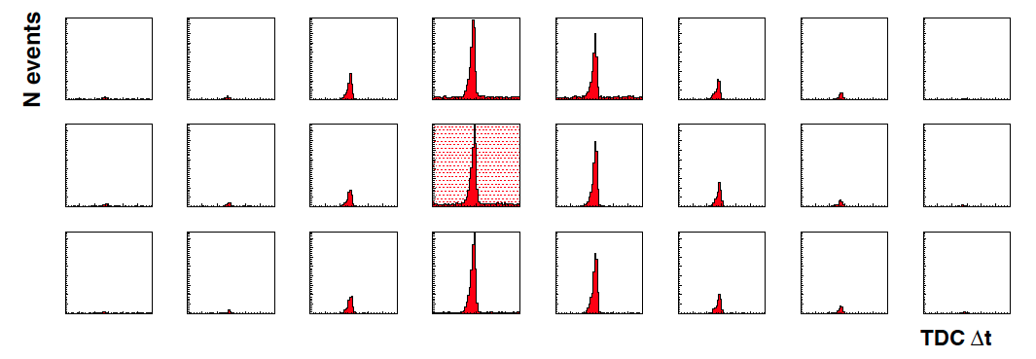
R&D: Innovative Sensors
SiPMs
✓ Mass production technology
✓ Photon counting
✓ Excellent time resolution
✓ Compatible with magnetic field
✓ High dark rate
✓ Low radiation tolerance
Work at low temperature
Beam

Slide 9
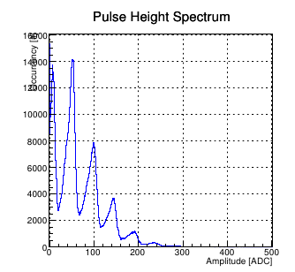
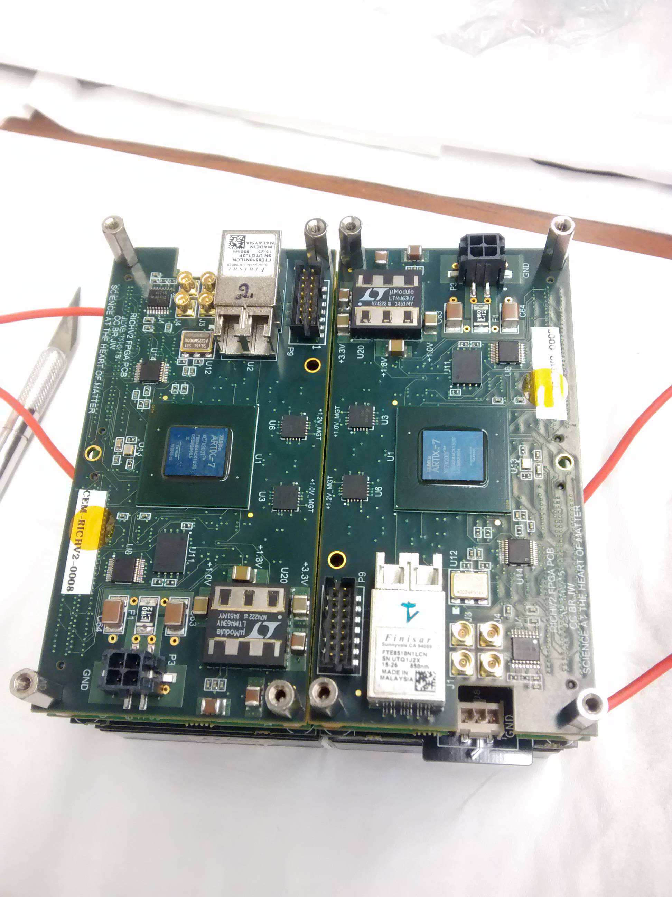
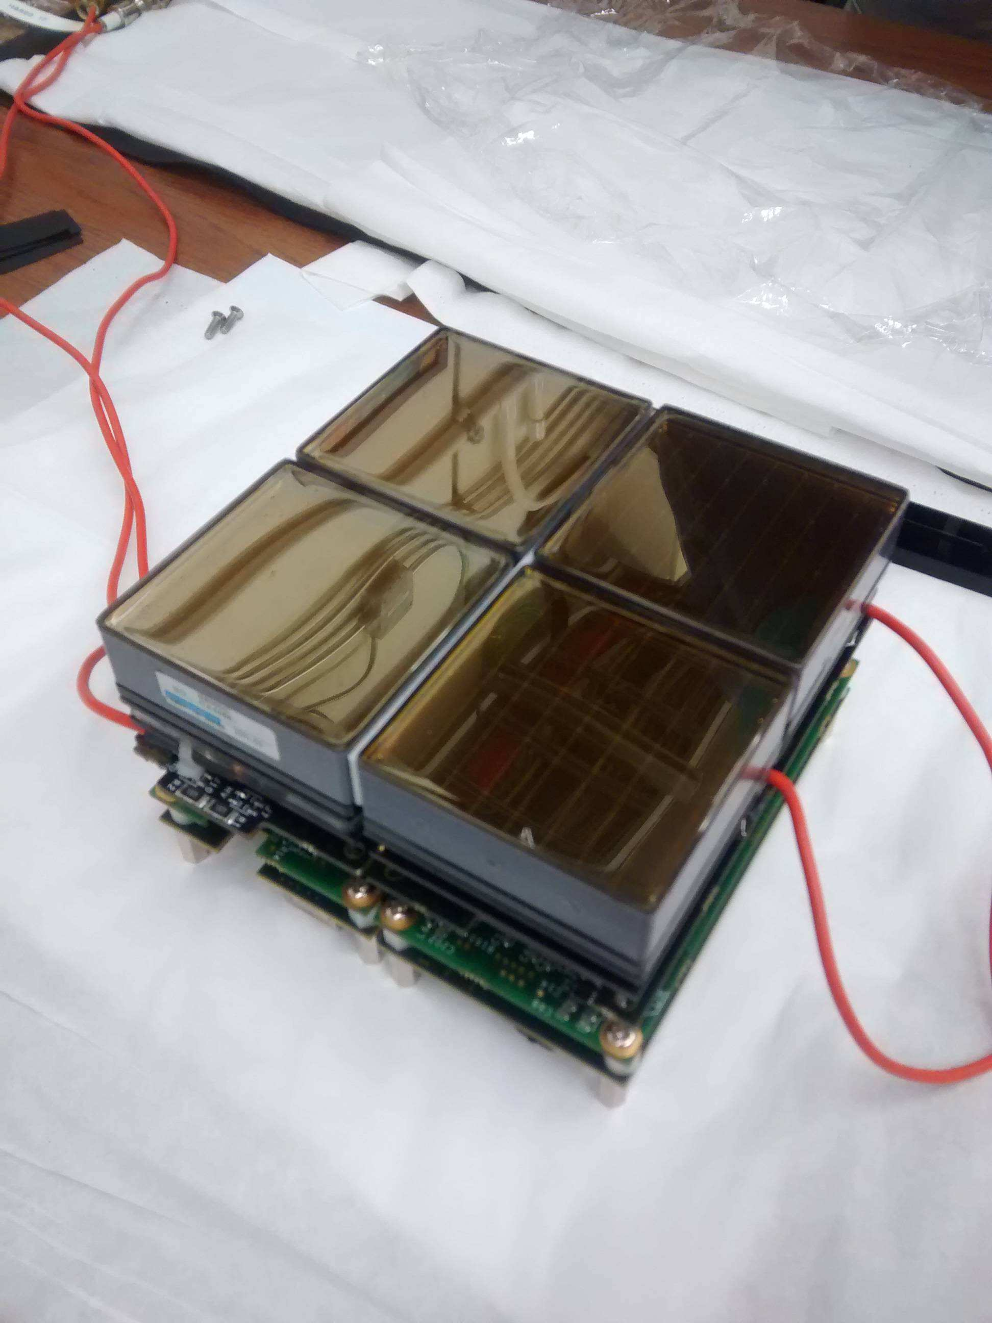
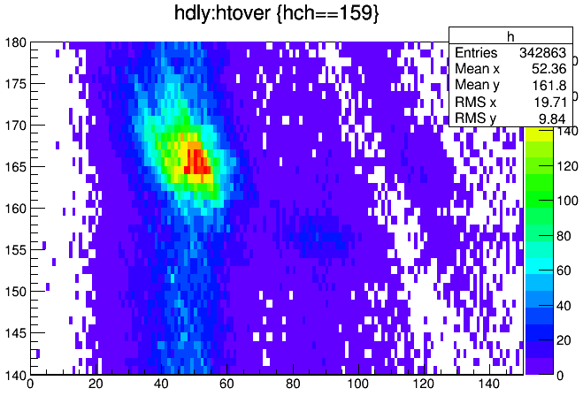
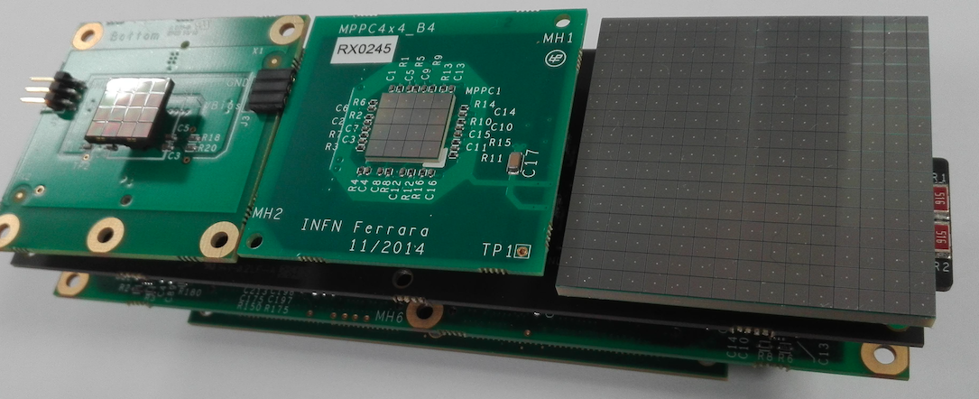
R&D: Readout Electronics
Compact and modular readout electronics for
multi-pixel detectors
Photon counting with
ADC charge measurement (SiPM)
Single photon discrimination with
TDC time measurement (SiPM)
Cherenkov light detection with SiPM
2 p.e.

Slide 10
Biomedical Applications
✓ The development of innovative, compact photon detection techniques, deployable on large active areas at affordable costs, and characterized by low noise, may find valuable applications in Nuclear Medicine and related fields.
✓ Large area optical photon detectors combined to charged particle tracker (scatterer) are the essential components of the Compton Camera, one of the newest and most technologically challenging device in medical physics.
✓ Compton Camera may offer improved spatial resolution, larger number of radionuclides (respect to PET), higher efficiency (respect to SPECT), extended energy of photon (up to 1 MeV) improving quality of images!
✓ Best application is 3D diagnostic medical imaging; potential relevant application in hadron-therapy.
✓ Additional application of low noise photon detector can be found in the field of beta- radiopharmaceutical imaging in radio-metabolic tumor therapy, exploiting the Bremsstrahlung process.
✓ Tentative goal of the project: exploit the development in photon sensors as well as charged particle trackers to design either a novel Compton Camera or a beta- imaging system; evaluate the performance by MonteCarlo and address potential applications. Depending on funding, provide and characterize a small prototype.

Slide 11
Compton Camera
J
g’
Scatterer
g
Gamma
Detector
Source position is reconstructed by backtracking of scattered gamma: need to measure energy (and/or direction) of scattered electron and energy of scattered photon.
Source can be a decaying radiotracer (nuclear medicine) or a
nuclear photo-emission (hadron-therapy)

