Slide 1
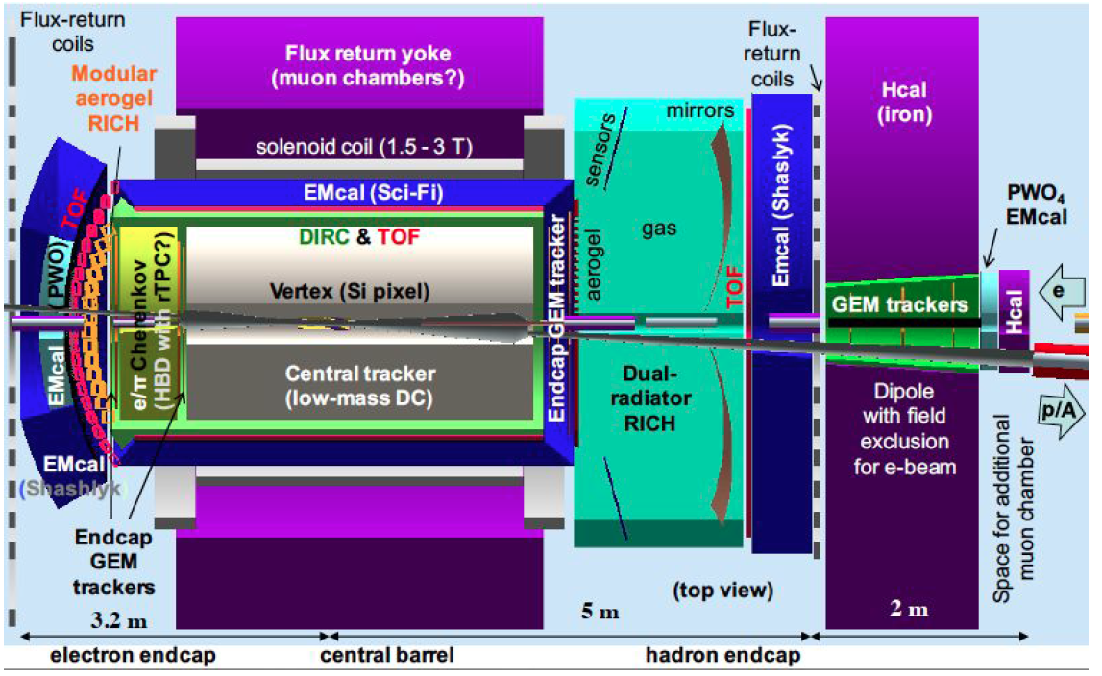
EIC CHERENKOV DETECTORs (FE, LNF, CT, RM1)
mRICH as compact solution for
Limited momentum range
(up to ~ 10 GeV/c)
dRICH as dual radiator for
Extended momentum range
(up to ~ 50 GeV/c)
Collaboration with JLab, GSU, Hawaii U., DUKE
Notes:
Fare una immagine del PMT sulla risoluzione

Slide 2
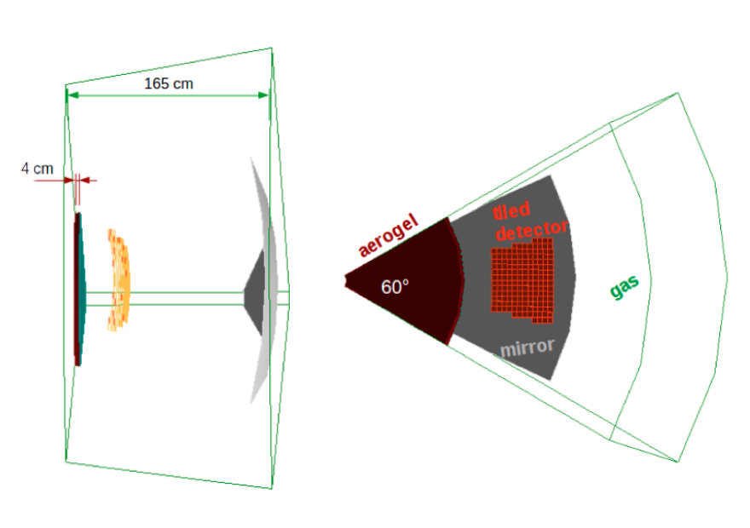
Dual RICH (dRICH)
Classic approach
- delicate interplay between the two radiators
- expensive MCP-PMT or new technology (cooled SiPM) for
single-photon detection in magnetic field
2
Notes:
Fare una immagine del PMT sulla risoluzione

Slide 3
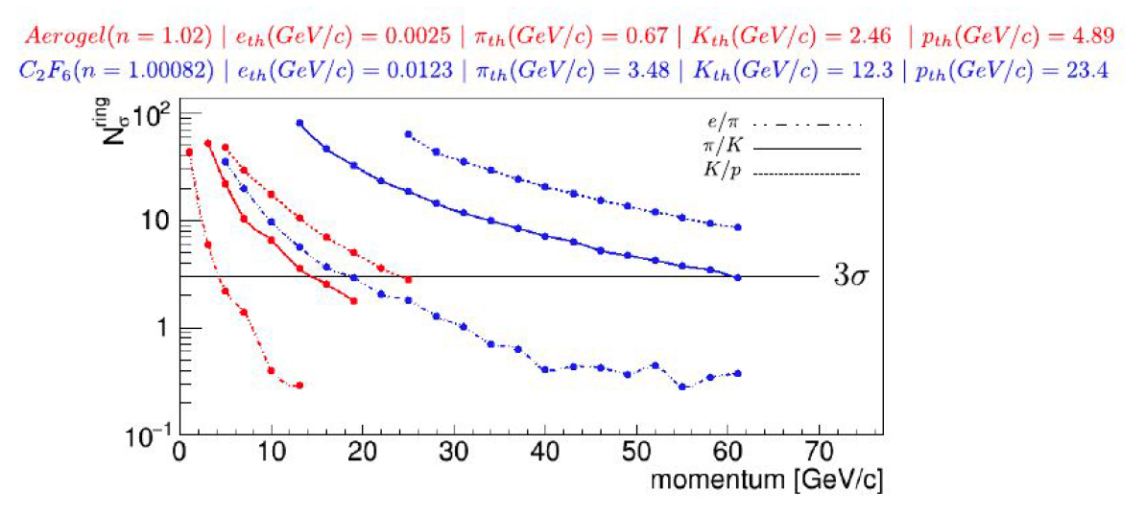
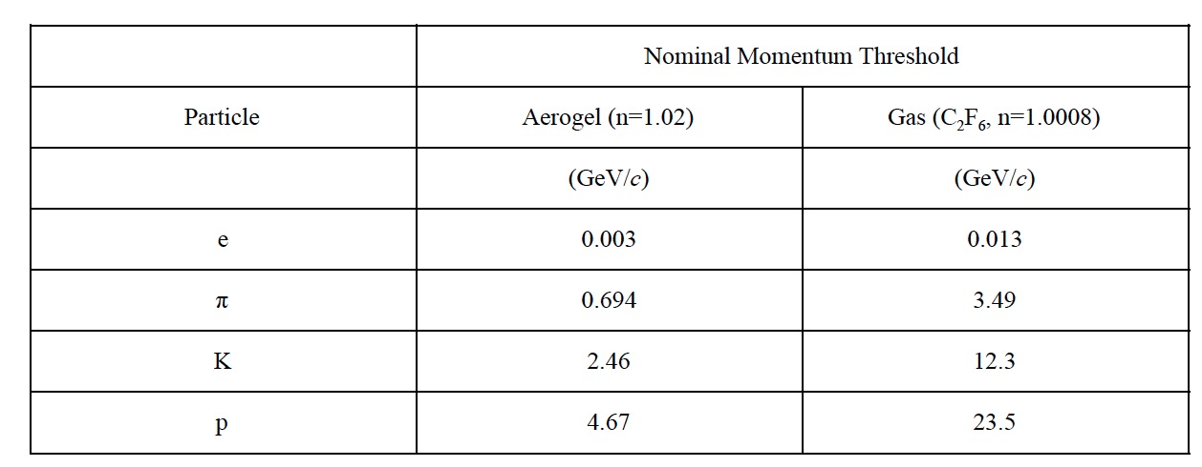
dRICH Expected Performance
3
Notes:
Fare una immagine del PMT sulla risoluzione

Slide 4
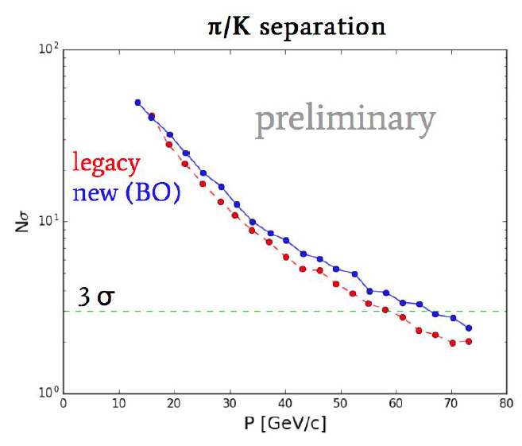
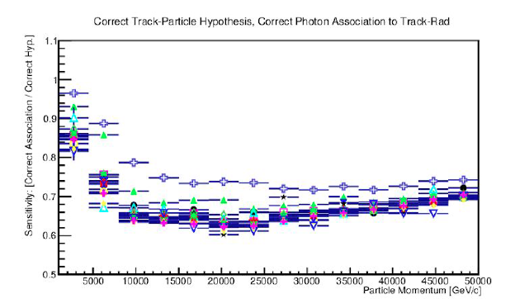
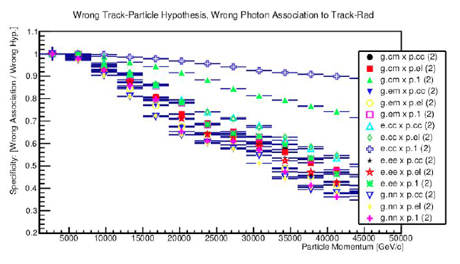
dRICH Optimization
dRICH design refinements based on
Bayesian optimization
Likelihood for hit association in multi-track events
Success for good hypothesis
Failure for bad hypothesis
4
Notes:
Fare una immagine del PMT sulla risoluzione

Slide 5
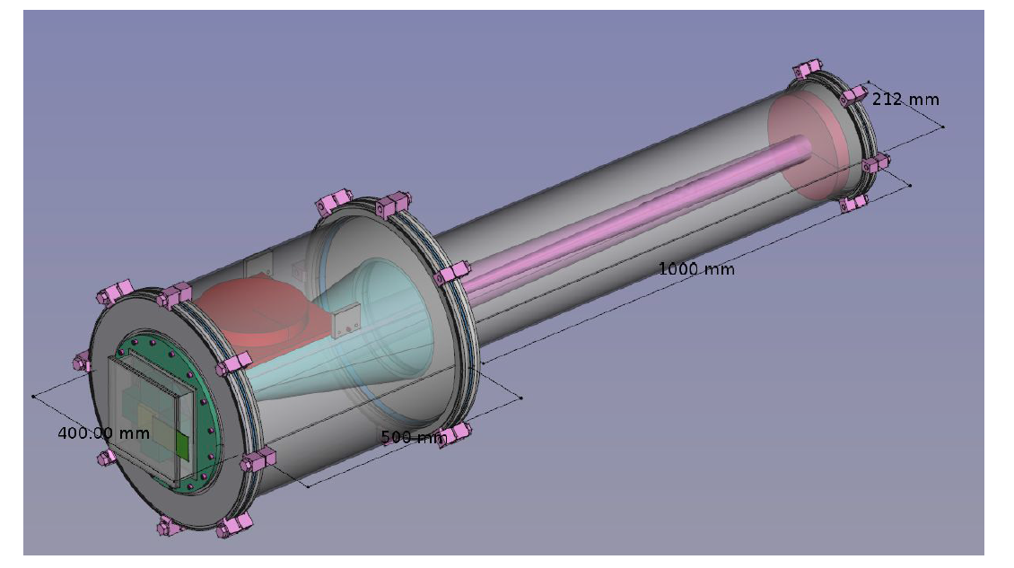
dRICH Prototype Design
Commercial vacuum technology for safety and cost effectiveness
5
Notes:
Fare una immagine del PMT sulla risoluzione

Slide 6
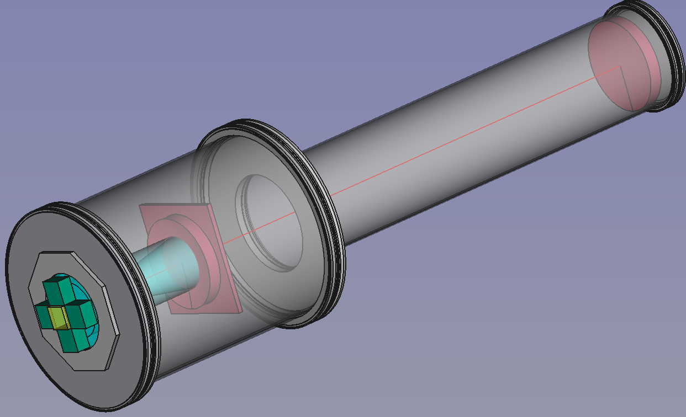
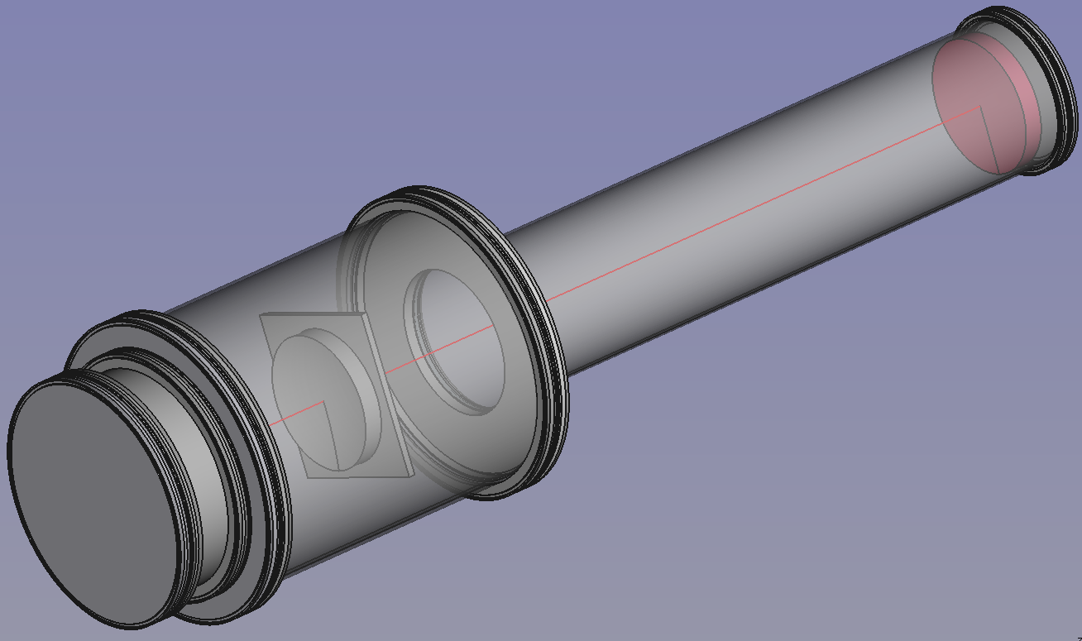
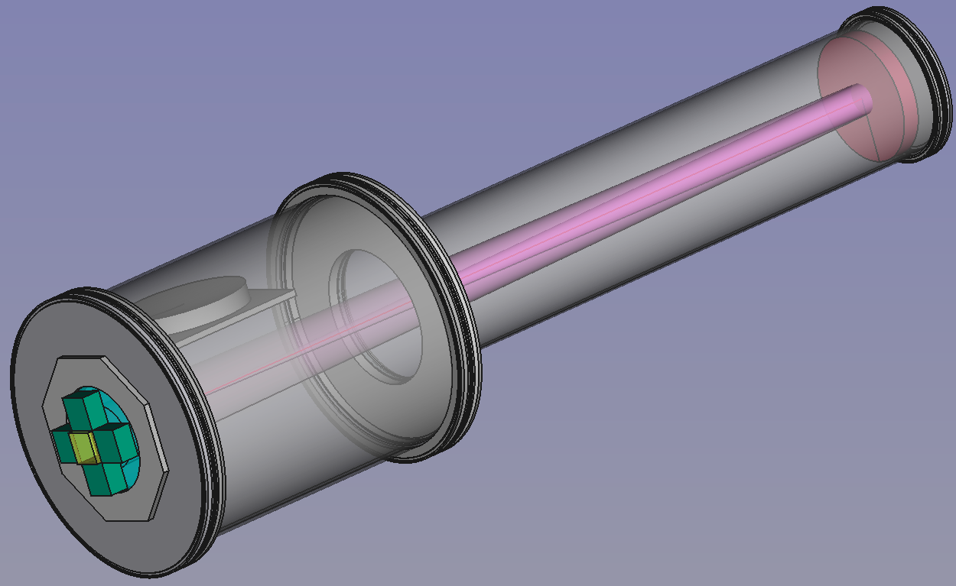
dRICH PROTOTYPE Design
Two radiators with almost
overlapping rings
(to optimize the active area)
Configuration 1:
Aerogel ring
Configuration 2:
Gas (freon) ring
6
Notes:
Fare una immagine del PMT sulla risoluzione

Slide 7
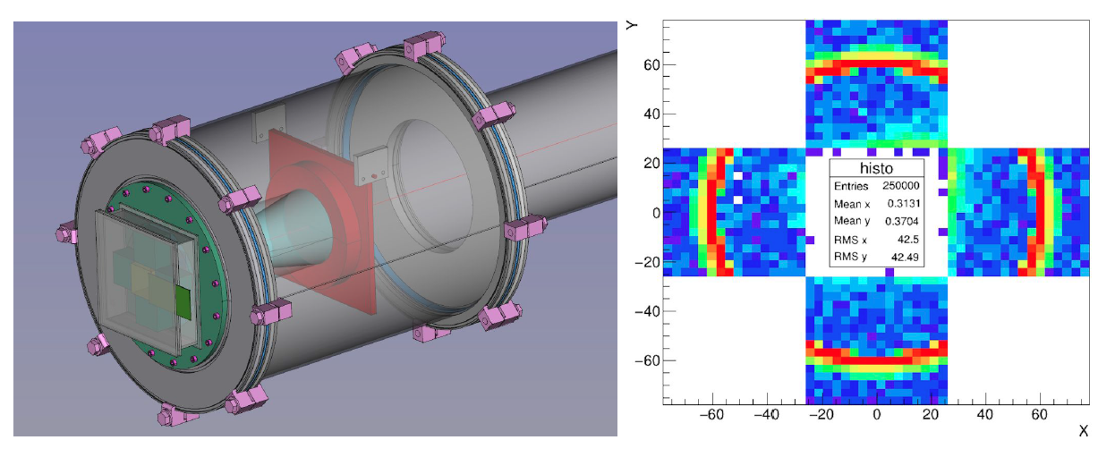
dRICH Prototype Design
Imaging on the same sensor area (for either radiator)
Compatible with various sensor types (PMTs, SiPMs, GEMs)
7
Notes:
Fare una immagine del PMT sulla risoluzione

Slide 8
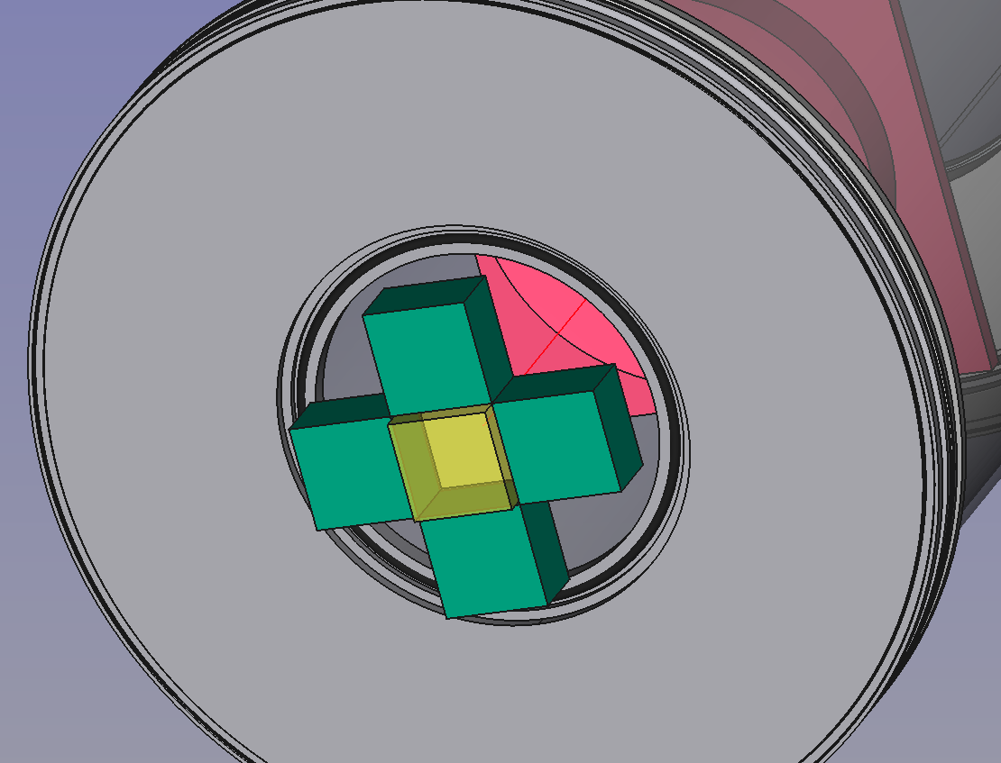
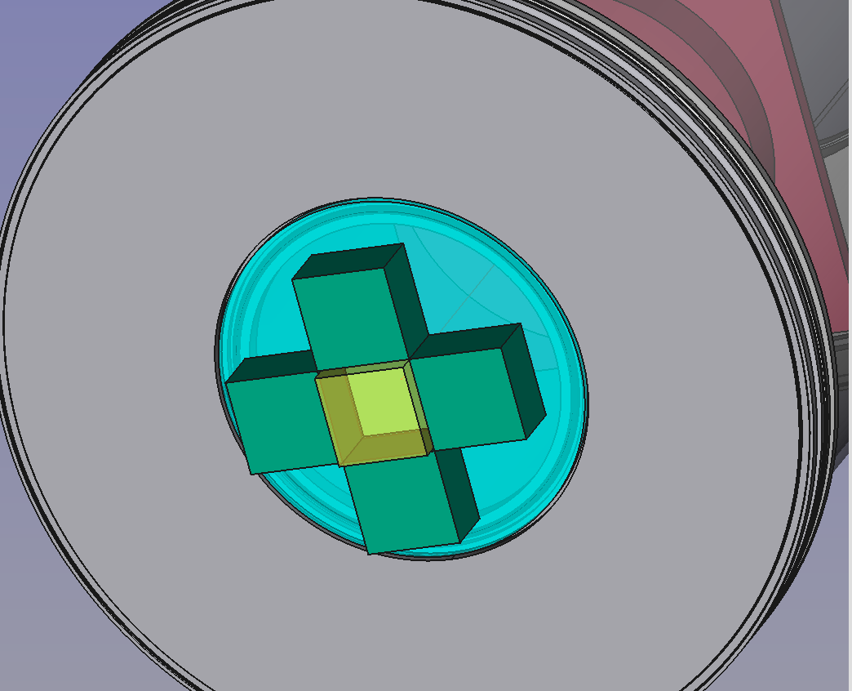
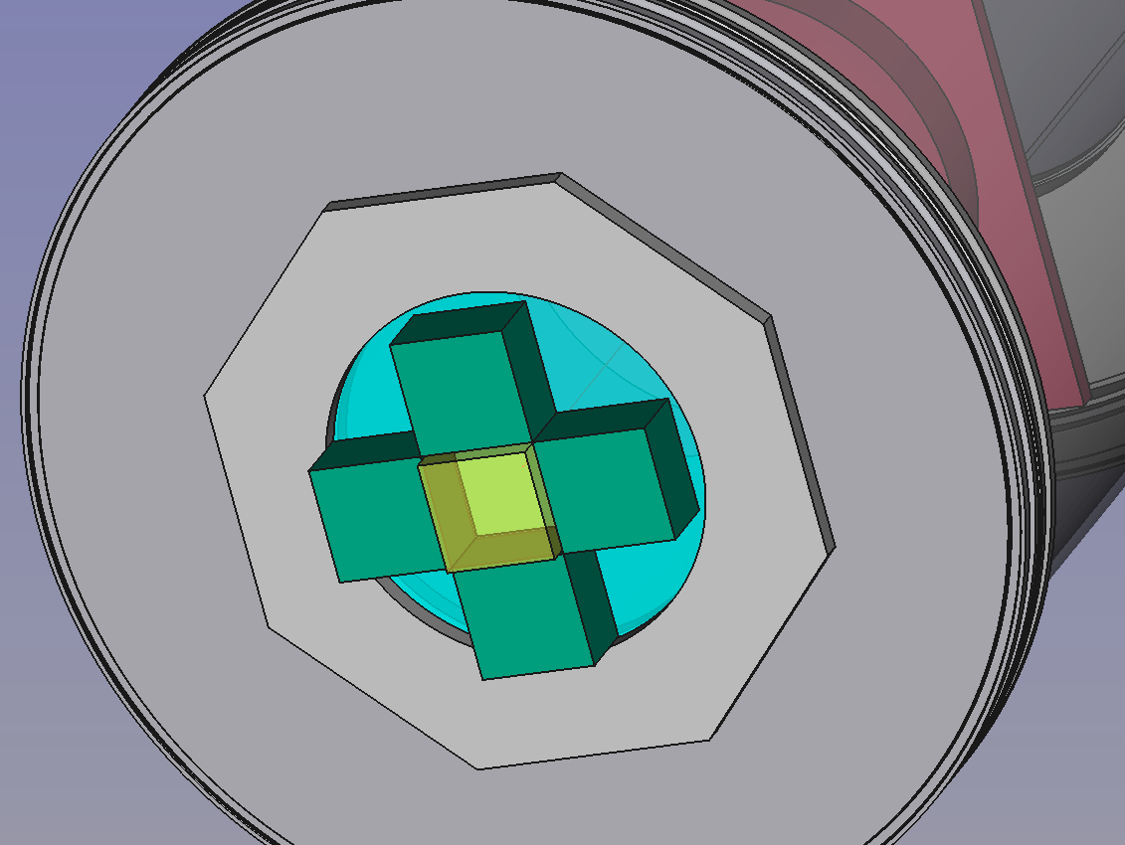
dRICH PROTOTYPE
Sensors
Oring
Aerogel
Lucite/Quartz
Sealing flange
Re-use of mRICH concepts
for sensors + electronics
8
Notes:
Fare una immagine del PMT sulla risoluzione

Slide 9
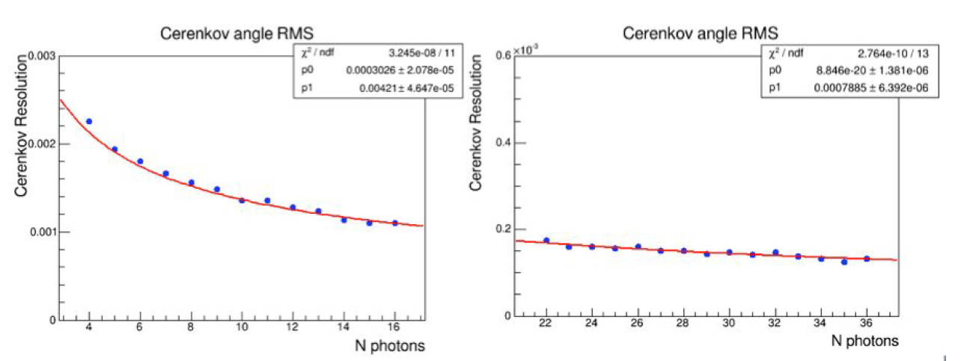
dRICH Prototype Performance
9
Notes:
Fare una immagine del PMT sulla risoluzione

Slide 10
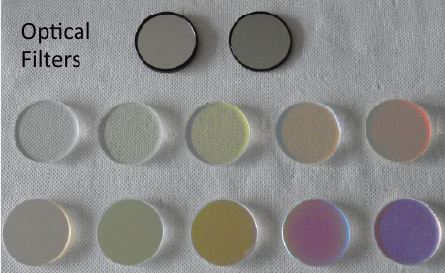
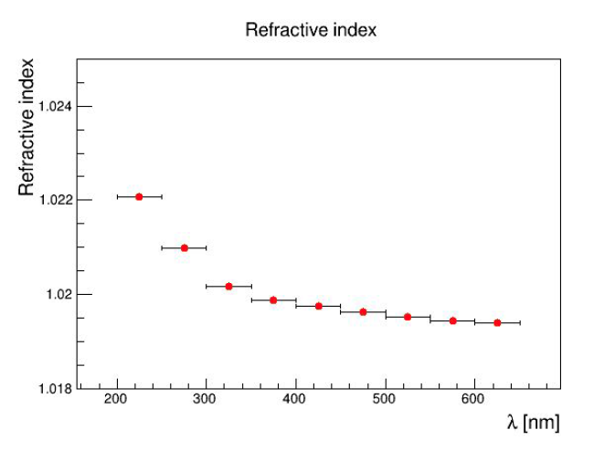
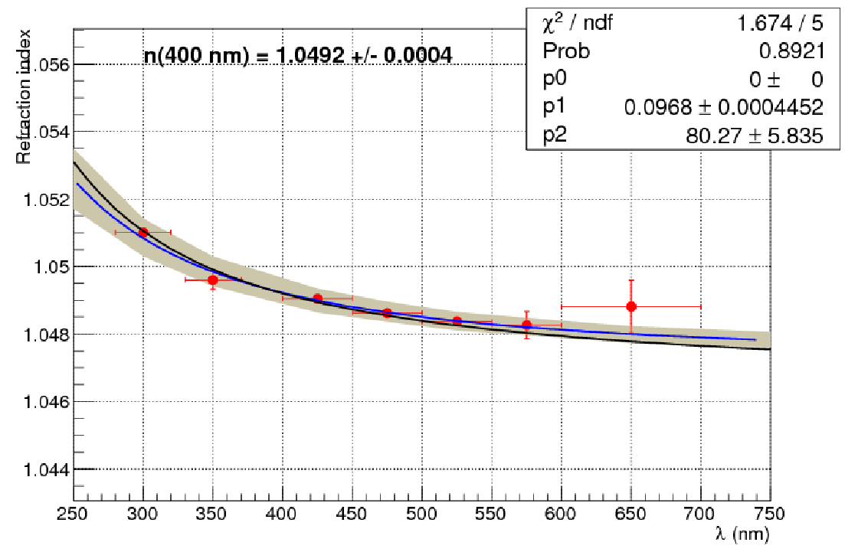
Aerogel Chromatic Dispersion by Filters
CLAS12 prototype
dRICH prototype
fit
MC
Direct measurement of the major expected contribution to the dRICH Cherenkov angle resolution.
Expected value from density:
n²(400nm) = 1+0.438ρ
n(400nm) = 1.0492
10
Notes:
Fare una immagine del PMT sulla risoluzione

Slide 11
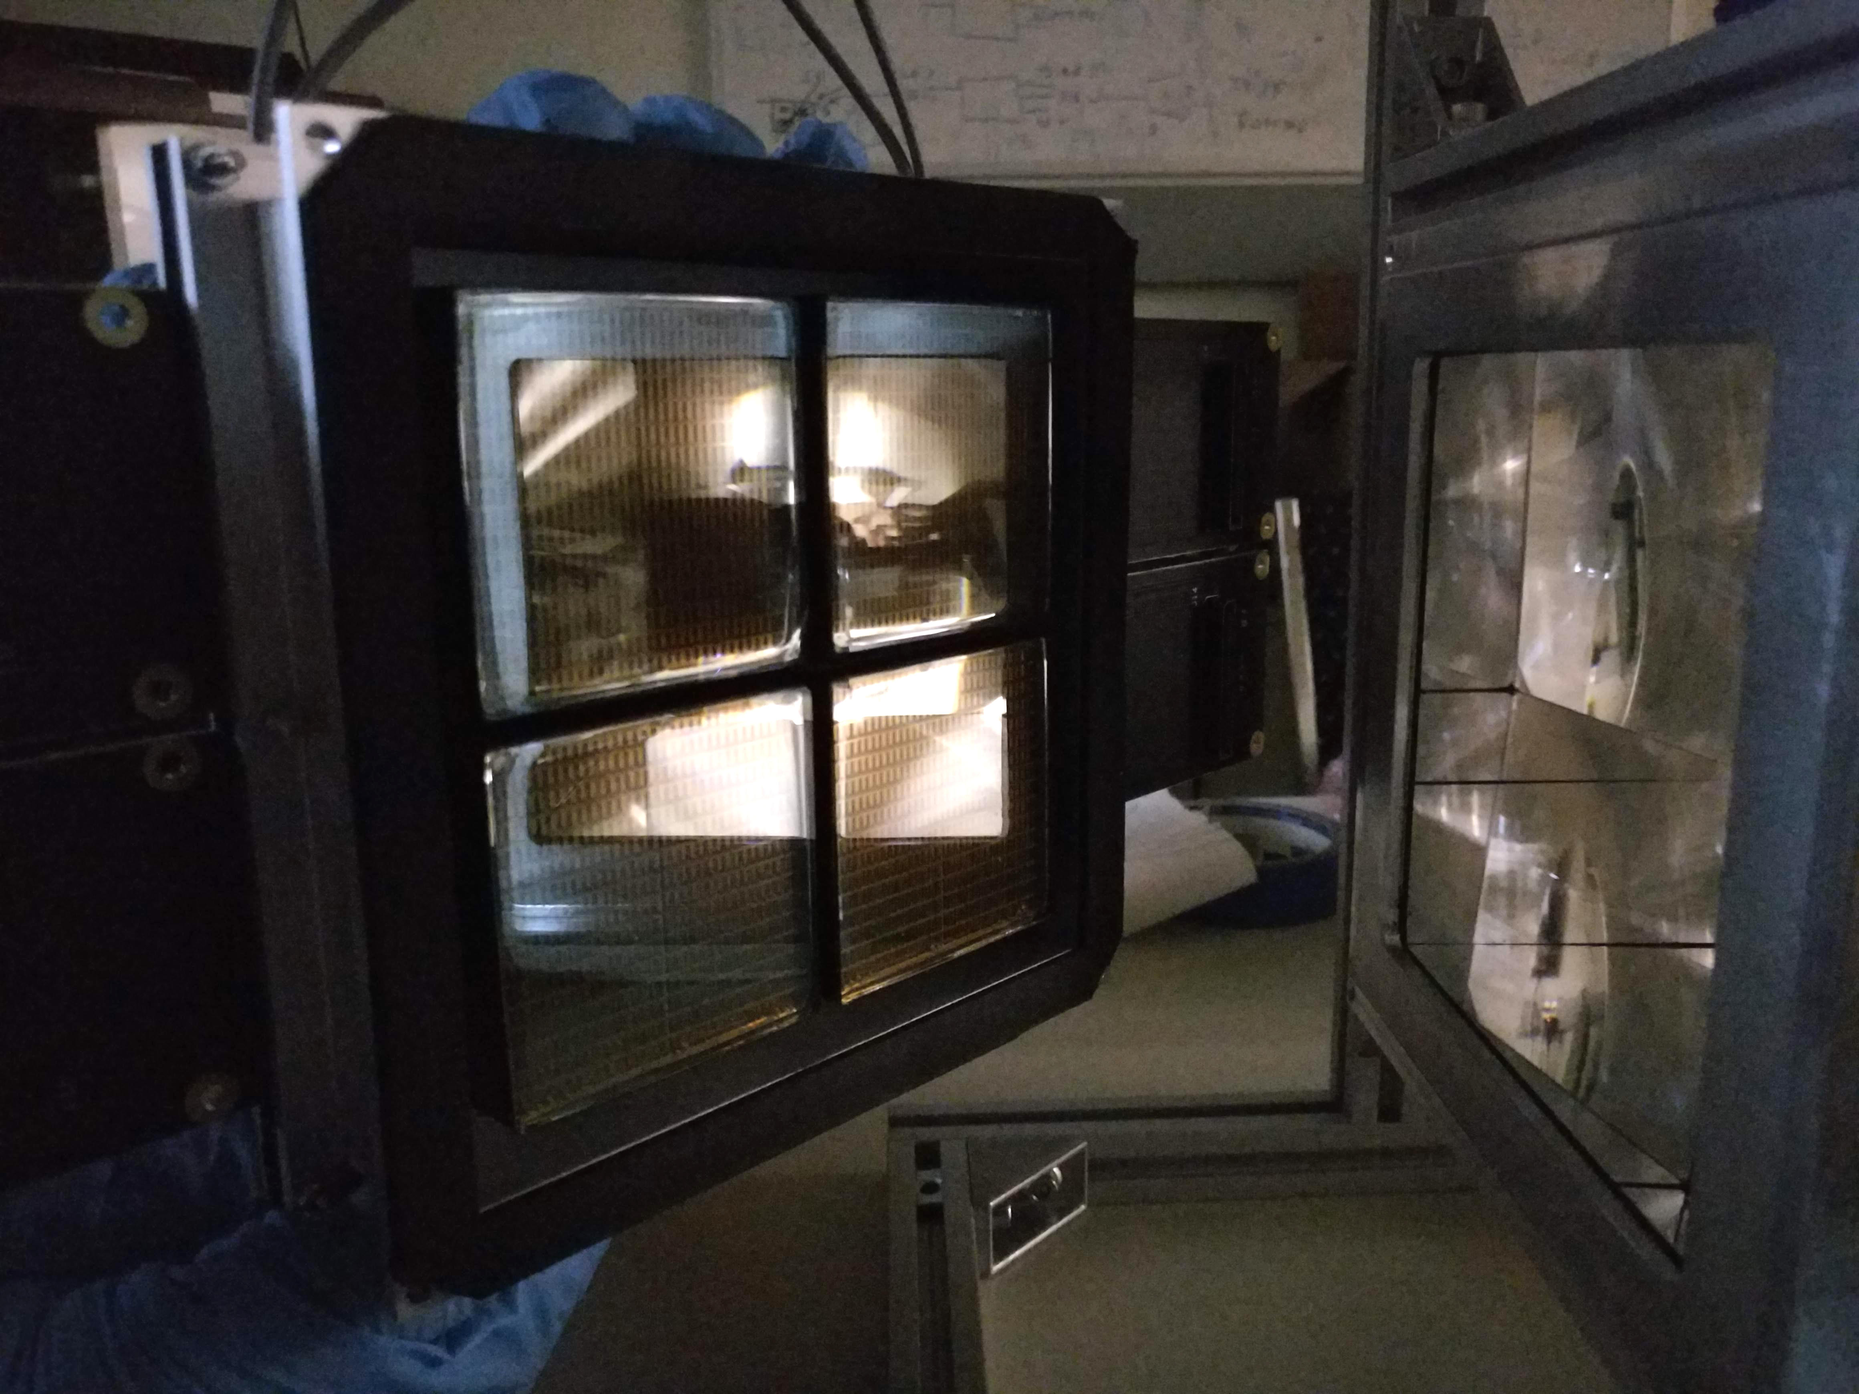
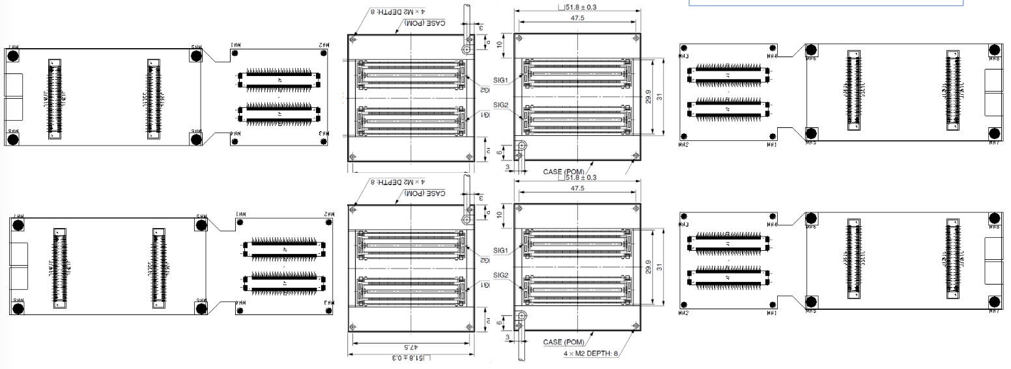
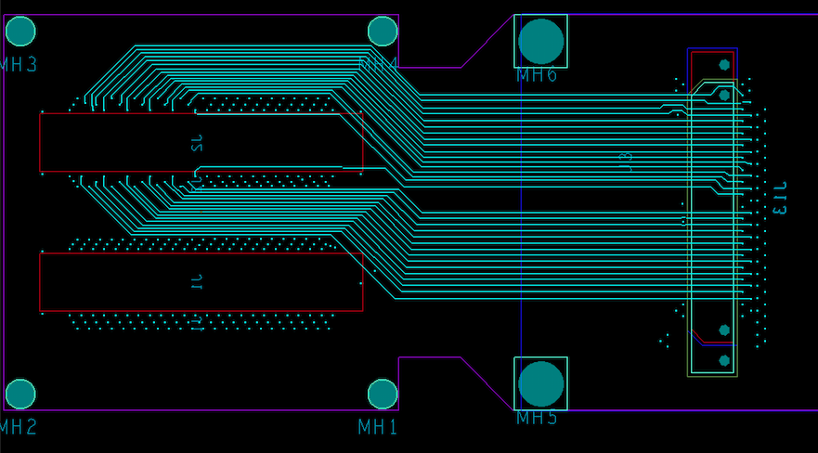
H13700 READOUT BOX
Derived from CLAS12 RICH readout:
1024 channels
MAROC 64 channel parallel digitalization
FPGA generated 1 ns timestamp
DAQ protocol based on VME/VSX SSP
Custom adapter boards
- Compact distribution
Use of existing MAROC boards
Light and gas tightness
11
Notes:
Fare una immagine del PMT sulla risoluzione

Slide 12
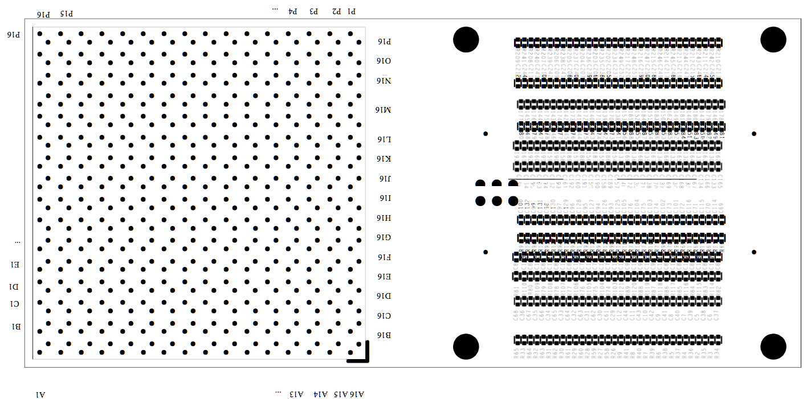
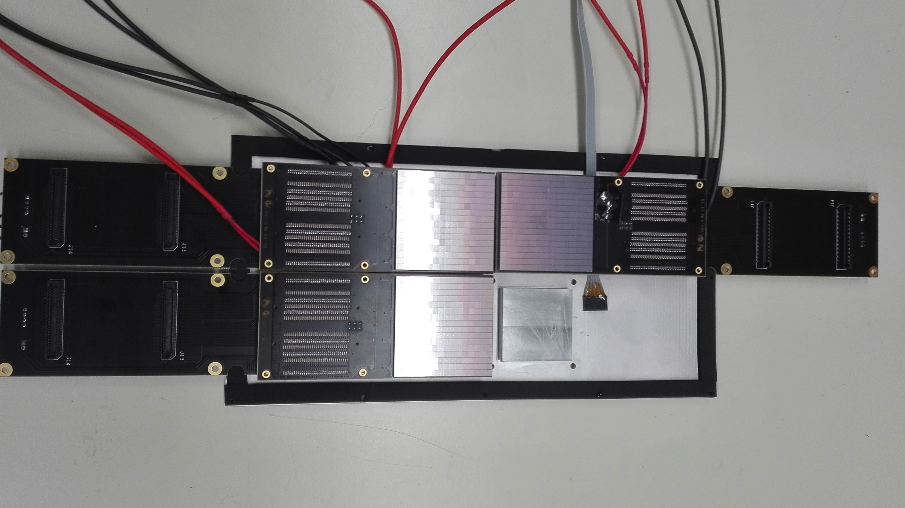
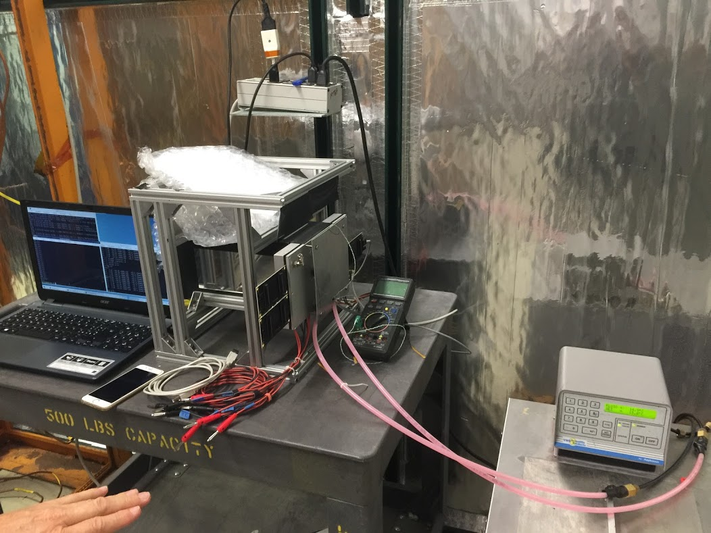
SIPM READOUT BOX
Dedicated board for readout and cooling
of a surface Mounting SiPM Matrix
SiPM might offer a cheaper and more efficient solution, expecially in a longer time perspective for other sectors
Robust device with low sensitivity to magnetic field
Fast improvement in dark rate and cost
but so far missing radiation hardness
Challenge: cooling integrated into the sensitive readout
Custom cooling plate
Soldered to the board
Peltier cell cooling
Down to -30º in N₂
Contalbrigo M.
eRD14 PID Consortium – 01/07/19
12
12
Notes:
Fare una immagine del PMT sulla risoluzione

Slide 13
Capitolo | Sezione | Anagrafica | Materiale | 2019 (assegnato) | 2020 (richiesto)
Consumo | CT | 0.4 FTE (5) | Meccanica (flange / dark box) | 3 | 4
 | LNF | 0.3 FTE (3) | Scheda lettura ottica | 2
 |  |  | Mirrors and supports |  | 4
 | RM1 | 0.2 FTE (2) | Gas+aerogel | 1.5 | 2
 | FE | 0.3 FTE (2) | SiPM + cooling | 3
 |  |  | Adattamento elettronica |  | 2
Goal: base prototype ready for a test-beam in 2020.
Notes:
bare mechanics elements costs quoted around 4 keu
(does not account for mechanical adaptation for feed-throughs and windows)
- Freon gas is expensive due to minimum delivery requirements
Commercial mirrors are quoted around 1000 euro each
The supports should allow alignment
13
Notes:
Fare una immagine del PMT sulla risoluzione

Slide 14
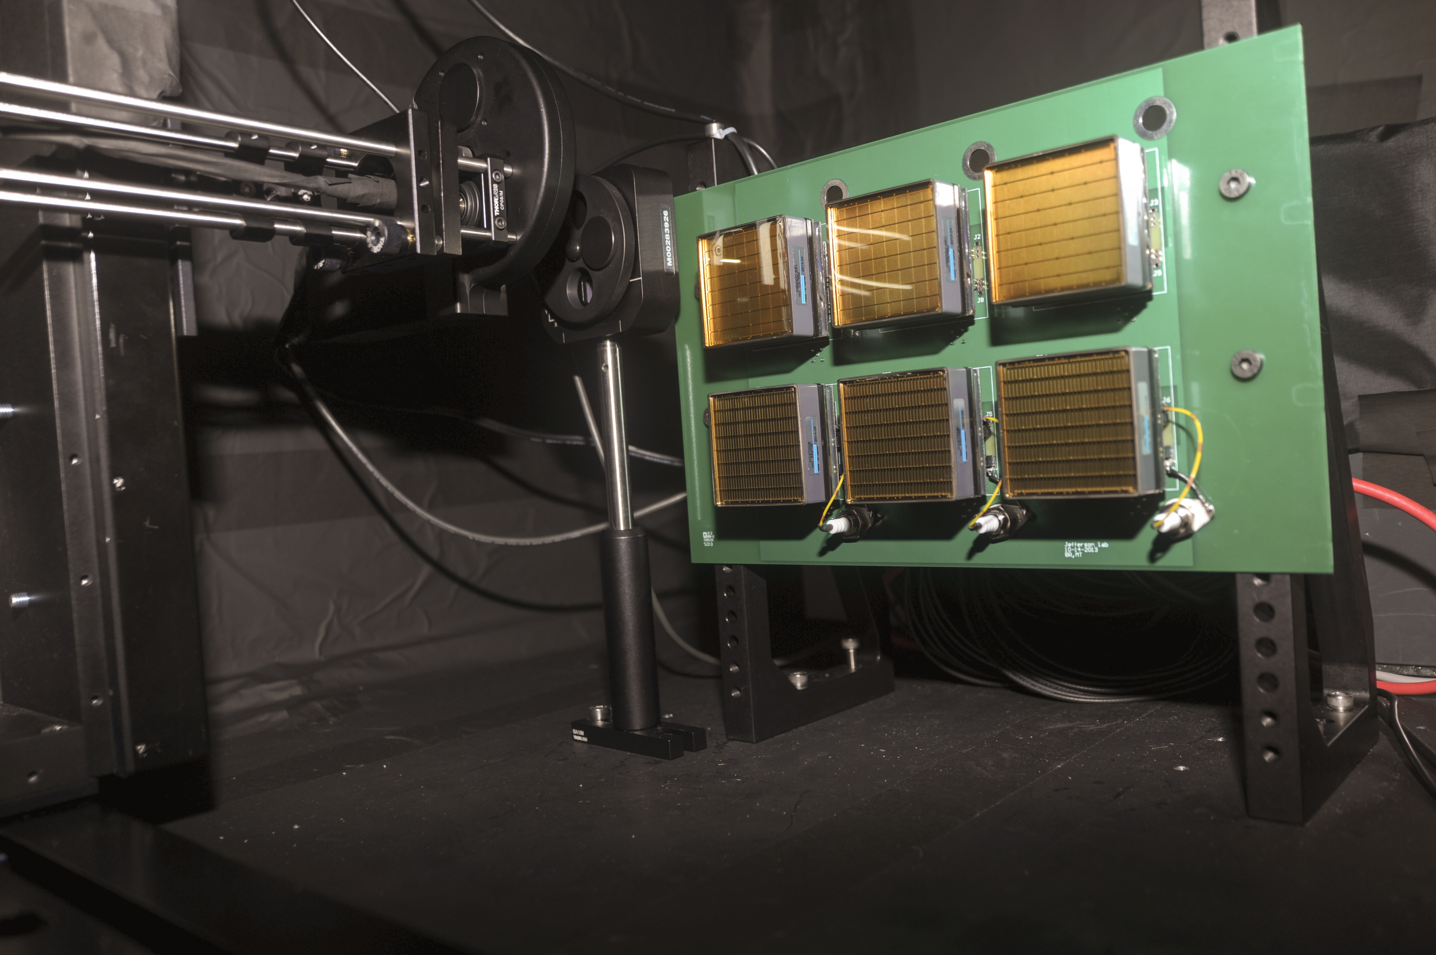
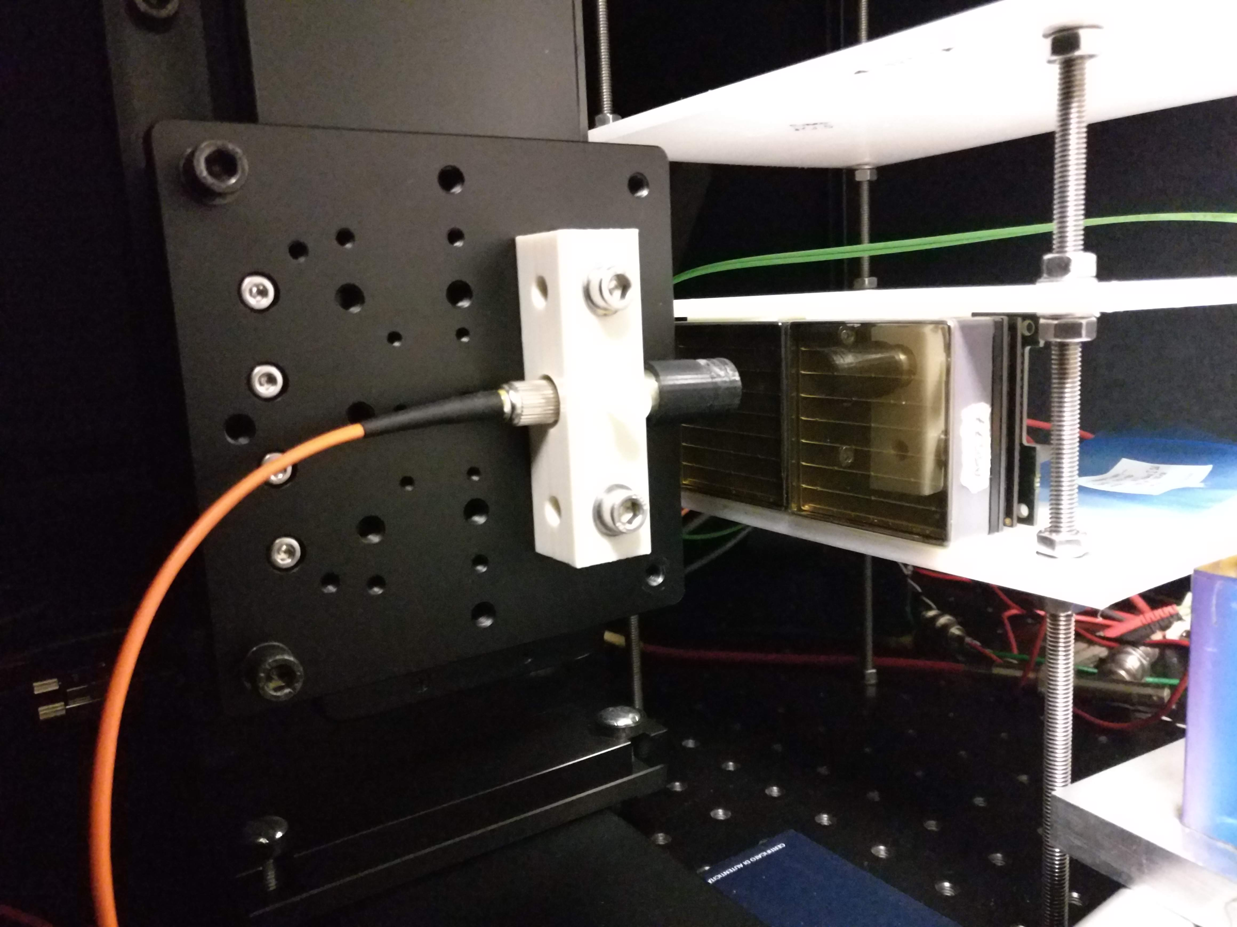
PULSED LASER TEST BENCHES
Detailed characterization
Sensors: gain, efficiency, cross-talk, radiation tolerance
Electronics: gain, cross-talk, thresholds, time resolution
JLab
632 nm picosecond pulsed laser light
Light diffuser to illuminate the whole MAPMT surface
Standardized system with CLAS12 electronics
H8500 6x6 mm² pixel sensor so far
Laser head +
diffuser
MAPMT holder
INFN
632 nm and 407 nm picosecond pulsed laser light
Light concentrator to scan the sensor surface
Flexible layout supporting various sensors and
Front-End electronics
Laser head +
collimator
MAPMT holder
14
Notes:
Fare una immagine del PMT sulla risoluzione

Slide 15
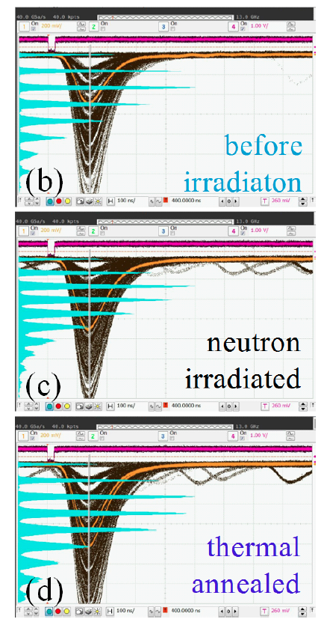
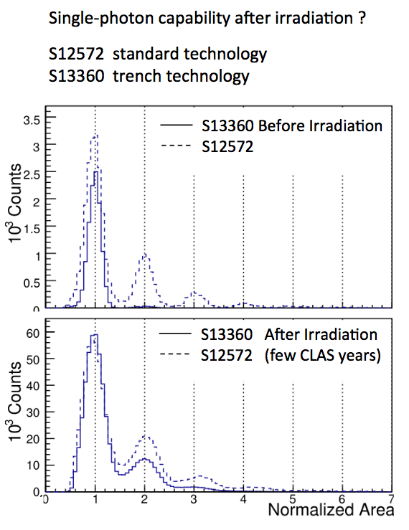
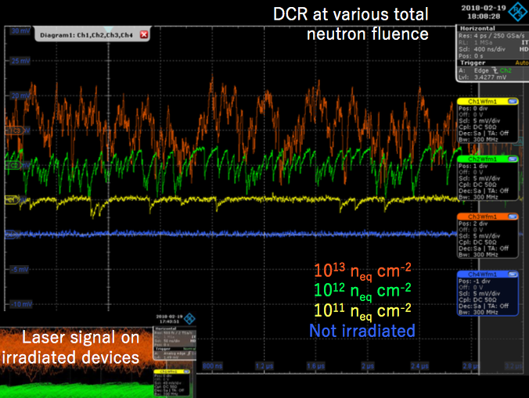
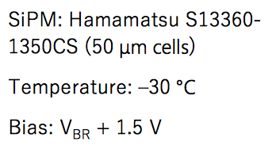
SIPM RADIATION TOLERANCE
T. Tsang et al.
JINST 11 (2016) P12002
I. Balossino et al.
NIMA 876 (2017) 89
Paolo Carniti
@ RICH 2018
T= 84 K
10⁹ n_{eq} cm²
Annealing at 250 ºC
T= 0 C
few 10⁹ n_{eq} cm²
15
Notes:
Fare una immagine del PMT sulla risoluzione

