Slide 1

Attività Gruppo III
Paolo Lenisa
Consiglio di Sezione
Ferrara, 5 Luglio 2018

Slide 2



Esperimenti di Gruppo III a Ferrara
JLAB12 (R.L. & R.N: Marco Contalbrigo)
- spin physics
- transverse momentum phenomena (TMDs) & 3D imaging
- GPDs, EM Form Factors
JEDI (R.L. & R.N. Paolo Lenisa)
- EDM, tests of fundamental symmetries
EIC_NET (R.L.: Marco Contalbrigo)
- QCD machine

Slide 3
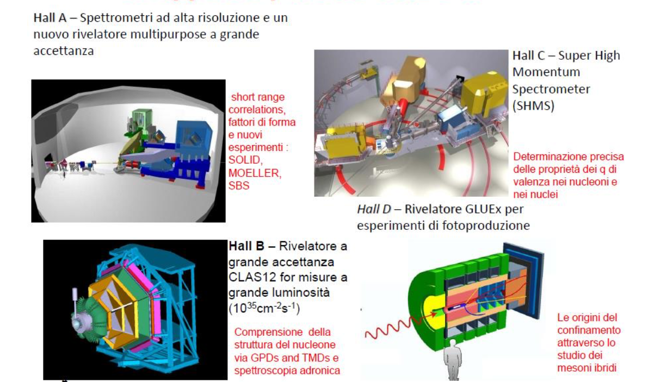
Collaborazione JLab12
Responsabile Locale e Nazionale
M. Contalbrigo

Slide 4
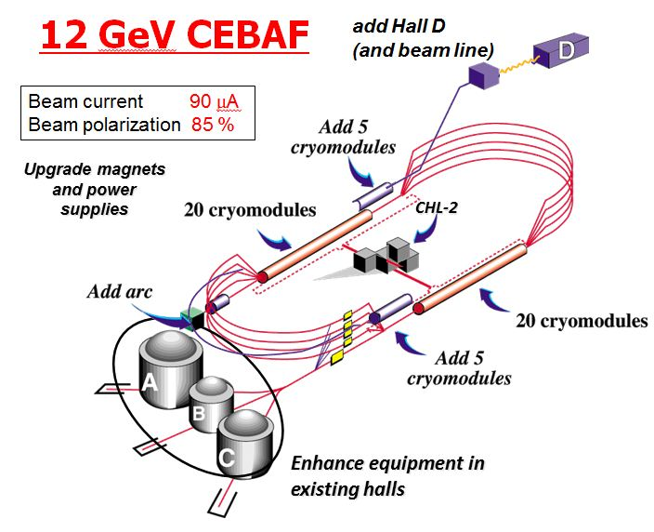
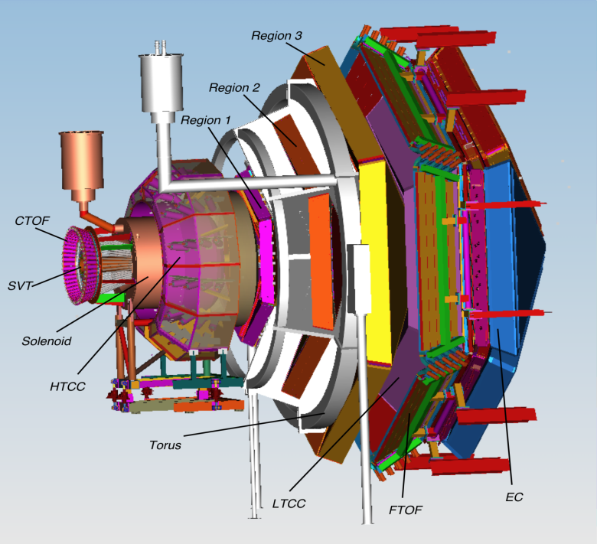
Towards the 12 GeV era
CLAS12 detector
Lumi up to
High polarized electron beams
H and D polarized target
Broad kinematic range
Very good PID
Physics program:
Hadron spectroscopy
Nuclear effects in hadronization
Nucleon structure (TMDs, GPDs)
4

Slide 5
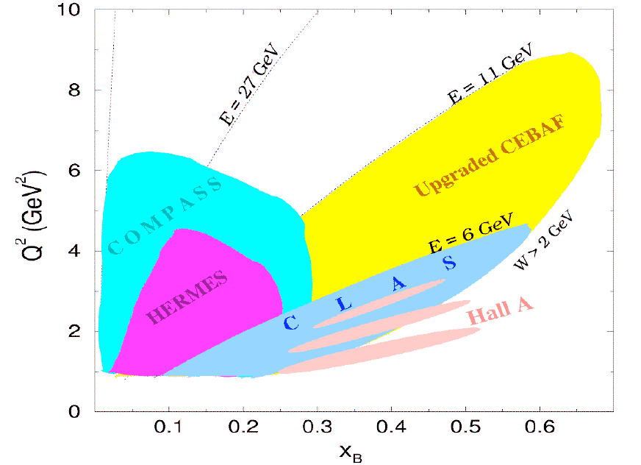
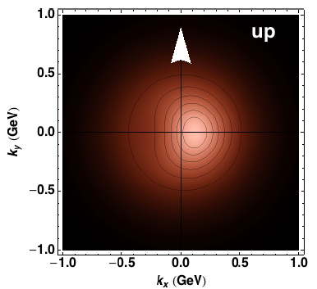
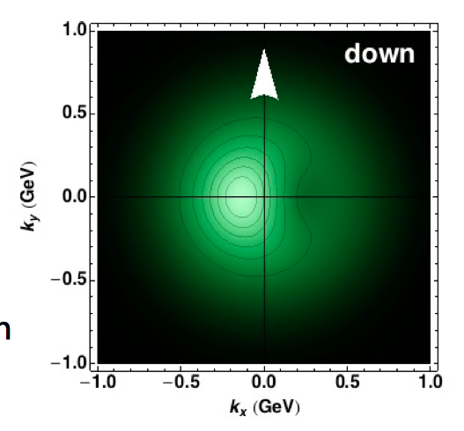
Towards the 12 GeV era
Investigating QCD spin-orbit
and dynamic effects
5

Slide 6
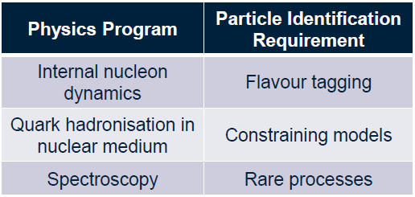


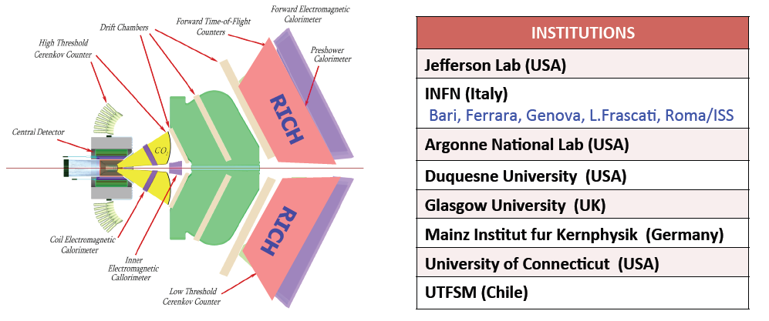
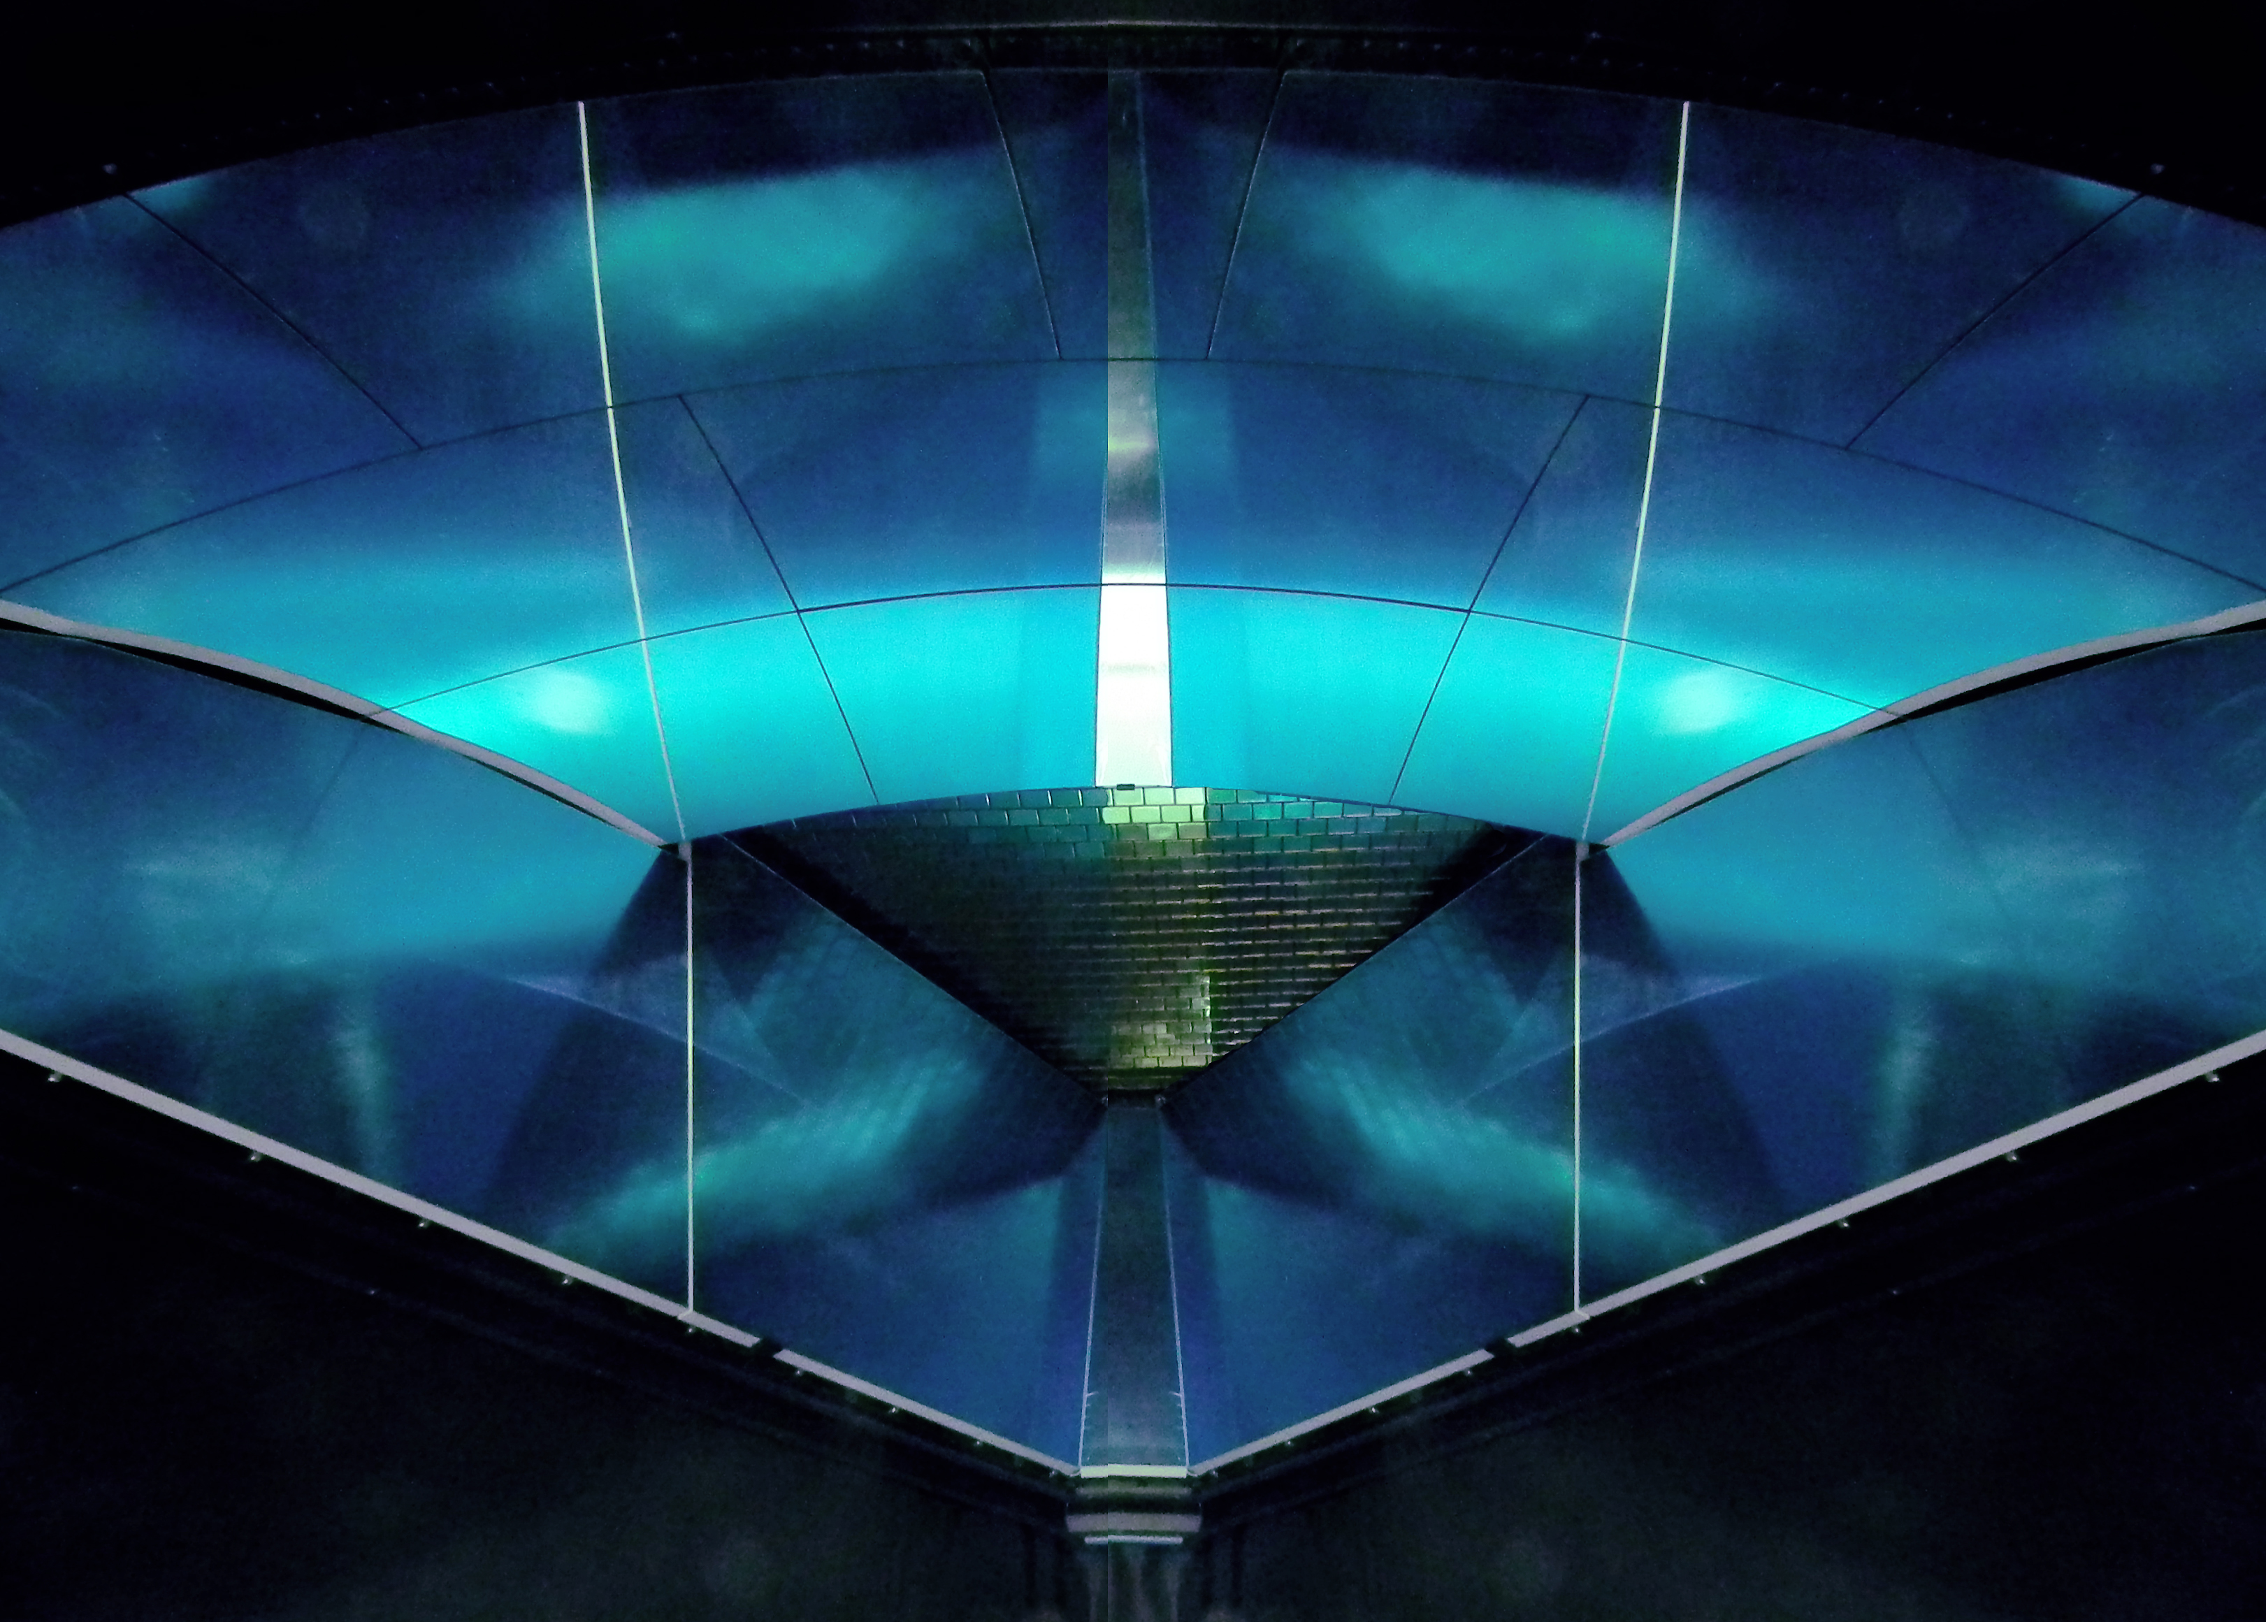
The CLAS12 RICH
INSTITUTIONS
INFN (Italy) Bari, Ferrara, Genova, L.Frascati, Roma/ISS
Jefferson Lab (Newport News, USA)
Argonne National Lab (Argonne, USA)
Duquesne University (Pittsburgh, USA)
George Washington University (USA)
Glasgow University (Glasgow, UK)
J. Gutenberg Universitat Mainz (Mainz, Germany)
Kyungpook National University, (Daegu, Korea)
University of Connecticut (Storrs, USA)
UTFSM (Valparaiso, Chile)
Notes:
6

Slide 7

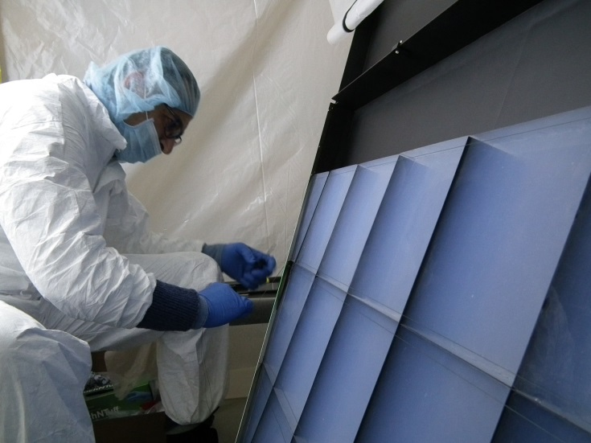
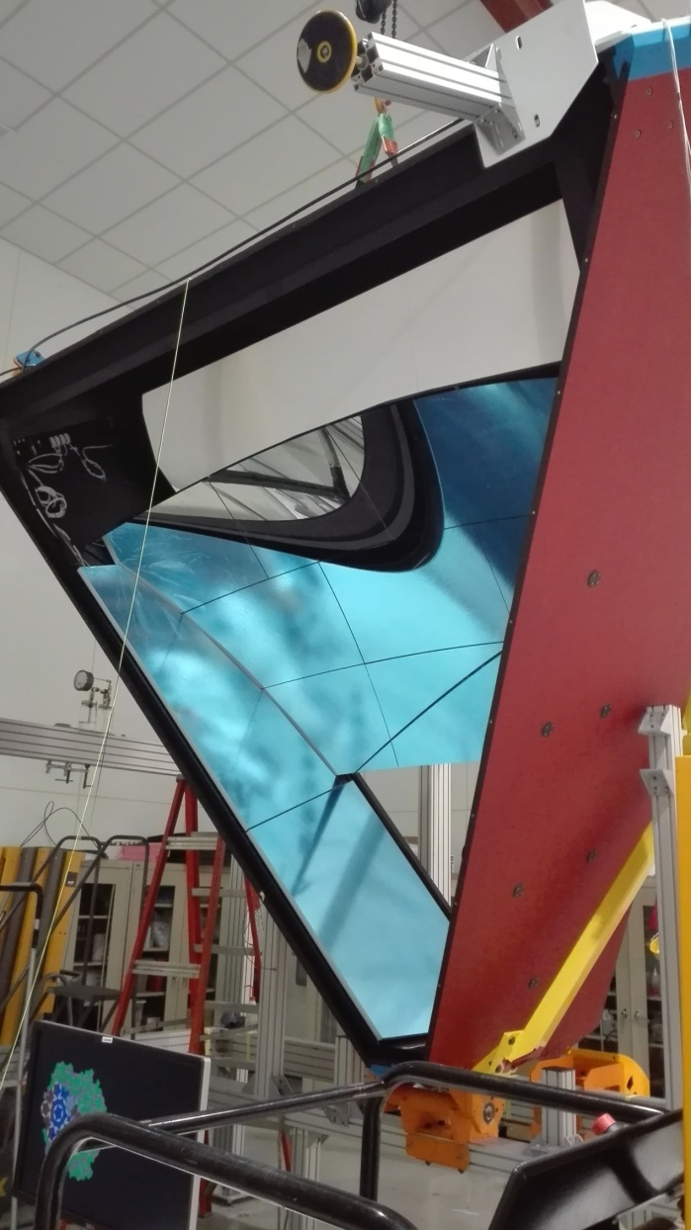
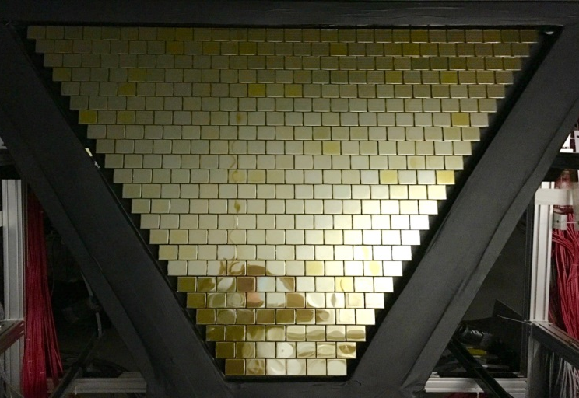
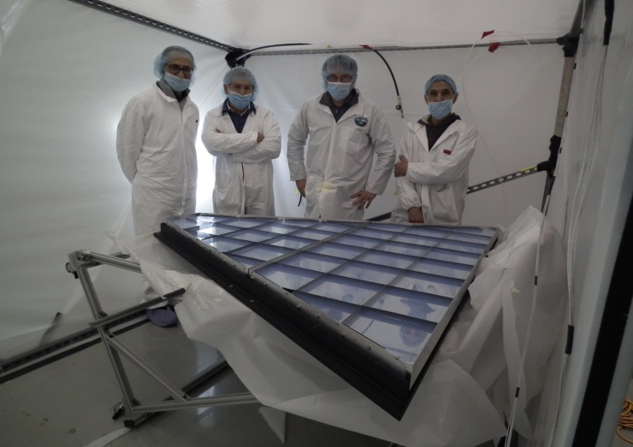
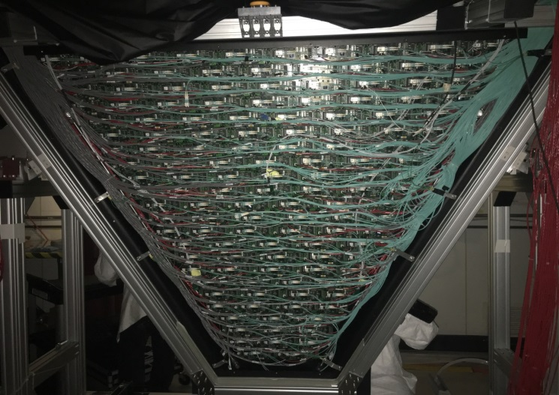
The CLAS12 RICH
First module installed in January 2018
Second module in preparation for 2021
Notes:
7

Slide 8
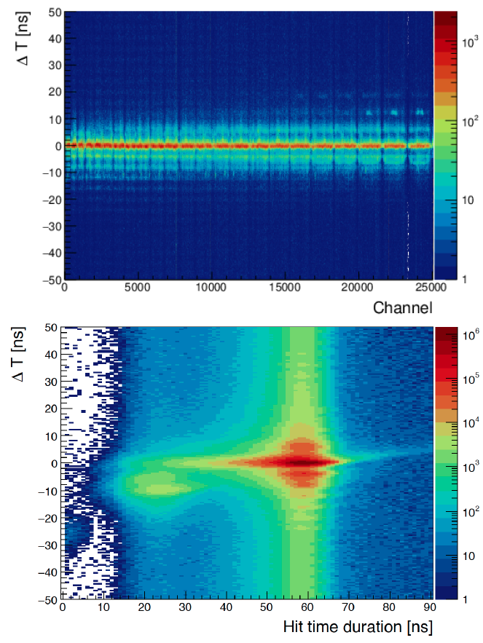
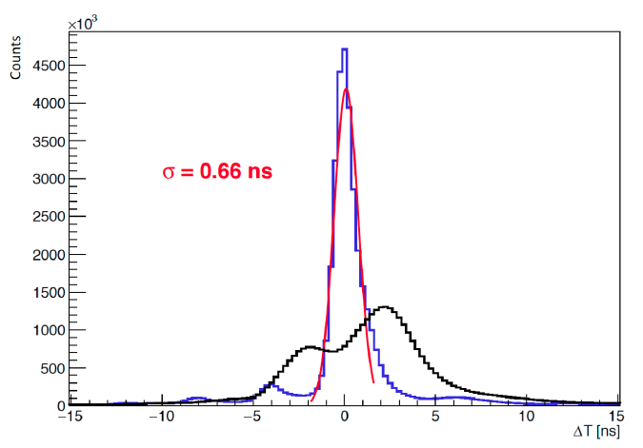
Pedestal rms at the limit of sensitivity (1 DAC)
RICH: Time Peformance
RICH readout based on single-photon
time tagging (design resolution < 1 ns)
Notes:
8

Slide 9
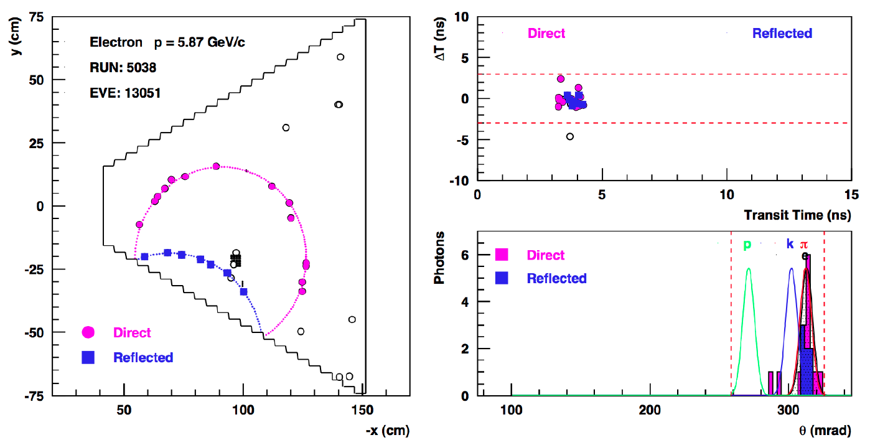
Pedestal rms at the limit of sensitivity (1 DAC)
RICH: Event Reconstruction
Notes:
9

Slide 10
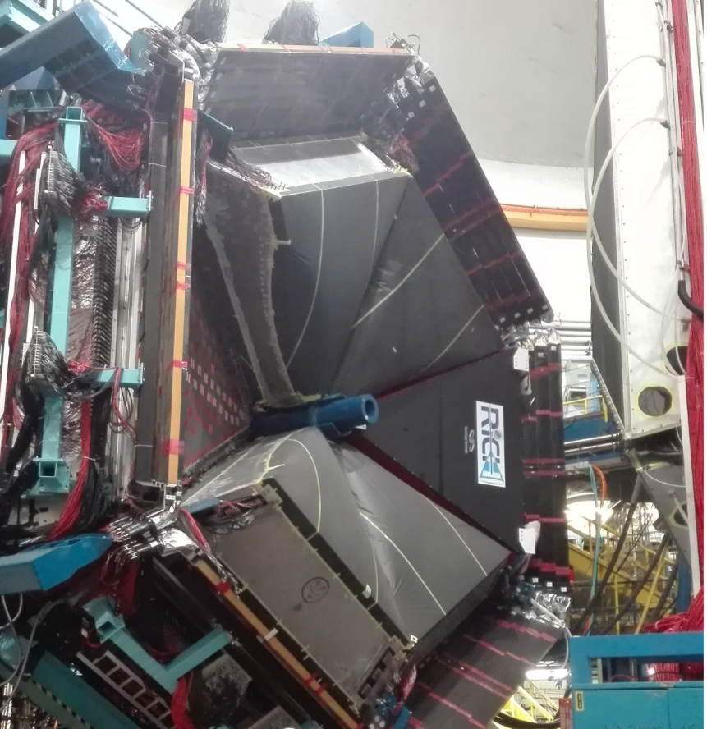
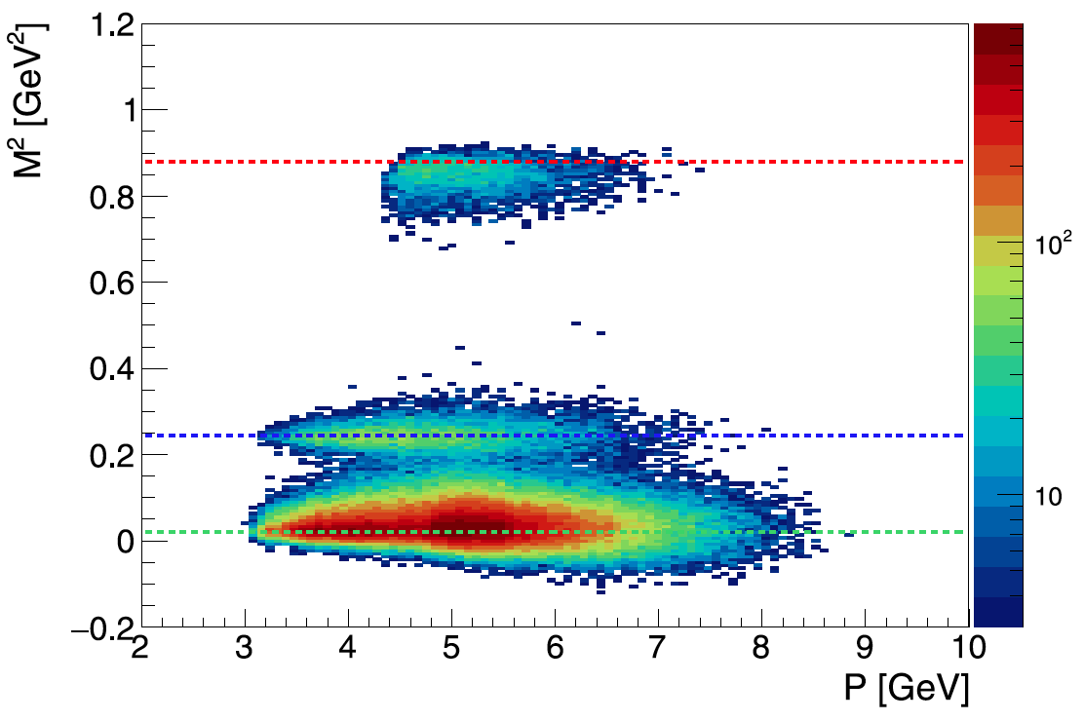
The Seccond RICH
V.D. Burkert et al., NIMA 959 (2020) 163419
M. Contalbrigo et al., NIMA 964 (2020) 163791
Second Module Plan (FY) | 19-2 | 19-3 | 19-4 | 20-1 | 20-2 | 20-3 | 20-4 | 21-1 | 21-2 | 21-3 | 21-4 | 22-1
Mechanics
Aerogel
Mirrors
Electronics
MAPMTS
Assembling
Services in Hall + Installation
Second RICH module timeline
P. Lenisa

Slide 11
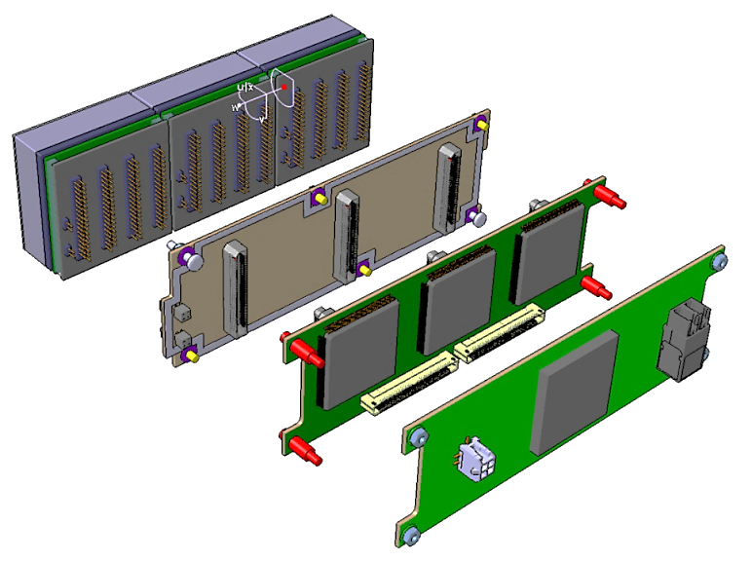
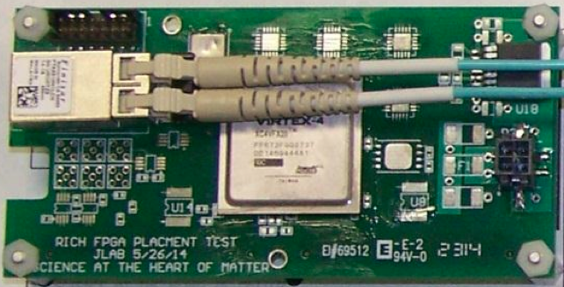
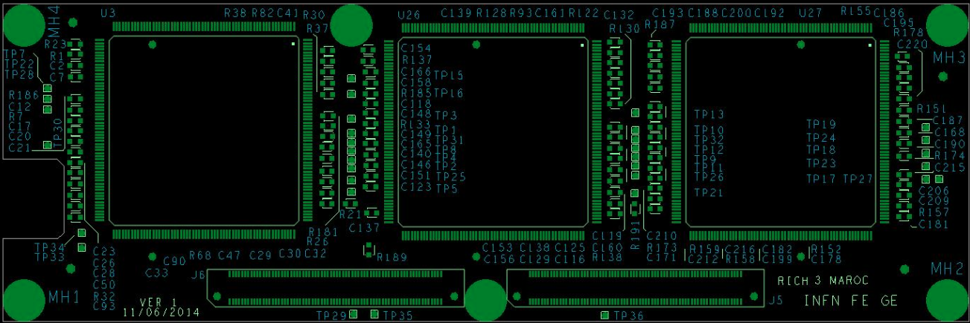
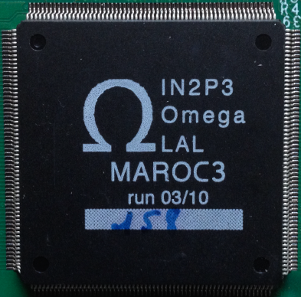
Front-End Electronics
Compact and modular electronics to readout multi-anode PMTs
Adopted by GlueX DIRC and EIC eRD14, under test for SOLID, possible applications under study
PMTs
ADAPTER BOARD
FPGA board (Jlab)
ASIC BOARD
FPGA BOARD
ASICs board (Ferrara)

Slide 12
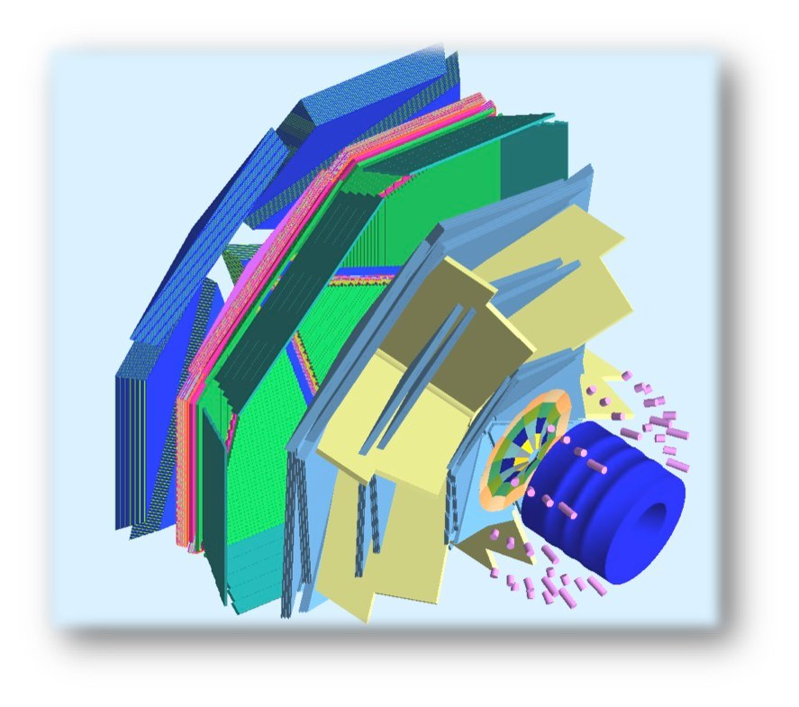
HD-ICE TRANSVERSE TARGET
(L. Barion, G. Ciullo, M. Contalbrigo, P.L., M. Statera, F. Spizzo)
Tracking solenoid
design field 5 T longitudinal
HDice target working field 2 T
4K L-He cryostat
diameter 440 to 942 mm
length 1500 mm
HD-ice Transverse Target:
high polarization
f 25 mm – Length 25 mm
transverse field 0.5-1.25 T
target
superconducting
solenoid
polarized
e⁻ beam
superconducting
torus

Slide 13
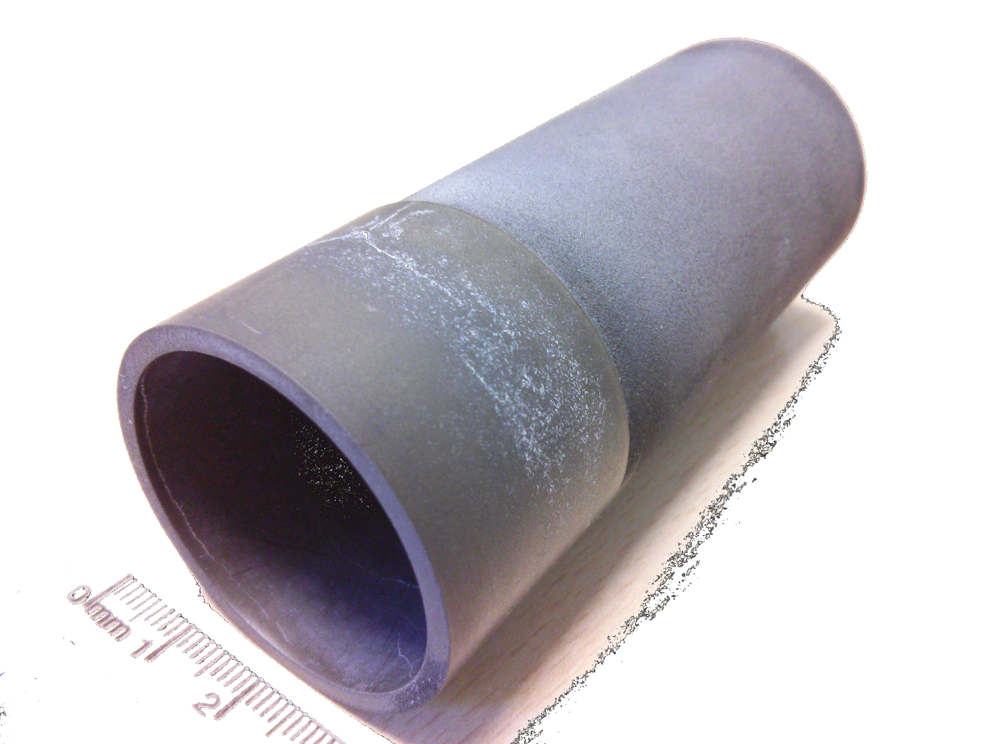
Bulk Transverse Magnet
By
Bz
Bulk cylinder (MgB₂)
longitudinal shield
transverse magnetization
Features
no current leads
Cu free
self tuning
few mm thickness
external magnet for magnetization
existing sample (courtesy of G. Giunchi)
diameter 39 mm
length 90 mm
thickness ~1 mm

Slide 14
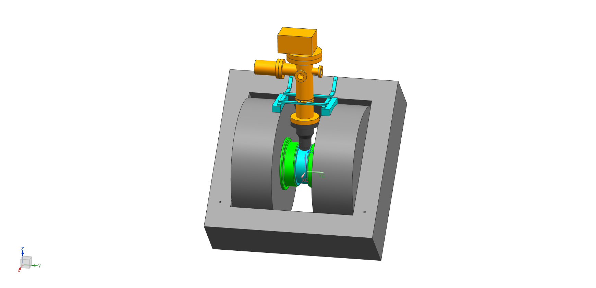
FERRARA SETUP
coldhead
support (316L)
resistive magnet
transverse field
custom poles
max field about 1 T
vacuum chamber (316L and Al)
liquid free cryostat
controlled cylinder temperature
minimum temperature <20 K
ΔB/B < 2 10⁻³ (on cylinder volume)
turbo
Al chamber
chamber (316L)
support (nylon)
pole
(ARMCO)
cylinder
resistive coil
iron yoke

Slide 15
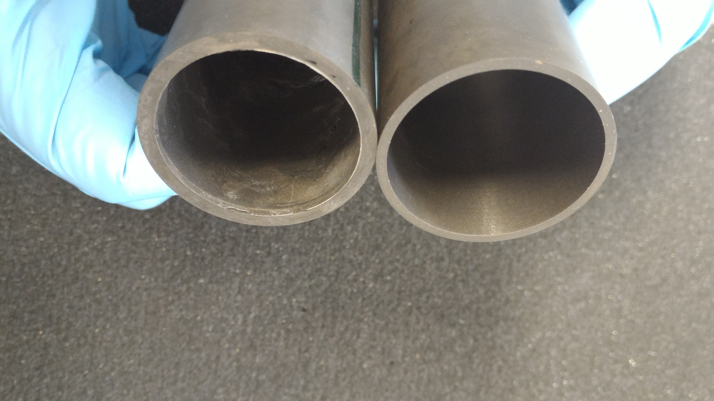
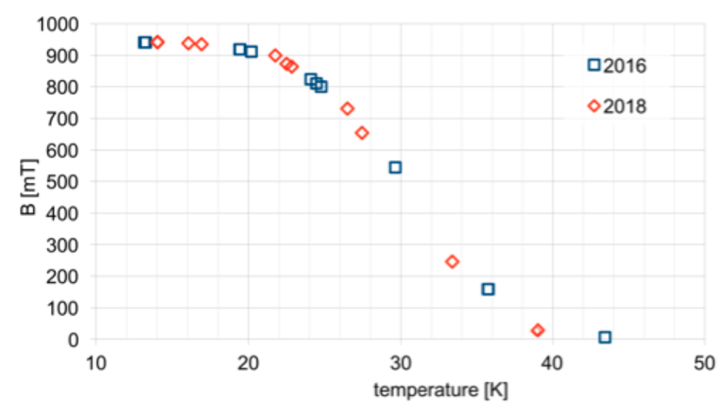
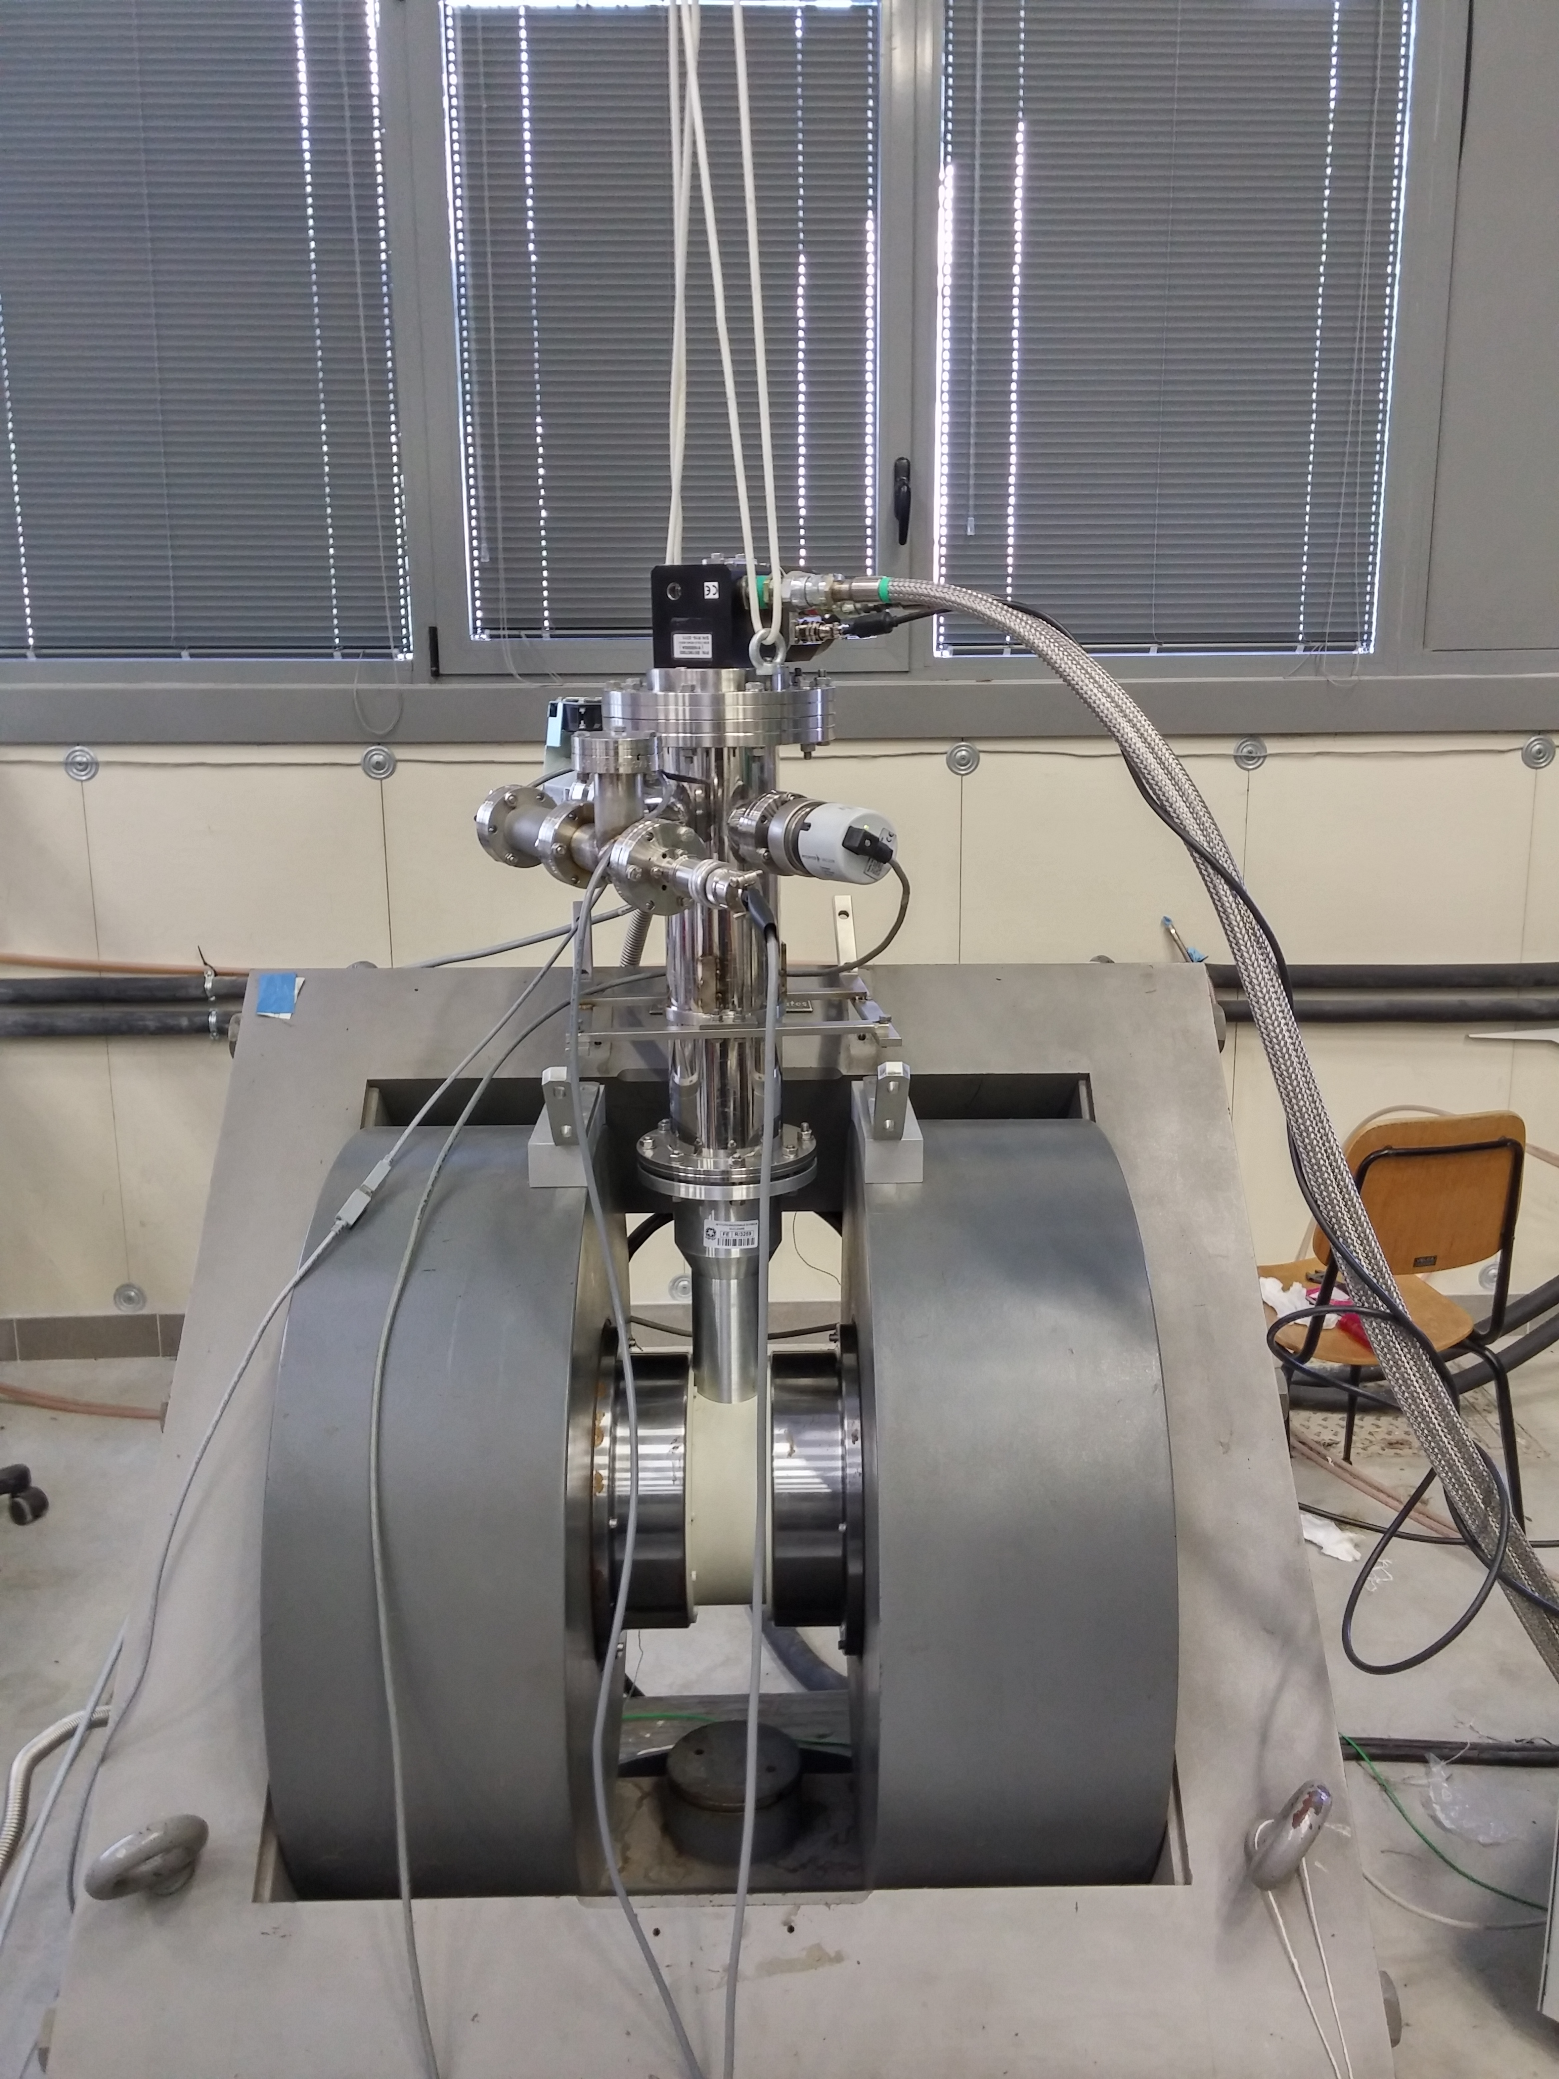
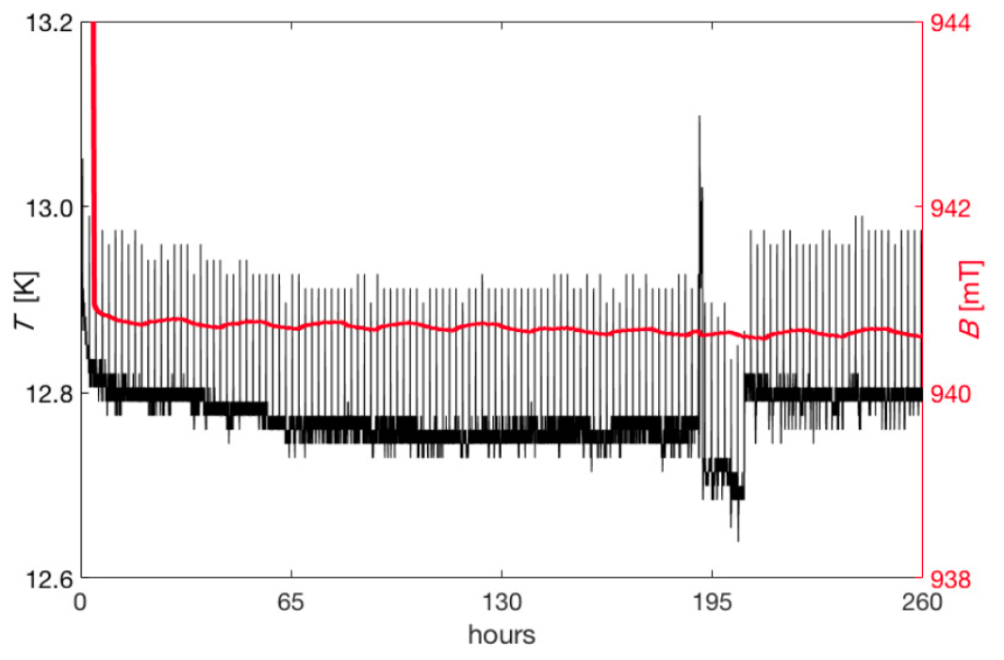
MAGNETIZATION
Dipole field frozen for days inside a MgB₂ cylinder
Field vs
Temperature
Field vs Time

Slide 16
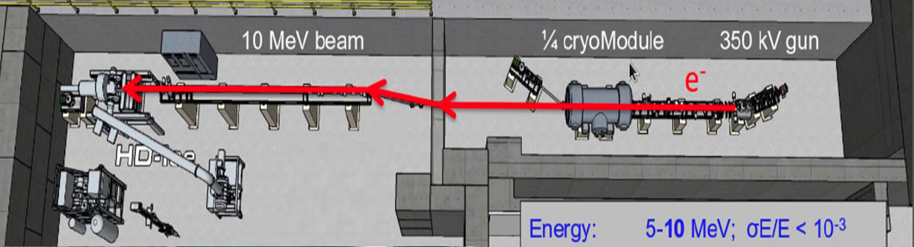
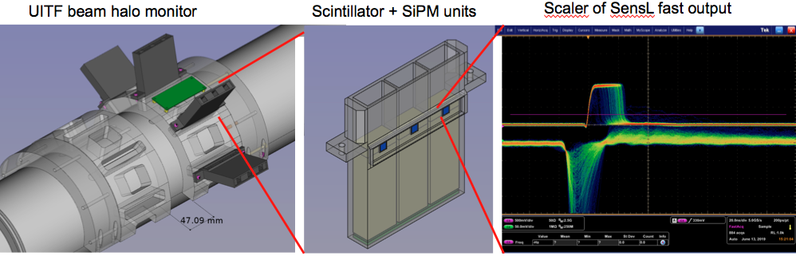
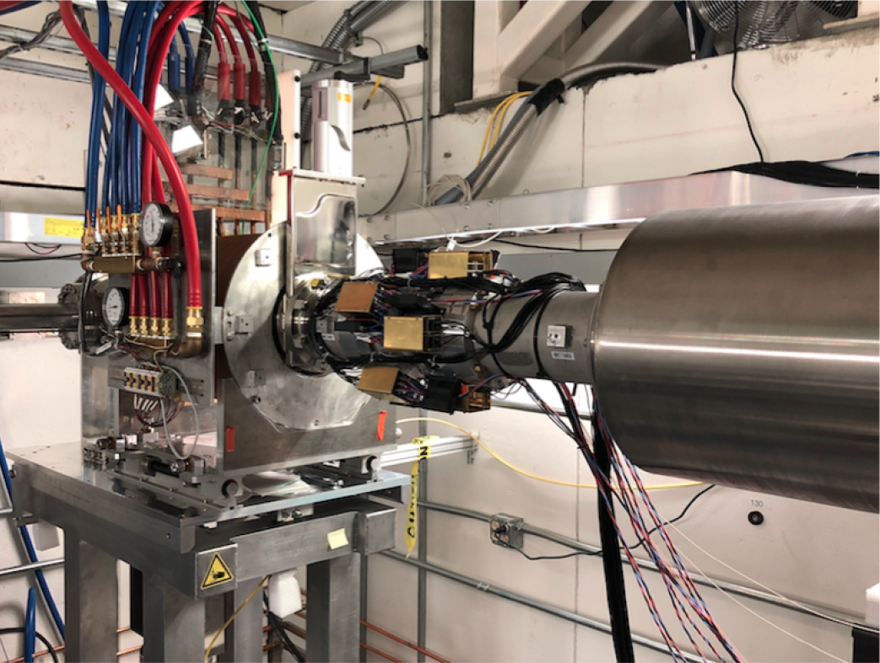
Polarized Target Tests with Electron Beam
In preparation at UITF JLab with beam halo monitor made by Ferrara

Slide 17
Il gruppo di Ferrara @ JLAB12
Responsabilita’:
M. C.: responsabile locale e nazionale di JLab12
M.C.: membro CLAS Coordination Committee
M. C. responsabile progetto RICH
M. C. & L.P. Co-spokesperson di diverse proposte di esperimento (PAC34,37,38,39)
Contributi principali
Data analysis
- Coordination of deep-process group
- Data processing
RICH detector
- Reconstruction algorithms
- Second RICH module construction
Magneti superconduttori
- Configurazione magnetica per HD_Ice target
- Frozen field con magneti a bulk di superconduttore

Slide 18
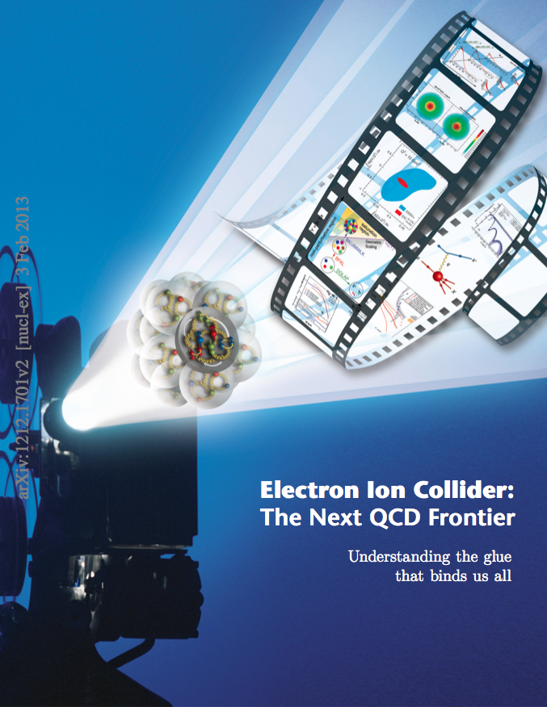
The Electron-Ion Collider
CD0 Announced in January 2020
“Yellow Report” in preparation
“Expression of Interest” survey ongoing
“Call for Detectors” expected in 2021
Strong interest in Italian nuclear physics
community (theory and experiment)
Increasing R&D effort
INFN Ferrara working with the PID R&D
Consortium (eRD14).

Slide 19
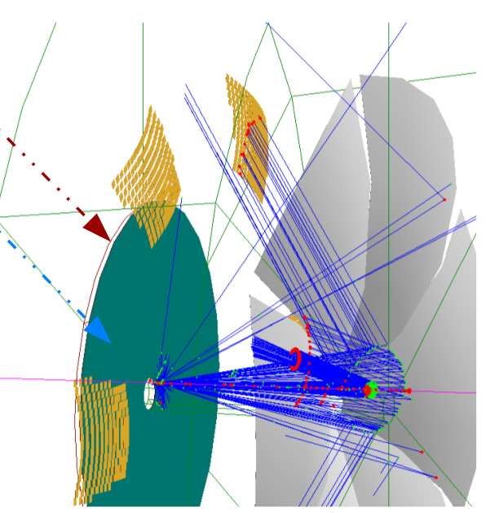
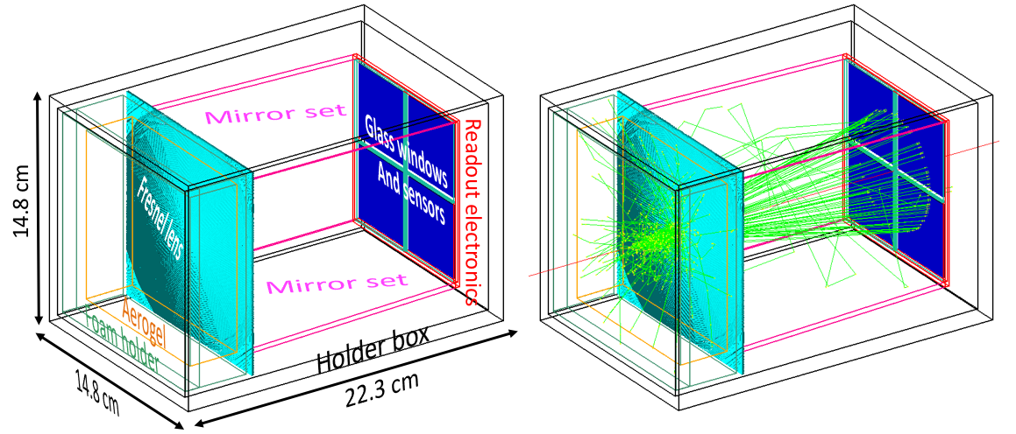
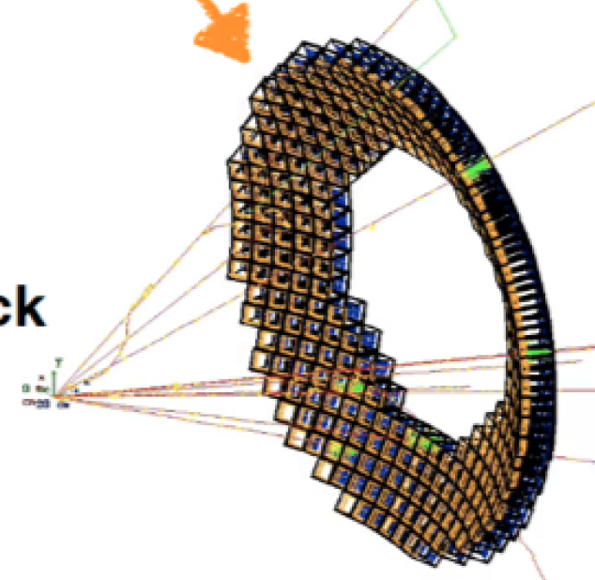
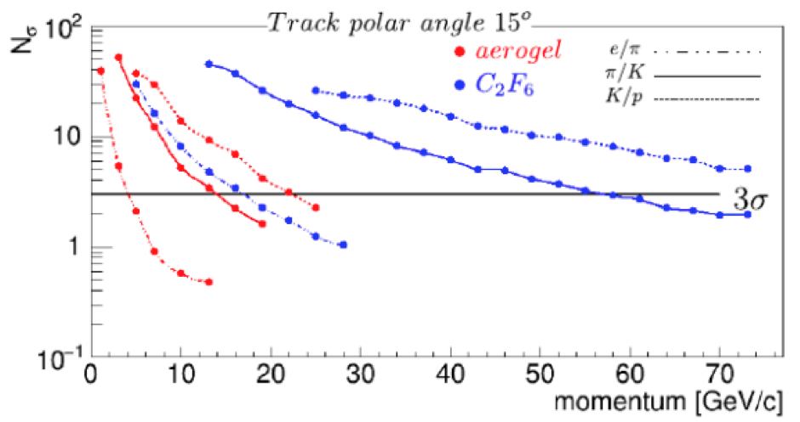
EIC PID Study
Compact solution for few-GeV range
Dual-radiator for extended momentum range
mRICH: An aerogel RICH with Fresnel lens focalization for compact and projective imaging
π/K sepration up to ~ 10 GeV/c
dRICH: A RICH with two radiators (gas + aerogel) for wide momentum coverage
Separation
π/K up to ~ 50 GeV/c
e/π up to ~ 15 GeV/c
Fresnel lens
Aerogel
Sensor plane

Slide 20
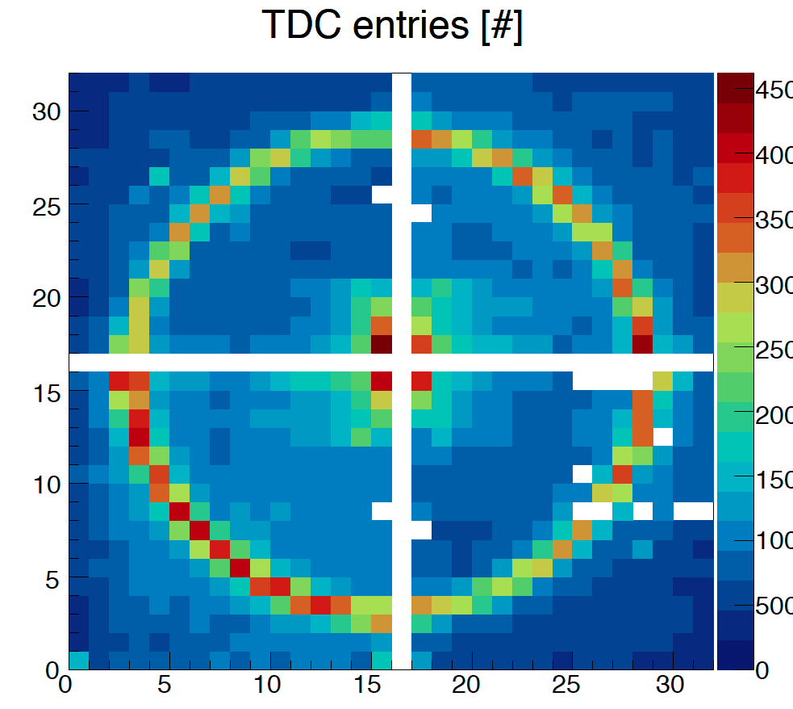
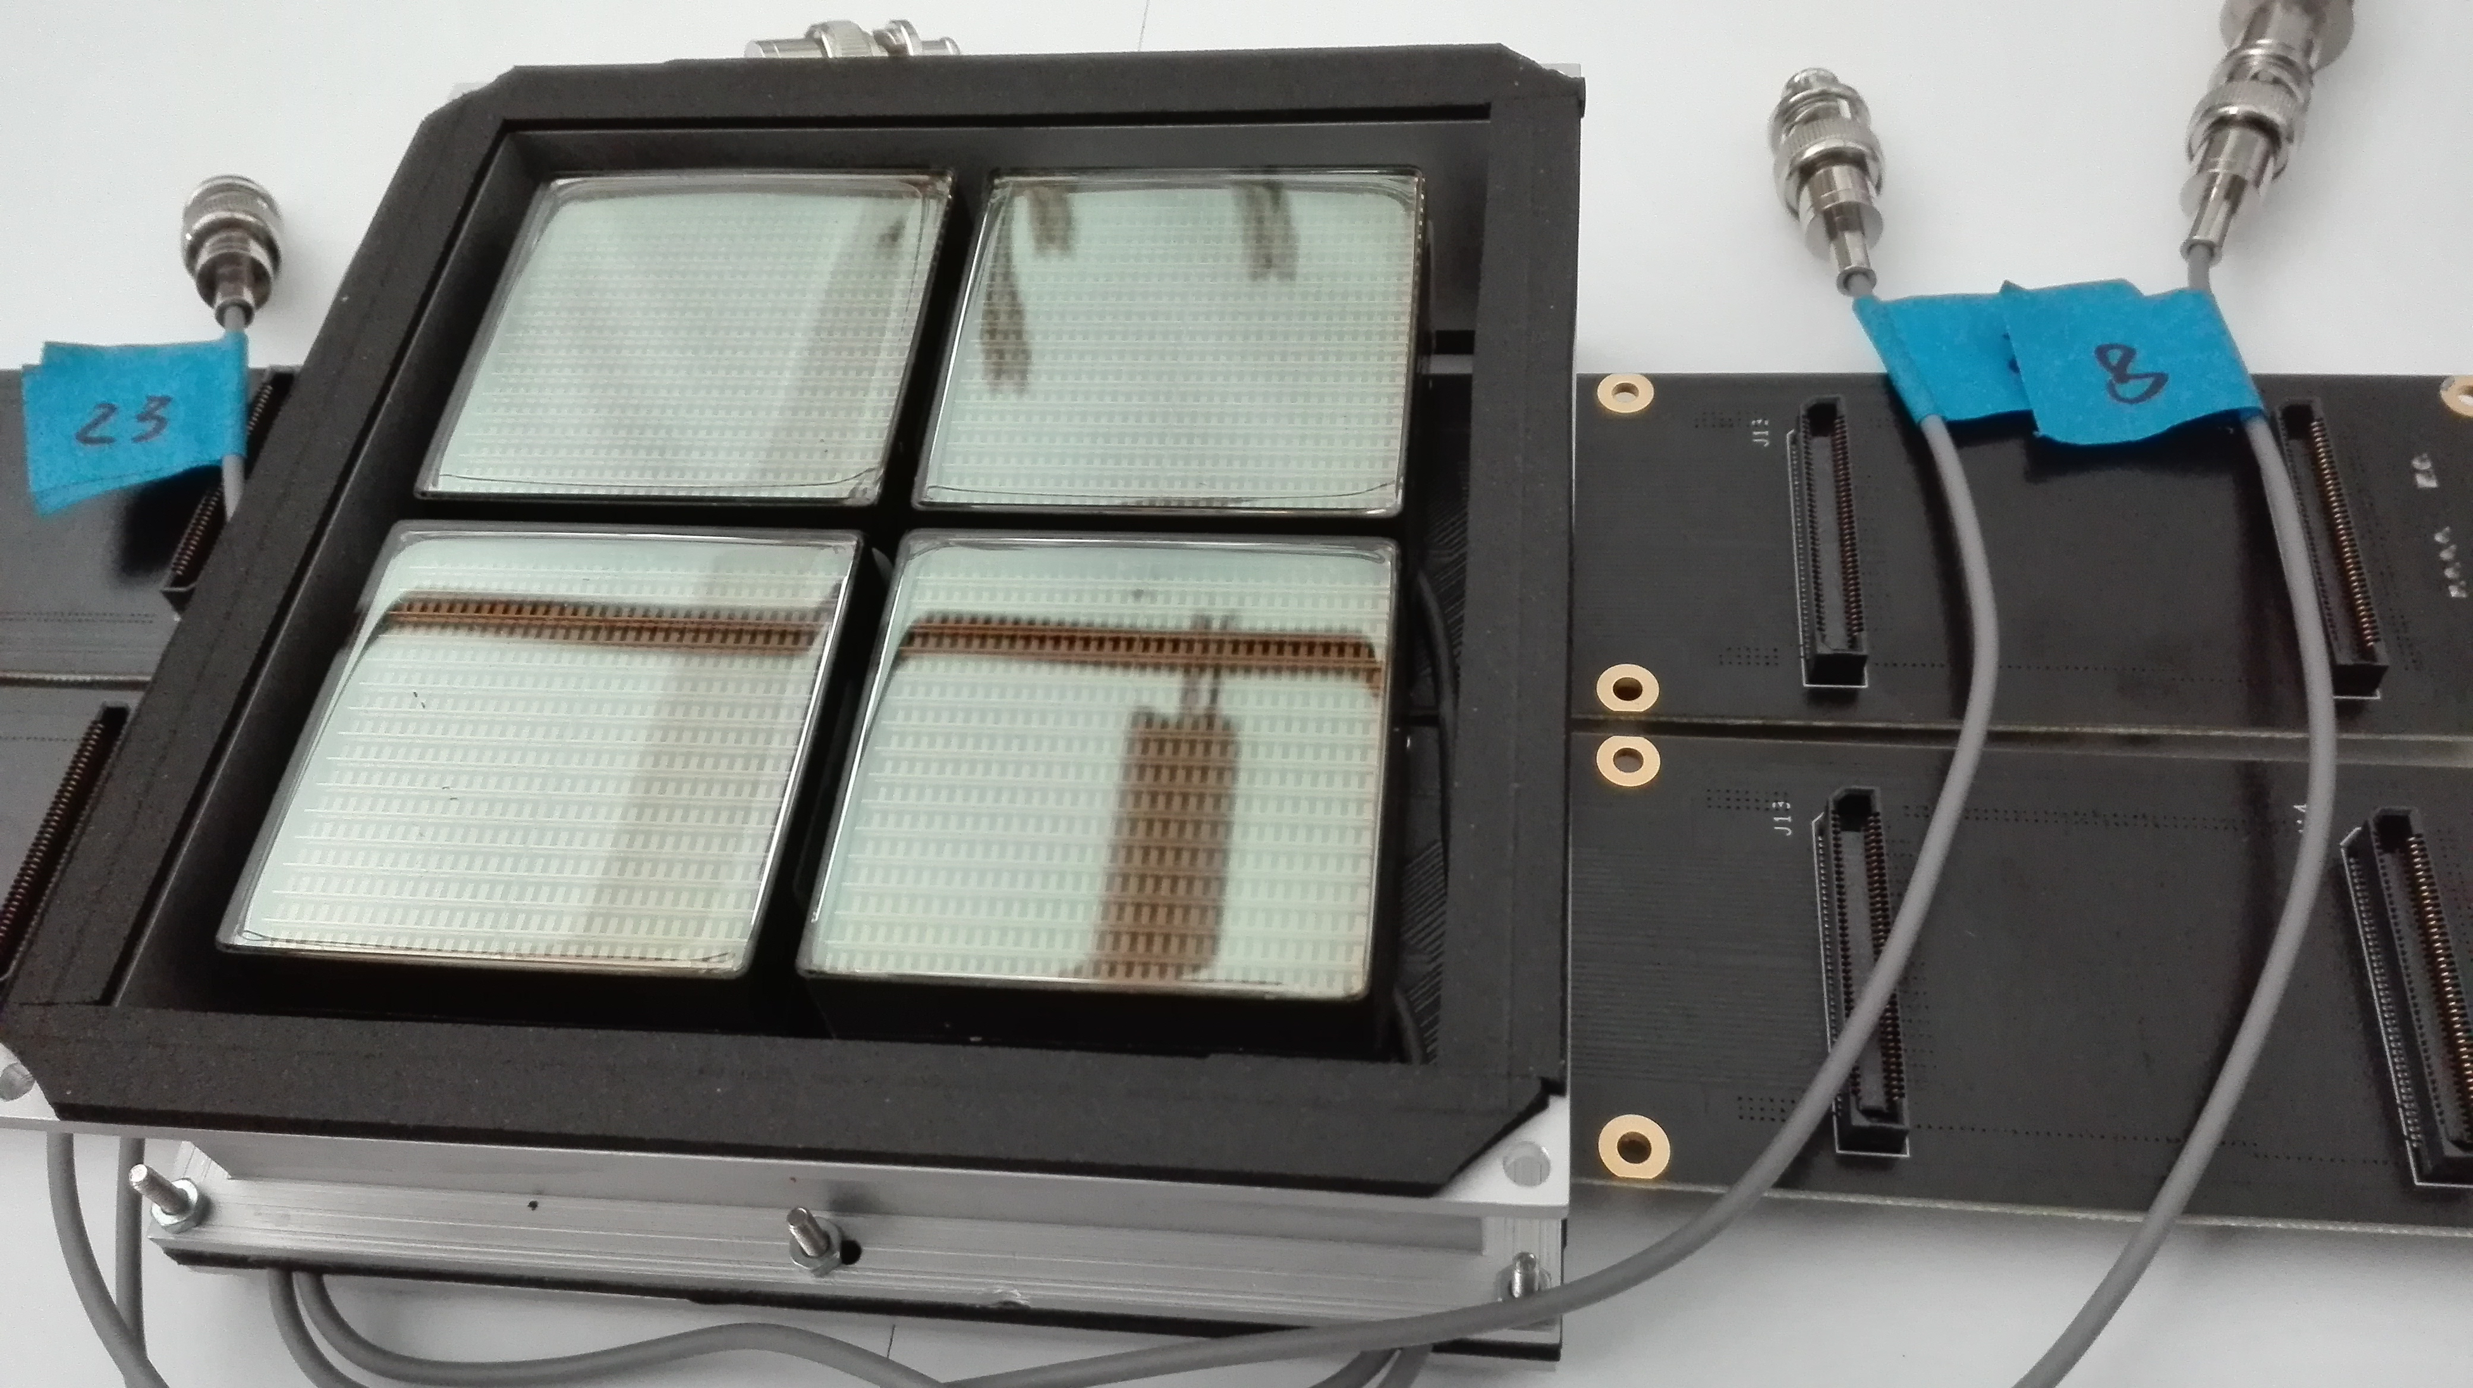
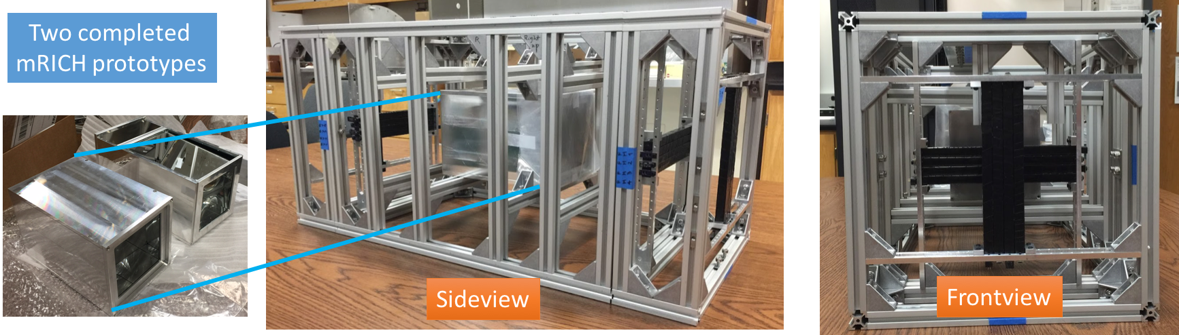
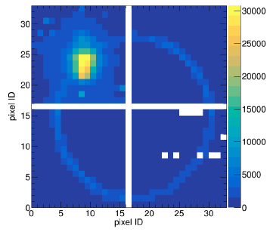
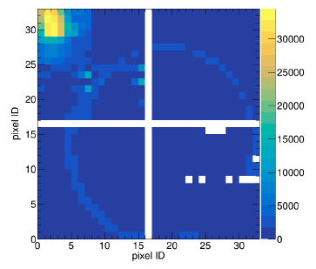
The modular RICH (mRICH)
≥3σ π/k separation
∼ 2 ÷ 10 GeV/c
Compact and modular RICH independent elements
Fresnel lens
20 cm
10 cm
Aerogel
Sensor plane

Slide 21
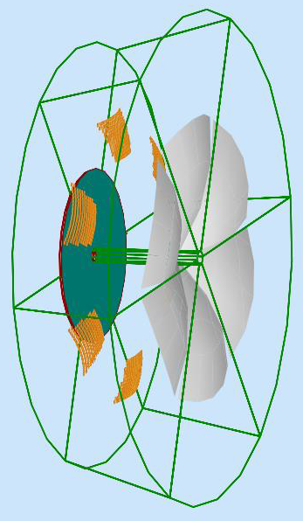
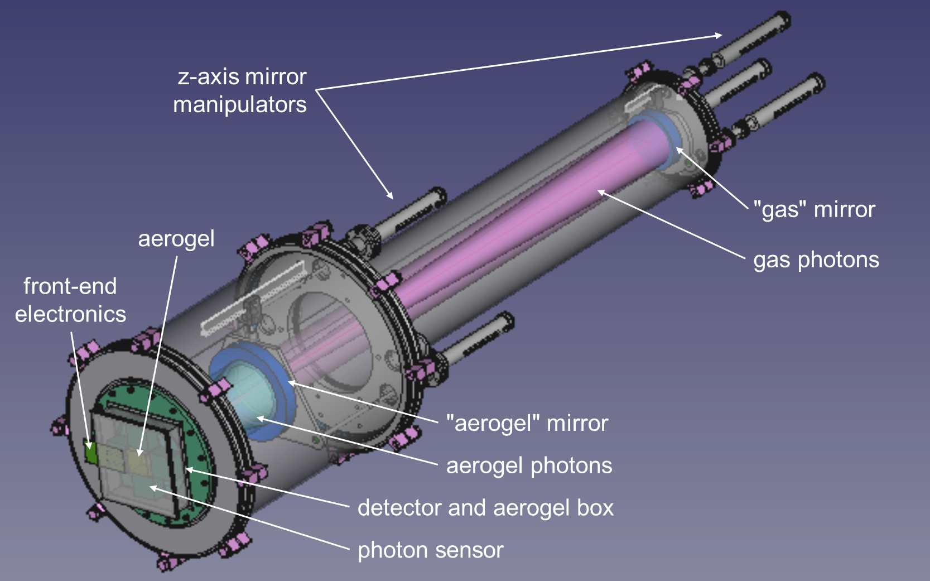
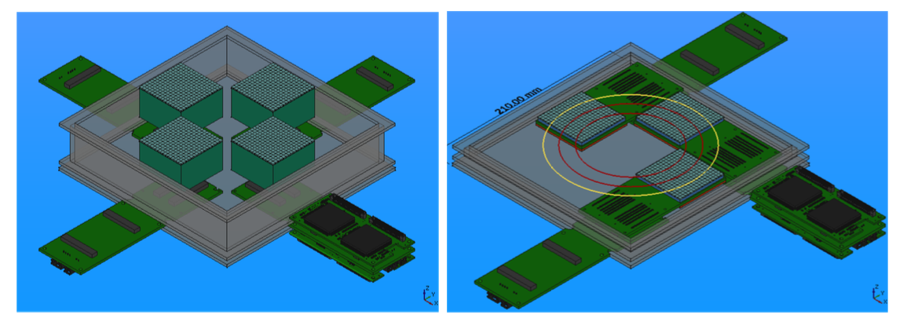
The dual RICH (dRICH)
≥3σ π/k separation
∼ 2 ÷ 50 GeV/c
Extended 3-60 GeV momentum range
Prototype under construction
INFN FE, BO, CT, LNF, RM1, TO

Slide 22
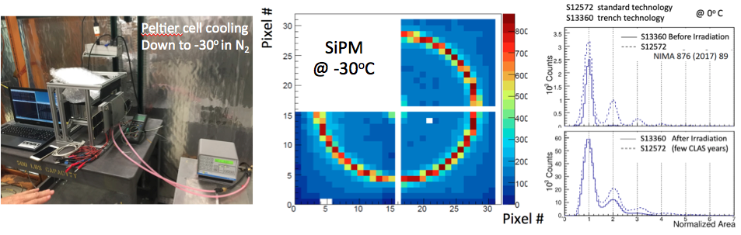
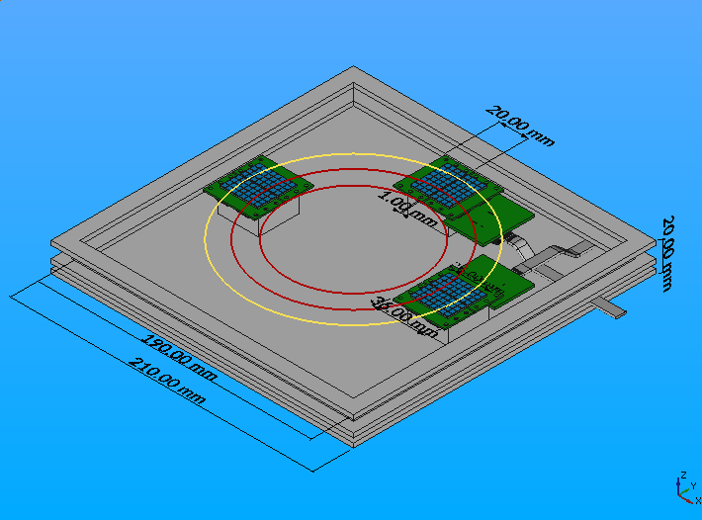
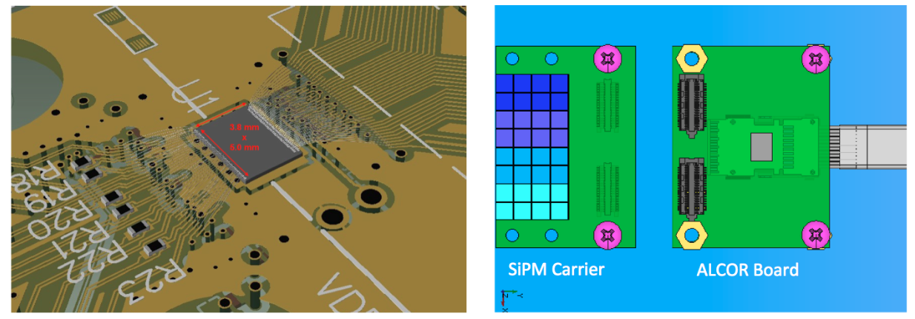
The SiPM Program
Cherenkov imaging with irradiated SiPM and ALCOR (DarkSide) chip

Slide 23
Il gruppo di Ferrara @ EIC_NET
Responsabilita’:
M. C.: responsabile locale EIC_NET
M.C.: activity leader eRD14
M. C.: IAC POETIC (Physics Opportunities at EIC) Conference
Contributi principali:
mRICH detector
- Prototyping and data analysis
dRICH detector
- Prototyping and SiPM program
Electronics
- MAROC (reference) + ALCOR (INFN development)
- VME and Ethernet DAQ in collaboration with Jlab

